Slide 1
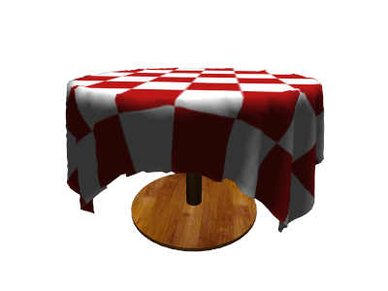
Intro. To Computer Graphics
Project Cloth Simulation
Sahand Kashani
Sébastien Corthésy
Florian Briant
Fall Semester 2012

Slide 2
Goals of the project
Develop a realistic virtual model of a piece of cloth
Make it realistically interact in a basic environment (wind, gravity, ....) with differents objects and itself.
Attach a cape to a Batman-like virtual model

Slide 3
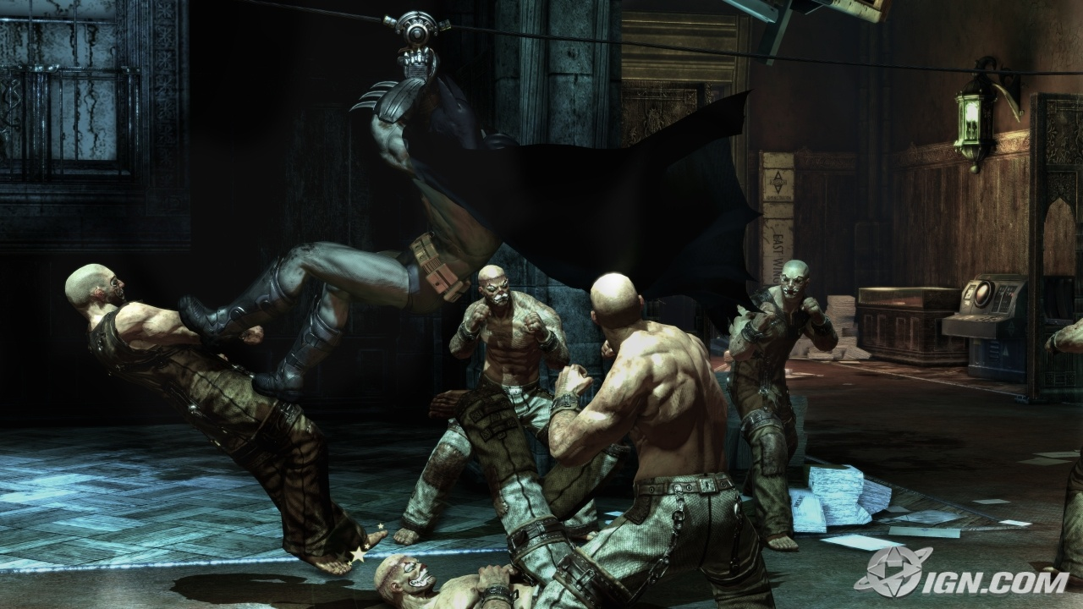
Image from Batham : Arkham Asylum
Source : http://www.simpsonscity.com

Slide 4
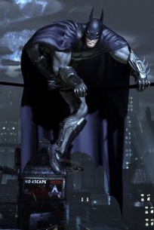
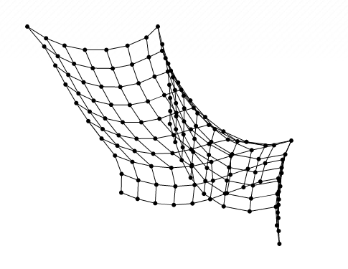
Batman with his cape
Mass-spring Model

Slide 5
Planning of development
Set up a basic mass-spring model

Slide 6
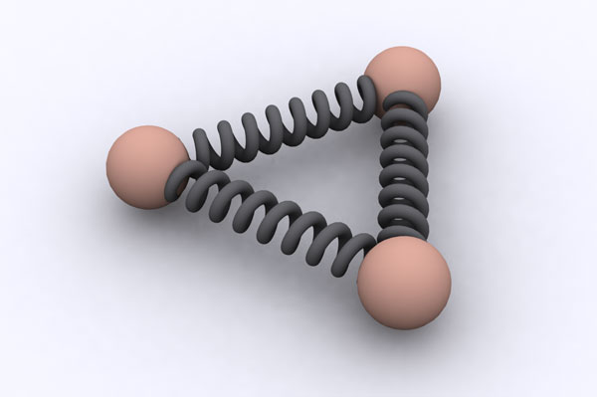
What is a mass-spring model ?
It is a large plane set of particles
Each particle has springs attached to itself and to other « neighbor » particles
The springs keep the particles connected

Slide 7
Planning of development
Set up a basic mass-spring model
Add basic environment (wind, gravity, ....)
Add tearing effects (what if wind is too strong?)
Add interactions with basic closed object (spheres, triangles)

Slide 8
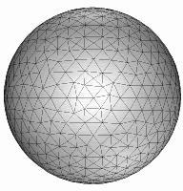
Why closed objects ?
Each complex object will be represented with triangles
An open object would have more than one normal
It is difficult to tell if we intersect with an open object such as a bowl :
How can we tell if we are inside or not ?
Which normal should we consider ?
Eventually : Create opened-objects
with a thin width

Slide 9
Planning of development
Set up a basic mass-spring model
Add basic environment (wind, gravity, ....)
Add tearing effects (what if wind is too strong?)
Add interactions with basic closed object (spheres, triangles)
Add self-interactions (what if the cloth folds on itself?)
See how we can make a demo of a batman-like human form with a cape attached to it.

Slide 10
Current Results
We already set up a working framework (with Code::Blocks on Linux)
We defined what are the specificities of :
  A particle
  A spring
  A cloth (set of particles connected with springs)

Slide 11
Next Steps
Add environment, tearing effects, etc.
Add interactions and self-interactions
Have fun creating complexe scenes with a piece of cloth !

Slide 12
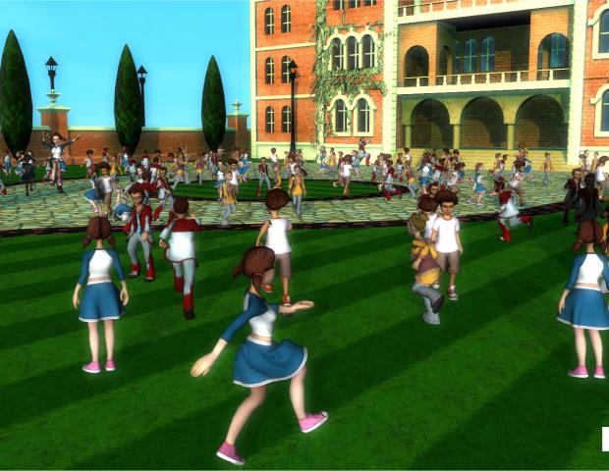
Next Steps
Add environment, tearing effects, etc.
Add interactions and self-interactions
Have fun creating complexe scenes with a piece of cloth !

