Slide 1
Process migration
on a RISC-V
microkernel
An empirical comparison of migration call paths
A. S. R. Silva
Coventry Index: 14946338
Notes:
Suggested speaking time: 20 seconds.
This project asks how migration costs compare on the same RISC-V microkernel. I built a bounded checkpoint-and-restore mechanism, measured two invocation paths, and retained the evidence so the comparison can be repeated. The project is a systems-engineering experiment.
Sources: Final_Report.docx, cover and abstract. The full report title is Process Migration on a RISC-V Microkernel: An Empirical Comparison of Kernel-Resident and User-Space Designs.

Slide 2
Why revisit migration placement?
Research question
Reasons for new measurements
How much migration cost does each call path add on the same Hydra configuration?
IPC optimisation
Communication mechanisms have changed.
Deployment demand
State preservation has practical use cases.
1993 Mach reported a substantial user-space penalty under its test conditions.
RISC-V adoption
An open baseline should be measured on the chosen ISA.
Report §§1.2, 1.6, 2.3.2. Milojičić et al. (1993, 1999), Gu et al. (2020), Chen et al. (2024).
02
Notes:
Suggested speaking time: 50 seconds.
The 1993 Mach experiment found a substantial penalty for its user-space design. This result concerned a particular kernel, platform and workload. Later IPC research, practical checkpointing demand and RISC-V adoption motivate new measurements. These developments motivate the experiment rather than predict its outcome. The refined research question concerns the cost actually observed for two Hydra call paths and the architectural conclusions that evidence permits.
Sources: Report §§1.2, 1.6, 2.3.2. Milojičić et al. (1993, 1999), Gu et al. (2020), Chen et al. (2024).

Slide 3
Five research objectives
01
Implement
Compare direct and wrapper migration call paths.
02
Measure
Record intervals, kernel-code contributions and calls.
03
Compare
Assess performance and shared kernel requirements.
04
Reassess
Revisit the 1993 finding and 1999 adoption barriers.
05
Reproduce
Provide source code, raw data and runnable benchmarks.
Report §1.3. Research objectives.
03
Notes:
Suggested speaking time: 35 seconds.
The five objectives connect implementation to measurement, comparison, interpretation and reproducibility. I will show which artefact supports each objective. The fourth objective is a literature-based reassessment, so a successful terminal test alone cannot establish it.
Sources: Report §1.3. Research objectives.

Slide 4
How the implementation developed
1
Hydra scaffold
Inherited the teaching kernel and application structure.
2
Migration mechanism
Added context/stack primitives.
393 lines in migration.c and migration.h.
3
Repeatable execution
Fixed task-slot reuse and the frozen startup counter.
4
Measurement harness
Added mode selection, BENCH timestamps and analysis.
5
Later functional work
Added ACK/retry, isolated images and verified demo inputs.
Report §§5.2.1–5.2.9. Repository contribution log: docs/changes.md.
04
Notes:
Suggested speaking time: 60 seconds.
Hydra supplied the teaching-kernel scaffold, scheduler and application structure. I added checkpoint/restore primitives, mode selection, instrumentation, a working VirtIO-Net path and test applications. Two inherited bugs blocked repeatable benchmarking: task slots were never reused, and the startup counter stopped after raytracer launch. The fixes enabled the repeated sweep. Later work added acknowledgements and isolated task images. The current presentation rehearsal also corrected a scheduler-test time source and console input polling. Those later changes are engineering validation, separate from the original dataset. The historical migration-file count is 393 lines, not the size of the complete trusted kernel.
Sources: Report §§5.2.1–5.2.9. Repository contribution log: docs/changes.md.

Slide 5
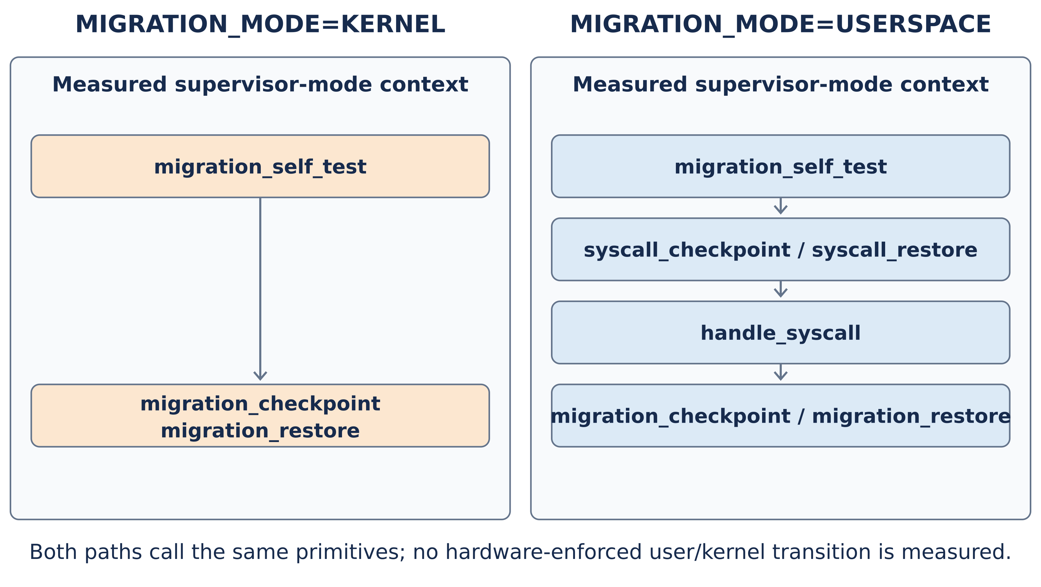
Both paths share checkpoint and restore
Report Fig. 5.3, §§5.2.1, 5.2.4. Both historical paths execute in supervisor mode.
05
Notes:
Suggested speaking time: 45 seconds.
KERNEL calls migration_checkpoint and migration_restore directly. USERSPACE calls the C wrappers syscall_checkpoint and syscall_restore, then handle_syscall dispatches to the same primitives. In this historical comparison both paths execute in supervisor mode. There is no measured isolated-server transition, address-space switch or protection boundary. MIGRATION_MODE selects the path at build time. The saved diagram is Figure 5.3 from the report. The migration files total 319 plus 74 equals 393 lines, excluding other privileged components.
Sources: Report Fig. 5.3, §§5.2.1, 5.2.4. Both historical paths execute in supervisor mode.

Slide 6
Controlled experimental design
120
Control | Configuration
Platform | Same Hydra and QEMU RISC-V64 virt
Workload | Counter task and fixed 8 KB stack
Extra payload | 0, 4, 16 and 64 KB
Instrumentation | 9 timestamps defining 5 intervals
Analysis | Means and separate 95% confidence intervals
local observations
2 modes × 4 sizes
× 15 repetitions
Approximate state sizes: 8, 12, 24 and 72 KB. Extra bytes are synthetic.
Report Chapter 3, §§4.2.1–4.2.4. Experimental unit: one migration run.
06
Notes:
Suggested speaking time: 60 seconds.
This is a factorial systems experiment, rather than a human survey. The experimental unit is one instrumented migration run. The sample contains two modes, four synthetic-extra sizes and fifteen repetitions per cell: 120 local observations. Both modes use the same Hydra, RISC-V64 QEMU virt platform and shared primitives. Nine cycle timestamps define five intervals. The approximate total-state labels add the eight-kilobyte stack. The local transport tags are consecutive timestamps, not network-transfer measurements. Total latency ends when the restored task becomes READY, not at its first resumed instruction. I report descriptive means and approximate 95% confidence intervals for separate means.
Sources: Report Chapter 3, §§4.2.1–4.2.4. Experimental unit: one migration run.

Slide 7
Similar means under the measured conditions
1.00
pooled wrapper/direct ratio
rounded to two decimals
4,061,687
KERNEL mean cycles
4,061,801
USERSPACE mean cycles
15 observations per size and mode. Similar means do not establish equivalence.
Original dataset: bench/results/KERNEL.log and USERSPACE.log. Report §§4.2.1–4.2.4.
07
Notes:
Suggested speaking time: 65 seconds.
The pooled mean total costs are 4,061,687 cycles for KERNEL and 4,061,801 for USERSPACE. Their ratio rounds to 1.00 to two decimal places. The editable chart shows the mean at each of the four approximate state sizes, with fifteen samples per mode at each size. It is a means-only summary; the original report Figure 4.2 includes per-size uncertainty, and the backup metrics slide gives pooled mean confidence intervals. The samples do not establish statistical equivalence. The finding is small observed wrapper cost within this supervisor-mode QEMU baseline, not a verdict on isolated user-space placement.
Sources: Original dataset: bench/results/KERNEL.log and USERSPACE.log. Report §§4.2.1–4.2.4.

Slide 8
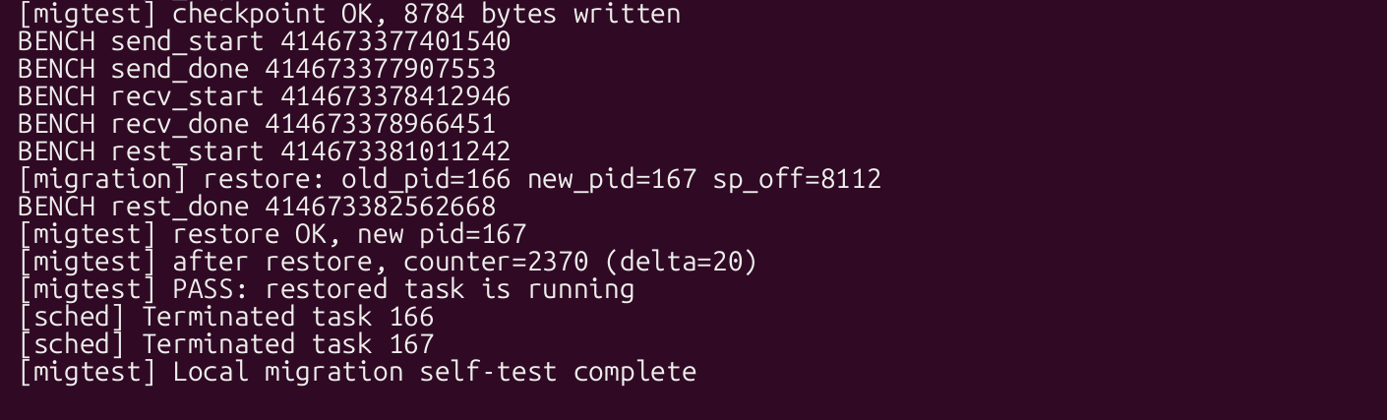
Checkpoint and restore produce a running task
8,784 bytes
166 / 167
+20
PASS
Checkpoint captured
Original / restored PID
Counter delta
Restored task running
Optional 36-second QEMU demonstration
Later QEMU recording, 14 Oct 2026. Actual UART output with a recreated terminal appearance.
08
Notes:
Suggested speaking time: 50 seconds.
This screenshot-style view comes from the later actual QEMU terminal recording. Its window appearance is recreated, but its log text is unchanged. The original task PID is 166, the checkpoint writes 8,784 bytes, and restoration creates PID 167. After restore, the counter rises from 2,350 to 2,370, and the self-test reports that the restored task is running. This is observable continuation in the bounded local counter model. The local send and receive tags are placeholders. The current run includes sixty automatic restores plus this additional c command, and two fault-recovery passes. The optional 36-second video also shows r injecting a controlled task failure and recovery. These later functional counts do not replace the report timing sample.
Sources: Later QEMU recording, 14 Oct 2026. Actual UART output with a recreated terminal appearance.

Slide 9
Transport reliability required a second iteration
8 / 15
15 / 15
Original completions
Later supervisor restores
Best-effort multicast
No ACK or retransmission
ACK/retry validation
Plus 1 isolated-task restore
Current acceptance audit
supervisor=15/15 isolated=1/1 acks=16/16 errors=0
Report §4.2.5, §6.3.2. Original sample and later acceptance logs are separate.
09
Notes:
Suggested speaking time: 60 seconds.
The original cross-node experiment completed eight of fifteen attempts over best-effort UDP multicast with no ACK or retransmission. Seven attempts timed out. This is an attempt failure proportion, not a per-fragment loss rate. Later code added migration identifiers, duplicate handling, acknowledgements and retry. A separate current functional validation completed fifteen supervisor migrations and one isolated task migration, with all sixteen acknowledgements and zero unexpected errors. The isolated task checked private data and heap contents. The two records use different protocol versions and must not be pooled into a timing distribution or described as a controlled reliability improvement percentage. One isolated completion is functional evidence only. Physical hardware and loss-injection evaluation remain future work.
Sources: Report §4.2.5, §6.3.2. Original sample and later acceptance logs are separate.

Slide 10
The adoption barriers depend on deployment context
1999 barrier | Reassessment in the report
Lack of applications | Weaker in selected state-preservation use cases
Lack of infrastructure | Weaker, with platform support still varying
Simpler alternatives | Depends on whether execution state must persist
Sociological resistance | Depends on ownership, tenancy and policy
Contextual interpretation alongside the measurements. No universal architectural verdict.
Report §6.2.2 and Fig. 6.1. Milojičić et al. (1999, §7.3).
10
Notes:
Suggested speaking time: 55 seconds.
This is a literature-based interpretation. Application demand and infrastructure barriers are weaker in selected deployment contexts. RPC can still be a simpler choice for stateless workloads, while preserving execution state can matter for others. Centrally managed ownership can reduce the old workstation-owner objection, but tenancy, privacy and security policy still matter. The Hydra counter task does not measure GPU state, confidential-computing contexts or automotive workloads. The conclusion supports renewed empirical work and does not claim that all barriers have disappeared or that the 1993 experiment has been refuted.
Sources: Report §6.2.2 and Fig. 6.1. Milojičić et al. (1999, §7.3).

Slide 11
Limitations and next measurements
Experimental limit | Required follow-on measurement
Supervisor-mode comparison | Measure real protected-server transitions and IPC
QEMU execution | Repeat on calibrated physical RISC-V hardware
Bounded process state | Test private heaps and external resource ownership
Best-effort original transport | Measure retries, loss, failed attempts and tail latency
Production suitability and statistical equivalence remain questions for further experiments.
Report §§1.7, 4.2.10, 6.2.4 and 6.3. Later hardening is separate evidence.
11
Notes:
Suggested speaking time: 55 seconds.
The original comparison has three central limits: both call paths execute in supervisor mode, the platform is QEMU, and the process model captures bounded context and stack with synthetic payload rather than a private heap and external resources. The original transport also lacks reliability mechanisms. The four next experiments follow directly from those limits. The later isolated task image and acknowledged transfer demonstrate engineering progress, but there is no new controlled privilege-boundary performance result. Future equivalence claims need a prespecified meaningful margin, independent sessions and uncertainty for differences or ratios. Include all transfer attempts, retry cost and tail latency. The historical four-byte checkpoint-size discrepancy remains disclosed in Section 5.2.2; present format sizes do not resolve it.
Sources: Report §§1.7, 4.2.10, 6.2.4 and 6.3. Later hardening is separate evidence.

Slide 12
What the project established
Small observed wrapper cost in the measured baseline
Objective | Evidence retained
Implement | Two mode builds and shared checkpoint/restore primitives
Measure | BENCH intervals, source calls and contribution records
Compare | 60 observations per mode and matched-size analysis
Reassess | Cited analysis of historical findings and barriers
Reproduce | Source, raw logs, test scripts and capture metadata
github.com/sahanruwantha/Hydra-Microkernal
Report abstract and Chapter 6. Repository, retained datasets and demo evidence archive.
12
Notes:
Suggested speaking time: 45 seconds.
The project delivers an initial migration-cost baseline and a working reference implementation. Objective one has two selectable and tested call paths. Objective two has timestamp data, documented calls and code contribution records. Objective three has a matched 120-observation comparison and shared primitive requirements. Objective four has a contextual reassessment of the historical findings and barriers. Objective five has the source repository, retained data, harnesses and capture provenance. The architectural conclusion remains conditional because the timing comparison does not measure a real privilege boundary. Current demo assets and runtime corrections are still local at the time of this presentation build, so reproducing the latest functional capture also requires the included source patch. The original report dataset remains separate. The repository is https://github.com/sahanruwantha/Hydra-Microkernal.
Sources: Report abstract and Chapter 6. Repository, retained datasets and demo evidence archive.

Slide 13
Backup: phase means and uncertainty
Metric (cycles) | KERNEL mean ± 95% half-width | USERSPACE mean ± 95% half-width
Freeze | 275,362 ± 9,117 | 272,834 ± 7,245
Serialize | 1,078,726 ± 55,295 | 1,076,715 ± 48,517
Local transport tags | 782,891 ± 15,123 | 785,910 ± 14,762
Deserialize | 1,029,199 ± 70,017 | 1,016,759 ± 59,260
Total to READY | 4,061,687 ± 145,479 | 4,061,801 ± 118,173
Migration primitives: 319 C lines + 74 header lines = 393 lines
bench/results/comparison.txt. Report Tables 4.1–4.2 and §§4.2.7, 5.2.1.
13
Notes:
Suggested speaking time: 0 seconds.
Each row shows a mean plus or minus the approximate 95% confidence-interval half-width, in guest cycle-counter units. There are sixty observations per mode. These are the five timestamp-derived historical metrics, pooled equally across the four extra-payload sizes. The local transport interval is defined by consecutive BENCH tags, not a real wire transfer. Separate mean confidence intervals do not constitute a ratio confidence interval or an equivalence test. Total latency is defined to the restored READY endpoint. The migration-file count of 393 lines is a scoped code metric, not the complete kernel TCB or a security measurement. The original report contrasts it with the much broader Mach DIPC and DMM modules, so the functions differ.
Sources: bench/results/comparison.txt. Report Tables 4.1–4.2 and §§4.2.7, 5.2.1.

Slide 14
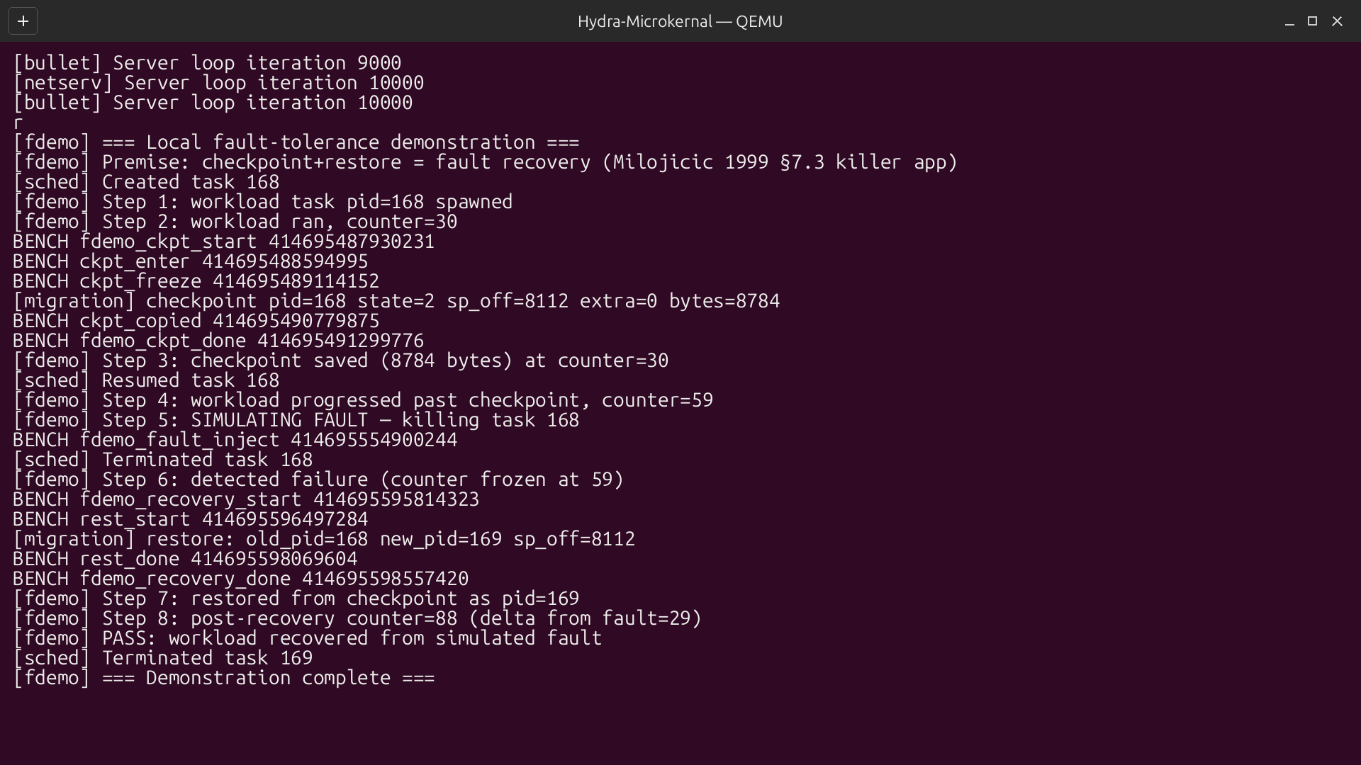
Backup: controlled task recovery
Frozen counter: 59
After recovery: 88 (+29)
Later QEMU r-command recording. Report §4.2.6 describes the bounded task-recovery demonstration.
14
Notes:
Suggested speaking time: 0 seconds.
This is the r command from the same later QEMU recording used for the checkpoint demonstration. The task saves an 8,784-byte checkpoint, progresses to counter 59, and is deliberately terminated. The counter remains at 59 while it is stopped. Restore creates PID 169, after which the shared workload counter reaches 88, a delta of 29 from the stopped value. The test prints recovery PASS. The checkpoint buffer lives in BSS in the surviving kernel. This demonstrates controlled task-failure recovery; it does not demonstrate host crash, persistent storage or rollback of the shared global counter. Use the original recording and log for audit. The terminal window appearance is recreated while the text remains unchanged.
Sources: Later QEMU r-command recording. Report §4.2.6 describes the bounded task-recovery demonstration.

Slide 15
Selected references
Milojičić et al. (1993)
Task Migration on Top of the Mach Microkernel. USENIX Mach Symposium, pp. 273–290.
Milojičić et al. (1999)
Process Migration. HP Laboratories Technical Report HPL-1999-21.
Gu et al. (2020)
Harmonizing Performance and Isolation in Microkernels with Efficient Intra-kernel Isolation and Communication. USENIX ATC, pp. 401–417.
Chen et al. (2024)
Microkernel Goes General: Performance and Compatibility in the HongMeng Production Microkernel. USENIX OSDI, pp. 465–485.
Clark et al. (2005)
Live Migration of Virtual Machines. USENIX NSDI, pp. 273–286.
Waterman and Asanović (2019)
The RISC-V Instruction Set Manual, Volume I: Unprivileged ISA. Version 20191213.
Full Harvard reference list: Final_Report.docx, References. Figure/data sources appear in slide notes.
15
Notes:
Suggested speaking time: 0 seconds.
These references are selected from the dissertation bibliography and cover the historical comparison, adoption survey, modern communication mechanisms, practical migration motivation and ISA. Full citations and the remaining sources appear in the report. The slide summaries use the revised report and retained data rather than independently rechecking all publications.
Sources: Full Harvard reference list: Final_Report.docx, References. Figure/data sources appear in slide notes.

