Slide 1
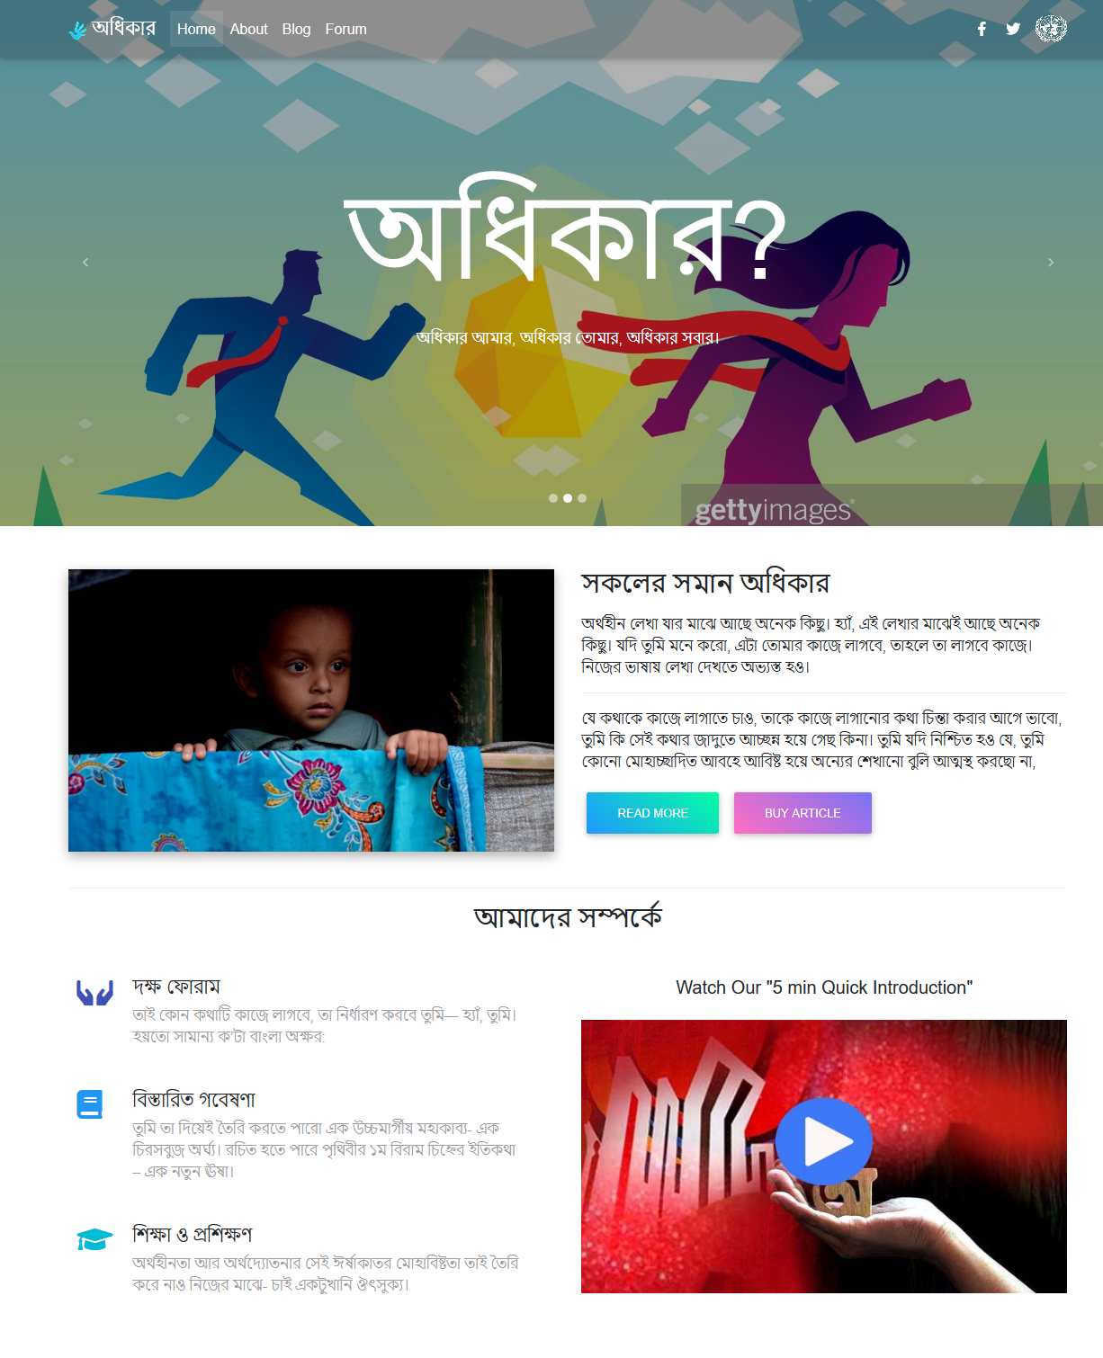

AwaKvi

Slide 2
The most tedious thing for a backend developer is designing frontend.
“

