Slide 1
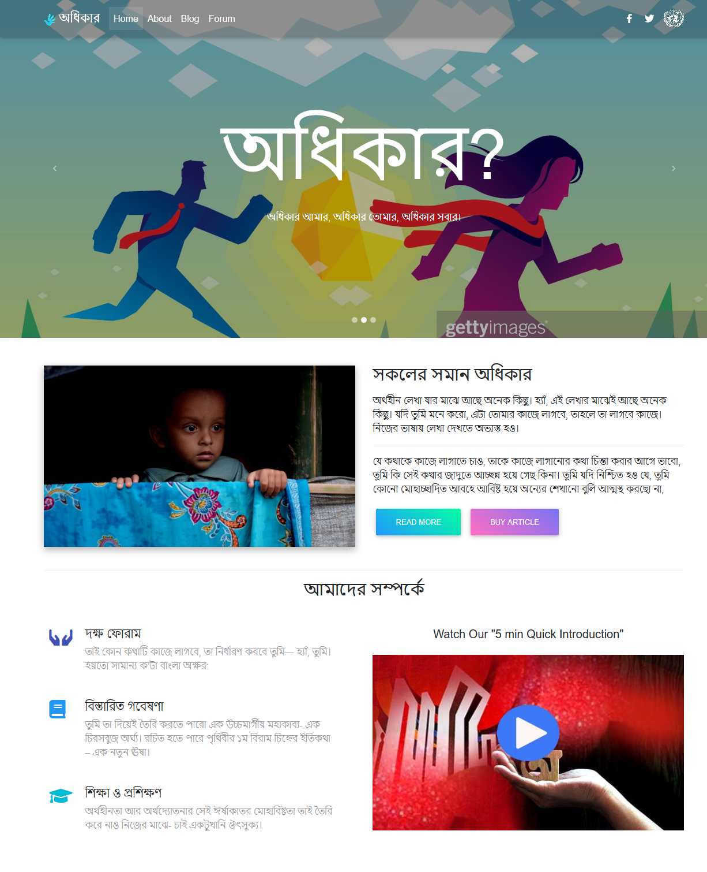
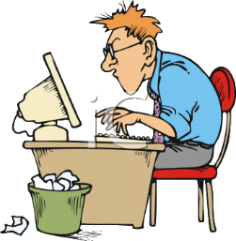
AwaKvi
Group: Name….
Members
Rumon Chowdhury *C
Pranta Saha
Ramjan Ali
…………

Slide 2



Details of Project
This is a non profit organization website. Main motive of this organization is to work for human rights.

Slide 3

Motives of the Project
We want to …
Teach people about their rights
Teach people to work for ensuring others rights
Help people for building a better civilization
Ensure a sound and peaceful life for everyone

Slide 4








Technology Used
MDB
Popper.js

Slide 5

All Human Beings are born free and equal in dignity and rights. –UN, Charter-1945
“

