Slide 1



UK – Train Analysis
Introduced by:
“Insight Innovators”
Sarah Farag Sahar Hamdi
Nada Saad Mona Hassan
Sara Mohamed Dina Yasser

Slide 2

Introduction
In the first few months of 2024, the UK’s National Rail was caught in a roller-coaster of challenges. Drivers’ strikes, disrupted schedules, ticket office closures stirred uncertainty among passengers, and extreme weather conditions added chaos to the mix.
Amidst this turbulence, as a motivated group of data analysts, we were handed a mission: to make sense of it all.
Tasked with analyzing train ticket sales from January to April,
our goal was to uncover the most popular hours, pinpoint peak travel times, break down revenue by ticket types and classes, and diagnose the factors behind on-time performance—delays included. With a dataset that held everything from ticket types to journey schedules, departure and arrival points, and ticket prices, we set out to create exploratory dashboards that could turn confusion into clarity.

Slide 3
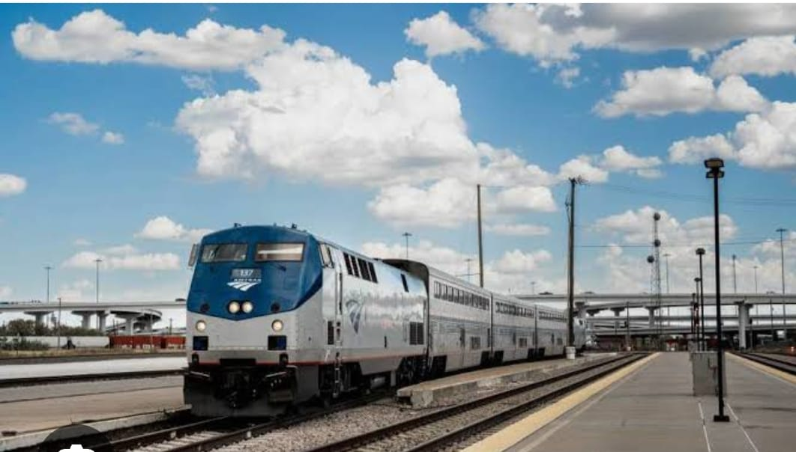
Project Scope
Objective
Analyze railway journey data to uncover insights.
Data Period
January 1st, 2024 – April 30th, 2024.
Key Dataset Features
Railway card usage patterns.
Journey statuses (on-time, delayed, canceled).
Reasons for delays and disruptions.
Other relevant operational details.

Slide 4

Key Focus Areas and Expected Outcomes
Focus Areas
Identify trends and patterns in railway operations.
Understand factors impacting passenger experience.
Expected Outcomes
Enhance railway efficiency and reliability.
Improve overall passenger satisfaction.

Slide 5
Problem Statement
The dataset reveals significant issues, such as high numbers of delays and missing railway card data. These issues impact operational efficiency and passenger experience.
Collaborative Process
Pain Points
Frequent delays causing passenger dissatisfaction.
Incomplete data affecting the accuracy of analysis.
Lack of insights into the reasons for delays and their impact on revenue.

Slide 6

Data Exploratory
Data Cleaning and Preparation
01
All necessary columns with object data types will be converted to appropriate date/time formats for accurate analysis.
Standardization
02
The values in the "Reason for Delay" column will be unified into specific categories:
Weather → “Weather Conditions”.
Signal failure → “Signal Failure”.
Staff Shortage → “Staffing”.
03
Research and Analysis
Analyze ticket types to study the behavior of passengers
Conduct research on various reasons of delay such as weather conditions , signal failure and staffing .
Investigate the impact of payment method and ticket type on the revenue and how does impact on the refund request.

Slide 7



Tools
1. Data Exploration, Preprocessing, and Cleaning
Excel: For initial data exploration, organization, and basic transformations.
Python: For advanced data cleaning, preprocessing, and analysis (e.g., Pandas, NumPy).
2. Data Visualization and Dashboard Creation
Tableau: For creating interactive dashboards and insightful visualizations.
.

Slide 8
Data Analysis Q&A
What are the most common purchase types (Online vs. Station)?
What is the demographic profile of passengers purchasing online versus at stations?
What Percentage of tickets are purchased with Rail-cards?
What are the most sold ticket type and class are purchased and why is the most used?
What are the peak times for ticket purchases?
What is the most ticket price sold?
.

Slide 9
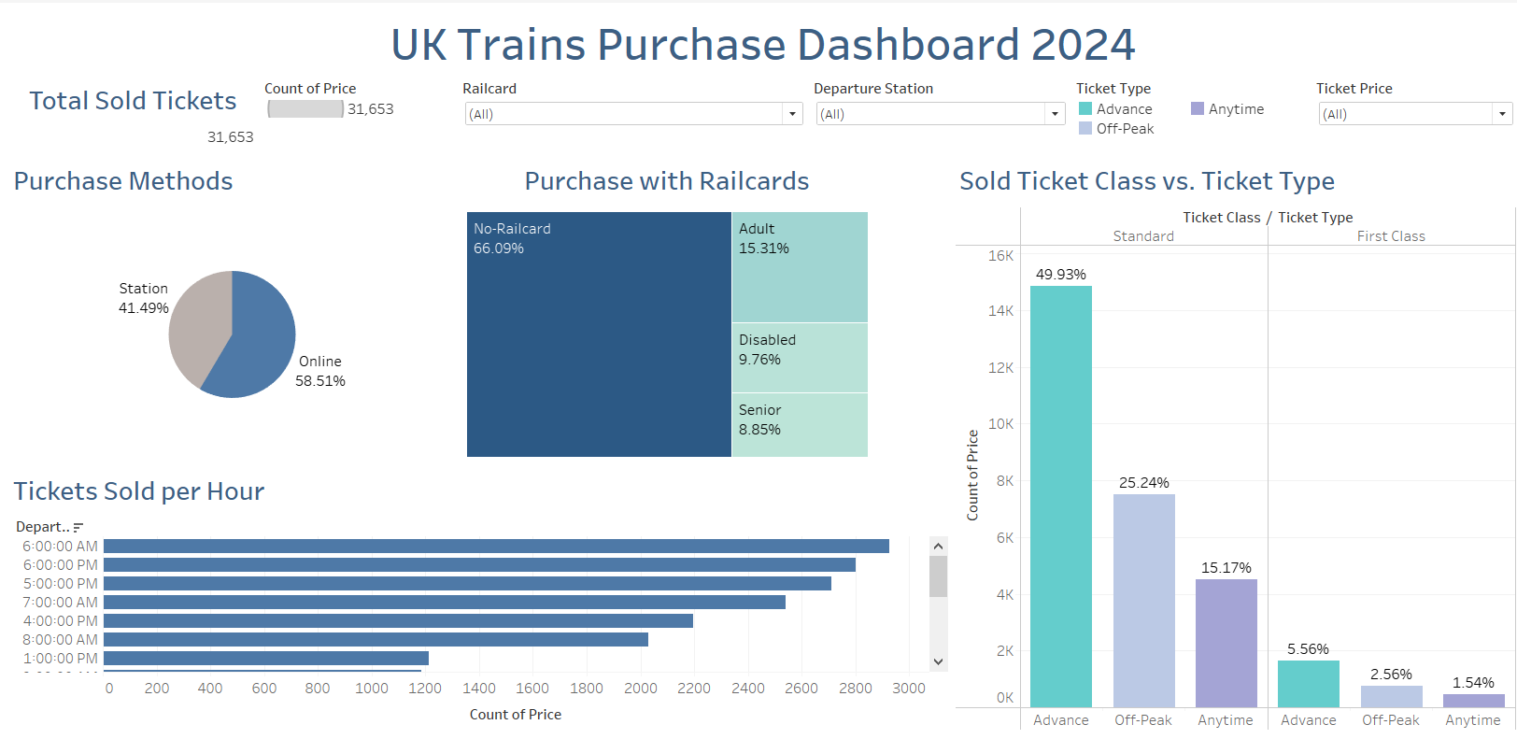
Uk Trains Purchase Dashboard
.

Slide 10
Recommendations
1. Improve the Mobile App & Website
Make the app and website user-friendly for smoother trip booking.
Simplify the process of purchasing tickets online.
2. Promote Rail-cards with Awareness Campaigns
Launch targeted campaigns on social media, mobile ads, and at stations.
Highlight cost-saving benefits and eligibility for rail-cards.
3. Offer Discounts to Encourage Rail-card Use
Provide introductory discounts or free trial periods for new rail-card subscribers.
.

Slide 11
Recommendations
4. Add Support at Stations
Install kiosks and help desks to guide passengers in buying tickets.
Train staff to assist passengers, including those with disabilities, in self-purchasing tickets.
5. Collaborate with Charities for Accessibility
Partner with charities to fund accessible upgrades in major cities like London and Liverpool.
.

Slide 12
Data Analysis Q&A
What is the total revenue generated by UK train ticket sales in January – April 2024, including and excluding refunds?
Which departure station generates the highest revenue, and how does it compare to other stations?
What are the revenue contributions of different ticket types, such as Standard Advance or First Class Anytime?
How does revenue vary across different hours of the day, and which time slot generates the most revenue?
How do payment methods (credit card, contactless, debit card) influence total revenue, and which is the most profitable?
What impact do refund requests have on net revenue, particularly at high-refund stations like Liverpool Lime Street and Manchester Piccadilly?
.

Slide 13
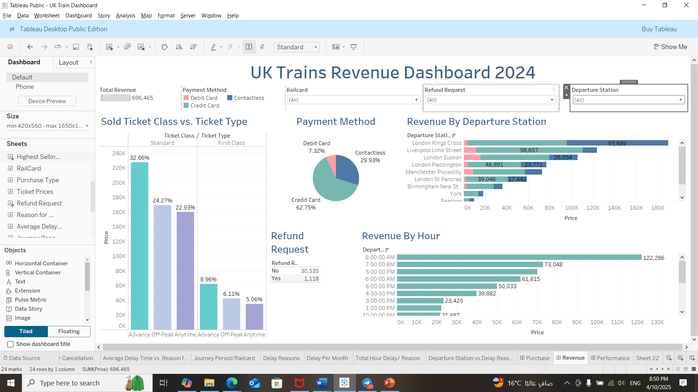
UK Trains Revenue Dashboard
.

Slide 14
Recommendations
Promote Ticket Options
Highlight cost-saving benefits of Advance tickets for budget travelers.
Emphasize First Class perks to attract premium passengers.
Reward Loyal Customers
Offer a free/discounted First Class ticket to loyal customers who booked 50+ trips online.
Adopt Best Practices
Use insights from high-revenue stations (e.g., Liverpool Lime Street) to improve other stations.
Target Commuters with Discounts
Launch campaigns, bundles, and discounts for daily commuters and students traveling the same route (e.g., 8:00 AM Monday-Friday).
.

Slide 15
Recommendations
5. Affordable Breakfast Options
Provide discounted breakfast deals via vending machines during early morning hours.
6. Improve Peak Hour Services
Enhance accessibility and services during busy periods to reduce congestion and improve efficiency.
7. Gather Feedback for Improvement
Actively seek passenger feedback to resolve refund issues and boost overall satisfaction.
.

Slide 16
Data Analysis Q&A
What are the primary reasons of train delays, and Which is the highest percentage?
How do reasons affect total delayed hours?
Which departure stations experience the highest frequency of delays, and what are the associated reasons?
How do delays and cancellations vary from January to April 2024?
Which type of delay contributes most significantly to total service problems?
.

Slide 17
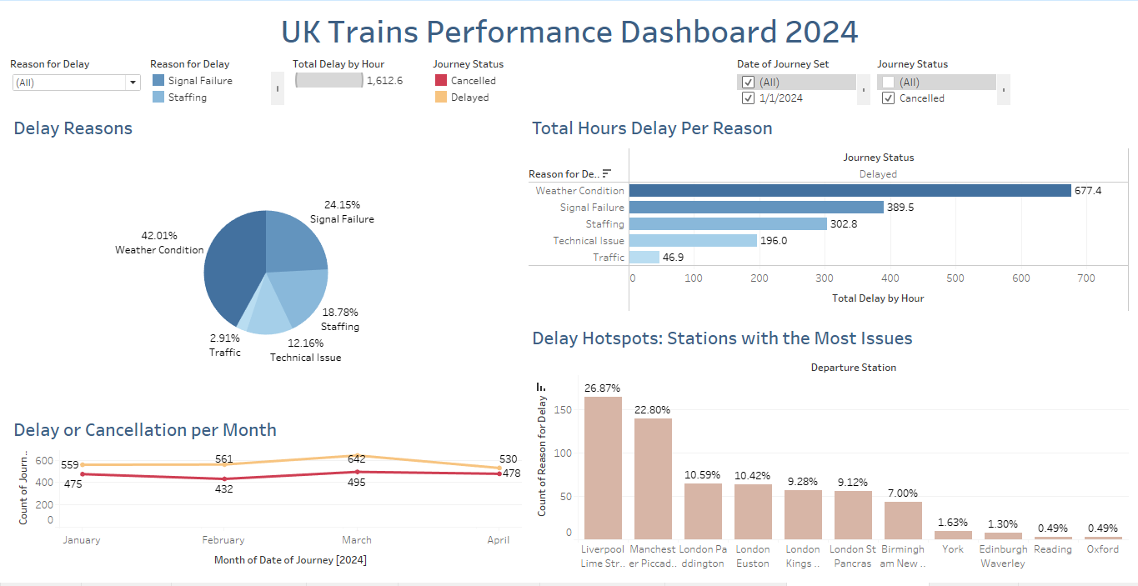
UK Trains Performance Dashboard
.

Slide 18
Recommendations
Insulate power stations with protective materials to withstand storms.
Invest in hybrid train engines to reduce reliance on traditional power systems.
Address staff needs by improving work conditions and compensation.
Offer additional bonuses or support for handling storm-related disruptions and high work pressure.
.

Slide 19
Thank You
.

