Slide 1
IteRace
Practical Static Race Detection for Java Parallel Loops
Sahar Atias

Slide 2
Parallelism
Parallelism helps software execute faster.
More and more developers move to parallelism approach.
Memory problems may arise with parallelism – called race conditions.
Race conditions are very hard to detect.
Early detection of such conditions help us avoid unexpected behavior.
Therefore static and dynamic race detectors were invented.
IteRace is a static race detector.

Slide 3
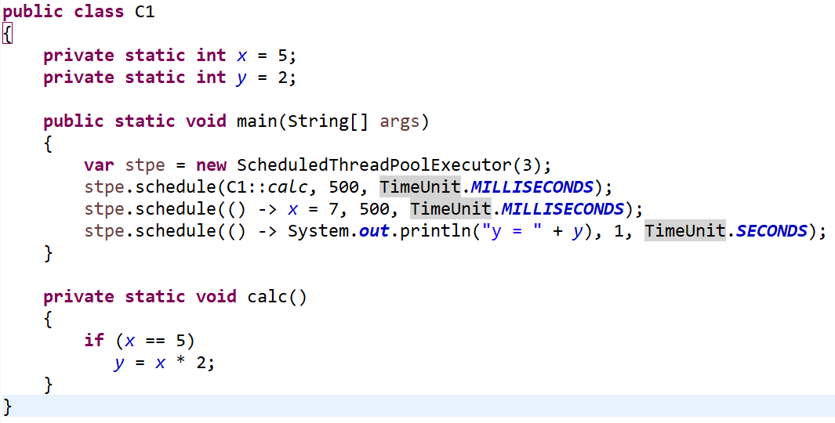
Race condition example 1
Output 1:
y = 2
Output 2:
y = 10
Output 3:
y = 14

Slide 4
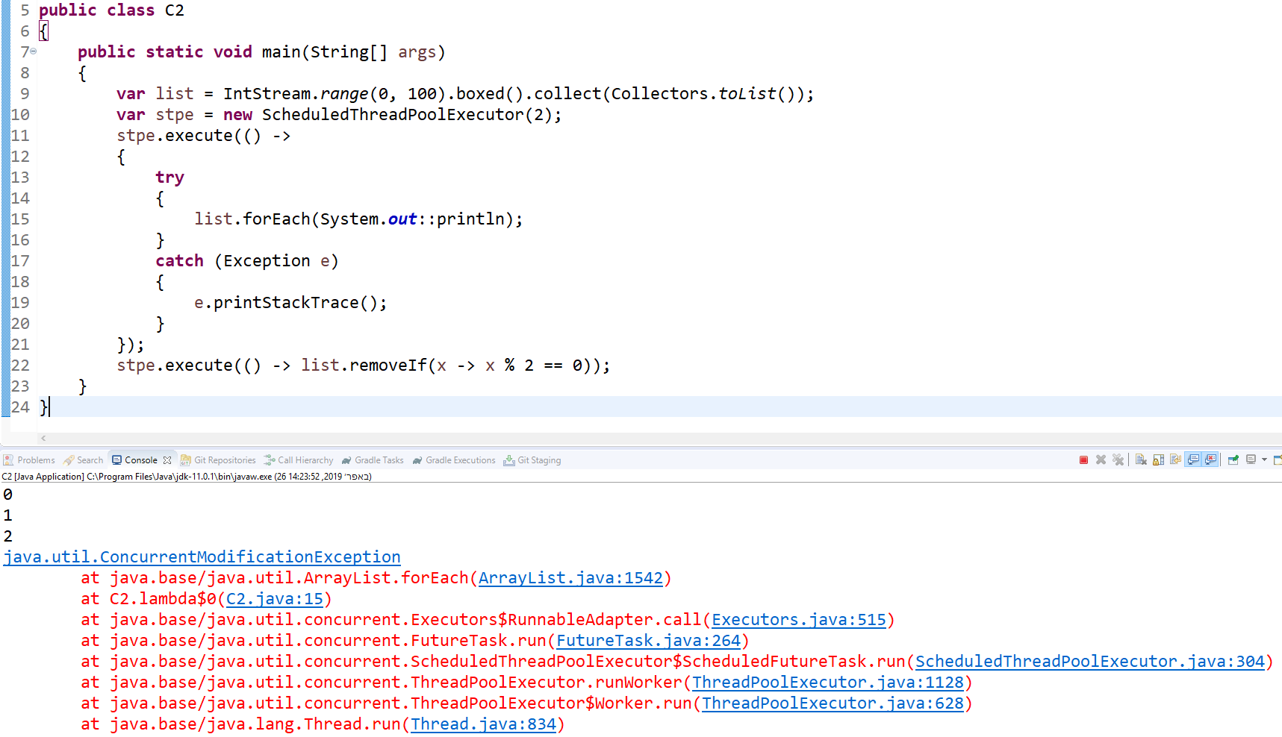
Race condition example 2

Slide 5
Static analysis approach
All static analysis approaches before IteRace were impractical.
They tried to work equally for any kind of parallel construct.
They did not differentiate between application and library code.
They did not use the documented behavior of libraries.
They were not scalable or reported high number of false warnings.

Slide 6
Dynamic analysis approach
Less false warnings than static analysis.
Higher overhead.
Miss race conditions on code paths that weren’t executed.

Slide 7
IteRace
Cosmin Radoi from Illinois University and Danny Dig from Oregon State University, USA – have invented IteRace.
IteRace goals are to find race conditions with as little false-warnings as possible and without missing any true races.
To achieve these goals, it exploits the mechanism of threads and safety & data-flow structures.
So far, IteRace found six bugs in real-world applications so far, which were then confirmed and fixed by their corresponding developers.

Slide 8
IteRace techniques
We will have a look at 3 techniques used by IteRace:
2-Threads: make the analysis aware of the threading and data-flow structure of parallel operations.
Bubble-up: report races in application code, not in libraries.
Filtering: filter the race warnings based on a thread-safety model of a library class.

Slide 9
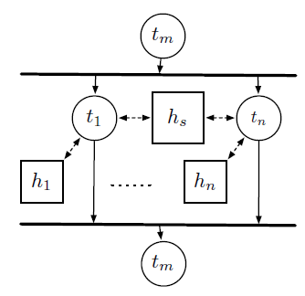
2-Threads - Runtime
A parallel loop is an SPMD-style computation.
Its iterations are identical tasks with different inputs.
Without loss of generality: we assume each iteration is a task.
The main thread forks multiple identical threads at the beginning of the loop and waits for them to join at the end.
Each task can access a part of the heap.

Slide 10
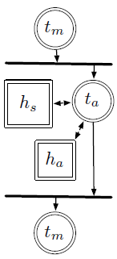
2-Threads – General Approach
A general race detector models the identical threads by 1 thread.
This makes the thread specific sets indistinguishable from each other.
Escape analysis or other techniques are used to refine the results and reduce the number of false warnings.

Slide 11
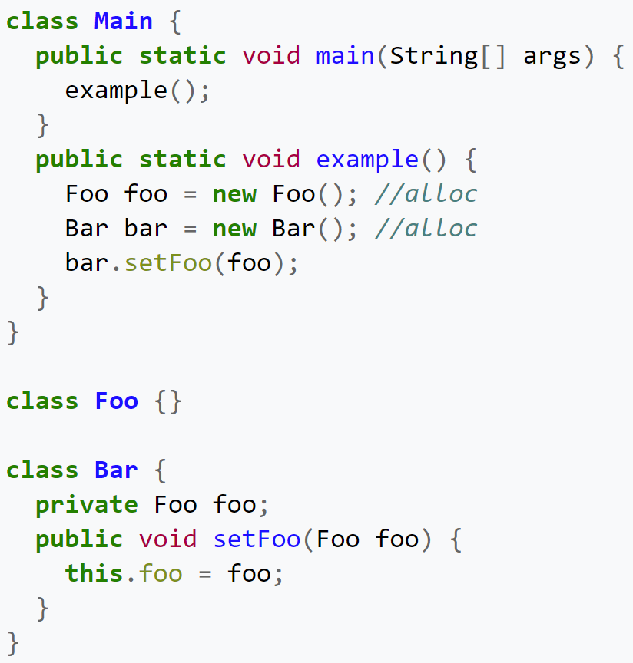
Escape Analysis
Escape analysis is used to check whether an object x can escape a method or thread y.
The java compiler uses this technique to decide whether to allocate objects on the stack or on the heap.
In our case, if an object escapes a thread, it can cause a potential race, otherwise its thread-safe.

Slide 12
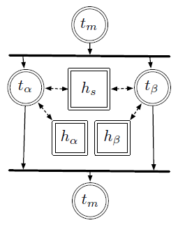
2-Threads – IteRace Approach
In contrast, IteRace models the identical threads by 2 distinct threads.
Thus, there are 2 different sets for each thread.
IteRace still uses Escape Analysis but in a more precise manner.

Slide 13
Bubble-up
All java applications are built on libraries.
General race detectors do not keep track of where the race appeared.
If an issue occurred inside a library, IteRace tracks back the race warning to the application.

Slide 14
Filtering
To improve performance, many library classes employ advanced synchronization techniques (compare & swap, immutability etc).
These classes pose a challenge for any static race detection.
Since IteRace aims to analyze only application code, it assumes all libraries are correctly implemented and thus able to use a lightweight version of these libraries according to their documentation.

Slide 15
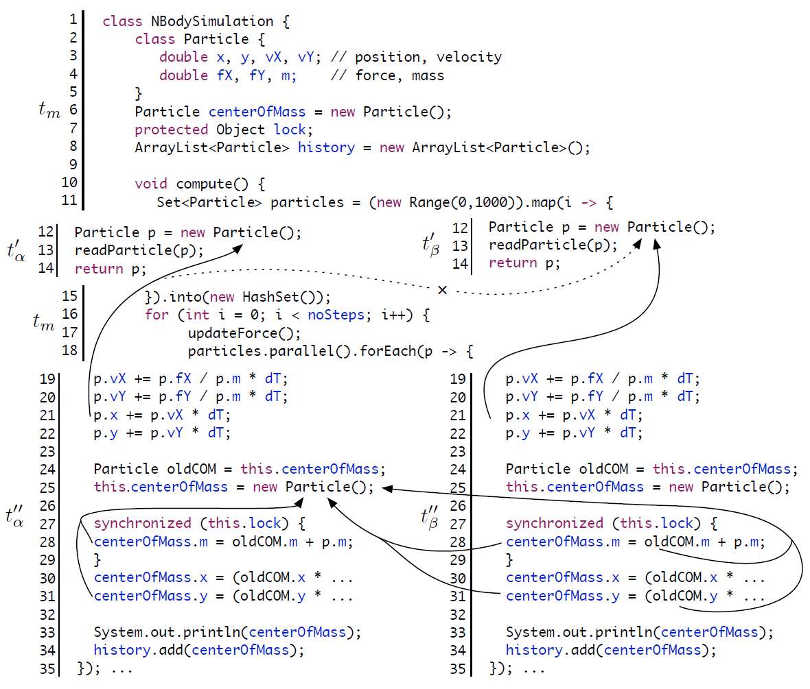
Example
Main thread creates some shared objects.
Parallel loop creates the particles.
Main thread iterates the particles in parallel again.
Lines 19-22, 28 and 33 are thread safe.
Lines 24-25, 30-31 and 34 are not thread safe.
Filtering phase eliminates the races from the standard output.
Bubble-up phase transforms the warnings from the ArrayList to a single warning on line 34.

Slide 16
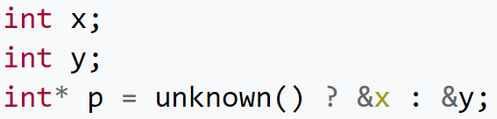
Some definitions
Andersen-style static pointer analysis: used to create a set of potential variables that each pointer can be assigned to.
Call / Control Flow Graph: a graph representing relationships between methods.
Context Sensitivity: whether or not two items relate to each other.
Flow Sensitivity: whether or not the way commands are written has any importance.
Data-flow Analysis: tells all possible values of each variable at any point of program’s execution.

Slide 17
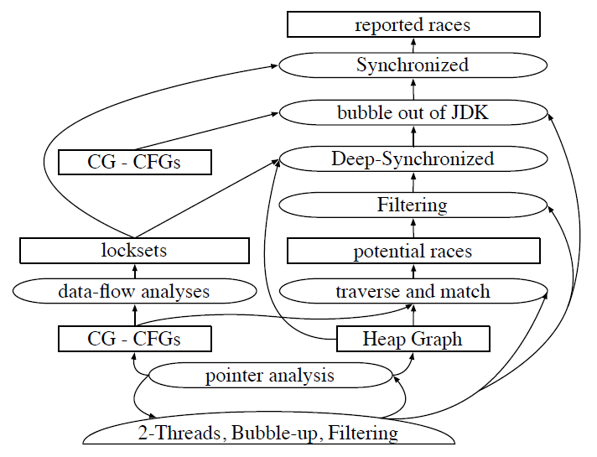
Race Detection by IteRace
Bottom half oval represents the mechanism.
Ovals represents sub-analyses.
Rectangles represent data structures.

Slide 18
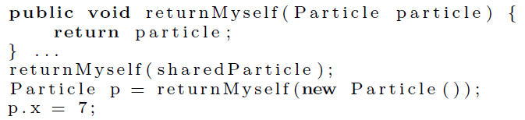
False warning example
Without any context sensitivity, pointer analysis would decide that the possible object graph for returnMyself’s particle would be both sharedParticle and new Particle.
In order to deal with it, IteRace adds for each object its instantiation thread, therefore sharedParticle and new Particle can never be in the same context.

Slide 19
Method labels
threadSafe – if this method cannot create any race conditions.
threadSafeOnClosure – if the method is threadSafe and any of its invocations is also threadSafe.
instantiatesOnlySafeObjects - if all objects instantiated inside the method are thread-safe.
circulatesUnsafeObjects - if the method either return or receive a possibly non-thread-safe object as a parameter.
Interesting (and Uninteresting) – if this method should be investigated at all by IteRace.

Slide 20
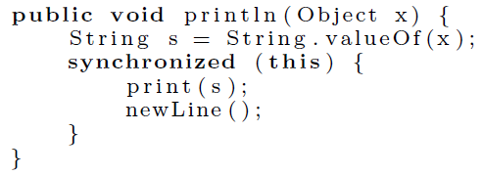
Labels usage
Labels are used by the Filtering phase to tell which race warnings are relevant and which aren’t.
In addition, these labels allows extendibility to the end-user, adding the relevant labels to his own custom libraries.
The Interesting and Uninteresting flags allow the end-user to decide how deep he wishes to go inside method calls.
The below example is threadSafe but not threadSafeOnClosure

Slide 21
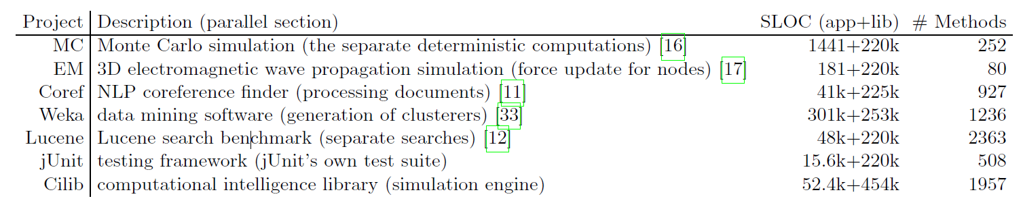
Is IteRace practical?
Determined by number of warnings the programmer has to inspect.
Determined by number of true warnings.
IteRace was compared with other static race detector called JChord.

Slide 22
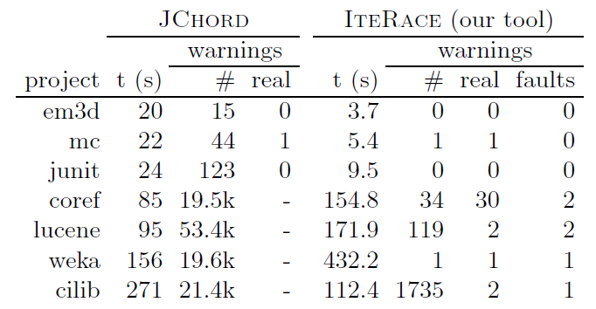
t (s) – the time it took the rece detector to run.
# - the total number of warnings.
real – the real number of warnings.
faults – amount of mistakes that led to these warnings.
For the first 3 projects nearly none of the warnings that were found by JChord were real.
JChord warnings for the last 4 projects were too big to inspect.

Slide 23
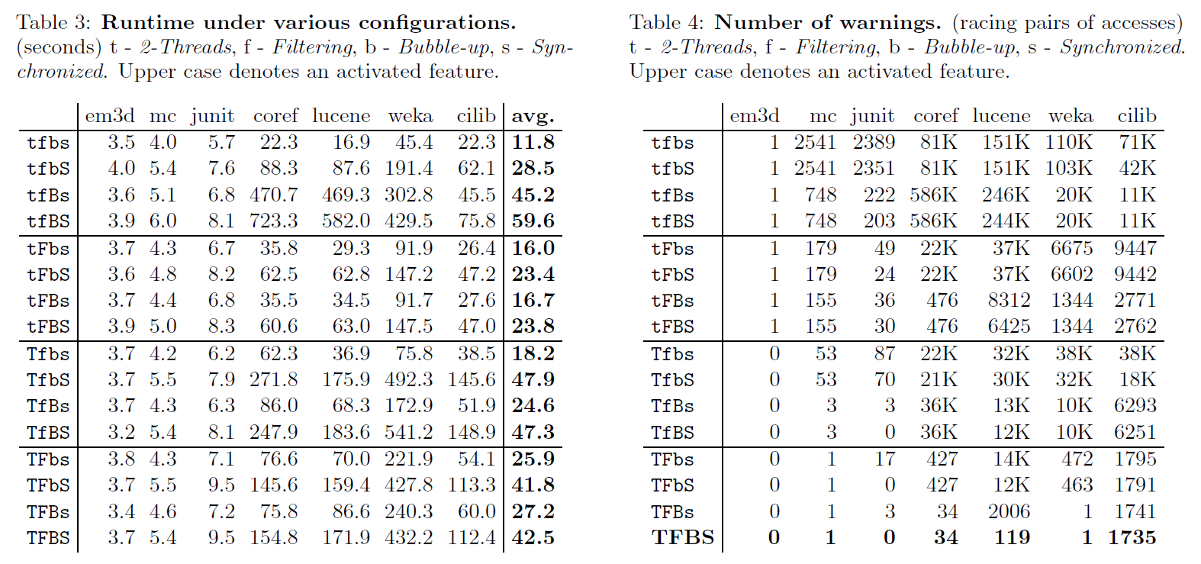
Performance

Slide 24
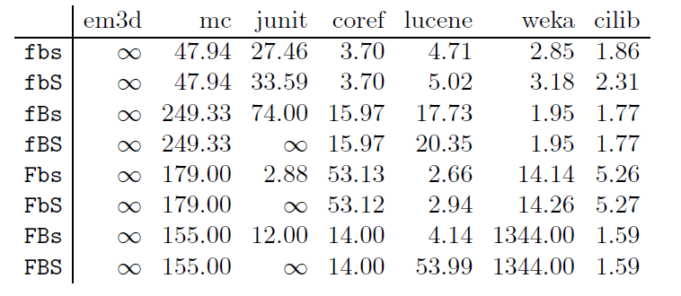
Performance
The table below shows the improvement provided by 2-Threads.
IteRace created such a table for each of their techniques.
A higher ratio means more warnings were filtered.
∞ means the number of warnings went down to 0.

Slide 25
Conclusion
Dynamic race detectors takes time to run and miss potential races.
Static race detectors creates many false warnings that needs inspection.
IteRace is a static race detector which uses new techniques to overcome the cons of the approaches that came before it.
The End

