Slide 1
Part of speech – Israelis politicians adjective
A project in Digital Humanities

Slide 2
introductioninintroductionf
This project is related to the course "Subjects in Digital humanities".
In this project I hoped to achive a knowledge about how Isreali politicians are being reviewed in the new apps/websites.
In order to do that, we’ll need to understand the context of the articles about them.

Slide 3
Understand the contextfכunderכ
In order to understand the context , we’ll have to fine adjectives from the content.
We’ll do that by extracting adjectives from the articles.

Slide 4
Technical steps
Set a Python environment
Prepare politicians name/nickname data-set.
Get content from an API
Parse the content
To sentences
To tokens
Apply YAP – a natural language parser for Hebrew.

Slide 5
Step 1 – python Envgfdhsדsdfdgd
In this project I chose to use python because in its easy api to “newsapi” and its easy syntax.
In order to make the project suitable to other users, I used python virtual envrionment.
The instruction for setting can be found in the README.md file.

Slide 6
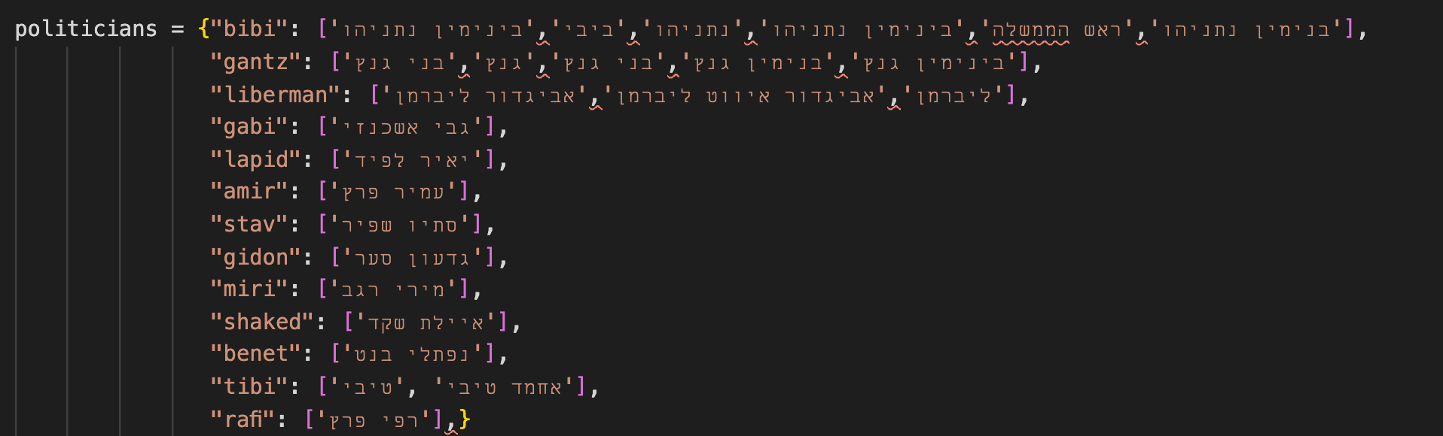
step 2 – prepare dataffbfgbfgfgdfgdffffdfsדגגsssstep
Create “bank of key words”
In these project I focused on Israelies politicians
In general – the project can be applied to any context you wish to research.
Example:

Slide 7
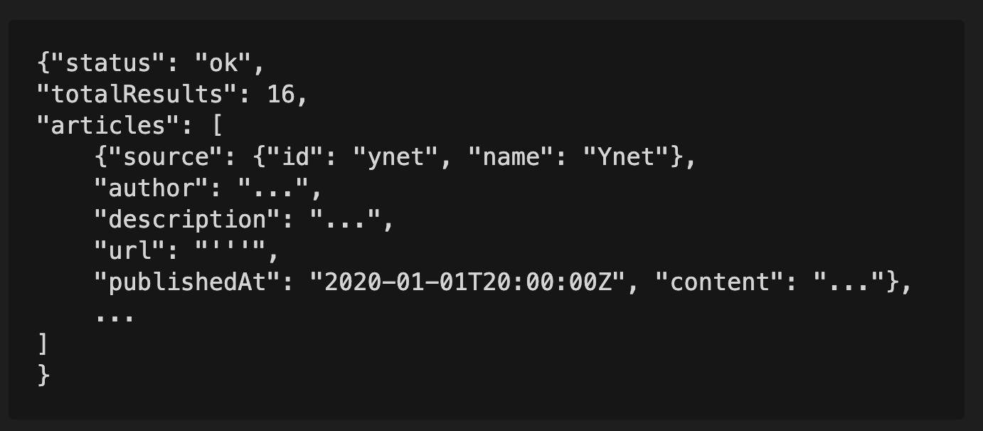
step 3 – api callsffbfgbfgfgdfgdffffdfsדגגsssstep
Get the data from the API (with filters if exists).
Save the content in json files accoring to the instructions in the README.md file.

Slide 8
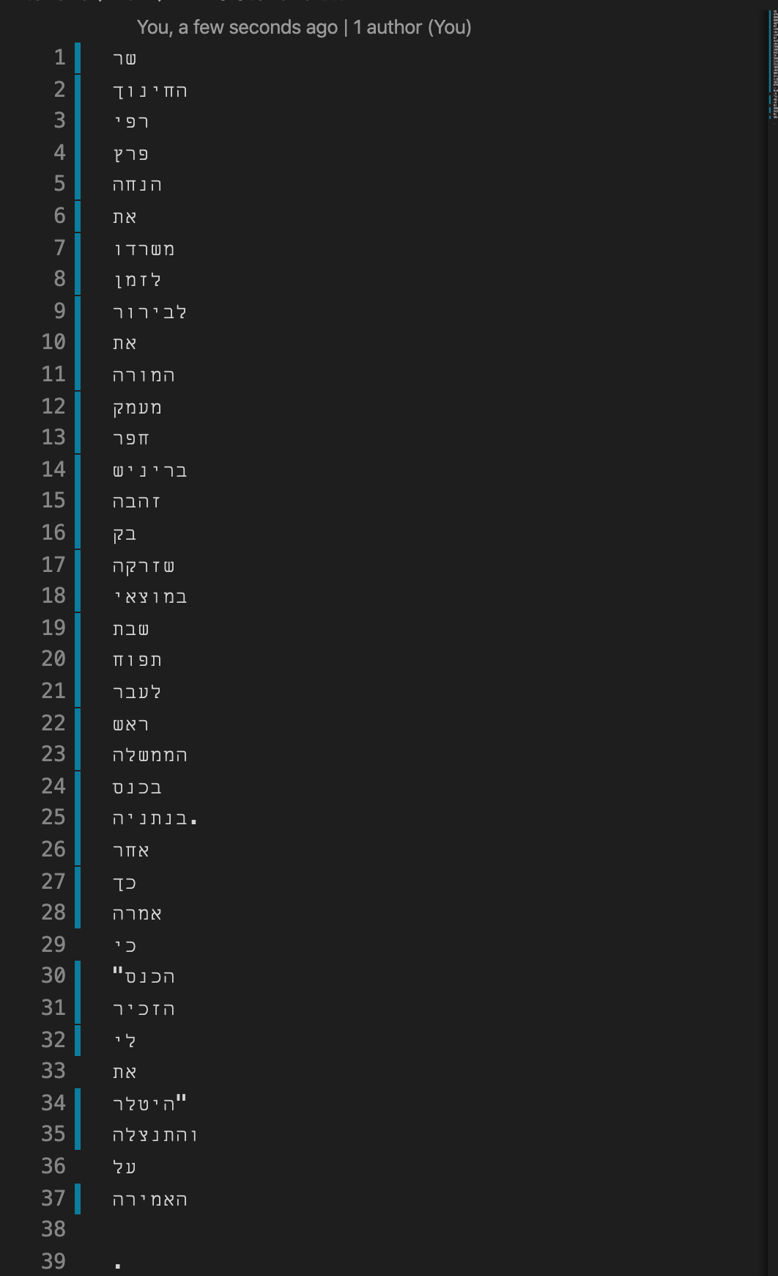
step 4 – parse content - Extracting tokens ffbfgbfgfgdfgdffffdfsדגגsssstep
Assuming the content is set in the right way, this phase will extract the content and parse it into tokens.
Iterate the content and do:
Parse into sentences
Parse into tokens

Slide 9
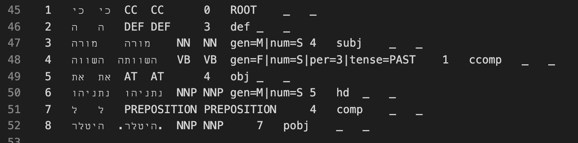
step 5 – apply yap utils ffbfgbfgfgdfgdffffdfsדגגsssstep
In this step, we'll apply yap utils to extract "Part of speech" in Hebrew.
I wrote a shell scripts that applies yap program on the files.

Slide 10
Difficulties during the projectffbfgbfgfgdfgdffffdfsדגגsssstep
Changes in the Newsapi policies
in the middle of the project the API I used, has changed its terms of use.
The content I could get is only of the previous month (1 month).
So the project became less ”retro research”.
Change in the Newsapi response
Another change was in the api response content.

Slide 11
The change in the project’s target ffbfgbfgfgdfgdffffdfsדגגsssstep
Due the diffeculties, I decided to change to concept of the project from “reseach” to “plugin platform”.
That means that - I created a generic infrustructure that can consume any api that provides hebrew content.

Slide 12
The resultsffbfgbfgfgdfgdffffdfsדגגsssstep
Adjective – can look for:
NN | JJ | COMP
Lets take a look
We can also run ”demo”.

