Slide 1

Cryptography
------------
September 2020

Slide 2
On daily basis…
Private key
https
certificated
Sha256
TLS
Hash
Public key
Encrypted data
AES

Slide 3
#1

Slide 4
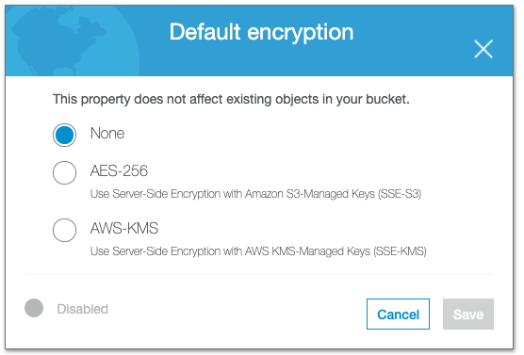
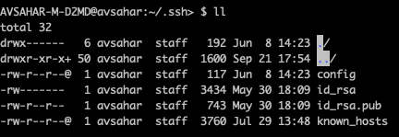
Where did we see that before?

Slide 5

Main goals
Protect our data
Protect our customers
Prevent attack

Slide 6
Types of encryption // Type of key
Symmetric Encryption
Both sides are sharing the same key
Asymmetric Encryption
Each side has its own key

Slide 7
Topics
Symmetric Encryption Concept
Main rules
Simple encryptions
DES
AES
Long messages
HASH
Authentication
Security

Slide 8
Symmetric Encryption

Slide 9

Symmetric Encryption
Concept
Main rules
Simple encryptions
DES
AES
Long messages
HASH
Authentication
Security

Slide 10

Symmetric Encryption

Slide 11



Symmetric Encryption

Slide 12
Symmetric Encryption
<Gen, Enc, Dec>
Gen – Random algorithm for key generation
Enc – Known algorithm that gets key and message and returns ciphered message
Enc(k, m) → c
Dec – Known algorithm that gets key and ciphered message and returns a message
Dec(k, c) → m
Definition of Truth:
Dec(k, Enc(k, m)) → m

Slide 13
Symmetric Encryption
Kirchhoff's laws
Enc and Dec will be known
Why?
It’s easier to save short key rather that algorithm
Key rotation
Same methods for multi-users system

Slide 14
Simple Examples
Modulo encryption:
Enc(k, m) → (m + k) mod 26
Switch enctyption (permutation cipher):
A → R
B → Z
C → A
Vigenere cipher
More information
Hill cipher (using matrix)
More information
Linear Feedback Shift Register (LFST)
More information

Slide 15
Type of Attacks
Cipher text only attack
The attacker see some ciphered messages and tries to understand the original ones.
Known plain text attack
The attacker see come pairs of:
<M, Enc(k, M)>
The attacker crack the system if a new message is being encrypted by him.
Chosen plain text attack
The attacker can ask for encryption for M
The attacker crack the system if a new message is being encrypted by him.

Slide 16

Security
$𝕂$ Keys space - <0000000000> → 2^10
$𝕄$ Messages space
$ℂ$ ciphered messages space - <0000> --> 2^4 = 16 – 1/16
Perfect secrecy
$\operatorname{Pr}\left(C=c \right|M=m)=\operatorname{Pr}{(C=c)}$
$\operatorname{Pr}\left(M=m \right|C=c)=\operatorname{Pr}{(M=m)}$
Math – Independence
Intuitive – When the attacker sees c message, he cannot get any information about m.
If Enryption system is Perfectly secured then $|𝕂|≥|𝕄|$

Slide 17

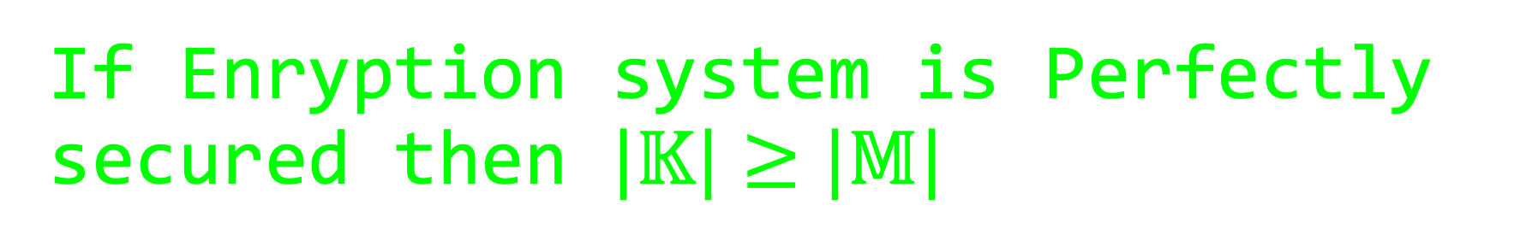
If Enryption system is Perfectly secured then $|𝕂|≥|𝕄|$
Let’s say $\left|𝕂\right|<|𝕄|$
We’ll take $c ∈ℂ$
$𝕄\left(c\right)=\{m: ∃ k∈𝕂, Dec\left(k, c\right)=m\}$
All the messages that are decrypted from c by any k
Since $\left|𝕂\right|<|𝕄|$, $|𝕄\left(c\right)|<|𝕄|$
So there’s $m^{′}∈𝕄 \bigwedge{m ∉𝕄\left(c\right)}$
So $\operatorname{Pr}\left(M=m^{′}\right)=1/|𝕄|$, $\operatorname{Pr}\left(M=m^{′}\right|C=c)=0$
$Pr⁡(M=m^{′})≠Pr⁡(M=m^{′}|C=c)$

Slide 18
Security
The common Encryption systems are not perfectly secured, because in real life we cannot implement systems that their keys are longer than the messages.
Perfectly secured is not practical.
We would want that:
The system can be hacked, but with low probability

Slide 19
Attacks
Brute-force attack
In theory, we can hack and crack any encryption algorithm by Brute-force attack
We want to create a complex encryption algorithm, that cannot be hacked in high probability

Slide 20

Important Terms
XOR $⊕, 111⊕000=111, 10⊕11=01$
Permotation – תמורה – reorder the bits by specific method

Slide 21
DES – Data Encryption Standart
1975 (Federal Register)
standardized in January 1977
IBM

Slide 22

DES – Data Encryption Standart
m (64 bit)
DES
C (64 bit)
Key (56 bit)

Slide 23

16 iterations
In each iteration we split the message to 2:
<32 bit, 32 bit> → [Li , Ri]
Each iteration has its own key Ki
We get the ki key be expansion of the init key
Enc: In each iteration we calculate:
$L_{i}=R_{i−1}$
$R_{i}=L_{i−1}⊕f(R_{i−1}, k_{i})$
Dec: same process only backwards.

Slide 24
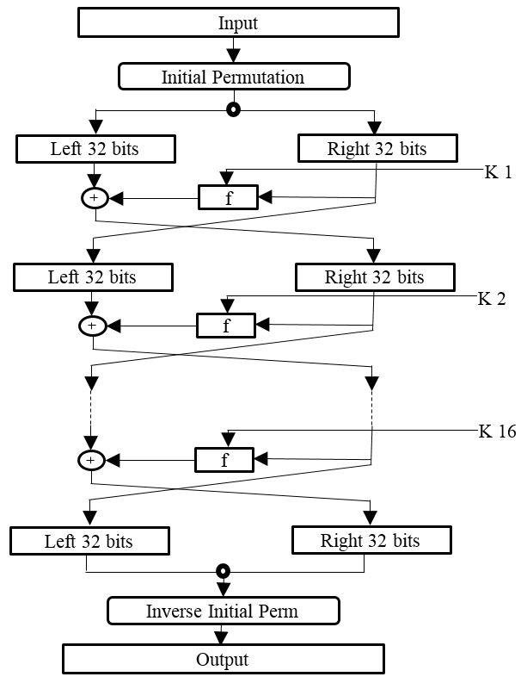
The Algorithm (Enc)

Slide 25
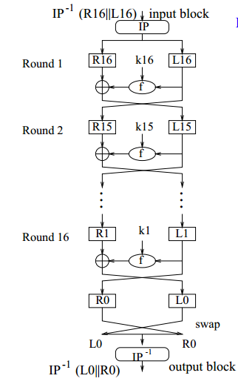
The Algorithm (Dec)

Slide 26


The $f$ function
F has 4 steps:
Extend Ri from 32 bits to 48 bits by the table E:
<32,1,2,3,…>
XOR: $E\left(R\right)⊕K_{i}$
<-6-,-6-,-6-,-6-,-6-,-6-,-6-,-6->
Apply 8 S-boxes (same for all the iterations)
<-6-> → s-box → <-4->
The ouput of the 8 s-boxes is the output of f function.

Slide 27
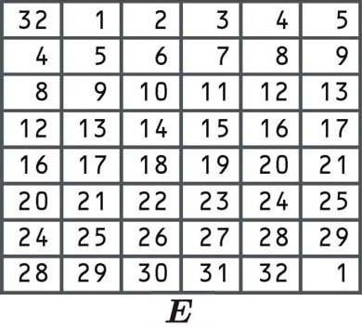
E table

Slide 28
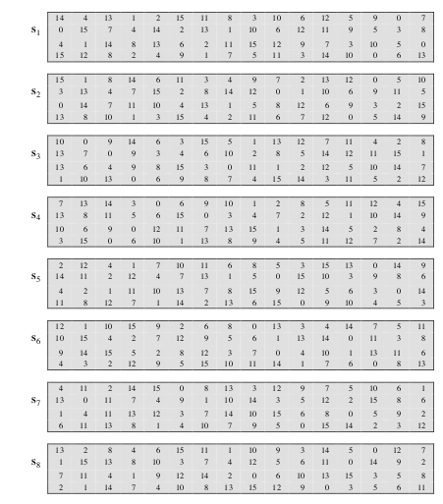
S-Box
Described by the tables on the attachments.
Each combination of 6 bits, returns the same combination of 4 bits.
011011
Col
b2, b3, b4, b5
Row
S-Box
b1
b6
o2, o3, o4, o5
Notes:
B1b6 is the rown number if the table of the s-box
B2b3b4b5 is the col
The cell [I,j] contains the output

Slide 29

DES today
m (64 bit)
DES
X (64 bit)
DES
C (64 bit)
2DES
3DES
It’s hard to crack but unless the user rotate the keys every few hours, it’s risky to use.
In 2023 it will be forbidden to use as part of TLS standart (https, ssl)

Slide 30
What did we cover
Symmetric Encryption Concept
Main rules
Simple encryptions
DES
AES
Long messages
HASH
Authentication
Security

Slide 31
#2

Slide 32
Topics
✔ Symmetric Encryption Concept
✔ Main rules
✔ Simple encryptions
✔ DES
AES
Long messages
HASH
Authentication
✔ Security

Slide 33
Symmetric Encryption

Slide 34
Symmetric Encryption

Slide 35
AES – Advanced Encryption Standart
AES-128 // 10 iterations
AES-192 // 12 iterations
AES-256 // 14 iterations
AES-i → i refers to the length of the key.

Slide 36
AES – Advanced Encryption Standart
1998

Slide 37
AES – Advanced Encryption Standart
m (128 bit)
AES
C (128 bit)
Key (128/192/256 bit)

Slide 38
AES
Each message is a size of 128 bits devided into 4X4 matrix
Each cell is 1 byte (8 bits) → 4X4X8 = 128
Each iteration has its own key Ki
We get the key be expansion of the init key
Each iteration has 4 steps:
subBytes
shiftRows
mixCols
addRoundkey
In the last iteration we do 1,2,4 steps
1 byte

Slide 39
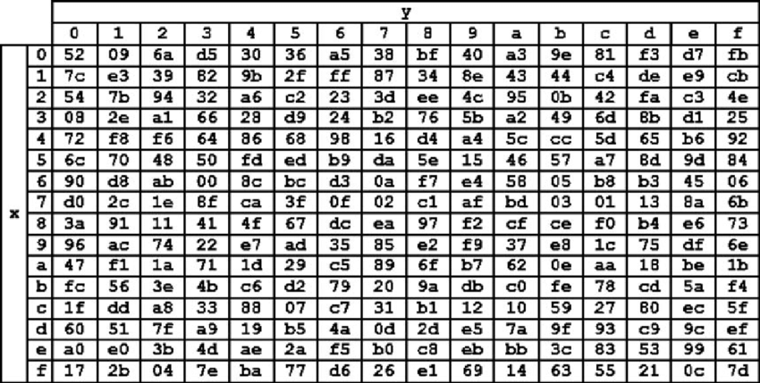
Sub bytes
Apply the S-box for each byte
byte (8 bit)
S-BOX
byte (8 bit)

Slide 40
Shift Rows
For each row i, we shift left i places.

Slide 41
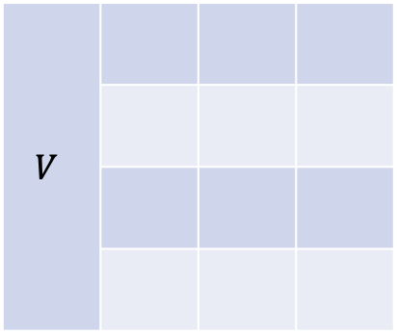


Mix Columns
Each column, will be multiple by a C matrix.
$C ∈M_{4×4}$
$$V$$
$$CV$$

Slide 42
Add Round Key
XOR: $M_{i}⊕K_{i}$

Slide 43
A single bit effects all
*
*
ARK
S-Box
Shift Rows
Mix Cols
ARK+S-box
Shift Rows
Mix Cols

Slide 44
AES today
Commanly used
S3 bucket
Soc2

Slide 45
Long messages encryption (AES)
We want to encrypt a long message by AES
Let’s give it a try (a simple way)
m
m (128 bit)
AES
C (128 bit)
m (128 bit)
AES
C (128 bit)
m (128 bit)
AES
C (128 bit)
m (128 bit)
AES
C (128 bit)
m (128 bit)
AES
C (128 bit)
m (128 bit)
AES
C (128 bit)
Key (128/192/256 bit)
Key (128/192/256 bit)
Key (128/192/256 bit)
Key (128/192/256 bit)
Key (128/192/256 bit)
Key (128/192/256 bit)
c

Slide 46



Why it’s not safe?
$M_{0}=m_{0}m_{1} →AES →c_{0}c_{1}$
$M_{1}=m_{0}m_{2} →AES →c_{0}c_{2}$
Let’s try to fix it - let’s try to fix every block
m
m (128 bit)
AES
C (128 bit)
$$1 ⨁$$
m (128 bit)
AES
C (128 bit)
$$2 ⨁$$
Key (128/192/256 bit)
Key (128/192/256 bit)
c

Slide 47

Why it’s not safe?
$M_{0}=m_{0}m_{1} →AES →c_{0}c_{1}$
$M_{1}=m_{0}m_{2} →AES →c_{0}c_{2}$
These methods are deterministic!

Slide 48
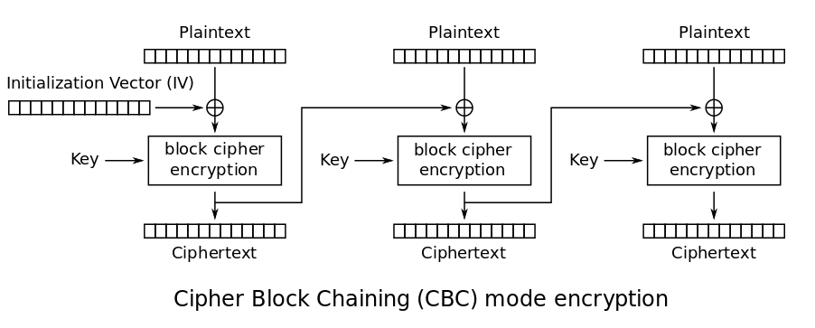
AES – cipher block chaining

Slide 49
AES – cipher block chaining
Pros:
Harder to crack
Cons:
Synced
If we get error in one step it effects the following

Slide 50
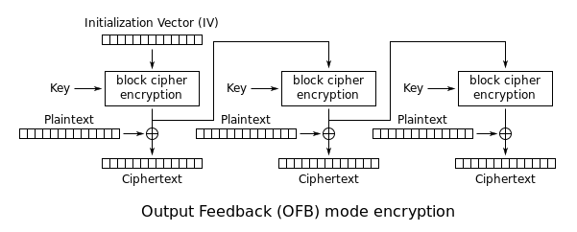
AES – output feedback mode
IV

Slide 51

AES – output feedback mode
Pros:
An error in one step will not effect the rest
Pre-calculation of Z
Cons:
Synced
If we use the same IV, it could be risky:
$C_{1}=IV,\left(z_{1}⊕m_{1}\right),z_{2}⊕m_{2}$
$C_{2}=IV,\left(z_{1}⊕{m`}_{1}\right),z_{2}⊕{m`}_{2}$
$C_{1}⊕C_{2}=0…0, m_{1}⊕m`_{1}, m_{2}⊕m`_{2}$

Slide 52
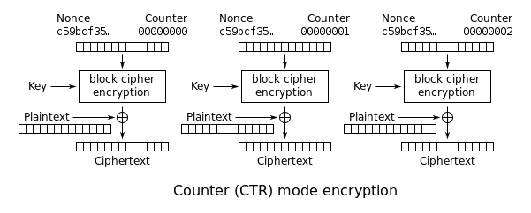
AES – counter mode (a common usage)

Slide 53

AES – counter mode
Pros:
An error in one step will not effect the rest
Pre-calculation of Z
Asynced
Cons:
If we use the same IV, it could be risky:
$C_{1}=IV,\left(z_{1}⊕m_{1}\right),z_{2}⊕m_{2}$
$C_{2}=IV,\left(z_{1}⊕{m`}_{1}\right),z_{2}⊕{m`}_{2}$
$C_{1}⊕C_{2}=000…000, m_{1}⊕m`_{1}, m_{2}⊕m`_{2}$

Slide 54
What did we cover
✔ Symmetric Encryption Concept
✔ Main rules
✔ Simple encryptions
✔ DES
✔ AES
✔ Long messages
HASH
Authentication
✔ Security

Slide 55
#3

Slide 56
What did we cover
✔ Symmetric Encryption Concept
✔ Main rules
✔ Simple encryptions
✔ DES
✔ AES
✔ Long messages
HASH
Authentication
✔ Security

Slide 57
Asymmetric Encryption
Concept
Main rules
Simple encryptions
RSA
KMS

Slide 58
What did we see before?
Perfect secrecy
Symetric key encryption
DES
AES

Slide 59
Symmetric Encryption

Slide 60
Problems in real life
What if Bob has to access to Alice’s key?
How can Alice and Bob share the key?

Slide 61

Asymmetric Encryption

Slide 62






Asymmetric Encryption
We have Alice and Bob
Each one has its own public key (PK) and secret key (SK).
The public key is known to everyone
The private key is known only to its owner
<Gen, Enc, Dec>
Definition of truth:
$Dec\left(SK, Enc\left(PK, m\right)\right)=m$
I’m public

Slide 63
RSA – Ronald Rivesr, Adi Shamir, Adeiman
1977

Slide 64


Reminder #1: $φ\left(N\right) −$𝑇ℎ𝑒 𝐸𝑢𝑙𝑒𝑟 𝑃ℎ𝑖 𝐹𝑢𝑛𝑐𝑡𝑖𝑜𝑛
Bdida / numbers theory:
$φ\left(N\right)=The number of the coprime integers to N that are smaller than N$
= מספר המספרים הזרים ל-N והקטנים ממנו
$φ\left(2\right)=1 →\{1\}$
$φ\left(4\right)=2 →\{1, 3\}$
$φ\left(12\right)=4 →\{1, 5, 7, 11\}$
$φ\left(15\right)=8 →\{1, 2, 4, 7, 8, 11, 13, 14\}$

Slide 65
Reminder #2: GCD
Intro to CS
GCD = Greatest common divisor
GCD (30,36,24) = 6
If GCD (x, y) == 1
Then x, y are coprimes (זרים)

Slide 66
Reminder #3: Modulo operation
Algebra
We’ll work within specific field (Cyclic group).
All the arithmetic operation we’ll be done in the scope of a Cyclic group.

Slide 67

RSA
Gen – Key generation:
Randomize q, p – 2 big primes numbers.
Calculate: $N=pq, φ\left(N\right)=\left(p−1\right)(q−1)$.
Randomize(find) $e∈Z_{φ\left(N\right)}$ such as:
$GCD\left(e, φ\left(N\right)\right)=1$ → תביא לי מספר זר לגודל השדה
Find $d∈Z_{φ\left(N\right)}$ such as:
$e∗d=1 modφ\left(N\right)$
Public key = (N, e)
Secret key= (N, d)
Enc: $RSA$ (m, (N, e)) = $m^{e}mod N=c$
Dec: $RSA^{−1}$ (m, (N, d)) = $c^{d}mod N=m$

Slide 68

Proof:
We want to proove:
$Dec\left(SK, Enc\left(PK, m\right)\right)=m$
$Dec\left(SK, Enc\left(PK, m\right)\right)=$ $RSA^{−1}\left(SK, RSA\left(PK, m\right)\right)=$ ${\left(m^{e}mod N\right)}^{d}mod N=$ $m^{ed}mod N=$ $m^{ed mod φ(N)}mod N=$ $m^{1}mod N=$ $m$

Slide 69
Where did we see it before?

Slide 70



HTTPS (TLS)

