Slide 1
Databases | indexes

Slide 2
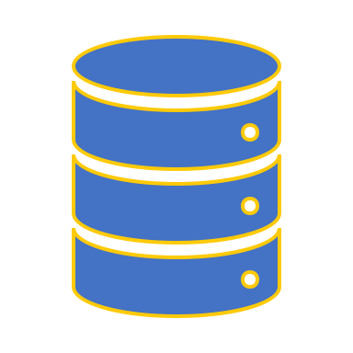
Databases | index
Example from real life
Full scan
Indexes concept
Index scan
Creating index
Why index in not always the best solution

Slide 3



Example | Buying clothes online
Let’s think about ASOS.
ASOS in a retail company that sells clothing items online and ships it worldwide.
What kind of data should they store?
Transactions
Registered users
Tracking info
Stock information

Slide 4
EXAMPLE | Stock table
DEMO

Slide 5
Let’s put an index on it!

Slide 6
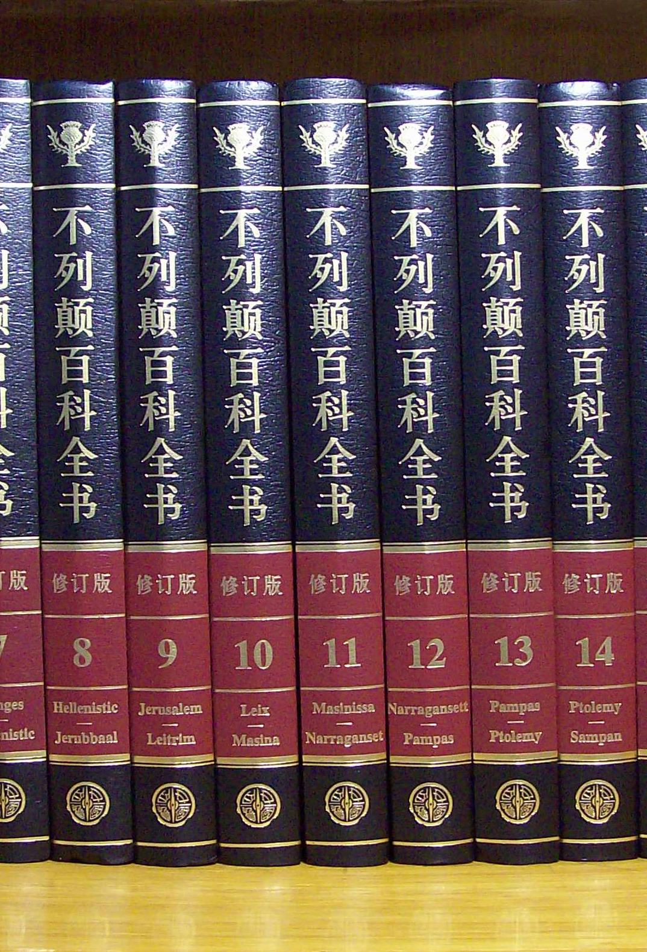
Indexes concept | encyclopedia
Back in the old days, before GOOGLE era…
When we wanted to look up for a term we used encyclopedia.
Encyclopedia = set of books giving information on many subjects or on many aspects of one subject and typically arranged alphabetically.
Some versions had wrote the range of letter of every book.
What happened when it just want there?
INDEX (key)!
An extra book that keeps the location of every subject’s definition.
AKA – A reference – INDEX = book of references/keys.

Slide 7
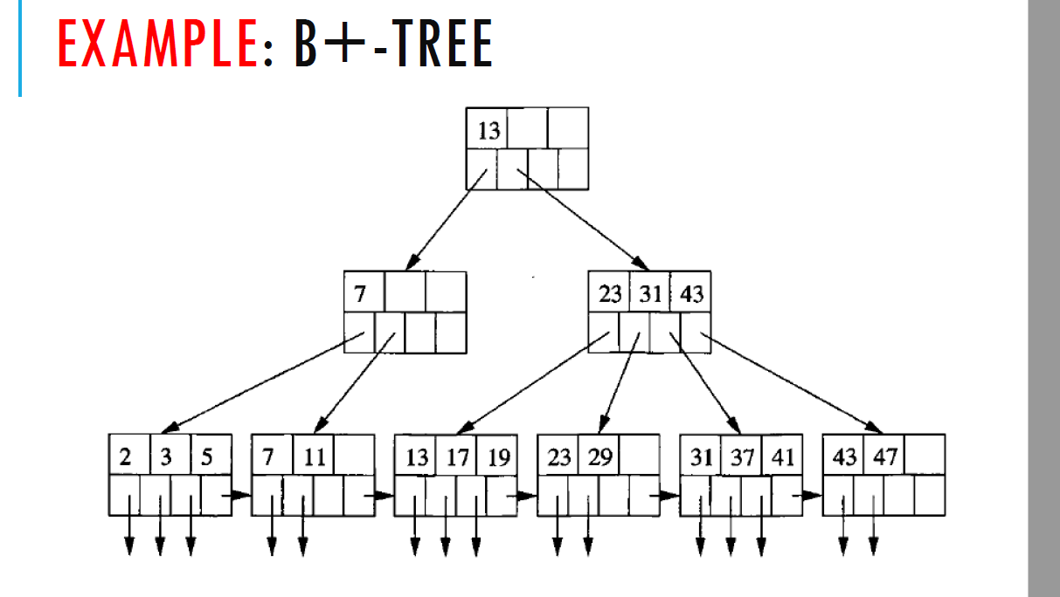
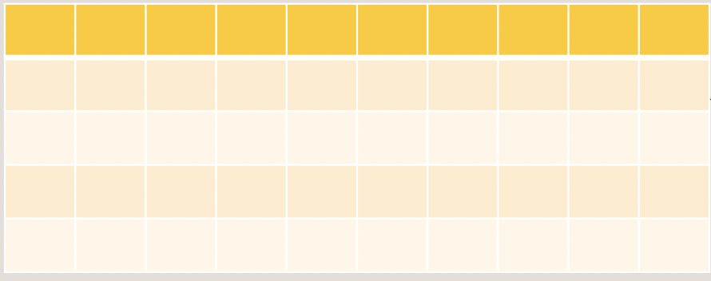
Index scan
When you’re quering a table by a column that has index
Instead of going over the whole table row by row (full scan).
The optimizer is going to use the index, and upon the index scan, will return the rows that the index is reffering to.

Slide 8
Databases | index
Example from real life
Full scan
Indexes concept
Index scan
Creating index
Why index in not always the best solution

Slide 9
Creating an index | sql
DEMO

Slide 10
Why not index every column in the world?!??!!?
Space in disk
Insert, delete time
Not always best practice
DEMO
Querying could take longer time…

Slide 11
Databases | index
Example from real life
Full scan
Indexes concept
Index scan
Creating index
Why index in not always the best solution

