Slide 1
Flu Shot Learning Predict H1N1 and Seasonal Flu Vaccine
Name : Sahar Afshan A.Qadir

Slide 2
Introduction
There are two main types of influenza (flu) virus: Types A and B. The influenza A and B viruses that routinely spread in people (human influenza viruses) are responsible for seasonal flu epidemics each year.
In the spring of 2009, a novel influenza A (H1N1) virus emerged. It was detected first in the United States and spread quickly across the United States and the world.
This new H1N1 virus contained a unique combination of influenza genes not previously identified in animals or people.

Slide 3
Seasonal Epidemics Vs. Pandemics
Seasonal Influenza | Influenza Pandemics
A public health problem each year | Appear in the human population rarely and unpredictably
Usually some immunity built up from previous exposures to the same subtype | Human population lacks any immunity
Infants and elderly most at risk | All age groups, including healthy young adults

Slide 4
WHO is working with countries and partners to improve global vaccination coverage, through the “Global Vaccine Action Plan 2011-2020”. Through the plan, WHO:
WHO Works to increase funding for immunization and ensure safe and reliable vaccine supply systems.
Develops targeted research and development innovations for new and improved vaccines.
Since it continues to circulate seasonally worldwide vaccination was the first and most important step to be carried out .
In this paper, we use the data to compare the how people got H1N1 or seasonal flu vaccine

Slide 5
Dataset Used
The purpose of the dataset was to monitor and evaluate H1N1 influenza vaccination efforts among adults and children.
It provides us with details such as the H1N1 and seasonal influenza vaccination status of adults and children, as well as influenza vaccination status, views on the safety and efficacy of influenza vaccine, recent respiratory illnesses and pneumococcal vaccination status.

Slide 6
Data Cleansing and Pre Processing
Data is collected from diverse sources such WHO, CDC etc. that’s why this data need to clean and make it ready for further processing
For this purpose we will follow below steps
Read data
Eliminate null values
Check no missing values are left
Encoding categorical features
Normalization(make all values between 0-1)
Check if data types are correct or not

Slide 7
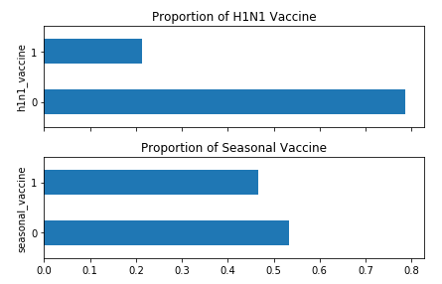
Explore the Data
There are two target variables
Seasonal Vaccine
H1N1 Vaccine
It seems half the people have received the seasonal flu vaccine, but only about 20% of people have received the H1N1 flu vaccine.

Slide 8
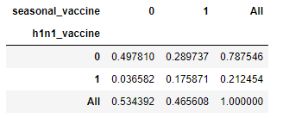
Are two target variables independent?
These two variables have a phi coefficient of 0.37, indicating a moderate positive correlation.
It is also depicted in cross-tabular format
People with the H1N1 flu vaccine also got the seasonal flu vaccine.
Few of those who had the seasonal vaccine got the H1N1 vaccine, at a higher rate than those who did not get the seasonal vaccine.

Slide 9
Features
The feature variables are almost all categorical: a mix of binary, ordinal, and nominal features
Let's pick a few and see how vaccination rates can differ according to the levels of trait variables.
If a feature is associated with the target, we expect different vaccination patterns as you change the values ​​of the attribute.

Slide 10
Plotting more variables
Demographics have a stronger correlation with the seasonal vaccine, but so far h1n1_vaccine is much less. We see a particularly strong correlation with age_group with seasonal vaccine, but not with h1n1_vaccine
With seasonal flu, it seems, people are acting appropriately by the fact that people are more affected and the risk of flu-related complications is higher with age
It turned out that H1N1 flu has an interesting relationship with age: Even if older people had a higher risk of complications, they were less likely to become infected! While we know something about causality from this analysis, risk factors appear to be reflected in vaccination rates

Slide 11
Conclusion
This conclude the analysis, to better understand the characteristics have been associated with seasonal and H1N1 vaccination
People get the H1N1 vaccines where they have serious symptoms
People who get seasonal influenza got the normal vaccine
Also the comparison with respect to categories

