Slide 1
Introduction to Python

Slide 2
Programming
What is a program?
Input
Function
Output
Remember: Programs do what you tell them to do, not what you want them to do.

Slide 3
The Programming Process
Identify the required input(s)
Decide what the output will be and how you want it formatted
Make an overall design – the general method – for creating the output
Write some pseudocode (# Comments)
"Read in the FASTA file"
"Calculate the reverse complement"
"Reverse it"
"Substitute A for T, G for C, and vice-versa"
"Print it out in FASTA format"
Fill in the actual code

Slide 4
Compiled vs. interpreted programs
Compiled programs
translate human-readable code into something recognizable by the processor
the programs need to be compiled before running
this is the case for most programs you use
examples: C, C++, Fortran
Interpreted programs:
not compiled; human-readable code is processed on the fly by an interpreter
these are called "interpreted" or "scripting" languages
examples: MATLAB, Perl, Python, R

Slide 5
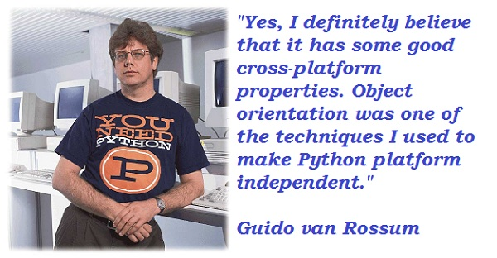
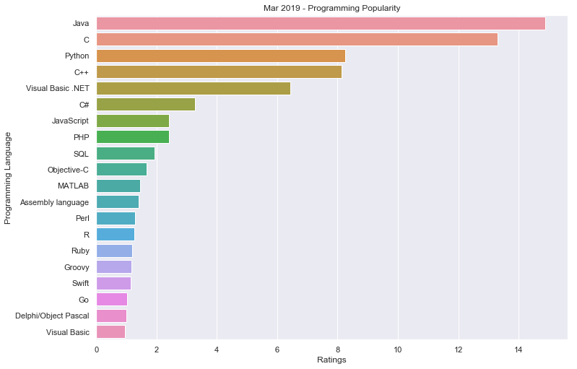
Python
clean, readable code
huge momentum, especially in biology
good packages for mathematical and statistical analyses
good packages for data visualization
a very young language (1991)

Slide 6
Resources for Learning Python
Python
Software Carpentry
Stack Overflow
tons of others
Jupyter
Introduction to the Jupyter Notebook
Jupyter Notebook Tutorial

Slide 7
Which version of Python?
Major changes from Python 2.7 to Python 3.x
Python 2.7 is probably installed on your computer
A lot of code still available in Python 2.7, but it stopped being supported in 2020
We will learn Python 3.*

Slide 8
Basic programming concepts

Slide 9
Variables
a variable is a name that holds a value, and the value can change
variables have several important attributes
name: a word that (ideally) describes what the variable is meant to contain (e.g., 'plot_number', 'dna_seq', 'aa_seq')
type: the kind of information the variable holds
value: the actual piece of information the variable holds; a variable can only hold one type of value

Slide 10
Variable types
There is a need to manage tradeoffs between versatility, utility, and memory consumption.
integers (e.g., 1, 2500, –12)
floating points: decimals that can "float" to any position (e.g., 3.14)
booleans: True [1] or False [0]
strings: a sequence of text or characters; can include numbers, which the computer sees as characters in string context
addition of integers: 123 + 4 = 127
addition of strings: "123" + "4" = "1234"
arrays and lists: ordered lists of values or variables; Python distinguishes arrays vs. lists; basically, you can do math on arrays
dictionaries: unordered lists of values or variables; individual elements are accessed by a "key", which can be a word, for example

Slide 11
Functions
similar to little stand-alone programs called inside your program
lots of them are built into the language
print(), round(), etc.
"pass" variables (called "parameters") within parentheses to a function
print( 'hello world' )
round(3.1452)
you can write your own functions for common tasks

Slide 12
Methods
a method is like a function that belongs to a specific variable type
use the dot notation to access these methods
variable.method(method arguments)
# the dir() function lists all of the available variables and
# methods nested within a specified variable
dir(my_dna)
# use the lower() method to print 'my_dna' in lower case
print(my_dna.lower())

Slide 13
Mathematical operators
Operator | Description | Usage
+ [Addition] | Adds values on either side of the operator. | a + b
- [Subtraction] | Subtracts right hand operand from left hand operand. | a – b
* [Multiplication] | Multiplies values on either side of the operator | a * b
/ [Division] | Divides left hand operand by right hand operand | b / a
% [Modulus] | Divides left hand operand by right hand operand and returns remainder | b % a
** [Exponent] | Performs exponential (power) calculation on operators | a**b

Slide 14
Comparison operators
a = 10
b = 20
Operator | Description | Example
== | If the values of two operands are equal, then the condition becomes true. | (a == b) is not true.
!= | If values of two operands are not equal, then condition becomes true.
> | If the value of left operand is greater than the value of right operand, then condition becomes true. | (a > b) is not true.
< | If the value of left operand is less than the value of right operand, then condition becomes true. | (a < b) is true.
>= | If the value of left operand is greater than or equal to the value of right operand, then condition becomes true. | (a >= b) is not true.
<= | If the value of left operand is less than or equal to the value of right operand, then condition becomes true. | (a <= b) is true.
https://www.tutorialspoint.com/python/python_basic_operators.htm

Slide 15
Assignment operators
a = 10
b = 20
Operator | Description | Example
= | Assigns values from right side operands to left side operand | c = a + b assigns value of a + b into c
+= Add AND | It adds right operand to the left operand and assign the result to left operand | c += a is equivalent to c = c + a
-= Subtract AND | It subtracts right operand from the left operand and assign the result to left operand | c -= a is equivalent to c = c - a
*= Multiply AND | It multiplies right operand with the left operand and assign the result to left operand | c *= a is equivalent to c = c * a
/= Divide AND | It divides left operand with the right operand and assign the result to left operand | c /= a is equivalent to c = c / ac /= a is equivalent to c = c / a
%= Modulus AND | It takes modulus using two operands and assign the result to left operand | c %= a is equivalent to c = c % a
**= Exponent AND | Performs exponential (power) calculation on operators and assign value to the left operand | c **= a is equivalent to c = c ** a
//= Floor Division | It performs floor division on operators and assign value to the left operand | c //= a is equivalent to c = c // a
https://www.tutorialspoint.com/python/python_basic_operators.htm

Slide 16
Logical operators
Operator | Description | Common symbols
and Logical AND | If both the operands are true then condition becomes true. | and, &, &&
or Logical OR | If any of the two operands are non-zero then condition becomes true. | or, |, ||
not Logical NOT | Used to reverse the logical state of its operand. | not, !, ~

Slide 17
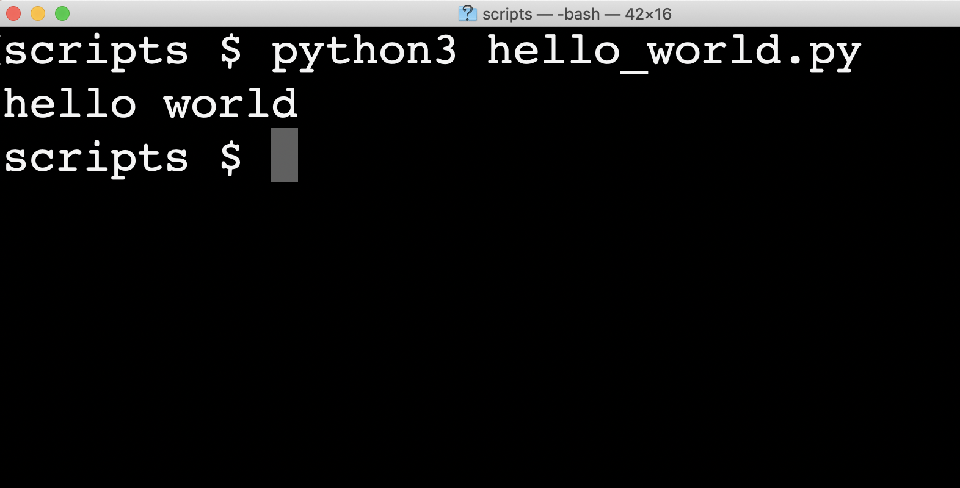
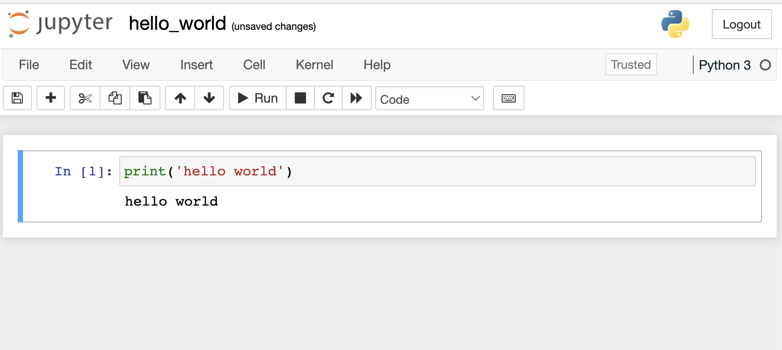
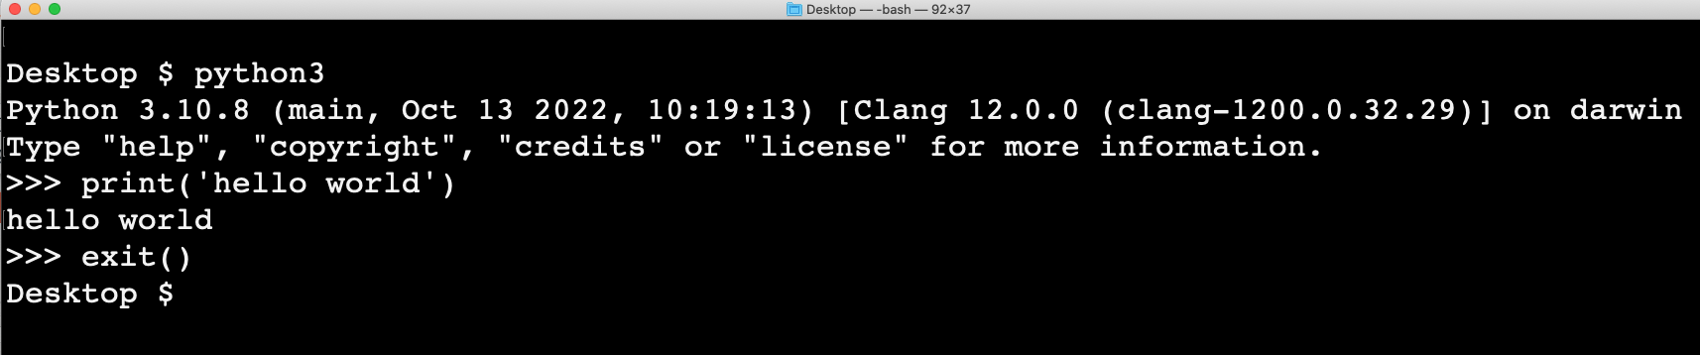
Ways to write and execute Python code
plain text files with Python code
interactive
"notebooks"
Jupyter
VS Code
Google Colab
from the command line

Slide 18
What is Jupyter?
open-source web application
create digital notebooks that contain live code, equations, output including graphics, comments and text
includes different kernels (i.e., the programs that run code), including Python and Julia
Jupyter

Slide 19



Launch Jupyter
From the command line:
python_scripts $
python_scripts $ jupyter notebook
From the dock:
Jupyter
VS Code
from your browser

Slide 20
Stand-alone scripts
#! /usr/bin/env python3
# my first script
print(‘hello world’)

