Slide 1
Sales Dashboard – Tableau Project Summary
Name: Saharsh Reddy Kaidhapuram
Internship Task: Task 4
Tool Used: Tableau Public
Date: 25th April 2025

Slide 2
Task Objective
Create an interactive dashboard for sales analysis
Use KPIs and visualizations to uncover insights
Deliver summary presentation and Tableau workbook

Slide 3
Dataset Overview
File: Sales_DataSet.csv
Rows: ~5,000+ sales records
Fields Used:
Sales,Profit,Order Date,Region,Catgory,Segment,etc.
Source: Superstore-style dataset

Slide 4
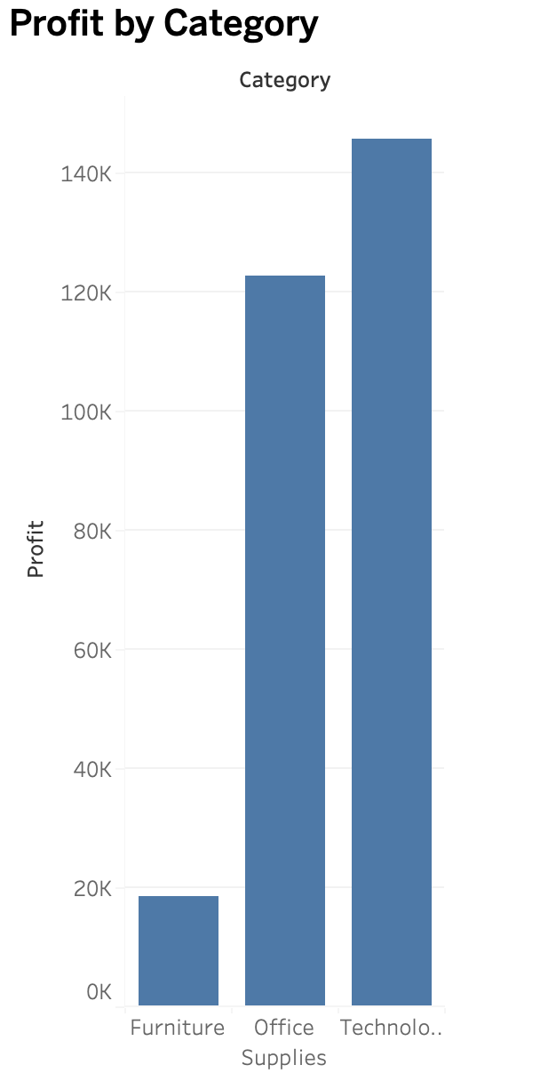
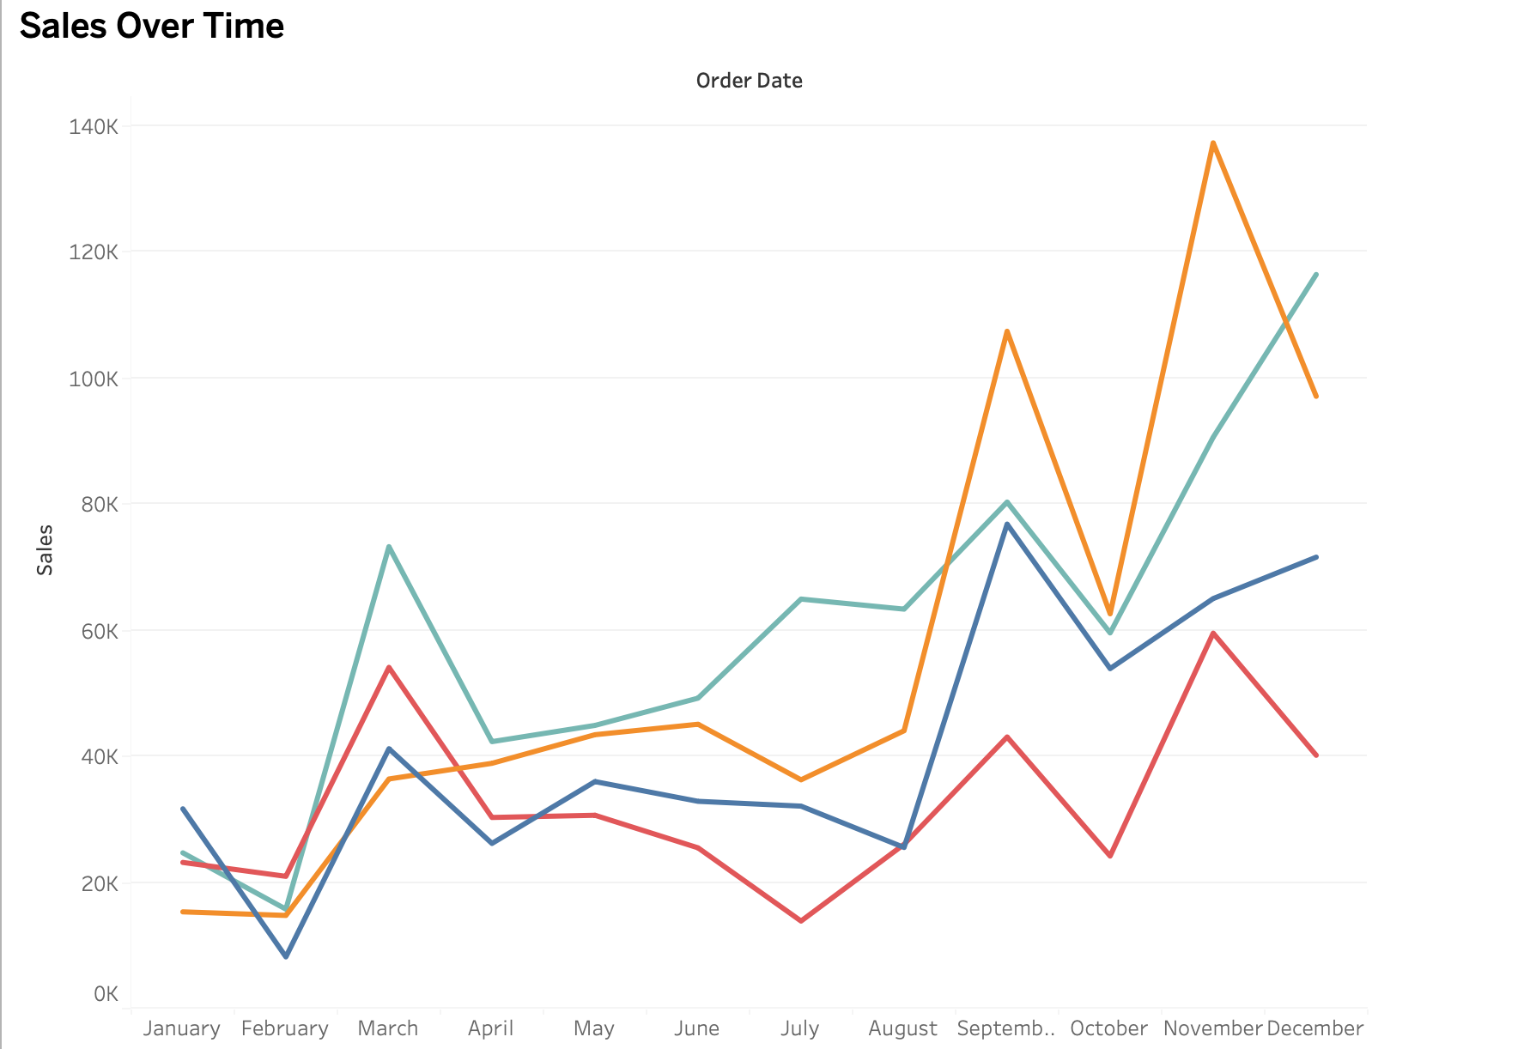
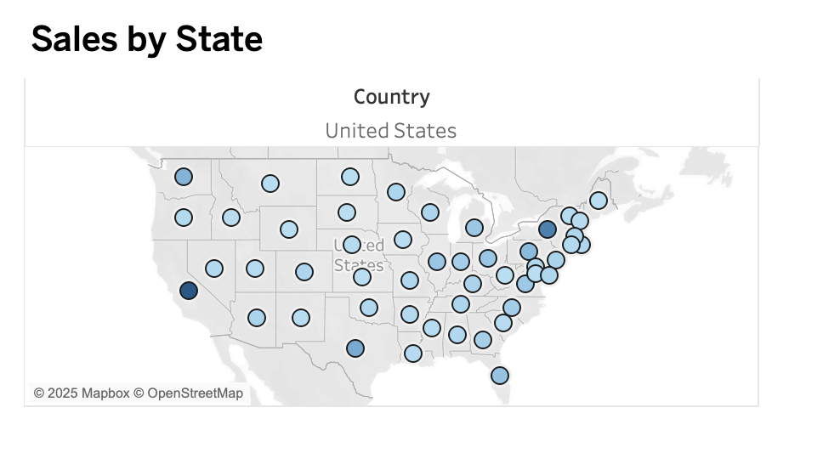
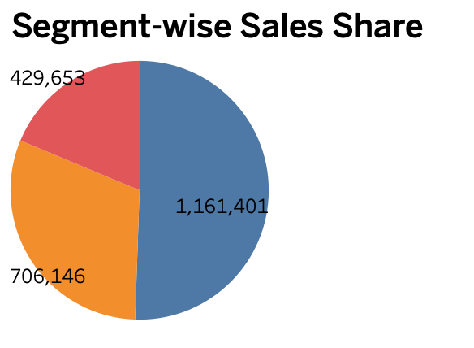
Key KPIs
KPI Field to Use
📦 Total Boxes Shipped | SUM(Boxes Shipped)
💰 Total Amount (Revenue) | SUM(Amount)
👥 Total Sales People | COUNTD(Sales Person)
📈 Boxes Shipped Over Time | Date + Boxes Shipped

Slide 5
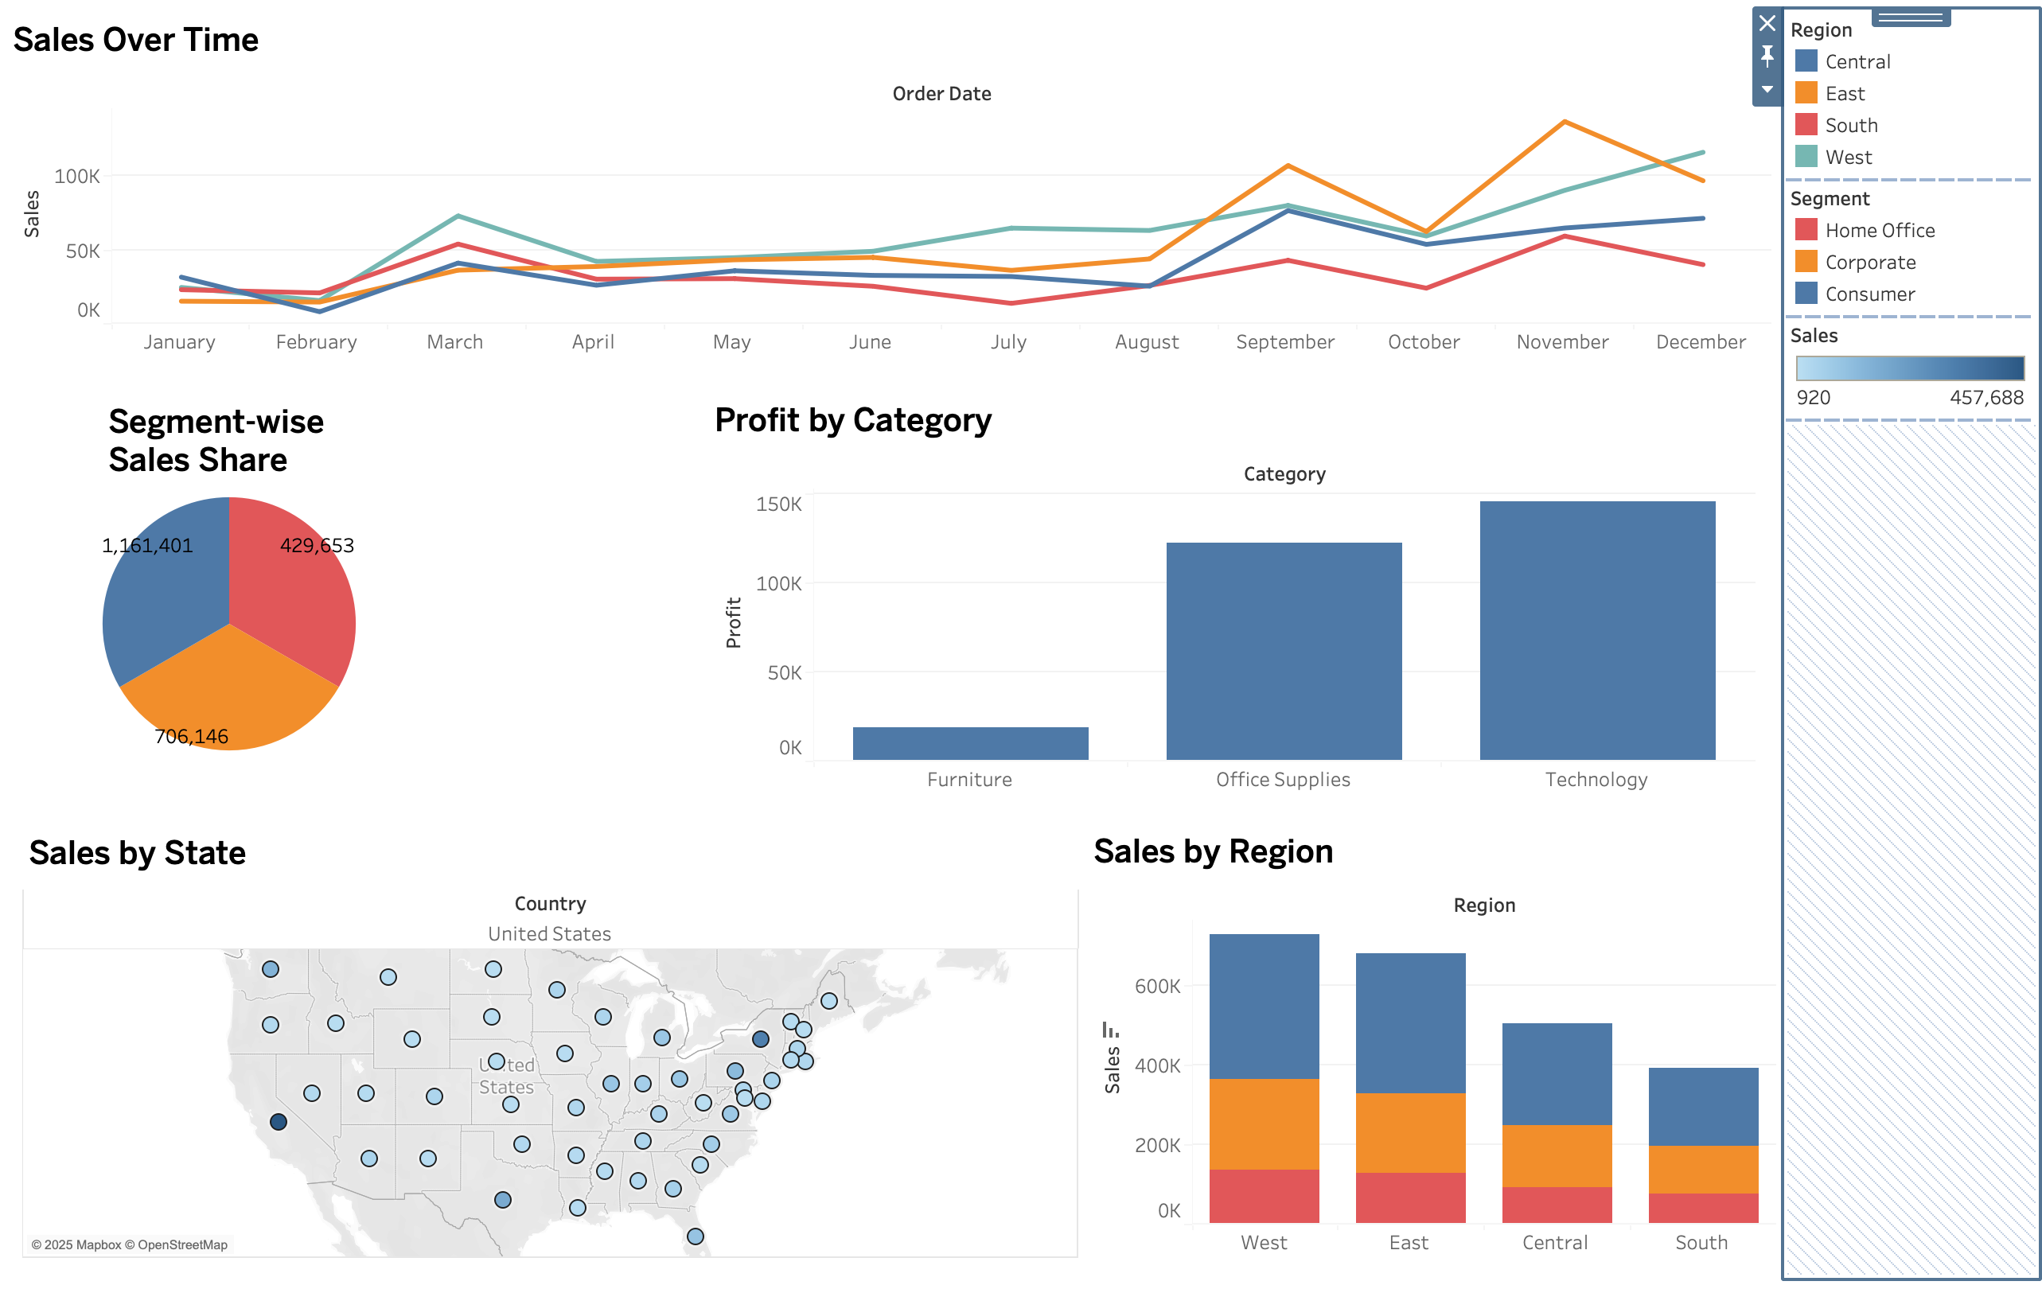
Dashboard Preview

Slide 6
Key Insights
📈 Sales peaked in Q4 of each year
🖥️ Technology category generated highest profit
📍 West region leads in total sales
🧾 Consumer segment contributes the most revenue
🗺️ Sales are concentrated in a few key states

Slide 7
Dashboard Features
Filters: Segment, Category, Region
Line chart with trend over time
Map with sales by state
Pie chart for sales share by segment

Slide 8
Conclusion
Dashboard helps stakeholders understand sales patterns
Identifies strong segments and regions
Can be extended with product-level or profit trend analysis

Slide 13
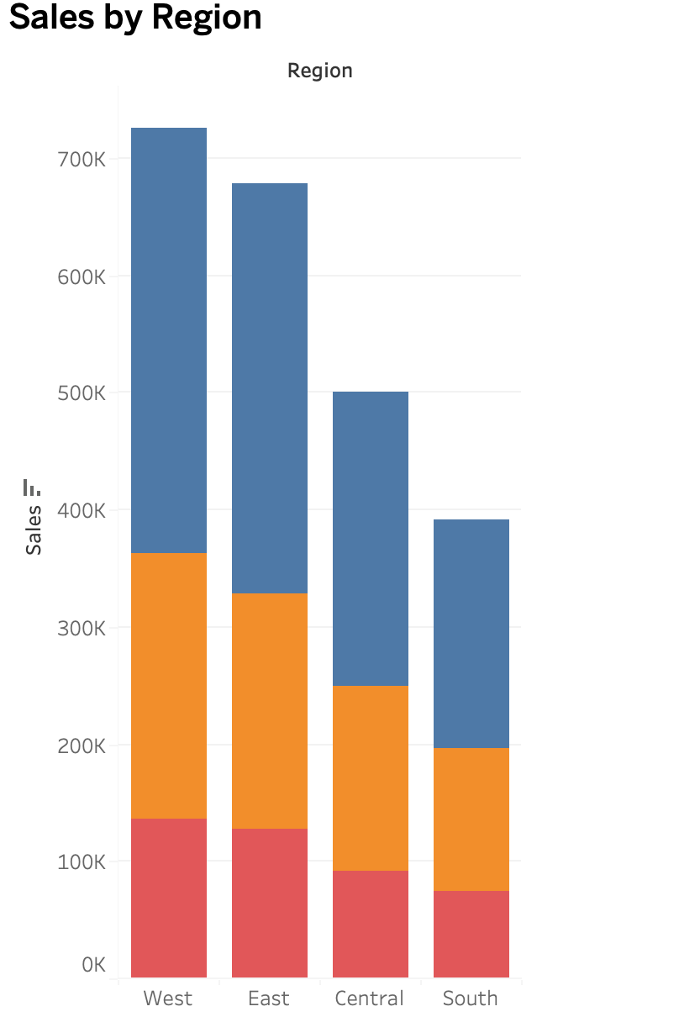

Slide 14
