Slide 1
Smart Home Automation System using HTTP Client–Server Integration
IIT Jammu IoT & Drones Online Internship
Project Team
Guided By
Anant Priyadarshi
Saharsh Mishra
Majid Sir
Domain
Internet of Things · Embedded Systems · Home Automation
ESP32 MICROCONTROLLER
HTTP CLIENT–SERVER
REAL-TIME MONITORING
SAFETY AUTOMATION
Made by: Saharsh & Anant

Slide 2
About IIT Jammu IoT & Drones Internship
Hands-On Training
Expert Mentorship
Practical exposure to Internet of Things and embedded systems design, bridging theory with real hardware implementation.
Guided by experienced IoT professionals with domain expertise in embedded systems and drone technology.
Real-World Applications
Project-Based Learning
Focus on industry-relevant IoT use cases including wireless communication, sensor integration, and automation systems.
End-to-end project development from problem identification through hardware assembly, firmware coding, and live demonstration.
Industry-Relevant Skills
Participants develop competencies in Wi-Fi networking, REST APIs, embedded C/C++, and hardware prototyping.
Made by: Saharsh & Anant

Slide 3
Problem Statement
Conventional homes rely on manual intervention for appliance control and lack integrated safety monitoring — creating inefficiency, risk, and fragmented device management.
Manual Control Inefficiency
No Real-Time Monitoring
Safety Hazard Gaps
Switching appliances manually is time-consuming and impractical for modern households requiring responsive automation.
Absence of continuous environmental sensing means temperature, humidity, and air quality go untracked in real time.
No automated response to critical events such as gas leaks or fire detection leaves occupants vulnerable to preventable accidents.
No Centralized Dashboard
Protocol Fragmentation
Devices operate in isolation with no unified interface for remote monitoring, status visualization, or control.
Multiple heterogeneous sensors lack a common communication protocol, making integration complex and unreliable.
Made by: Saharsh & Anant

Slide 4
Objectives
Core Engineering Goals
Outcome Targets
01
01
ESP32-Based System Design
Automated Safety Response
Design and implement a complete smart home system using dual ESP32 microcontrollers as client and server nodes.
Build an automated hazard detection and response system that triggers alerts and actuators upon gas or flame events.
02
02
Real-Time Sensor Monitoring
Web-Based Dashboard
Enable continuous acquisition and visualization of environmental sensor data including temperature, humidity, motion, gas, and flame.
Create a live web interface displaying real-time sensor values, system status, and remote control capabilities accessible from any browser.
03
HTTP Client–Server Communication
Develop a robust HTTP-based communication layer for bidirectional device control and data exchange over Wi-Fi.
Made by: Saharsh & Anant

Slide 5
Hardware Components
Microcontrollers & Sensors
Actuators, Display & Support
Component
Specification
Component
Role
ESP32 Dev Module
2 × 38-Pin, dual-core, Wi-Fi + BT
Relay Module
Controls fan and home appliances
DHT11
Temperature (0–50°C) & Humidity (20–90%)
Stepper Motor
Automated mechanical actuation
DC Fan
Ventilation response to motion/temp
PIR Sensor
Motion detection, 5–7 m range
MQ Gas Sensor
Analog gas concentration measurement
Active Buzzer
Audible safety alerts
SSD1306 OLED (0.96")
On-device status display via I2C
Flame Sensor
IR-based fire detection
Red / Green LED
Visual alert and status indicators
Made by: Saharsh & Anant

Slide 6
Software Stack & Technologies
Firmware
Communication Layer
Arduino IDE with Embedded C/C++ for ESP32 board support. Full peripheral driver integration for sensors and actuators.
HTTP Client–Server over Wi-Fi networking. REST API endpoints for sensor data ingestion and actuator command dispatch.
Web Frontend
Protocol Stack
HTML, CSS, and JavaScript dashboard. JavaScript fetch API polls server endpoints and updates UI elements in real time.
TCP/IP over Wi-Fi for reliable data exchange. JSON payloads ensure structured, human-readable data transmission between nodes.
Made by: Saharsh & Anant

Slide 7
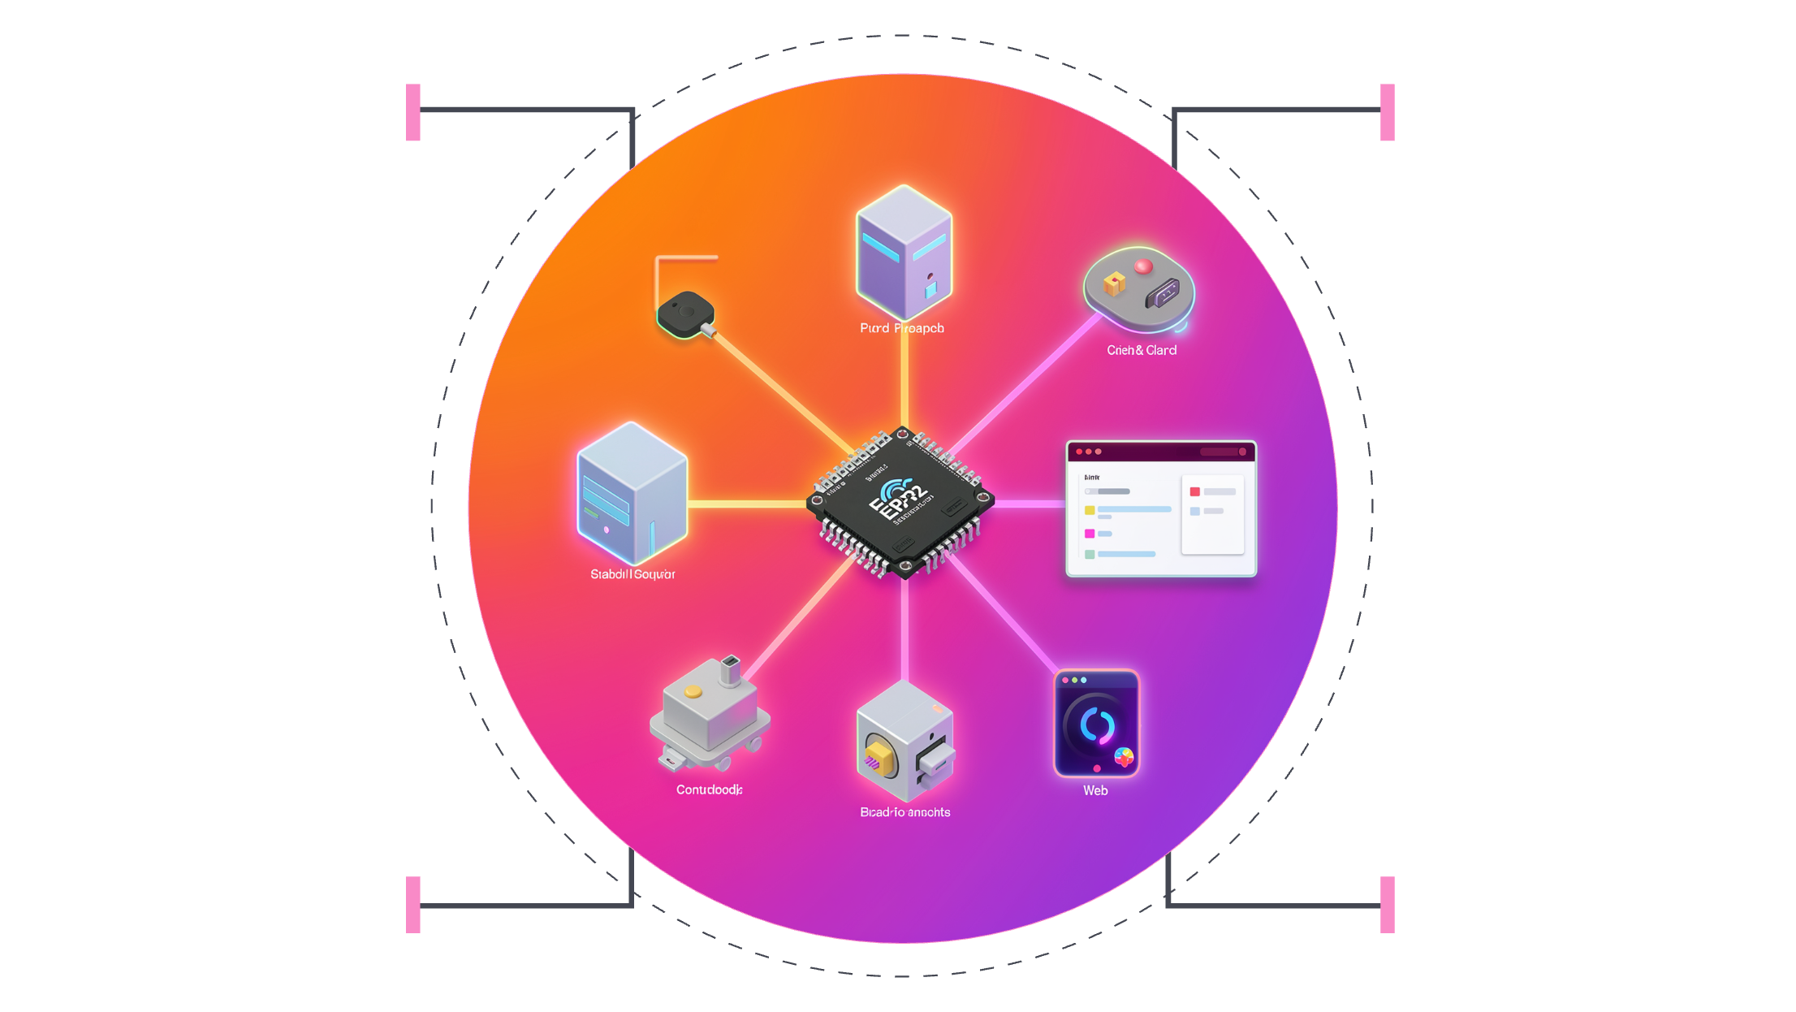
Overall System Architecture
The system employs a two-node ESP32 architecture where a dedicated server node manages all actuator logic and hosts the HTTP server, while a client node handles sensor acquisition and data forwarding.
Client ESP32
Server ESP32
Collects sensors and sends POST
Hosts HTTP server, controls relays
Actuators
Web Dashboard
Fan, buzzer, motor, indicator LEDs
JS UI shows live sensor data
Server ESP32
Client ESP32
Web Dashboard
Actuator Layer
Hosts HTTP server · Manages sensor data · Controls relays and actuators based on received inputs and embedded logic.
Collects readings from all sensors · Packages data as JSON · Sends HTTP POST requests to server at regular intervals.
Browser-based interface · Fetches live data from server via HTTP GET · Displays sensor values and system status dynamically.
Relay, fan, stepper motor, buzzer, and LEDs · Controlled by server logic in response to sensor thresholds and safety events.
Made by: Saharsh & Anant

Slide 8
Circuit Diagram & ESP32 Pin Connections
All sensors and actuators are mapped to specific GPIO pins on the ESP32. I2C bus (SDA/SCL) is reserved for the OLED display; analog ADC pins serve the MQ gas sensor.
Component
Interface
Pin Type
Function
DHT11
Single-wire
Digital GPIO
Temperature & humidity data
PIR Sensor
Digital output
Digital GPIO
Motion detection input
MQ Gas Sensor
Analog output
ADC Pin
Gas concentration measurement
Flame Sensor
Digital output
Digital GPIO
Fire / IR detection
Relay Module
Digital control
Digital GPIO
Fan and appliance switching
SSD1306 OLED
I2C
SDA / SCL
On-device status display
LEDs & Buzzer
Direct drive
Digital GPIO
Visual & audible alerts
Made by: Saharsh & Anant

Slide 9

Working Flowchart & System Logic
Initialize
Monitor
Detect Motion
Safety Check
Send Data
Initialization Phase
HTTP Data Transmission
ESP32 boots, connects to configured Wi-Fi SSID, initializes all sensor peripherals, and starts the HTTP server or client loop.
Client ESP32 packages all sensor readings into a JSON payload and dispatches an HTTP POST request to the server ESP32's endpoint.
Continuous Monitoring
Dashboard Update
Sensor polling loop executes every second — DHT11 reads every 2 s, PIR and flame sensors polled continuously for immediate response.
Server processes incoming data, updates internal state, and serves updated JSON to the web dashboard via HTTP GET endpoints.
Motion & Safety Response
PIR trigger activates buzzer, stepper motor, and DC fan. Gas or flame threshold breach initiates emergency protocol with red LED and buzzer.
Made by: Saharsh & Anant

Slide 10
HTTP Client–Server Communication
Communication Protocol Design
Performance Characteristics
01
<1s
HTTP POST — Sensor Upload
Client ESP32 sends sensor data as structured JSON payloads to the server's /data endpoint at regular intervals.
Alert Latency
Sub-second response time for critical safety events (gas, flame)
02
HTTP GET — Command Fetch
1s
Server responds with control commands and acknowledgments, enabling bidirectional communication over a single Wi-Fi network.
Poll Interval
03
Sensor data transmitted to server every second for live dashboard accuracy
JSON Data Structure
Dashboard Integration
Payload contains fields: temperature, humidity, motion, gas_level, flame_detected, and timestamp.
The web frontend uses JavaScript's fetch() API to periodically query the server's JSON endpoint and dynamically update DOM elements — no page reload required. All communication occurs over TCP/IP within the local Wi-Fi network, ensuring low latency and high reliability.
Made by: Saharsh & Anant

Slide 11

Sensor Integration & Automation Logic
Each sensor operates within defined thresholds that trigger specific actuator responses, forming a closed-loop automation system with real-time feedback displayed on the OLED and web dashboard.
Sensor
Range / Spec
Trigger Condition
Automated Response
DHT11
0–50°C · 20–90% RH · 2 s interval
Temperature exceeds threshold
Relay activates DC fan automatically
PIR Sensor
5–7 m detection range
Motion detected in zone
Buzzer alert · Stepper motor · Fan ON
MQ Gas Sensor
Analog ADC reading
Gas level exceeds safe threshold
Red LED ON · Buzzer alert · Dashboard warning
Flame Sensor
IR radiation detection
Flame / fire IR signature detected
Emergency protocol · Buzzer · Red LED · Server alert
Relay & Fan
GPIO-controlled switching
Motion OR temperature threshold
Automatic ON/OFF via server logic
OLED Display
SSD1306 · 0.96" · I2C
Continuous update
Shows live temp, humidity, motion, gas, flame status
All sensor thresholds are configurable in firmware. The OLED provides on-device feedback independent of Wi-Fi connectivity, ensuring local visibility even during network interruptions.
Made by: Saharsh & Anant

Slide 12
Conclusion
Project Outcomes
Skills Learned
IoT Concepts Applied
Impact
Successfully implemented a fully functional smart home automation system with real-time monitoring and control
Embedded systems programming, IoT protocols, web development, and hardware integration
Sensor integration, wireless communication, client-server architecture, and automation logic
Demonstrated practical application of IoT in home automation and safety systems
Thank You & Questions
Made by: Saharsh & Anant

