Slide 1




Introduction to
Git & GitHub & Version Control
Presented by:

Slide 2
Agenda
What is Version Control?
It’s time to get Git.
Working with repositories locally.
Working with remotes.
Working on another developer’s repository.

Slide 3




What is Version Control?
Time
Who took it
State and Location of pieces

Slide 4
This Idea of a safe point is exactly What Version Control is
Time
Who took it
State and Location of pieces

Slide 5
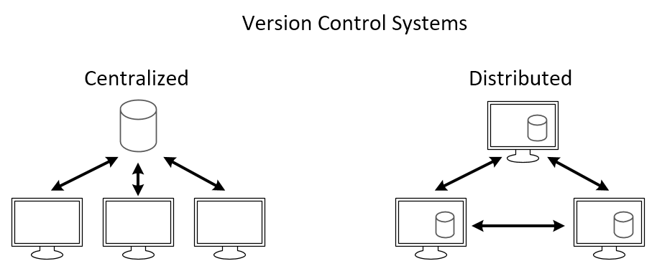
Version Control Systems (VCS)
Centralized (CVCS)
Distributed (DVCS)

Slide 6
Most Popular Version Control Systems
Git
Subversion
Mercurial

Slide 7


Distributed Version Control System.
Version Control Tool
Service hosts Git Projects

Slide 8
Terminology
Branching
Merging
Version Control System
SHA
Staging Index
Merge Conflicts
Source Code Manager
Index
Remotes
Staging area
Repository
Commit
Working Directory
Repo
Checkout

Slide 9
Terminology
git-cheat-sheet-education (github.com)

Slide 10
Exercise – Install and Configure Git
In this exercise, we will:
Download and install Git.
Perform first time configuration for Git.
Configure Git with out Code Editor.

Slide 11
How to get Git?
Installing Git
MacOS / Windows
go to git-scm.com/downloads
download the software for Mac/Windows
install Git choosing all of the default options
Linux
$ sudo apt-get install git

Slide 12
First Time Git Configuration
# sets up Git with your name
git config --global user.name "<Your-Full-Name>"
# sets up Git with your email
git config --global user.email "<your-email-address>"
# makes sure that Git output is colored
git config --global color.ui auto

Slide 13
Git & code Editor
Atom Editor Setup
git config --global core.editor "atom --wait"
VSCode Setup
git config --global core.editor "code --wait"

Slide 14
Review Git Configuration
# lists all the configuration properties
git config --list

Slide 15
Exercise – Working with a Local Repository
In this exercise, we will:
Create a Git Local Repository.
Make Changes, add, and commit them.
Review the repository’s history.

Slide 16
Initializing a Local Git Repository
$git init
Common terminal commands
$ls - used to list files and directories
$mkdir - used to create a new directory
$cd - used to change directories
$rm - used to remove files and directories
$pwd - used to print working directory
$touch - used to create and modify files
$start - used to open files or directories

Slide 17
Initializing a Local Git Repository
$git init
Common terminal commands
$ls - used to list files and directories
$mkdir - used to create a new directory
$cd - used to change directories
$rm - used to remove files and directories
$pwd - used to print working directory
$touch - used to create and modify files
$start - used to open files or directories

Slide 18
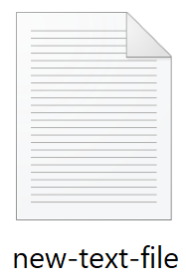
How Git works?
Working Directory
Staging Area
Local Repository
$ git add new-text-file.txt

Slide 19
How Git works?
Working Directory
Staging Area
Local Repository
$ git add new-text-file.txt
$ git commit –m “Message”

Slide 20
How Git works?
Working Directory
Staging Area
Local Repository
$ git add new-text-file.txt
$ git commit –m “Message”

Slide 21
Git Add
$ git add <file1> <file2> … <fileN>
$ git add .
This command moves your changes to the staging area.

Slide 22
Git Commit
$ git commit –m “Initial commit”
This command moves your changes to the local repository.
Try to always write your commit message in an imperative way.

Slide 23
Git Commit Message
Do’s
Keep the message short (less than 60-ish characters)
Explain what the commit does (not how or why!)
Don’ts
Explain why the changes are made
Explain how the changes are made
Use the word “and”

Slide 24
Reviewing the Repository’s History
$ git status
On branch master
Your branch is up-to-date with 'origin/master'.
Nothing to commit, working directory clean
$ git log

Slide 25
Reviewing the Repository’s History
$ git status
This command display’s the status of the working directory and the staging area.
It doesn’t show us history!

Slide 26
Reviewing the Repository’s History
$ git log
This command will show you the history of changes in the repository including:
the SHA
the author
the date
the commit message
$ git log --oneline

Slide 27
Exercise – Working with Remotes
In this exercise, we will:
Create a GitHub repository and clone it.
Make changes and push to GitHub.
Fork a repository and make a pull request.

Slide 28
How Git works?
Working Directory
Staging Area
Local Repository
Remote Repository
$ git add new-text-file.txt
$ git commit –m “Message”

Slide 29
How Git works?
Working Directory
Staging Area
Local Repository
Remote Repository
$ git add new-text-file.txt
$ git commit –m “Message”
$ git push

Slide 30
How Git works?
Working Directory
Staging Area
Local Repository
Remote Repository
$ git add new-text-file.txt
$ git commit –m “Message”
$ git push
$ git pull

Slide 31
How Git works?
Working Directory
Staging Area
Local Repository
Remote Repository
$ git add new-text-file.txt
$ git commit –m “Message”
$ git push
$ git pull

Slide 32
Next Steps
Learn more about GitHub on Microsoft Learn.
Finish Introduction to version control with Git learning path.
Please tell us how you liked this workshop by filling out this survey:
https://aka.ms/workshopomatic-feedback

