Slide 1
EDA + STATS PROJECT
Prepared by: Soha Mohamed Hosny
1

Slide 2
Table Of Content
Introduction
Objective
Methodology
Detailed Methodology
Visualization
Challenges
Insights
Conclusion and Feature Work
2

Slide 3
Introduction
This project focuses on energy usage analysis to identify patterns and optimize consumption.
The analysis leverages data to track energy consumption trends and behavior, providing valuable insights into how energy is used over time.
The project involves processing and analyzing large datasets related to energy usage, identifying key patterns
3

Slide 4
Objective
The aim is to develop strategies for better energy management, enabling users or organizations to reduce costs, improve energy efficiency, and make informed decisions based on data-driven insights.
4

Slide 5
Methodology
Data aggregated by hourly, daily, monthly usage.
Python libraries used for analysis and visualization.
Key steps include cleaning, aggregation, and trend analysis.
Steps followed to achieve the objectives.
5

Slide 6
Detailed Methodology
Step-by-step process: Data collection and preprocessing
Why Use Both ffill and bfill?
Forward fill fills gaps after a valid value.
Backward fill fills gaps before a valid value.
transformation of variables(DateTime).
check missing values.
check inconsistencies.
6

Slide 7
Detailed Methodology
Feature Engineering:
From consumption file & demand file extract new columns from column (DateTime) like: - Hour
- Day
- Month
- Year
- WeekDay
And merge files depend on this columns.
7

Slide 8
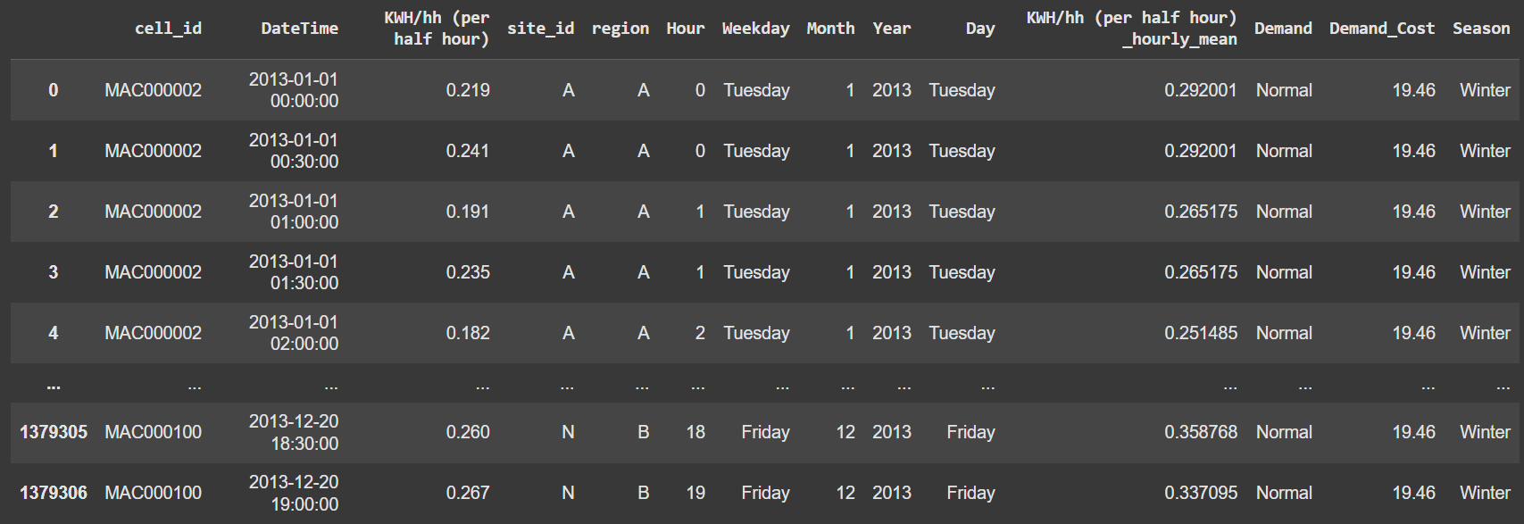
Detailed Methodology
And merge files depend on this extracted columns:
8

Slide 9
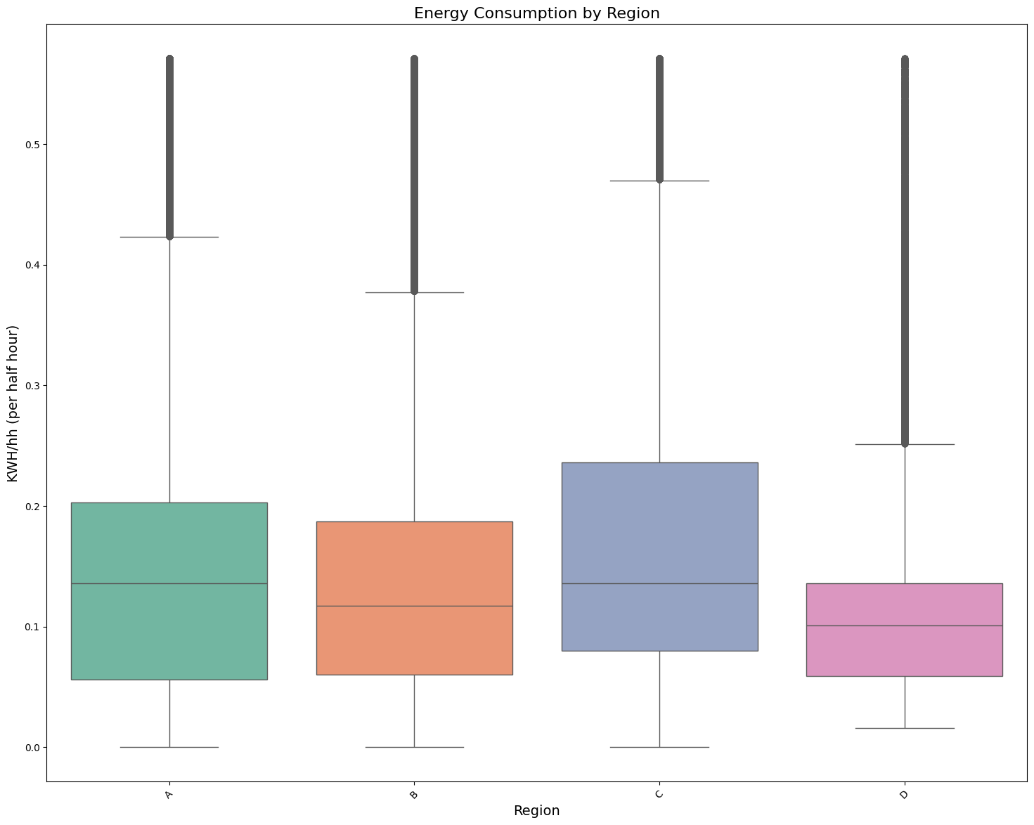
Visualization
• Box plot of energy consumption by region:
9

Slide 10
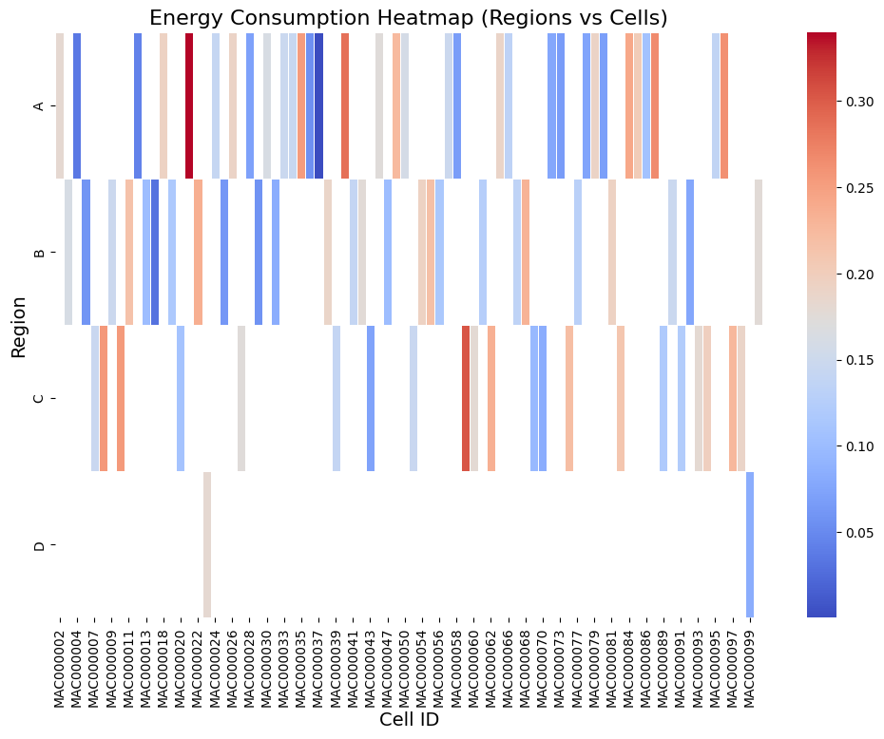
Visualization
• Heatmap of energy consumption across sites and cells:
10

Slide 11
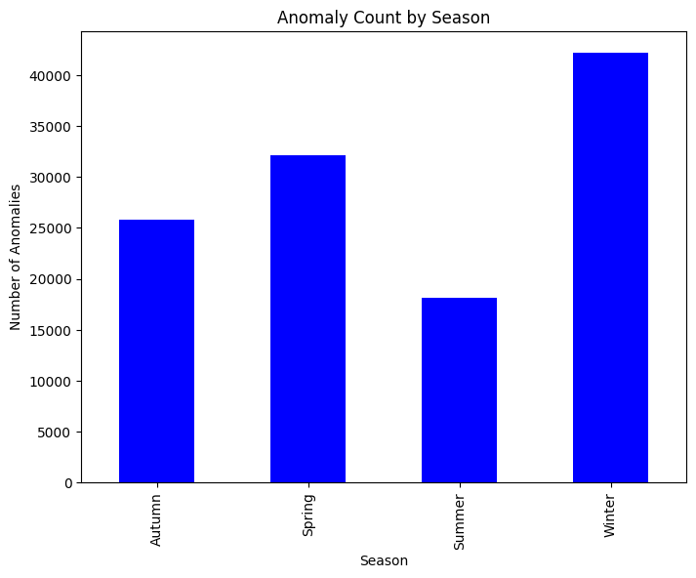
Visualization
• Season analysis:
11

Slide 12
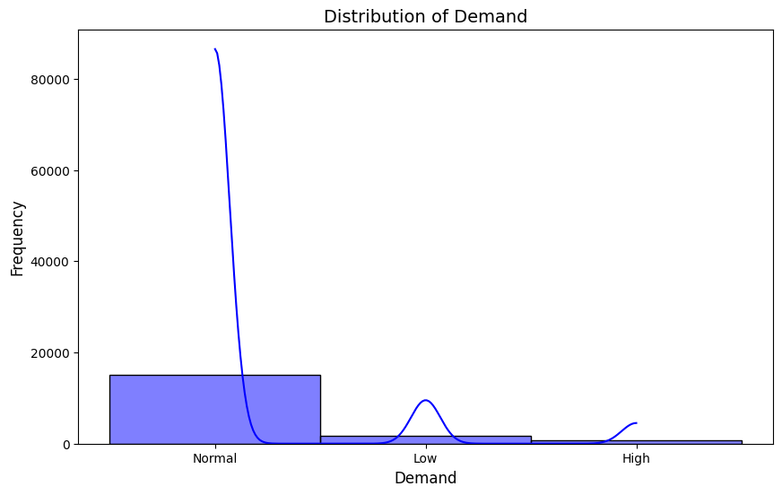
Visualization
• Demand analysis:
12

Slide 13
Challenges
Addressing missing or inconsistent data.
Visualizing multi-dimensional patterns.
Balancing regional and temporal analysis.
13

Slide 14
Insights
Region A has the highest energy consumption, likely due to high population.
June is the peak consumption month.
Fridays show the highest daily energy usage.
Most demand prices fall within a normal range.
14

Slide 15
Conclusion and Future Work
Key insights provide a foundation for energy-saving strategies.
Recommendations include targeting high-consumption regions.
Future focus: Implement dynamic pricing models for demand management.
15

Slide 16
Thanks ☺
16

