Slide 1


Airport Flight
Board Scheduler
TEAM NUMBER 24
G. Nagasai Sahasra - 2620030611
K. Sai Rishika - 2620030331
PSPJ PROJECT PRESENTATION

Slide 2
Abstract
Project overview at a glance
PURPOSE
SCOPE
APPROACH
OUTCOME
Plan and track flights.
Flight data and board display.
Built as a Java program.
Clear flight schedule view.
Java-based scheduler for airport flight information: flight number, airline, source and destination, arrival and departure time, gate, terminal and status.
Reduces manual board updates and presents flight records in an organized, consistent format.
02 / 12

Slide 3
Understanding Problem Statement
01
02
Passengers need live flight updates
Schedules change and must be updated
03
Manual handling causes errors
04
A reliable scheduler is needed
Operational challenges: schedules change often, delays and gate changes arrive late, and duplicate or invalid records are hard to catch.
Staff also struggle to search flight details quickly, so boards can fall behind real-time status.
Project goal: a simple, reliable Java scheduler that keeps flight records accurate and board displays timely.
03 / 12

Slide 4
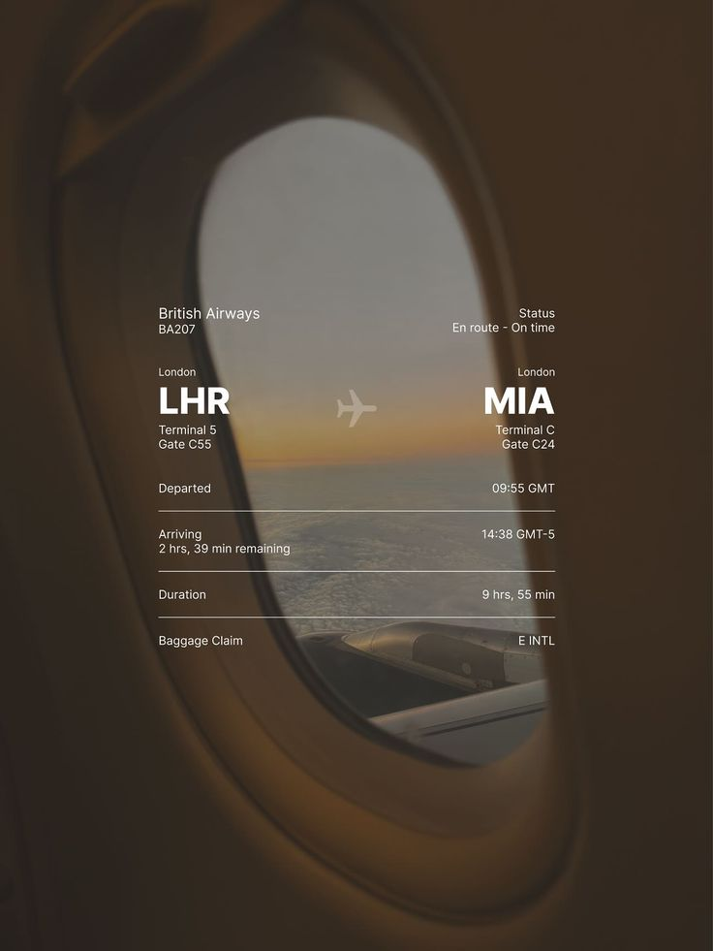

01
Computational Thinking
& Java Foundations
• Problem solving, algorithms and flowcharts
• Java environment, program structure and programming model
• Primitive data types, variables, constants, literals and operators
• Typecasting, expression evaluation, console I/O and Scanner input
Capture flight details with validated console input (Scanner), then compare and calculate times using operators and typecasting.
Display formatted flight-board records, built on computational thinking and algorithm design.
04 / 12

Slide 5

CO2 · Control Flow: Selection & Iteration
SELECTION
if, if-else, nested-if, if-else-if ladder, switch, default, break, compound statements. For flight records, decisions can assign Scheduled, Boarding, Delayed, Departed or Cancelled status.
ITERATION
while, do-while and for loops; continue and infinite loops. A menu loop can process records and display matching flights.
Control Flow
NESTED STRUCTURES
Module 2: if, if-else, switch, while, do-while, for, break and continue.
Nested if statements and nested loops.
05 / 12

Slide 6
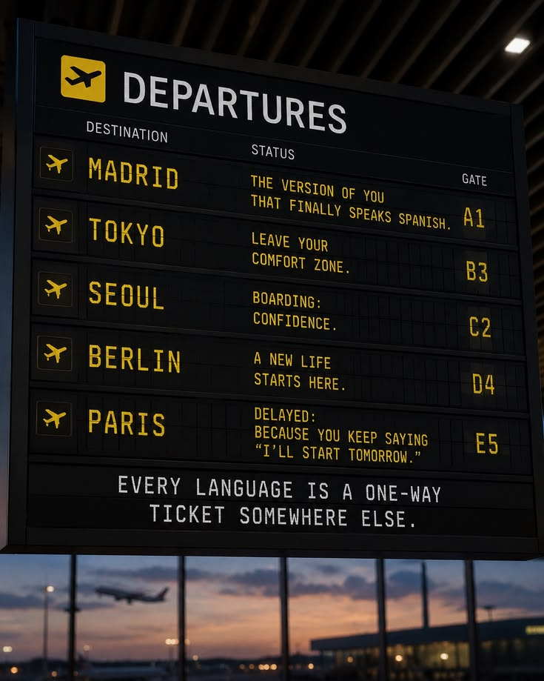
Decomposition with Methods
Recursion & Arrays
• Modular programming: method definition, invocation, overloading
• Parameter passing and return values; enhanced for-each loop
• Recursion with base and recursive cases
• 1D arrays for traversal, searching, sum, average; 2D matrix arithmetic
Reusable methods: addFlight, updateStatus, searchFlight, sortFlights and summary calculations.
Recursion and 1D/2D arrays store and traverse flight records for searching, totals and averages.
06 / 12

Slide 7
CO4 · Object-Oriented Modelling, Design & Exceptions
Module 4: classes, objects, encapsulation, inheritance, interfaces and exception handling.
1
CLASSES & OBJECTS
2
INHERITANCE
3
EXCEPTIONS
Fields, methods, instance vs static members, constructors, this, toString().
Is-a relationships, overriding, interfaces; encapsulation with private fields and accessors.
Errors vs exceptions; checked and unchecked; try-catch-finally, multi-catch, throw, throws.
Flight, AirportBoard and Scheduler classes model flight data with encapsulated fields and constructors.
Exceptions handle invalid input, missing flight records and unsafe updates.
07 / 12

Slide 8
CO5 · Strings, Library Algorithms & File I/O
STRING PROCESSING
Immutability, indexing, substring, comparison, searching; equals() vs ==; StringBuilder; split(), join(), trimming.
SORTING & SEARCHING
Arrays.sort(), Collections.sort(), Arrays.binarySearch(); Comparable and Comparator.
Strings & Files
Module 5: string handling, library sorting and searching, file I/O.
FILE INPUT & OUTPUT
Files and Path, buffered readers and writers, line-by-line processing, malformed records, try-with-resources.
Parse flight codes; compare destinations and statuses; sort and search schedules.
Load saved records, append updates, and handle malformed files safely.
08 / 12

Slide 9
06
Functional Programming
with Collections & Streams
• Lists, sets and maps: ArrayList, HashMap, HashSet, generics, autoboxing
• Iterators, lambda expressions, method references, functional interfaces
• Stream pipelines: filter, map, sorted, distinct, limit, forEach, collect, reduce
• Collectors (toList, groupingBy, counting, joining); reading file lines as a stream
Store flights in lists, maps and sets; filter by status or destination and sort by time.
Remove duplicates, group summaries, and generate reports from file lines as streams.
09 / 12

Slide 10
Conclusion
This project applies core Java concepts from Modules 1–6 to an airport flight board scheduler.
1
CORE PROGRAMMING
2
DATA & STRUCTURE
3
DESIGN & ERRORS
Computational thinking, data types, control flow and methods.
Arrays, strings, collections and streams store flight records, match flight codes and destinations, and keep schedule data organized.
Flight, AirportBoard and Scheduler classes with encapsulation, inheritance and exceptions for invalid input, missing records and safe updates.
Possible extensions, not yet implemented: flight alerts and a graphical interface.
KEY TAKEAWAY: modular, object-oriented Java for flight scheduling
10 / 12

Slide 11
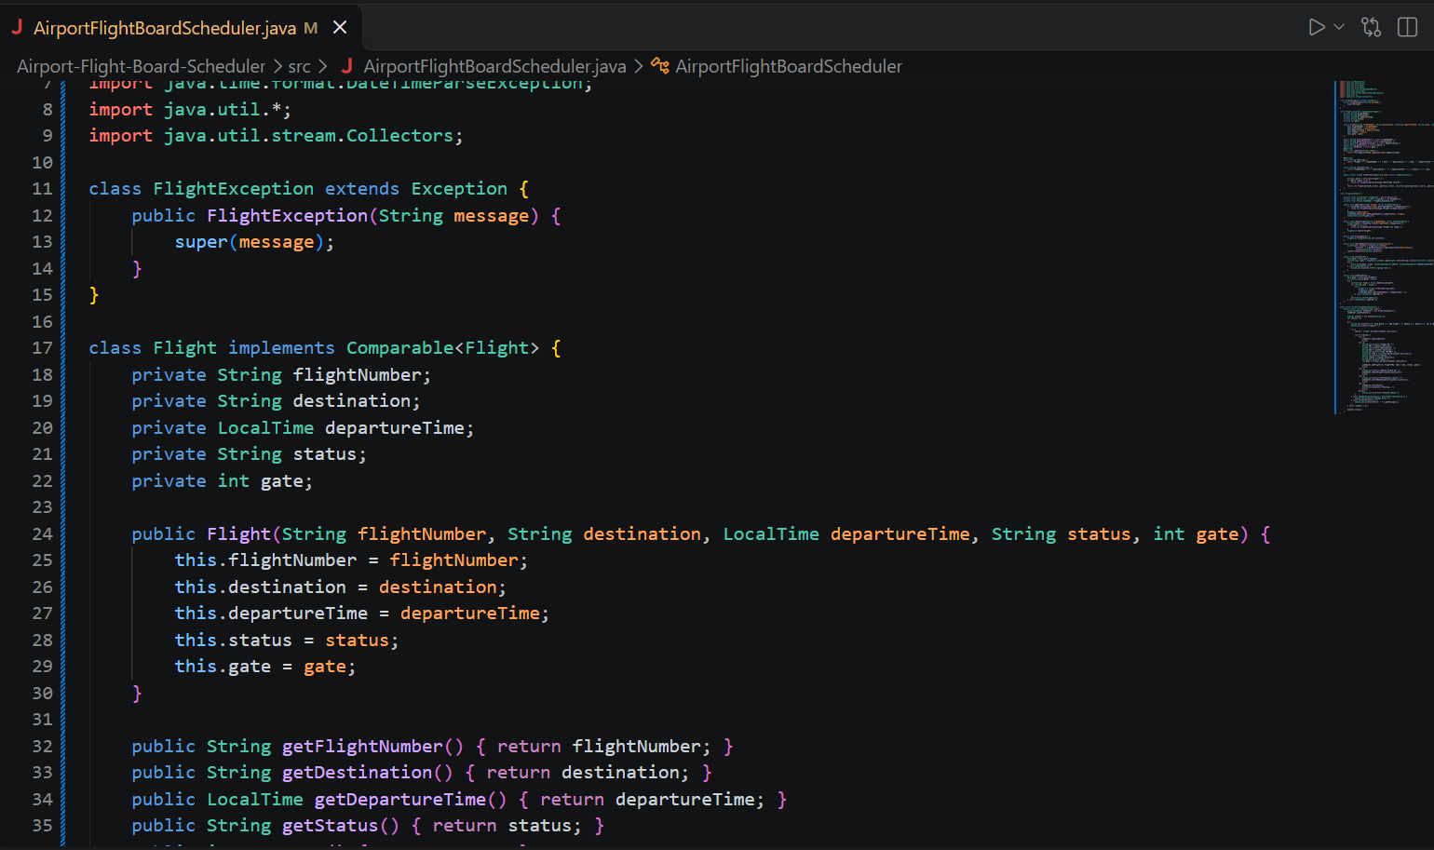
.
11 / 12

Slide 12
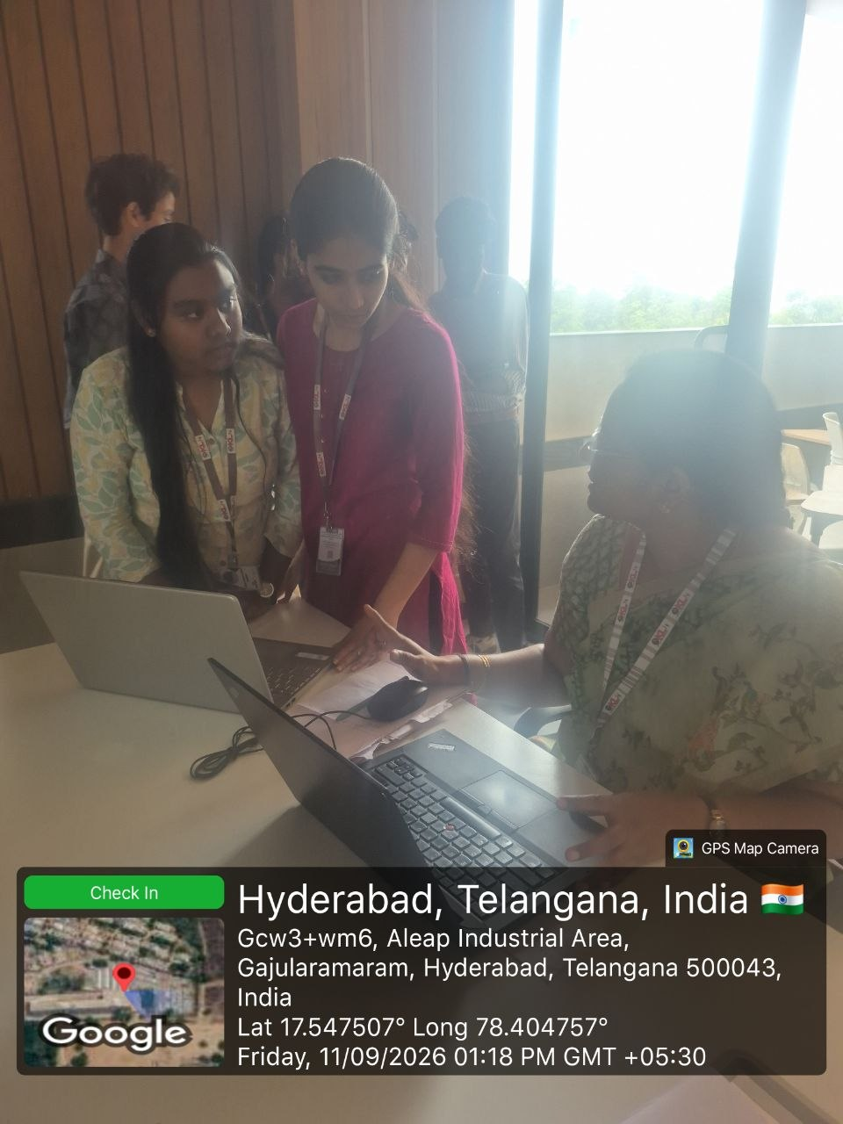
GITHUB LINK :- https://github.com/sahasra-grandhi/KLH_CSE_PSPJAVA_T24_AFBS
.
11 / 12

Slide 13
THANK YOU

