Slide 1
Cybersecurity: Security Incident
Reporting System
SOA Programming Microservices
(24ALT3101)
Submitted by:
rakesh vardhan-2420090090
sahasra.k-2420030068
Group Number: 22 Section: 7
sahasra.M-2420030459

Slide 2
Contents
Abstract
Problem Statement
Objectives
Literature Survey
Research Gap Identification
Innovation
Creativity
Novelty
Feasibility
System Architecture
Project Plan

Slide 3
Abstract
Security teams need a reliable way to receive, organize, investigate, and track cybersecurity incidents. Reports arriving through email, chat, or informal channels can be fragmented and difficult to audit.
This project proposes a Security Incident Reporting System that provides a centralized platform for submitting incidents, recording evidence, assigning severity, tracking investigation status, and maintaining an auditable incident history.
The system uses a secure web interface with REST APIs, JWT authentication, Spring Security, PostgreSQL for structured incident data, and Elasticsearch for fast incident search. The goal is to improve reporting consistency, response visibility, and incident management efficiency.

Slide 4
Problem Statement
Organizations may receive security incidents through multiple channels, making it difficult to maintain a single source of truth. Manual reporting can lead to incomplete information, delayed triage, duplicate records, and poor visibility into incident status.
A security incident reporting platform must also protect sensitive incident information, enforce role-based access, and maintain an audit trail. Basic ticketing systems may not provide security-focused workflows, structured incident fields, severity handling, and fast search across historical incidents.
The proposed system addresses these challenges through a centralized, authenticated, searchable, and trackable incident management workflow.

Slide 5
Objectives
The main objectives of this project are structured into three key categories:
1. ANALYZE
• Analyze patient data, clinical notes, symptoms, and test results using natural language understanding.
• Retrieve relevant clinical guidelines, evidence, and medical knowledge.
• Identify key clinical factors, potential risks, missing information, and warning signals.
2. BUILD
• Build an LLM-based Clinical Decision Support System that combines patient context with retrieved knowledge.
• Build modules for summarization, risk assessment, and evidence-aware recommendation generation.
• Design a simple, responsive, and user-friendly clinical interface.
3. INTEGRATE
• Integrate Retrieval-Augmented Generation (RAG) to ground responses in trusted clinical knowledge.
• Integrate explanations and supporting evidence for recommendations.
• Integrate a clinician-in-the-loop workflow so final decisions remain with qualified professionals.

Slide 6
Literature Survey
Standard / Framework | Key Focus | Relevance | Limitation / Gap
NIST SP 800-61 | Computer Security Incident Handling | Defines incident-response preparation, detection, analysis, containment, eradication and recovery. | Guidance framework; organizations still need an implementation platform.
ISO/IEC 27035 | Information security incident management | Provides principles and process guidance for managing information security incidents. | Does not by itself provide a ready-to-use reporting application.
NIST CSF 2.0 | Cybersecurity risk management | Connects cybersecurity activities with Govern, Identify, Protect, Detect, Respond and Recover. | High-level framework; detailed incident workflow must be implemented separately.
OWASP ASVS | Web application security requirements | Supports secure authentication, access control, validation and application security practices. | Focused on application security rather than end-to-end incident management.
CISA Incident Response Guidance | Incident response practices | Provides practical guidance for detecting, responding to, and recovering from cyber incidents. | Organizations still require centralized reporting, tracking and searchable records.

Slide 7
Research Gap Identification
• Many incident reporting solutions behave mainly as generic ticketing systems.
• Security-specific fields such as severity, affected assets, evidence, and incident category are not always structured.
• Incident information may be distributed across email, chat, spreadsheets, and separate tools.
• Historical incident search and correlation can be limited when data is not indexed for fast retrieval.
• Strong authentication, role-based access, and auditability are essential for handling sensitive security reports.
.
Innovation
The proposed system introduces:
• Centralized cybersecurity incident reporting and tracking.
• Structured incident classification, severity and priority handling.
• Secure authentication with JWT and Spring Security.
• Elasticsearch-powered search across historical incidents.
• Role-based access for different security-system users.
• Dashboard-based visibility into open, high-priority and resolved incidents.
• A complete incident lifecycle from report submission to closure.

Slide 8
• Many incident reporting solutions behave mainly as generic ticketing systems.
• Security-specific fields such as severity, affected assets, evidence, and incident category are not always structured.
• Incident information may be distributed across email, chat, spreadsheets, and separate tools.
• Historical incident search and correlation can be limited when data is not indexed for fast retrieval.
• Strong authentication, role-based access, and auditability are essential for handling sensitive security reports.

Slide 9
The project combines secure incident reporting with a practical security-operations workflow.
Key creative features include:
• Guided incident submission with structured security categories.
• Severity and priority indicators for faster triage.
• Incident status tracking from reporting to closure.
• Searchable incident history using Elasticsearch.
• Role-based access for reporters, analysts, and administrators.
• Centralized dashboard for open, resolved, and high-priority incidents.
• Incident timeline for recording updates and investigation actions.
• Clear separation between reporting, investigation, and administration.

Slide 10
The uniqueness of this project lies in integrating:
• A dedicated cybersecurity incident reporting workflow rather than a generic feedback form.
• Structured incident data for consistent classification and triage.
• JWT authentication and Spring Security for protected access.
• PostgreSQL for reliable transactional storage.
• Elasticsearch for fast full-text search across incident records.
• Role-based workflows and incident status tracking.
• Docker-based deployment for repeatable environments.
• A unified web interface for reporting, investigation, tracking, and incident visibility.
This combination aims to improve consistency, traceability, searchability, and security in incident management.

Slide 11
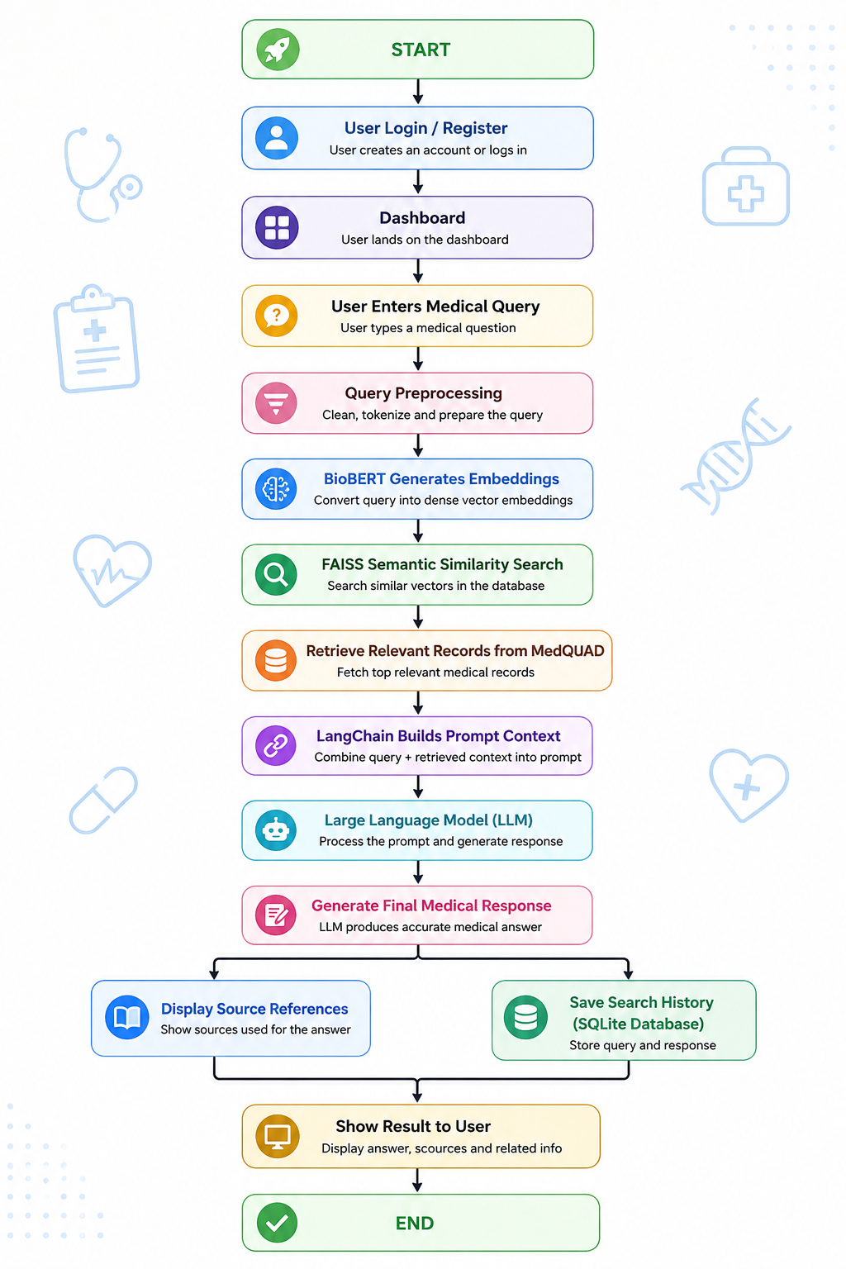
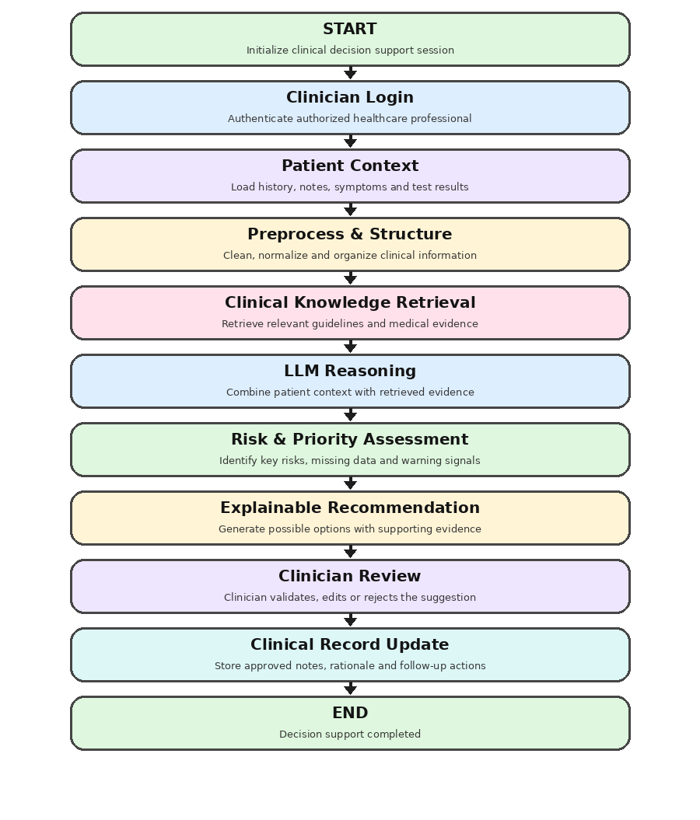
SYSTEM ARCHITECTURE
START
Initialize secure incident reporting session
System Architecture / Incident Workflow
User Login
Authenticate with JWT + Spring Security
Report Incident
Enter category, description, severity and affected asset
REST API
Validate request and process incident data
PostgreSQL
Store structured incident record and status
Elasticsearch
Index incident for fast search and filtering
Security Team
Review, assign, investigate and update status
Dashboard
Track open, high-priority and resolved incidents
END
Incident closed with complete history

Slide 12
Project plan
 | Activity | Description
Phase 1 | Requirement Analysis | Define users, incident types, workflow, access roles and security requirements.
Phase 2 | Literature Survey | Study incident-response standards, cybersecurity reporting practices and secure web application principles.
Phase 3 | System Design | Design frontend, backend, database, authentication and search architecture.
Phase 4 | Frontend Development | Build React pages for login, incident reporting, dashboards and incident details.
Phase 5 | Backend Development | Develop Spring Boot REST APIs for authentication, incidents, users and status management.
Phase 6 | Database Integration | Connect PostgreSQL for persistent incident and user data.
Phase 7 | Search Integration | Integrate Elasticsearch for full-text incident search and filtering.
Phase 8 | Security Integration | Implement JWT authentication, Spring Security and role-based authorization.
Phase 9 | Testing & Integration | Test APIs, workflows, access control, search, usability and reliability.
Phase 10 | Docker & Deployment | Containerize services with Docker and prepare deployment configuration.
Phase 11 | Documentation | Prepare report, presentation, user documentation and project demonstration.

Slide 13
Thank You

