Slide 1

AgentTwinDefect AI: An Agentic Digital Twin Platform for Real-Time Hidden Defect Prediction in Smart Manufacturing
SOA Project Review-3
 | Under the Guidance of Dr. Srikanth Cherukuvada Assistant Professor, Department of Computer Science and Engineering, KLH CSE Bowrampet Campus
Team Members K.AMULYA – 2420090132 P.SAHASRA – 2420090128 S.SUSHMITA – 2420090076

Slide 2


Base Paper: Generative and Predictive AI for Digital Twin Systems in Manufacturing
Authors: Dan Dai, Baixiang Zhao, Zhiwen Yu, Pasquale Franciosa, Dariusz Ceglarek — Frontiers in Artificial Intelligence (2025). DOI: 10.3389/frai.2025.1655470.
Core focus: integrating Generative and Predictive AI with Digital Twin systems to enable smarter, real‑time manufacturing monitoring and quality analysis.

Slide 3

Objective of the Base Paper
Integrate AI & Digital Twin
Real-time monitoring & prediction
Generative AI uses
Combine multi-model AI with DT to create an intelligent, data-driven representation of manufacturing processes.
3D reconstruction, training-data augmentation, and virtual testing to enrich the digital twin and reduce data scarcity.
Support continuous observation, anomaly detection, and forecasted quality outcomes during production.
Predictive AI uses
Proactive defect detection and predictive quality analysis to anticipate failures and prioritize inspection.
Application domain emphasized: welding manufacturing (case study and experiments).

Slide 4
AI Components Used in the Base Paper
Generative AI (GAI)
Predictive AI (PAI)
Future extensions (identified but not implemented)
3D reconstruction, synthetic data augmentation, and virtual testing for digital twin enrichment.
Supervised and semi‑supervised models for proactive defect detection and predictive quality scoring.
Explainable AI (EAI) — interpretability for model outputs and root-cause explanations.
Context‑Aware AI (CAI) — environment- and process-aware adjustments.
Agentic AI (AAI) — autonomous decision agents for corrective actions.

Slide 5
Experimental Results — Defect Detection
Dataset
Method
Metric & Result
450 welding videos → ~146,000 frames (1,247 labeled; ~145,138 unlabeled).
Semi‑supervised Teacher–Student framework (SSWD) leveraging unlabeled frames with GAI augmentation.
Evaluation: AP₅₀. Reported SSWD performance: 85.54% AP₅₀, outperforming Soft Teacher, Dense Teacher, PseCo, and ARSL in their comparisons.
Visual: SSWD AP₅₀ — 85.54% (single headline metric for viva emphasis).

Slide 6
Limitations Identified in the Base Paper
Implementation is partial — prototype scope limited to welding scenarios.
Demonstrated primarily on a single domain (welding); portability to other processes not validated.
Manufacturing data vulnerability: noise, occlusion, misalignment, and limited labeled samples.
Agentic, Explainable, and Context‑Aware AI components are not implemented — remain future work.
Consequence: additional research required to generalize the approach across heterogeneous manufacturing environments and to operationalize autonomous decision layers.

Slide 7

From Base Paper to Our Project — High‑Level Extension
We extend the base foundation (GAI + PAI + Digital Twin) by adding an implemented Agentic Decision layer, tighter predictive ML integration, and a data‑driven Digital Twin loop for simulation and recommendation.
1
2
3
4
Prediction
Digital Twin What‑If Simulation
Scenario Comparison
Agentic Decision & Recommendation
Predictive ML models estimate machine‑failure and defect likelihoods from sensor/process streams.
Automated comparison of simulated outcomes to predicted baselines to evaluate interventions.
Agent proposes corrective actions and prioritizes recommendations for operators or closed‑loop control.
Run parameterized virtual tests (GAI-enriched models) to simulate alternate actions and outcomes.

Slide 8
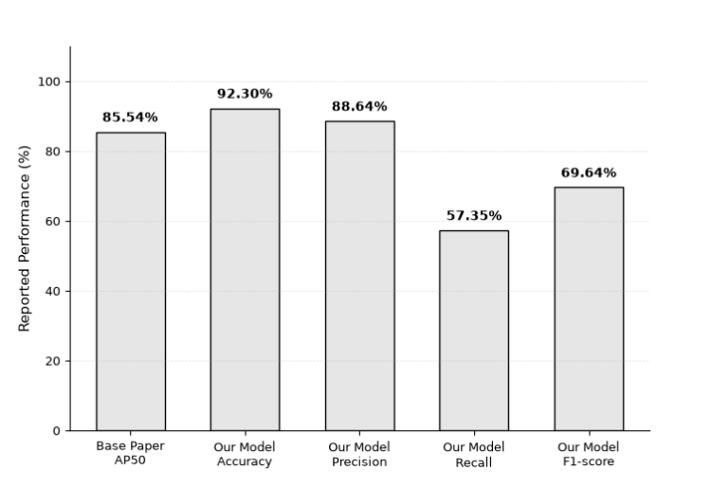
Key Contributions & Advantages of Our Extension
Operationalized agentic decision layer for corrective‑action proposals.
Integrated predictive ML with a data‑driven Digital Twin for closed‑loop evaluation.
Used generative augmentation tactically to enhance simulation fidelity and address label scarcity.
Enables “what‑if” validation of proposed interventions before shop‑floor enactment.
Supports human‑in‑the‑loop and automated decision modes for safety and oversight.
Designed for extensibility: planned integration of EAI and CAI to improve interpretability and context sensitivity.

Slide 9


THANK YOU

