Slide 1

PPO-BASED SEMANTIC AND AGE-OF-INFORMATION-AWARE SCHEDULING FOR MASSIVE IOT NETWORKS
Teaching an AI to decide which IoT device should send its data next
Team Members
M. Honeysha – 252004085
L. Sahasra – 2520040087
Nimisha Sri – 2520029127
Guide
Venu Bajaji Vinnakota
Domain
Reinforcement Learning + IoT Network Scheduling
Technology
Python | PPO | Simulation
KLH University Bachupally
1

Slide 2
THE SCHEDULING PROBLEM
Imagine 10 smart devices all wanting to send their data at the same moment. The network can only let one of them send at a time.
1
THE KEY QUESTION
Many devices → only one turn
“Who should get the next turn to send?”
TWO THINGS WE BALANCE
1
Freshness (AoI)
How old is the device’s last update?
  Only chase freshness → we may miss important data
  Only chase importance → other devices go stale
2
Importance (semantic)
How much does this data matter?
So we need a scheduler that balances both.
KLH University Bachupally
2

Slide 3
WHAT ARE WE TRYING TO ACHIEVE?
We want a scheduler that learns, on its own, which device to pick.
1
2
3
Fresh data
Important data
Smart scheduling
We track how old each update is (AoI).
Lower AoI means fresher information.
We give each update an importance score.
Higher score means it matters more.
We let PPO learn the decisions.
No single fixed priority rule.
OUR RESEARCH QUESTION
“Can PPO learn a good way to schedule devices by looking at both freshness and importance?”
KLH University Bachupally
3

Slide 4
PROPOSED PPO-BASED SCHEDULING FRAMEWORK
In every time slot, the PPO agent looks at the network and decides which device gets to send.
10 Virtual IoT Devices
Network State
PPO Agent
Select ONE Device
Transmission
Each one has data waiting to be sent
How old and how important each device’s data is
The AI that makes the decision
Only one turn is available
The chosen device sends its data
THE LEARNING LOOP
Look → choose → send → see what changed → get a score → learn → repeat
KLH University Bachupally
4

Slide 5
SIMULATION & RL FORMULATION
Term | In simple words
Setup | 10 virtual IoT devices, working in time slots. One device can send per slot. Importance is a number from 0 to 1.
State | What the agent sees: the AoI and importance of every device (AoI₁, Importance₁ … AoI₁₀, Importance₁₀).
Action | Which device to pick: 0 means Device 1, 1 means Device 2, … 9 means Device 10.
Transition | The chosen device sends and becomes fresh. Every other device gets one step older.
Reward | A score that is higher when the choice balances freshness and importance well.
One state → one action → one change → one reward
KLH University Bachupally
5

Slide 6
PPO-BASED SCHEDULING
PPO = Proximal Policy Optimization, an AI method that learns by trial and error
HOW PPO LEARNS
1
2
3
4
5
6
Look at the state
Pick a device
Device sends
State changes
Get a reward
Improve the policy
WHY PPO?
HOW WE CHECK IT
It learns by trying, getting a score, and improving.
It finds the balance between freshness and importance by itself, so we don’t have to hand-pick a formula.
The PPO training reward curve
If the line goes up during training, the scheduler is getting smarter.
KLH University Bachupally
6

Slide 7
BASELINE METHODS & EVALUATION
We compare PPO against three simple rules.
Scheduler | How it decides
Random | Picks any device by chance
Highest-AoI | Picks the device whose data is the oldest
Highest-Semantic | Picks the device whose data matters the most
PPO | Learns from experience what the best choice is
HOW WE MEASURE SUCCESS (↓ lower is better, ↑ higher is better)
Average AoI ↓
Peak AoI ↓
Semantic Utility ↑
Overall Reward ↑
How fresh data is overall
The oldest data ever seen
How much important data got delivered
The total score from the reward
KLH University Bachupally
7

Slide 8
EXPECTED / EXPERIMENTAL RESULTS
How the four schedulers perform
Method | Avg AoI ↓ | Peak AoI ↓ | Semantic Utility ↑ | Reward ↑
Random | 8.740 | 47.52 | 0.477 | 30.223
Highest-AoI | 4.509 | 10.66 | 0.478 | 38.809
Highest-Semantic | 40.486 | 50.00 | 0.906 | 9.599
PPO | 9.157 | 35.80 | 0.710 | 52.701
What we look for: does PPO keep data fresh and deliver important data better than the single-rule schedulers?
All numbers and improvement percentages come directly from our simulation. Nothing is assumed or made up.
KLH University Bachupally
8

Slide 9
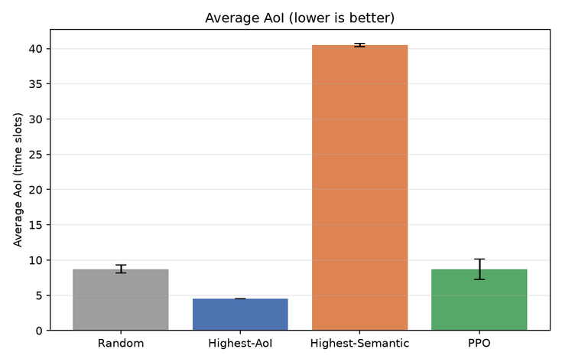
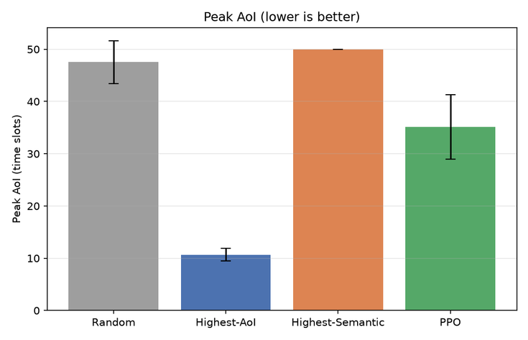
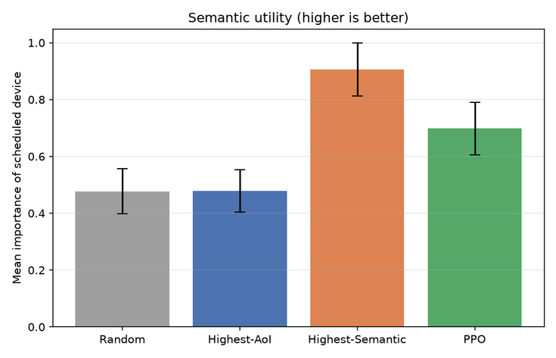
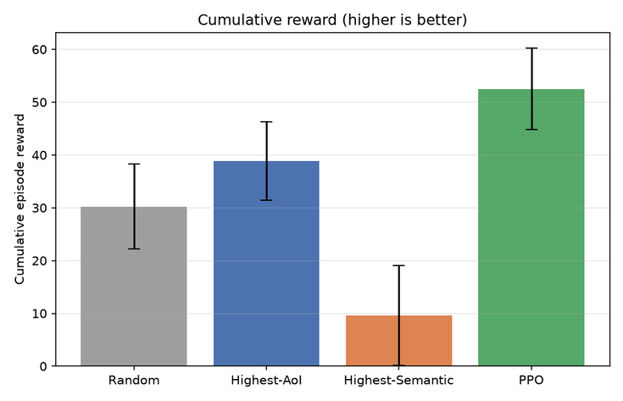
SIMULATION OUTPUT GRAPHS
AVERAGE AoI COMPARISON
PEAK AoI COMPARISON
Paste the peak AoI graph generated by my project.
SEMANTIC UTILITY COMPARISON
CUMULATIVE REWARD COMPARISON

Slide 10
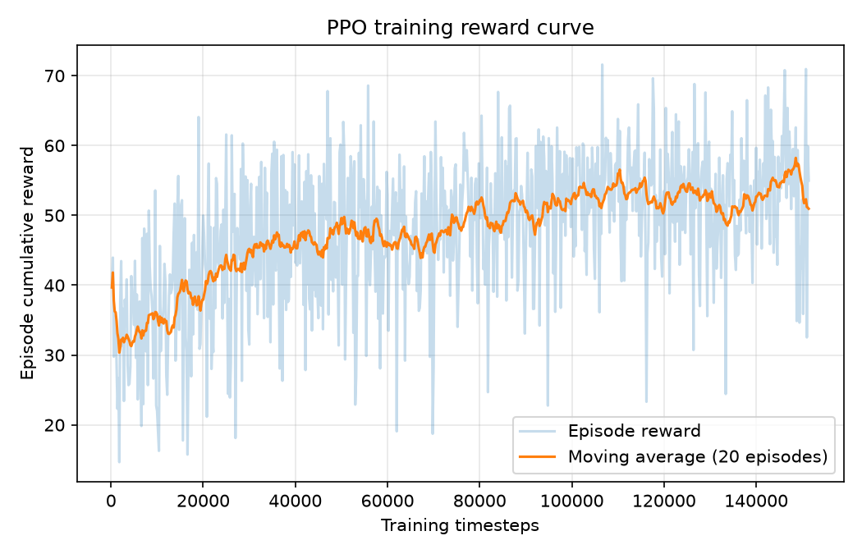
OUTPUT ANALYSIS
1. Random: Provides a basic reference for comparison.
2. Highest-AoI: Prioritizes the stalest information and achieves the lowest average and peak AoI.
3. Highest-Semantic: Achieves the highest semantic utility, but its average AoI is very high.
4. PPO: Achieves the highest cumulative reward under the implemented reward function, with semantic utility of 0.699 and average AoI of 8.682.
The results show a trade-off between information freshness and semantic importance. PPO achieved the highest cumulative reward under the implemented objective, while Highest-AoI performed best on freshness metrics and Highest-Semantic performed best on semantic utility.
Evaluation used 50 episodes per scheduling method, with 10 virtual IoT devices and 200 time steps per episode. Semantic importance values are synthetically generated in the current implementation.

Slide 11
CONTRIBUTION & CONCLUSION
WHAT WE DID
OUR GOAL
✓
Built a simulated IoT scheduling environment
“To find out whether PPO can learn to prioritize IoT devices smartly, by weighing freshness and importance when only a few transmission turns are available.”
✓
Modeled data freshness (AoI) and importance
✓
Turned scheduling into a reinforcement learning problem
✓
Implemented a PPO-based scheduler
✓
Implemented Random, Highest-AoI and Highest-Semantic rules
DELIVERABLES
Simulation • Baselines • PPO • Evaluation • Results • Analysis
✓
Designed an experiment to compare all the methods
10 IoT devices → 1 transmission turn → PPO learns what to prioritize
KLH University Bachupally
9

