Slide 1
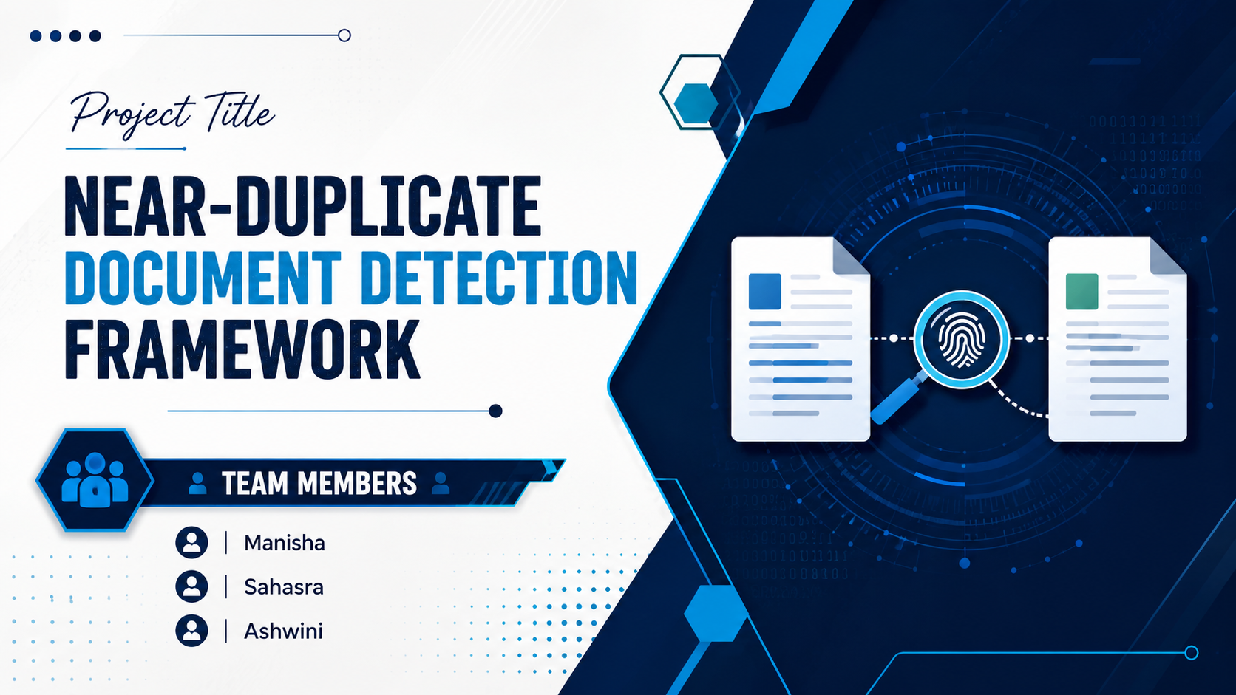
Title:
Near-Duplicate Document Detection Framework
SEC-7
Team members:
Sahasra 2510030377
Ashwini 2510030402
Manisha 2510030255

Slide 2
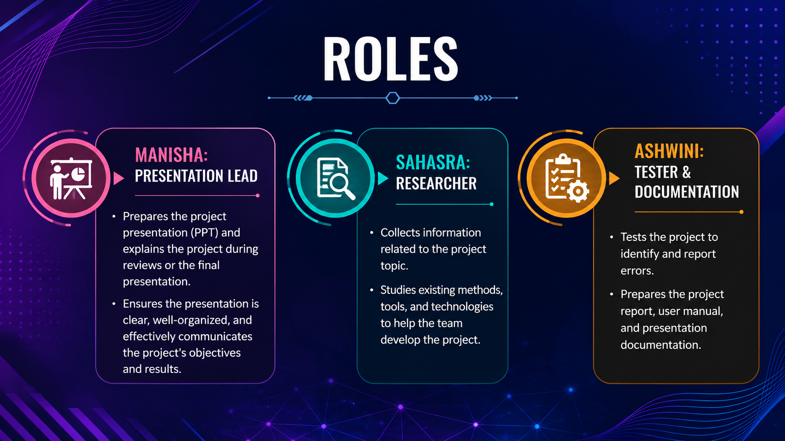
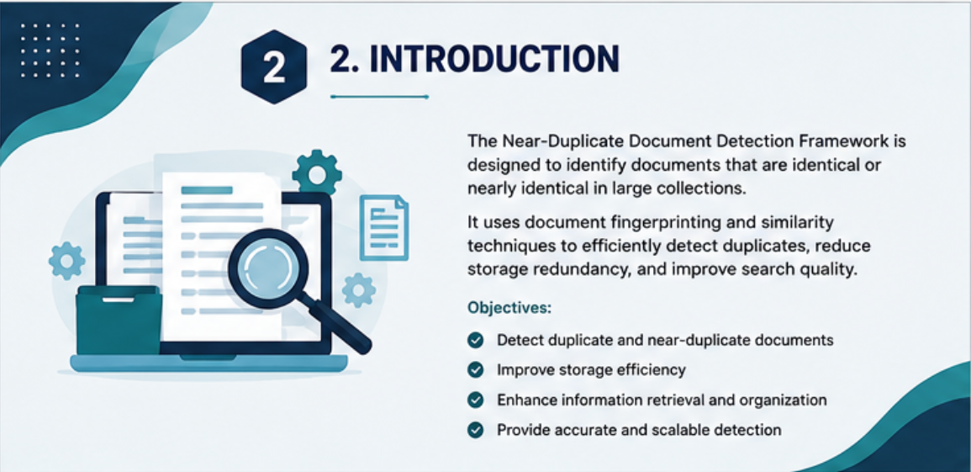
Roles:
MANISHA: Presentation Lead
Prepares the project presentation (PPT) and explains the project during reviews or the final presentation . Ensures the presentation is clear, well-organized, and effectively communicates the project's objectives and results.
SAHASRA: Researcher
Collects information related to the project topic.
Studies existing methods, tools, and technologies to help the team develop the project.
ASHWINI: Tester & Documentation
Tests the project to identify and report errors.
Prepares the project report, user manual, and presentation documentation.

Slide 3
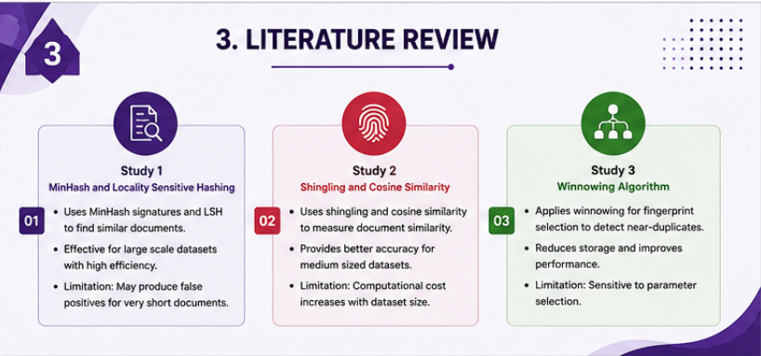
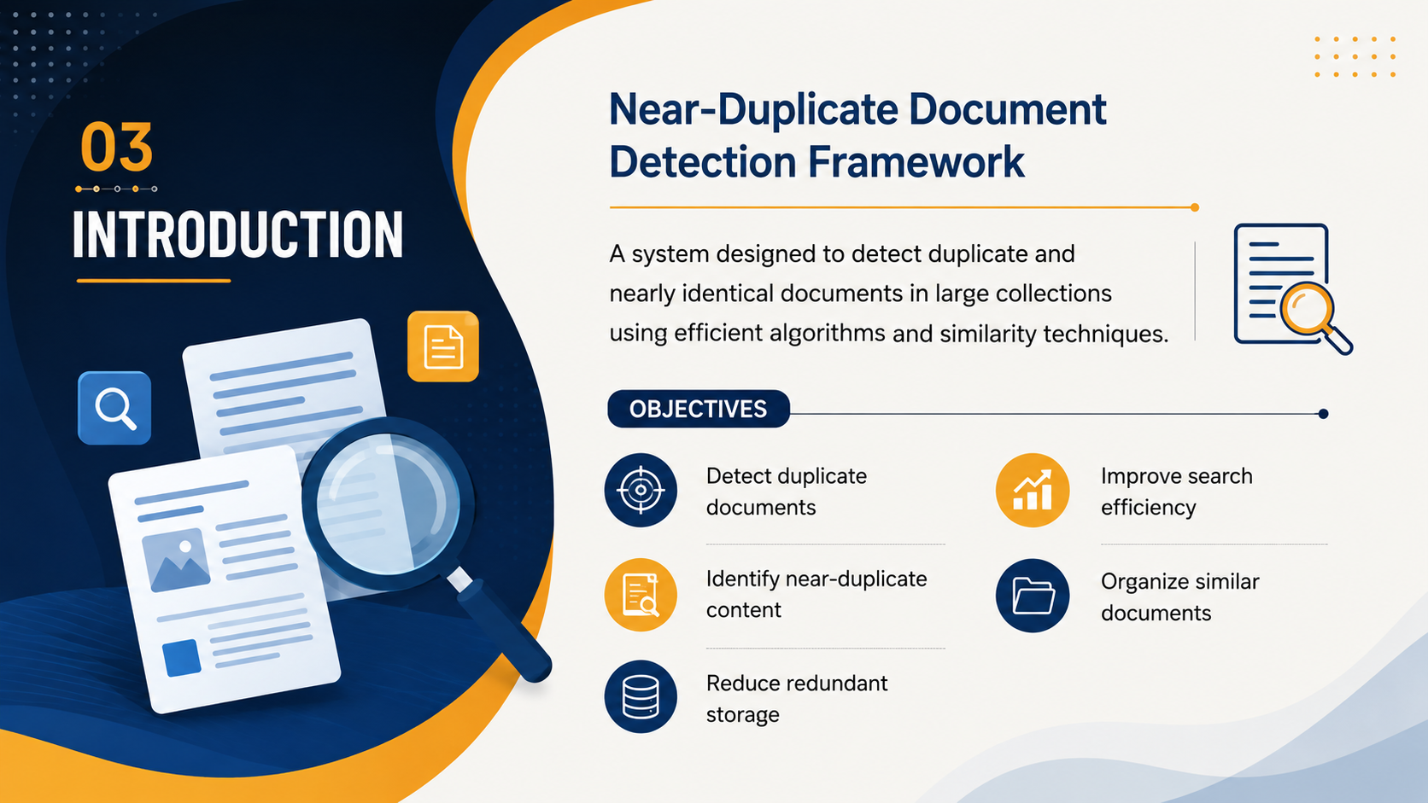
Introduction:
A Near-Duplicate Document Detection Framework is a system that identifies duplicate and nearly identical documents using techniques like Minhas and Locality Sensitive Hashing (LSH).
It helps reduce redundant storage, improve search quality, and efficiently manage large collections of text documents.
It is widely used in search engines, cloud storage, and content management systems.
Objectives:
To develop a system that can identify duplicate documents accurately.
To reduce manual effort by automating the document verification process.
To improve the accuracy and efficiency of document management.
To minimize duplicate records and maintain organized document storage.
To save time by quickly comparing and detecting similar documents.
To provide a simple and user-friendly interface for uploading and checking documents.
To improve data quality by reducing redundancy and preventing duplicate entries.

Slide 4
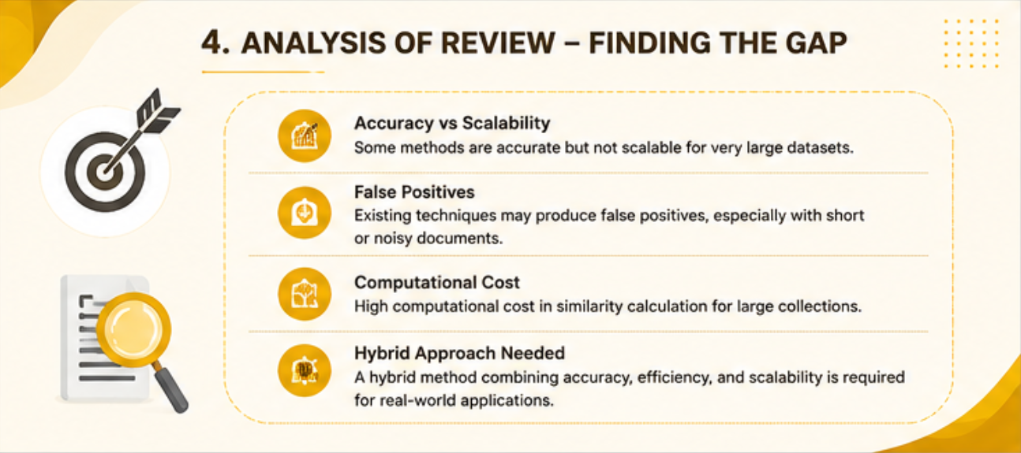
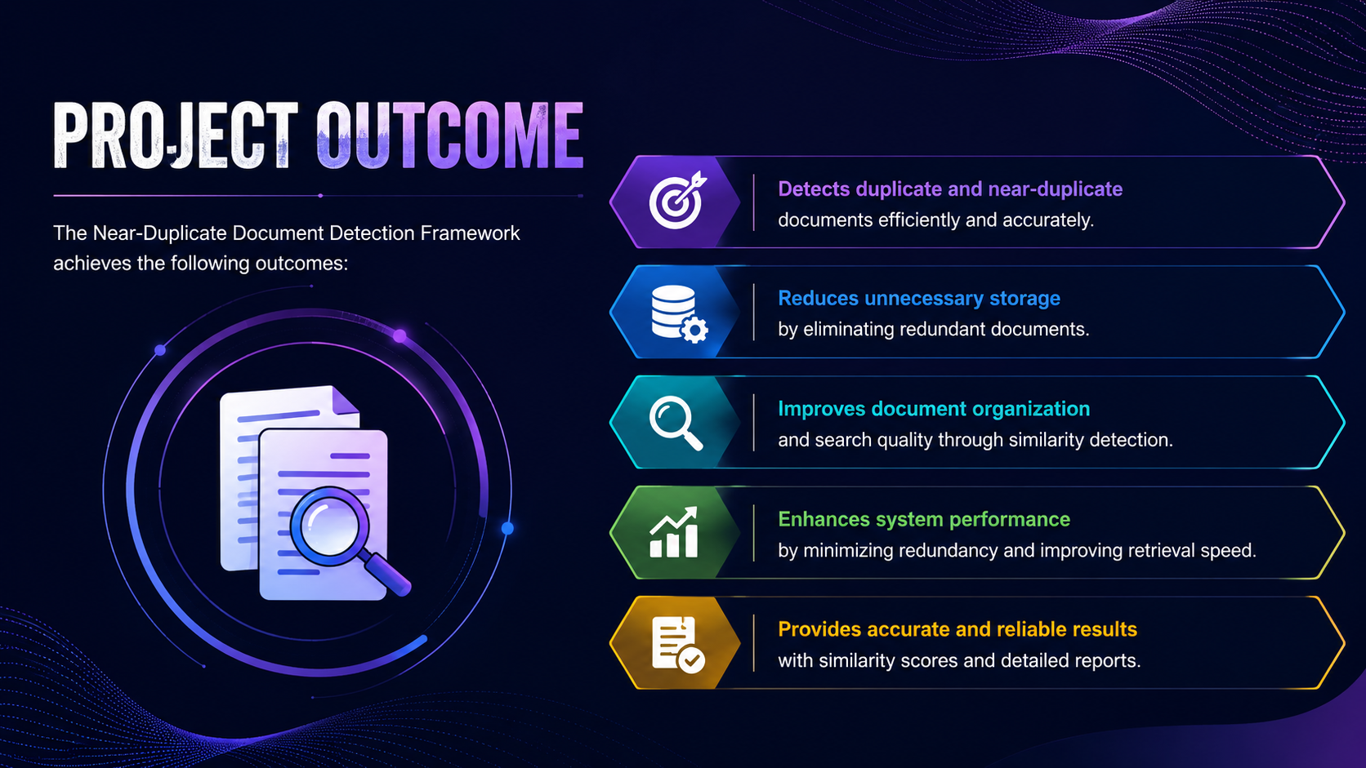
Project outcome:
Project Outcome
The project successfully detects duplicate and near-duplicate documents using Minhas and LSH algorithms. It:
Reduces redundant storage by eliminating duplicate content.
Improves search quality by removing repeated documents.
Speeds up document retrieval through efficient indexing.
Enhances content management and organization.
Generates duplicate reports for easy analysis.

Slide 5
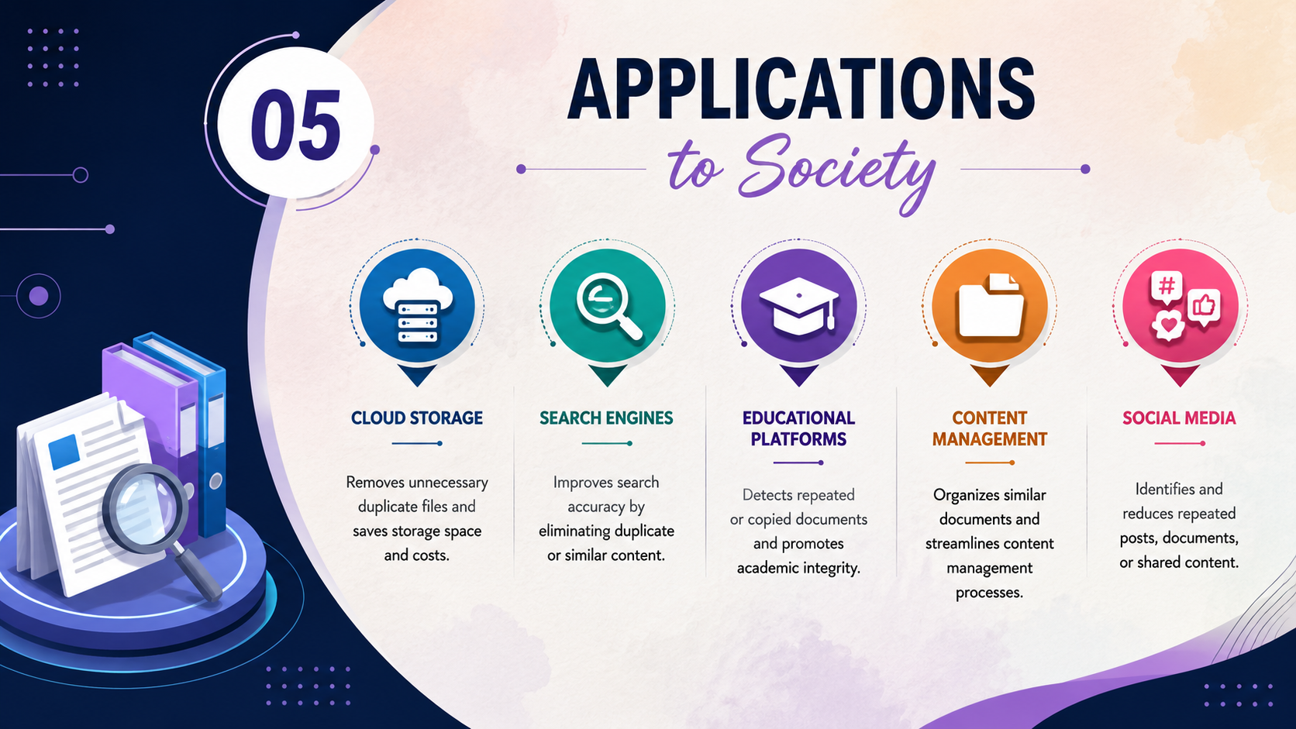
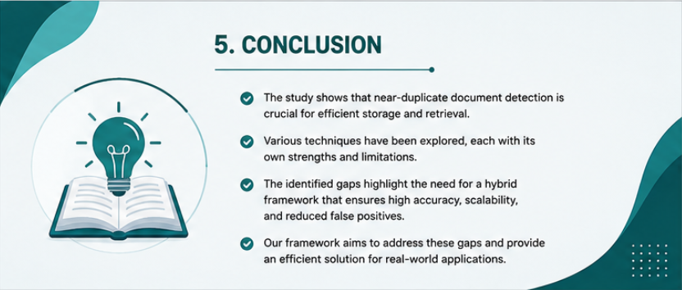
Applications to society:
Education: Prevents plagiarism and detects copied assignments or research papers.
Healthcare: Removes duplicate patient records, improving data accuracy.
Government: Eliminates duplicate documents in public databases and records.
Digital Libraries: Organizes books, articles, and journals by removing duplicate copies.
Search Engines: Improves search results by filtering duplicate web pages.
Social Media: Detects and reduces repeated or spam content.
Businesses: Saves storage space and improves document management.
News Platforms: Identifies duplicate news articles from different sources.

Slide 6
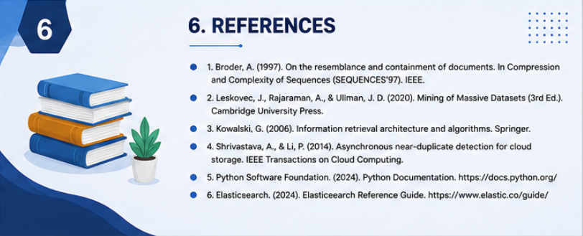

Github link:
https://github.com/sahasrar1130-arch/Near-Duplicate-Document-Detection-Framework

