Slide 1
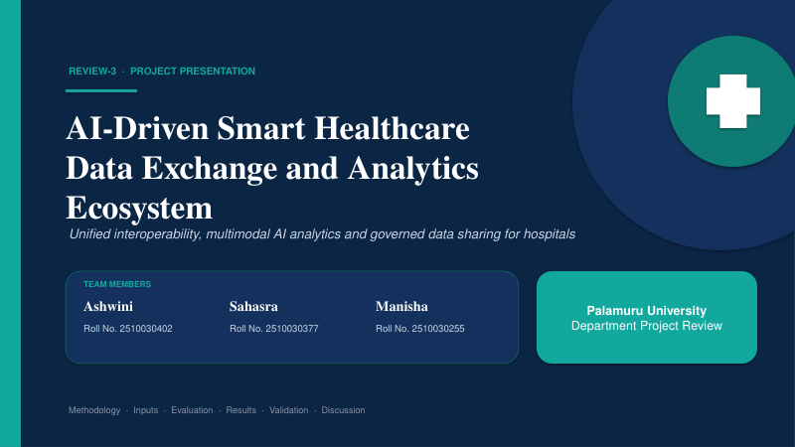

Slide 2
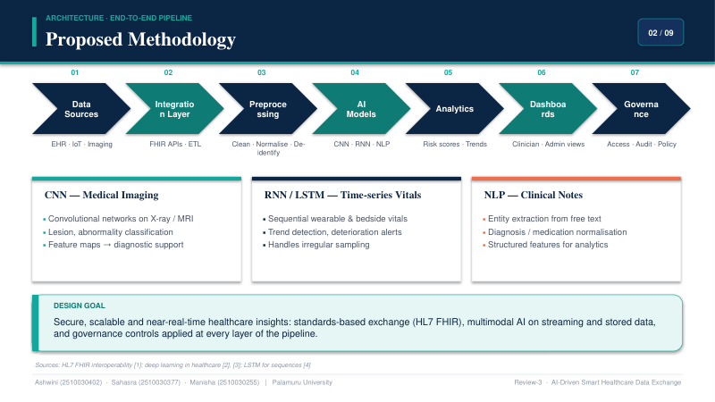

Slide 3
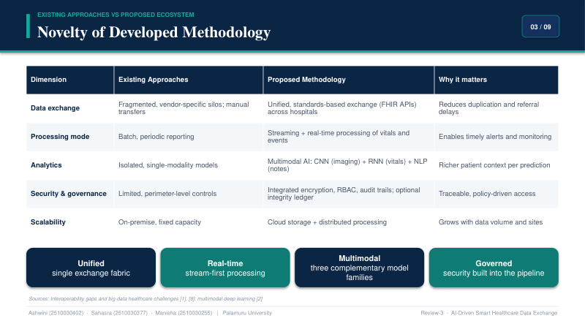

Slide 4
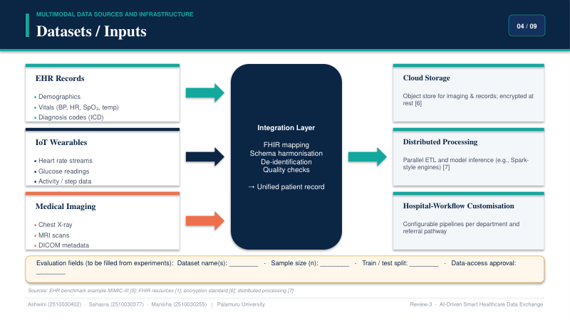

Slide 5
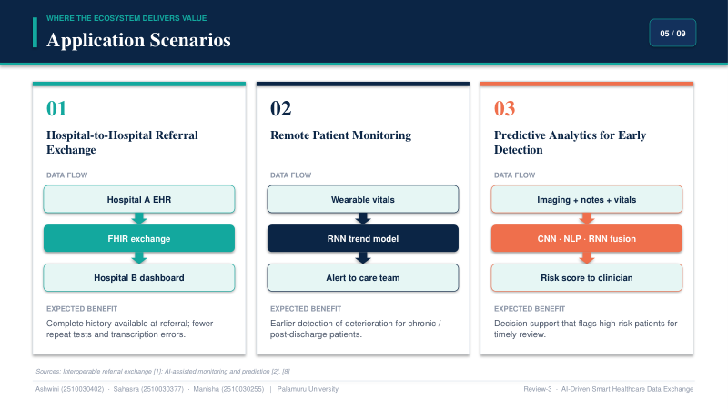

Slide 6
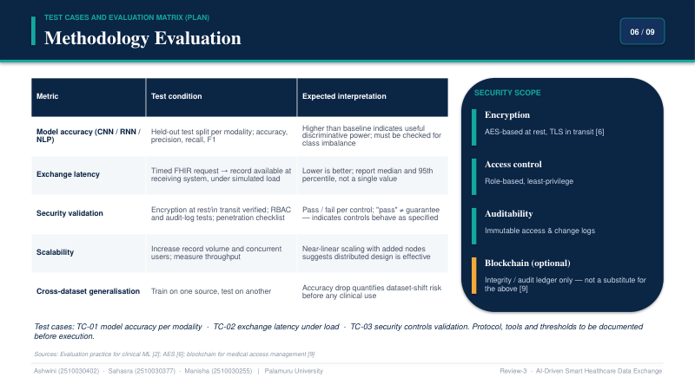

Slide 7
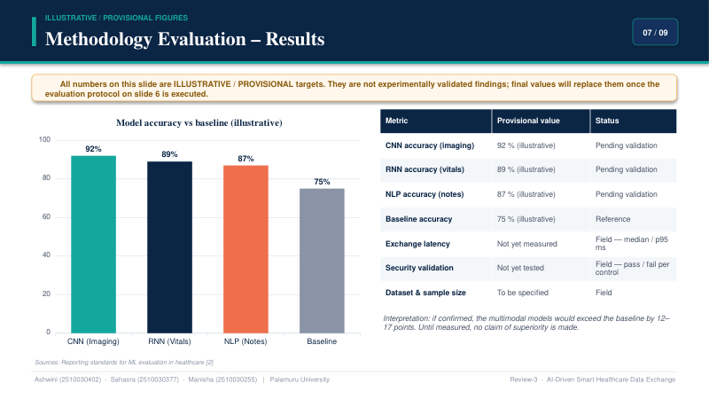

Slide 8
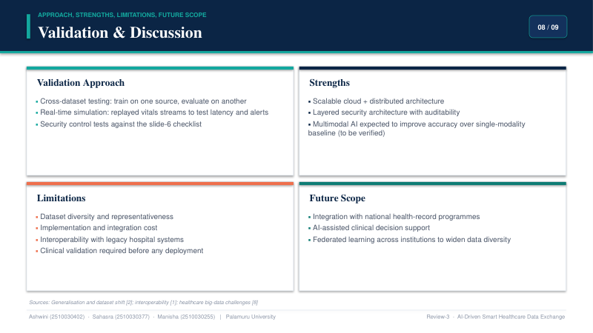
REVIEW 4 — Implementation & Results
AI-Driven Smart Healthcare Data Exchange and Analytics Ecosystem
Frontend & Security
Data & Microservices
Events & AI
• React.js + Vite
• JWT authentication
• Role-Based Access Control
• Patient, records, lab, prescription and consent modules
• FastAPI backend
• PostgreSQL + pgvector
• MongoDB wearable data
• Redis
• Branch-to-branch data exchange
• Kafka notifications/events
• Semantic search with embeddings
• Ollama Llama 3.2:3b
• RAG answer with source records
Verified Results
AI & Exchange Demo
• P001 patient data successfully displayed
• Wearable analytics: 2 records
• Average heart rate: 86.5 bpm
• Average SpO₂: 97.5%
• Total steps: 14,200
• Average sleep: 7.65 hours
• Main Hospital → Secunderabad Branch exchange
• Consent workflow demonstrated
• Kafka exchange events demonstrated
• RAG retrieves hypertension medical record
• AI assistant returns grounded answer with source
AI-Driven Smart Healthcare Data Exchange and Analytics Ecosystem • Review 4

