Slide 1

SANSKRIT to ENGLISH
Translation
Presented By : Sahasra Kamatam
UMBC | 2024

Slide 2
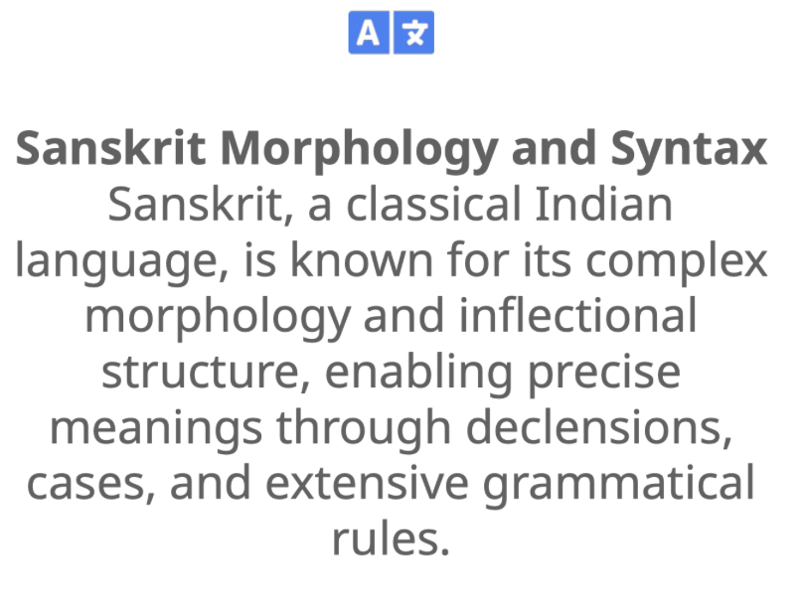
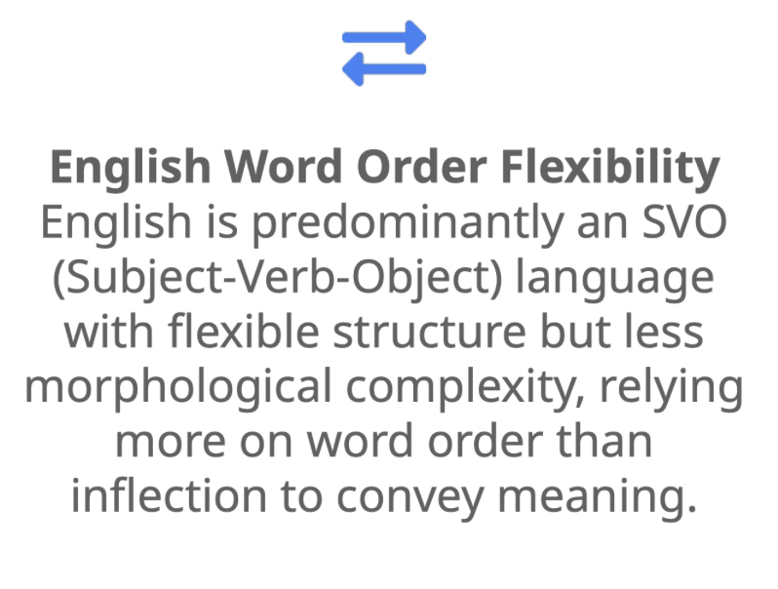
1
INTRODUCTION
Sanskrit to English translation presents unique challenges due to Sanskrit's intricate morphology and cultural depth, contrasted with English's reliance on word order and simpler structure.

Slide 3
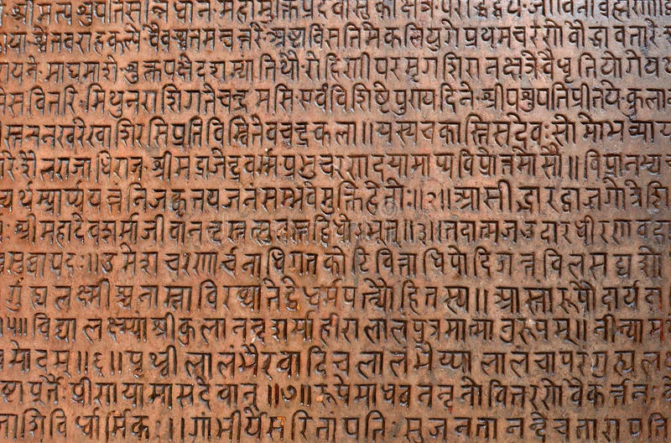
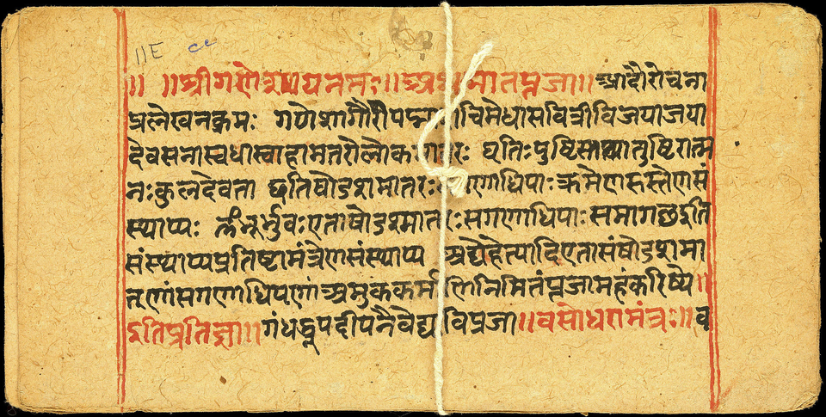
2
CHALLENGES
Free Word Order
Complex Morphology
Compounded Words
Limited Training Data

Slide 4
3
TRANSLATION APPROACHES
Traditional Methods
Neural Network-Based
Rule-Based Machine Translation (RBMT) uses predefined grammatical rules and dictionaries and Statistical Machine Translation (SMT), rely on probabilities derived from large bilingual corpora
Neural Machine Translation (NMT) leverages deep learning, specifically neural networks, to learn complex patterns from vast amounts of data.

Slide 5
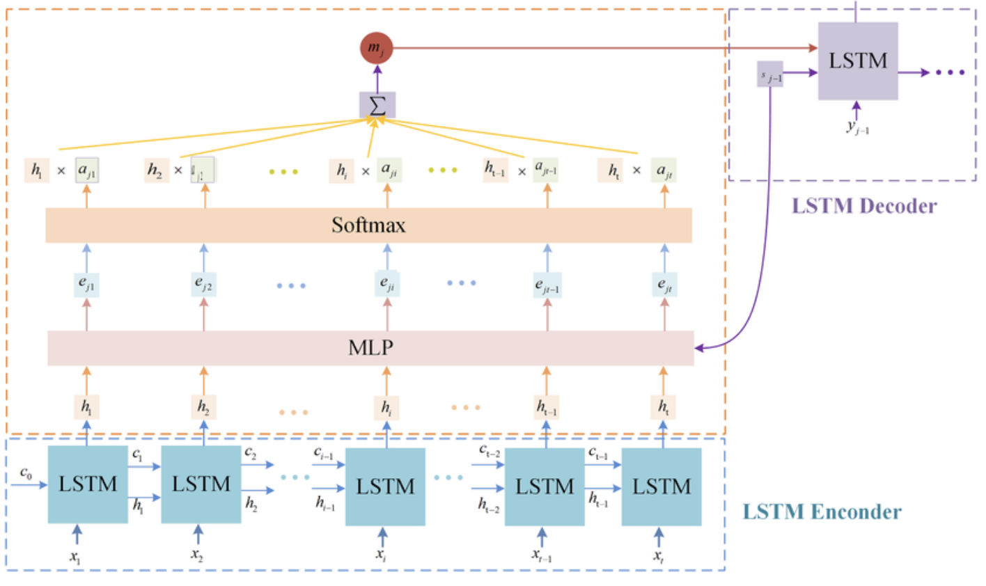
4
ENCODER-DECODER LSTM ARCHITECTURE
1
Input Processing:
The Encoder takes a sequence of tokens as input where each word is first embedded into a vector of fixed dimensions using an embedding layer.
2
Sequence Modeling:
The sequence of word embeddings is fed through
one or more layers of LSTM units.
LSTMs capture the sequential context by maintaining
a hidden state and a cell state that are updated at
each step in the sequence.
3
Context Vector Generation:
After processing the entire input sequence, the Encoder outputs a context vector.
This context vector is passed to the Decoder as the initial state, carrying the essential information needed to generate the translation.

Slide 6
5
ENCODER-DECODER LSTM ARCHITECTURE
1
Initialization:
The Decoder is initialized with the context vector from the Encoder and the Decoder uses this context to begin generating the translation in the target language.
2
Output Sequence:
The sequence of word embeddings is fed through one or more layers of LSTM units.
The Decoder generates each target word step-by-step, using its previous hidden states and the last predicted word to progressively build the sequence. During training, teacher forcing is applied.
3
Output Layer and Prediction:
Decoder’s hidden state is passed through a fully connected layer followed by a softmax layer, producing a probability distribution over the vocabulary.
The Decoder continues generating words until it predicts a special end-of-sequence (EOS) token, signaling that the translation is complete.

Slide 7
6
LSTM
Long-Term Dependency Management
LSTM (Long Short-Term Memory) is a type of recurrent neural network (RNN) architecture designed to capture long-term dependencies in sequential data. Unlike standard RNNs, LSTMs use specialized memory cells with gates (input, forget, and output gates) to control the flow of information, allowing them to retain or discard information over long sequences effectively.
LSTMs mitigate the vanishing gradient problem
Controlled Information Flow
Helps capture relevant details in complex sentences
Sequential Structure Handling
Ideal for sequence-to-sequence tasks

Slide 8
7
DATA PREPARATION
1
Dataset Sourcing:
Loaded “rahular/itihasa” dataset.
Dataset has 2 files one with Sanskrit text and the other file with translation text in English.
2
Data Cleaning:
Remove Extra Whitespaces, Special Characters, Numbers from text.
The Decoder generates each target word step-by-step, using its previous hidden states and the last predicted word to progressively build the sequence. During training, teacher forcing is applied.
3
Tokenization:
Sanskrit Tokenization: Tokenizing Sanskrit requires handling compounded words
English Tokenization: Standard tokenization methods are generally used for English

Slide 9
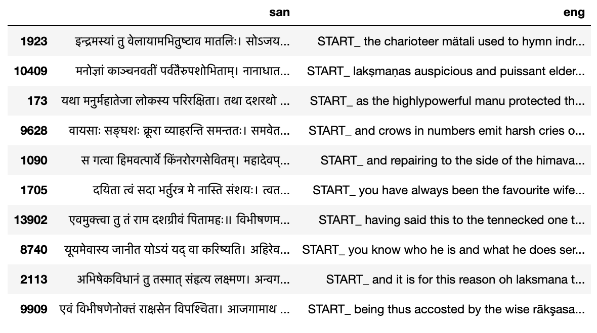
8
DATA PREPARATION

Slide 10
9
TRAINING PROCESS
Initializing the Model
Embedding Layers: Set up embedding layers for both Sanskrit and English vocabularies to convert words into vector representations.
Encoder-Decoder Architecture: Define the LSTM-based Encoder-Decoder architecture with an attention mechanism if applicable, allowing the model to focus on relevant parts of the Sanskrit sentence during decoding.
Training Steps
Forward Propagation: For each training example, pass the Sanskrit sentence through the Encoder to generate the context vector, and use this vector to generate the English sentence step-by-step through the Decoder.
Loss Calculation: Compute the loss between the predicted output and the actual English translation.
Backward Propagation: Update weights in the Encoder and Decoder using backpropagation through time (BPTT) to minimize the loss.

Slide 11
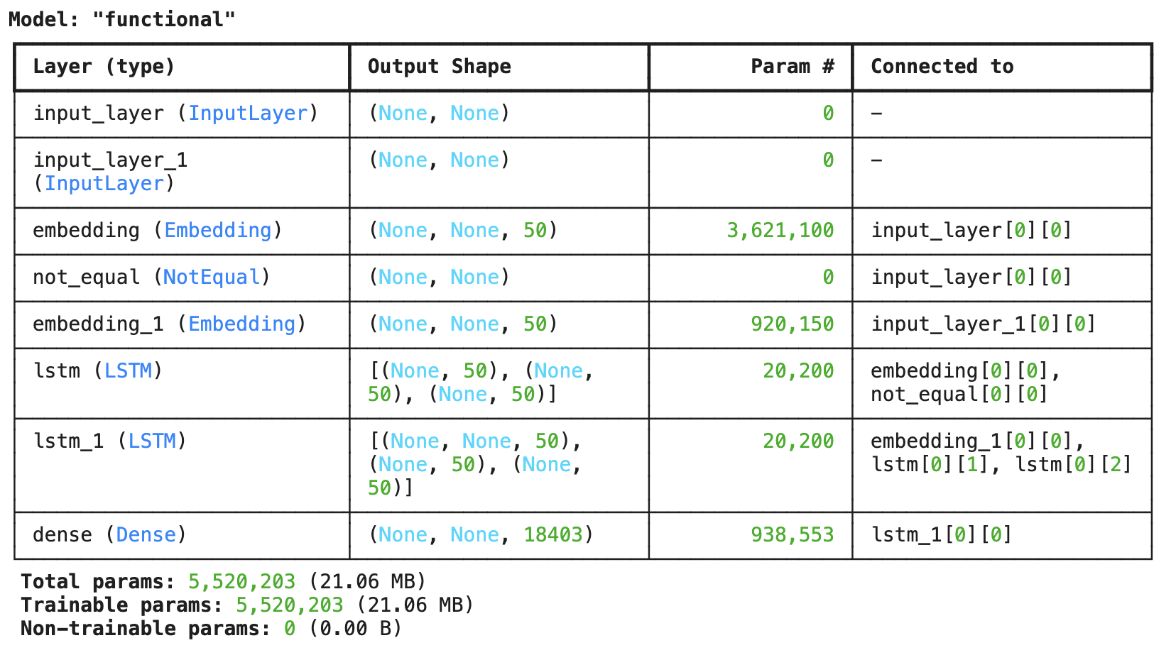
9
TRAINING PROCESS

Slide 12
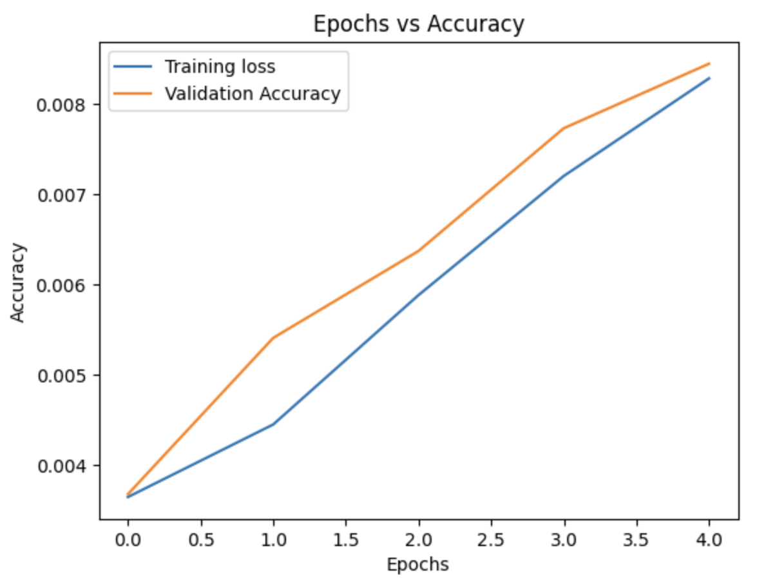
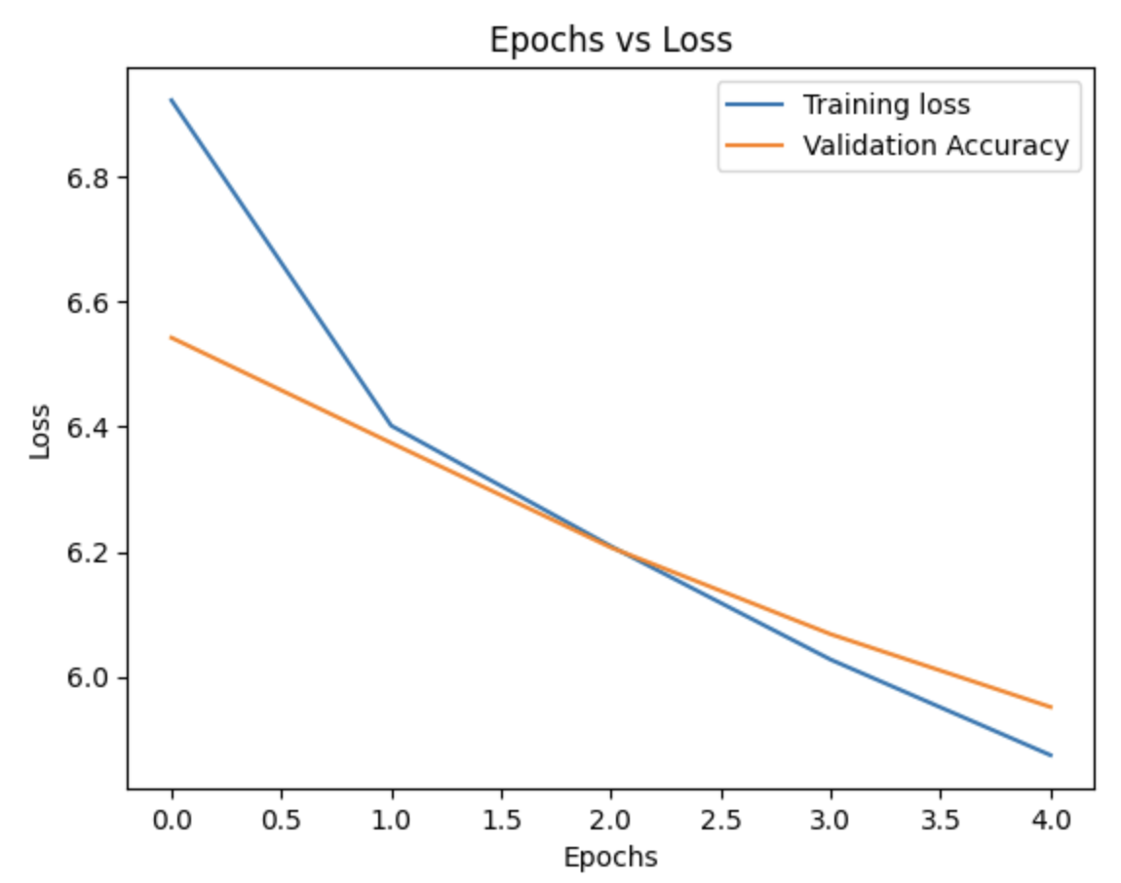
TRAINING PROCESS
9
Hyperparameter Tuning
Learning Rate: Optimize the learning rate, as it significantly impacts convergence.
Batch Size: Experiment with different batch sizes to find a balance between training speed and stability.
Number of Layers and LSTM Units: Tuning the number of LSTM layers and units per layer.
Dropout Rate: Use dropout to prevent overfitting
Optimization Strategies
Teacher Forcing: The actual next word is fed into the Decoder instead of the model’s prediction.
Early Stopping: Monitor the validation loss to prevent overfitting.
Regularization: Apply L2 regularization or dropout within the LSTM layers to manage overfitting.
Gradient Clipping: Prevent exploding gradients by clipping them to a maximum norm.

Slide 13
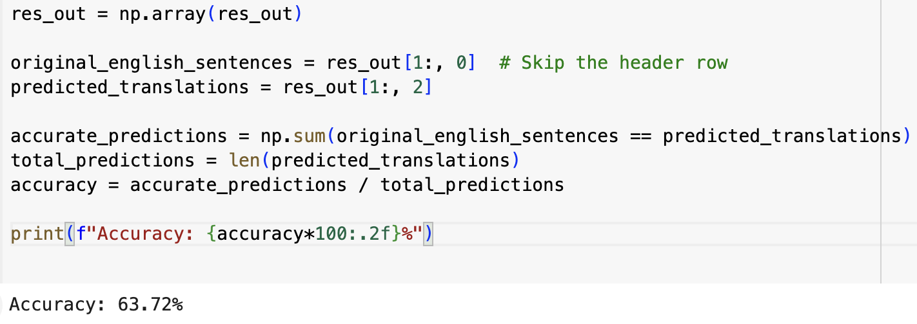
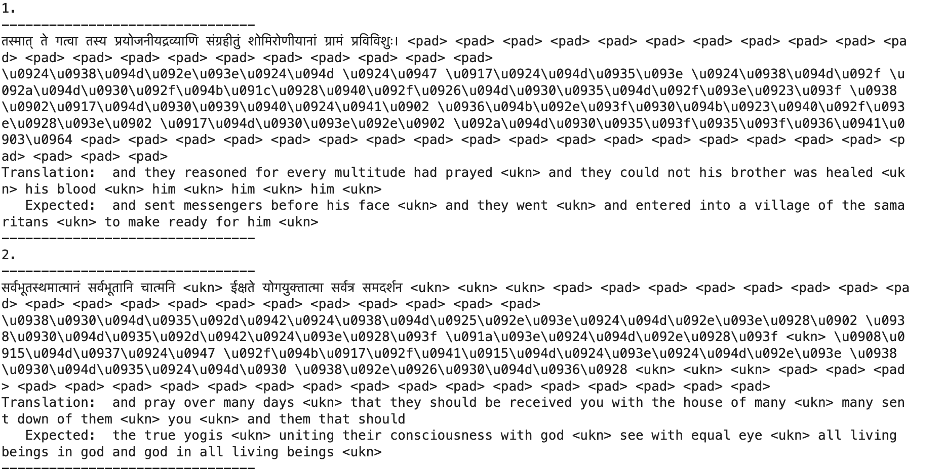
10
PERFORMANCE EVALUATION
Accuracy
On simpler sentences, the word-by-word accuracy was higher 63.72 while complex sentences showed lower accuracy due to compounding and syntax variations.

Slide 14
11
CONCLUSION
Summary: This project explored the challenges and approaches for Sanskrit-to-English translation using Encoder-Decoder LSTM models, highlighting the unique complexities of Sanskrit’s syntax, morphology, and context-dependent meanings.
Achievements: Successfully developed a model that translates basic Sanskrit sentences, paving the way for enhanced accessibility of Sanskrit texts in academia and beyond.
Challenges and Limitations: Handling complex sentence structures, compounded words, and data scarcity remains a challenge, impacting translation accuracy.
Future Potential: With advancements like Transformer models, attention mechanisms, and domain-specific fine-tuning, the model can be improved for better accuracy and wider application.
Final Thought: This work contributes to bridging the gap between ancient and modern languages, making Sanskrit's rich cultural and intellectual heritage more accessible in the digital age.

Slide 15
UMBC | 2024
THANK YOU

