Slide 1


$ ./chat --ipc
Inter-Process Chat Application Using IPC
Mahathi 2520080030
Sahasra 2520080062
S. Rishitha Reddy 2520090039
Branch: AI and DS , CS IT
Subject: Operating Systems AND Systems Programming
Notes:
Introduce yourself and the project: a terminal-based chat application in C where two processes talk through Linux named pipes (FIFOs). It runs on Ubuntu under WSL and was built in VS Code. Fill in your name and college on this slide.

Slide 2
Problem Statement and Objectives
Objectives
Inter-Process Chat Application Using IPC
1
Exchange messages using named pipes (FIFOs)
Demonstrate how two independent processes can exchange messages on a Linux system using inter-process communication.
2
Save messages with timestamps
3
View chat history and basic statistics
4
Terminate the conversation safely
Notes:
The problem is simple: show how two independent processes can talk to each other. The five objectives map directly to the five features: fork(), FIFOs, timestamped history, the history viewer, and a safe exit with /exit.

Slide 3
Technologies and Concepts Used
C language
Linux Ubuntu / WSL
GCC compiler
fork()
Low-level access to system calls
Linux environment on Windows
Compiles the C source files
Creates a child process
mkfifo()
File handling
Timestamps & history
Creates named pipes for messages
Reads/writes chat_history.txt
Records when each message was sent
Notes:
Go through each item: C for system programming, Ubuntu on WSL as the runtime, GCC to compile, fork() to create a child process, mkfifo() to create named pipes, file handling for chat_history.txt, and timestamps so each saved message records when it was sent.

Slide 4



System Architecture and Working
User A Terminal
User B Terminal
Process A
FIFO A → B
Process B
Parent: sends messages
Child (fork): receives
Parent: sends messages
Child (fork): receives
FIFO B → A
append message + timestamp (history.h)
chat_history.txt
Both users' messages are logged
reads history
history_viewer.c
Notes:
Walk the diagram. User A types in the terminal; Process A's parent sends the message through FIFO A-to-B, and Process B's child receives it and shows it on User B's terminal. The reverse path uses FIFO B-to-A. After the program calls fork(), the parent handles sending while the child handles receiving, so both directions work at once. Messages are appended with timestamps to chat_history.txt using history.h. history_viewer.c is a separate program that only reads the saved file.

Slide 5
Implementation and Algorithm
1
Create or open the named FIFOs
Simplified snippets (illustrative)
// FIFO
mkfifo("fifo_a_to_b", 0666);
// fork: child receives, parent sends
pid_t pid = fork();
if (pid == 0) { /* receive loop */ }
else { /* send loop */ }
// write to FIFO
write(fd, msg, strlen(msg) + 1);
// save to history
FILE *f = fopen("chat_history.txt", "a");
fprintf(f, "[%s] %s\n", time_str, msg);
2
Create a child process with fork()
3
Parent sends, child receives
4
Write messages through the right FIFO
5
Save messages with timestamps
6
Stop when /exit is entered
Notes:
Explain the six steps in order. The snippets are simplified illustrations of the system calls involved (mkfifo, fork, write, fopen/fprintf), not the full project code. Replace them with the exact lines from your own source if you prefer. Typing /exit ends the conversation.

Slide 6
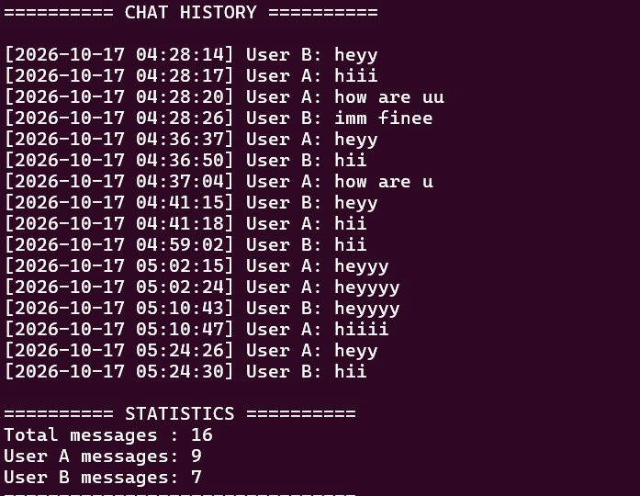
Output and Testing
Illustrative mockups, not real screenshots
Tests performed
User A terminal (example)
User B terminal (example)
You: Hello B!
B: Hi A, got it.
You: Testing FIFO chat
B: Works well.
You: /exit
A: Hello B!
You: Hi A, got it.
A: Testing FIFO chat
You: Works well.
[A ended the chat]
Message transmission
History recording
History viewer run
/exit termination
./history_viewer (example)
[10:15:02] User A: Hello B!
[10:15:09] User B: Hi A, got it.
[10:15:20] User A: Testing FIFO chat
[10:15:31] User B: Works well.
--- Total messages: 4 ---
[ Insert real screenshots here ]
Notes:
The terminal windows are example mockups so the layout is clear; they are not real execution output. Replace them with real screenshots from your WSL terminal: User A and User B exchanging messages, and the output of history_viewer. State only the tests you actually ran: message transmission, history recording, history viewer, and /exit.

Slide 7
Results, Conclusion and Future Scope
Results
Concepts Shown
Future Scope
Terminal-based IPC chat works between two users
Messages saved with timestamps
History viewer shows saved chat and basic statistics
/exit ends the chat
Process creation with fork()
Synchronization via blocking FIFO read/write
FIFO communication
File handling
Not implemented yet
Multi-user chat
Improved error handling
Graphical interface
Thank You
_
Notes:
Summarize: a working terminal IPC chat using fork(), FIFOs and file handling. The future scope items (multi-user chat, better error handling, a GUI) are ideas only and are not part of the current project. End with Thank You and invite questions.

