Slide 1
SEASONAL AGRICULTURE
PERFORMANCE ANALYSIS
Major Project • Data Analytics
AICTE STD ID:STU6a6b4aa9320441785416361_SREOSI SAHA
4,000
Records
28
Fields
Sreosi Saha
Manipal University Jaipur (MUJ)
1

Slide 2
Problem Statement
Why seasonal analysis matters
• Agricultural performance changes with season, weather, resources and market conditions.
• Raw data alone does not clearly show which seasons perform better or why.
• This project compares seasonal yield, profit, water use and risk to identify useful patterns.
Season × Performance
Core focus
Evidence-based
Decision support
Simple & visual
Communication
2

Slide 3
Project Description
From raw records to practical insights
• Loaded and reviewed the agricultural Excel dataset using Python and pandas.
• Cleaned missing values, removed duplicate records and prepared numeric fields for analysis.
• Compared seasons, crops and irrigation methods using averages, group-by analysis, correlations and charts.
• Focused the final story on a few findings that are easy to understand and defend.
4,000
Input rows
3
Seasons
4
Irrigation methods
7
Output tables/charts
3

Slide 4
Who Are the End Users?
People who can use the analysis for planning
Farmers
Agricultural planners
Analysts / researchers
Compare seasonal outcomes
and
resource use.
Use seasonal patterns
for planning and allocation.
Explore relationships
and unusual patterns.
4

Slide 5
Technology Used
Simple tools suitable for a reproducible analytics workflow
Python
Pandas
NumPy
Analysis & automation
Data loading and grouping
Numeric calculations
Matplotlib
Excel
Jupyter / script
Charts and visuals
Source dataset
Reproducible workflow
5

Slide 6
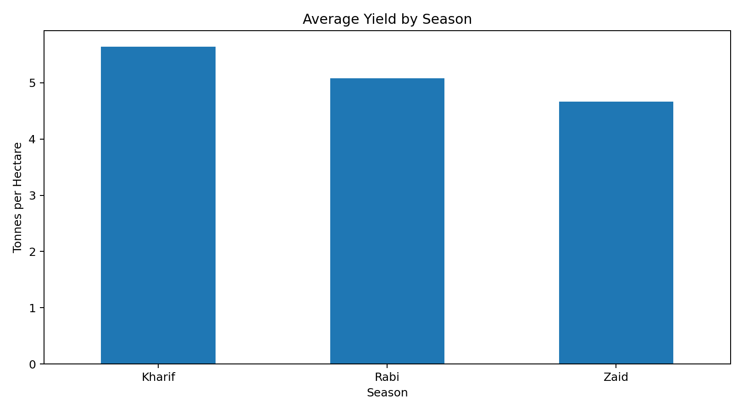
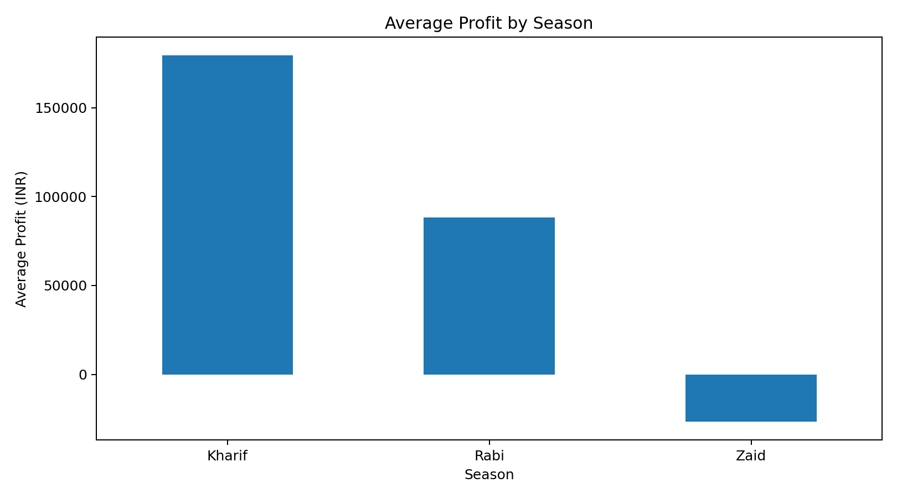
Results
Seasonal performance at a glance
Kharif
Highest average yield: 5.64 t/ha
Kharif
Highest average profit: ₹179,367
Zaid
Lowest average profit: -₹26,592
6

Slide 7
Results
Question 1: How does performance vary across seasons?
• Kharif has the strongest overall average performance: 5.64 t/ha yield and ₹179,367 profit.
• Rabi is in the middle at 5.08 t/ha and ₹88,197 average profit.
• Zaid has the lowest average yield (4.67 t/ha) and negative average profit (-₹26,592).
• The profitability rate is 57.7% in Kharif, 48.7% in Rabi and 35.5% in Zaid.
5.64 t/ha
Kharif yield
₹179k
Kharif profit
35.5%
Zaid profitable farms
7

Slide 8
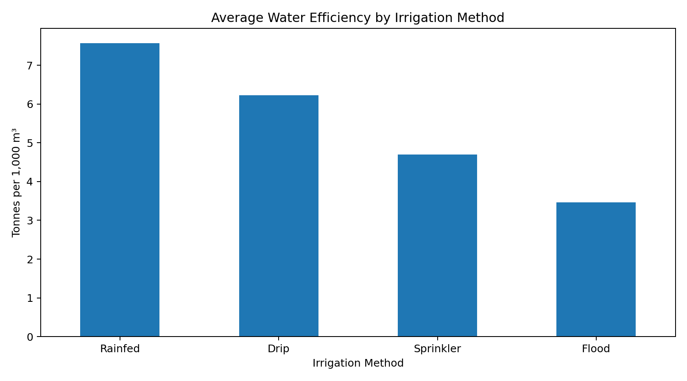
Results
Question 2: What major seasonal patterns can be observed?
• Higher seasonal performance is concentrated in Kharif across the main outcome measures.
• Water efficiency is highest in Kharif (5.91) and lowest in Zaid (4.44).
• Disease/pest risk is highest in Kharif (54.47%) and lower in Rabi (40.52%) and Zaid (38.22%).
• This shows that stronger output can come with higher environmental risk, so yield should not be viewed alone.
8

Slide 9
Results
Question 3: Which characteristics change between seasons?
Average yield
Kharif 5.64 • Rabi 5.08 • Zaid 4.67 t/ha
Average profit
₹179k • ₹88k • -₹27k
Water efficiency
5.91 • 5.18 • 4.44
Pest risk
54.47% • 40.52% • 38.22%
9

Slide 10
Results
Questions 4–5: Which groups matter, and what relationships stand out?
• Sugarcane has the highest average yield (46.94 t/ha) and the highest average profit (₹817,245) among crops.
• Drip irrigation has higher average yield (6.62 t/ha) than flood, sprinkler and rainfed methods.
• Flood irrigation uses the most water on average (8,029 m³) and has the lowest water efficiency (3.46).
• Yield has a strong positive relationship with water-efficiency measure (correlation ≈ 0.915). Profit is moderately related to yield (≈ 0.490).
46.94 t/ha
Sugarcane avg. yield
₹817k
Sugarcane avg. profit
8,029 m³
Flood avg. water use
10

Slide 11
Future Scope
How the project can be extended
• Add district/state-level analysis to identify regional differences.
• Build an interactive dashboard for season, crop, irrigation and profitability filters.
• Use predictive models to estimate yield or profit from weather, soil and farm inputs.
• Add time-series data from multiple years to separate seasonal effects from yearly changes.
• Introduce optimization analysis for water and input usage.
11

Slide 12
GitHub / Project Files
Reproducible analysis deliverables
Project analysis script included with this submission:
https://github.com/sahasreosi/Seasonal-Agriculture-Performance-Analysis.git
• Input: seasonal_agriculture_performance_dataset.xlsx
• Outputs: season, crop and irrigation summary tables plus presentation charts.
• The script prints direct answers to the project questions without complex statistical modeling.
12

Slide 13

VOIS Course Completion
Course: Data Visualization
VOIS / AICTE
Data Visualization
13

Slide 14
THANK YOU
Seasonal Agriculture Performance Analysis
Sreosi Saha • Manipal University Jaipur
14

