Slide 1
MAVERICK
AGENTIC UI · OVERVIEW DECK
Agentic UI for Angular
AG-UI · Hashbrown · A2UI · MCP
One library. Three protocols. Microfrontend-native.
PREPARED FOR
Senior executives · Solution architects · Developers
Q2 2026 release · v1.1.0 · Confidential
Notes:
Cover. Restrained on purpose — strategy/consulting deck convention.
30-minute path: cover, 1, 2, 3, 6, 11, 13, 16, 17, 19, 21, 22, 23, 25, 26-28, 29.
60-minute path: include the AG-UI / Hashbrown deep dives and the registry tour.

Slide 2
AGENDA
What you'll leave with
• The shift. Why agentic UIs are the next interface paradigm — and the protocol problem nobody owns.
• Three protocols. AG-UI, Hashbrown, A2UI — origin, model, fit, gaps.
• One library. @maverick/agentic-ui — 15 registries, MFE-native, MCP-ready, telemetry-instrumented.
• Working examples. demo-monolith, demo-shell + remotes, demo-multi-agent, demo-ediscovery — all in this repo.
• Decision frameworks. Protocol matrix, when-to-use guide, persona-by-persona benefit map.
• Roadmap & CTA. Where it's going through v1.0 — and where you can plug in.
Agenda
Maverick — Agentic UI for Angular
02 / 62
Notes:
Agenda. Pace this for 30 or 60 minutes — sub-deck markers in speaker notes for each track.

Slide 3
1 · THE SHIFT
FOR SENIOR EXECUTIVES
From chatbots to agentic UIs
Yesterday — chatbots
Today — agentic UIs
Tomorrow — agent-native apps
— Text-only conversation
— Apps wired to LLMs as a fancy autocomplete
— Hand-coded handlers per use case
— No structured affordances — every flow re-debated
— Tool-call protocols (AG-UI / Hashbrown / A2UI)
— Generative UI: LLM emits widgets, host renders
— Multi-agent orchestration with sticky routing
— MCP server for analyst workstations
— UI itself is plug-in registry data
— Federated remotes contribute capabilities mid-session
— Audit-grade observability across LLM ↔ tool ↔ UI
— Persona-scoped governance baked in
1 · The shift
Maverick — Agentic UI for Angular
03 / 62
Notes:
The exec framing. Yesterday was wrappers around an LLM. Today's protocols (AG-UI/Hashbrown/A2UI) make the agent + UI a real surface.
Tomorrow: the UI itself becomes plugin data. We are building for the third column.

Slide 4
1 · THE SHIFT
FOR SENIOR EXECUTIVES
Why now
• LLM-native tool calling matured. OpenAI, Anthropic, Google, Mistral all ship structured tool calls. Quality and latency now meet enterprise bars.
• Three competing protocols emerged. AG-UI from CopilotKit, Hashbrown from Liquid Frontiers, A2UI from a multi-vendor consortium. Each is the leader in a slice.
• MCP standardised the server side. Anthropic's Model Context Protocol made tool definitions portable across analyst workstations (Claude Desktop, Cursor, Zed).
• Generative UI moved past PoC. LLMs reliably emit JSON specifying widget + props; Angular signals + dynamic component loader make rendering trivial.
• Regulated industries are catching up. Legal, healthcare, finance — all need defensible audit trails. The agentic UI substrate has to ship them by default.
1 · The shift
Maverick — Agentic UI for Angular
04 / 62
Notes:
Why this matters now: protocols + tool-calling + MCP + generative UI all matured in a 12-month window.
Buying or building? The protocols change every quarter. A library that abstracts them is the right unit of investment.

Slide 5
1 · THE SHIFT
FOR ARCHITECTS
Three protocols, one library
AG-UI
Hashbrown
A2UI
By CopilotKit
By Liquid Frontiers
By Multi-vendor consortium
· Streaming via SSE
· Lifecycle + tool-call events
· Generative UI via show-component
· Mature client implementation
· Best for: server-driven agent flows
· UI-generation streams
· Widget + props natively
· Multi-provider (OpenAI, Google)
· Lighter than AG-UI
· Best for: rapid generative-UI demos
· ui-action event class
· Agent drives the whole UI
· Action-driven (not just tool-driven)
· Spec still evolving
· Best for: agent-driven nav + state
@maverick/agentic-ui — one AgenticBackend abstraction; chat shell, registries, and widgets stay protocol-agnostic.
1 · The shift
Maverick — Agentic UI for Angular
05 / 62
Notes:
AG-UI: most mature, best for server-driven flows where the agent emits streamed text + tool calls + widgets.
Hashbrown: lighter weight, faster to prototype, multi-provider out of the box.
A2UI: distinguishing feature is the ui-action class — the agent can navigate, fill forms, mutate stores. Spec still moving.

Slide 6
2 · AG-UI
FOR ARCHITECTS
Background & origin
Open protocol for agent ↔ UI communication, originated by CopilotKit.
• Transport-agnostic. SSE in practice; WebSocket and plain HTTP also valid carriers.
• Message-based. Discrete event types — RUN_STARTED, TEXT_MESSAGE_*, TOOL_CALL_*, RUN_FINISHED — not a free-form stream.
• Tool-call first-class. Distinguishes server-side tools (run on the agent host) from client-side tools (run in the browser).
• Generative UI by convention. Reserved show-component tool whose result tells the host which registered widget to render.
• Reference implementation. @ag-ui/client — the runUntilSettled loop + HttpAgent SSE adapter — is the canonical client.
• Adoption. CopilotKit, AG-UI Studio, multiple Mastra-based agent backends, several Angular and React reference apps.
2 · AG-UI
Maverick — Agentic UI for Angular
06 / 62
Notes:
AG-UI is the one most enterprise teams pick today. The reason: it cleanly maps lifecycle, text, and tool calls to discrete events — easy to log, easy to audit.
Origin: CopilotKit. Anglo/architects.io article is the canonical primer.

Slide 7
2 · AG-UI
FOR DEVELOPERS
Event timeline — one chat turn
Time flows left → right. Pills are the events on the wire; vertical position groups them by class.
LIFECYCLE
RUN_STARTED
RUN_FINISHED
TEXT
MESSAGE_START
Δ
Δ
Δ
Δ
MESSAGE_END
TOOL CALL
CALL_START
ARGS
CALL_END
RESULT
GENERATIVE UI
WIDGET_RENDER
POST-TOOL TEXT
MESSAGE
0 ms
1.2 s
3.4 s
5.1 s
Adapter @maverick/agentic-ui/ag-ui maps each event 1:1 onto the AgenticEvent union.
2 · AG-UI
Maverick — Agentic UI for Angular
07 / 62
Notes:
Real-shape timeline — every event a stable record. This is what makes AG-UI audit-friendly.
Note widget_render is synthesised from show-component tool-call result; it doesn't exist on the wire.

Slide 8
2 · AG-UI
Capabilities & where it fits
Strengths
Trade-offs / gaps
• Cleanest event model of the three
• Server-side tool execution baked in
• SSE — proxies and CDNs handle it natively
• Mature CopilotKit + Mastra ecosystem
• Trace-friendly: each event is a structured record
• Best fit for compliance / audit / regulated domains
• Heavier than Hashbrown — more events to handle
• ui-action / agent-driven nav not in core spec
• Generative UI is via convention, not a first-class event
• No standard form schema — apps roll their own
• Per-protocol adapter still required (we provide one)
2 · AG-UI
Maverick — Agentic UI for Angular
08 / 62
Notes:
When to pick AG-UI: regulated industries, audit-grade trails, server-side tool catalogs.
When NOT: lightweight prototypes, mostly-client-rendered UIs with little server orchestration — Hashbrown is faster to spin up.

Slide 9
3 · HASHBROWN
FOR ARCHITECTS
Background & origin
Open framework from Liquid Frontiers focused on generative UI and tool-calling.
• UI-generation native. Hashbrown's streams emit component + props directly — no show-component shim required.
• Multi-provider out of the box. OpenAI, Google, and Anthropic — swap providers via a config flag.
• Smaller surface than AG-UI. Fewer event types; lifecycle is implicit in stream open/close.
• React-first heritage. Original target was React; Angular adapter is recent. Our wrapper makes it idiomatic for either.
• Schema-driven UI generation. Zod-based component schemas anchor the LLM's structured output.
• Best fit. Rapid prototypes, demo-heavy generative UI, multi-LLM A/B comparisons.
3 · Hashbrown
Maverick — Agentic UI for Angular
09 / 62
Notes:
Hashbrown's pitch: thinner protocol, faster start, multi-provider built in.
Trade-off: the lifecycle isn't as crisp, so audit-grade logging needs extra work.

Slide 10
3 · HASHBROWN
FOR DEVELOPERS
Features at a glance
ui-stream
Emits widget + props natively — no shim
text-stream
Token-level text deltas
tool-stream
Function-call args + results
provider-mux
Switch OpenAI ↔ Google ↔ Anthropic at runtime
schema-anchor
Zod schemas anchor structured LLM output
react-bridge
First-class React; Angular via wrapper
3 · Hashbrown
Maverick — Agentic UI for Angular
10 / 62
Notes:
Highlight provider-mux — for an org doing LLM evaluation, Hashbrown lets you swap providers without rewiring the chat shell.
Highlight schema-anchor — Zod schemas are the contract; same library + skill in our schematics.

Slide 11
3 · HASHBROWN
Hashbrown vs AG-UI — when to pick what
Dimension
Hashbrown
AG-UI
Pick
Lifecycle clarity
Implicit (stream open/close)
Explicit (RUN_STARTED/FINISHED)
AG-UI
Generative UI
Native (UI-stream)
Convention (show-component)
Hashbrown
Audit-grade logging
Needs work — synth lifecycle
Drop-in — events are records
AG-UI
Time-to-first-prompt
Hours
Day or two
Hashbrown
Multi-provider
Built in
Adapter per provider
Hashbrown
Server-side tools
Adapter needed
First-class
AG-UI
Spec stability
Smaller surface · stable
Larger surface · stable
Tie
3 · Hashbrown
Maverick — Agentic UI for Angular
11 / 62
Notes:
Decision matrix to share with architects. Not a verdict — a guide.
Most enterprises pick AG-UI for production; Hashbrown for prototyping.

Slide 12
02–03 · PROTOCOLS
FOR ARCHITECTS
AG-UI vs Hashbrown — when and where
THIS DEMO USES
AG-UI for the eDiscovery reference — picked for streaming SSE, explicit lifecycle events, and audit-grade event records.
AG-UI
HASHBROWN
by CopilotKit · streaming · lifecycle-typed
by Liquid Frontiers · ui-stream native · multi-provider
PICK WHEN…
PICK WHEN…
• Audit and compliance bars (legal-tech, healthcare, finance)
• Server-side tool catalog managed by a separate team
• Mature multi-agent orchestrator (sticky routing)
• SSE traverses your existing CDN / proxy stack
• Need to trace runs end-to-end through OTel
• Rapid prototyping — generative UI in a day
• Multi-provider eval (OpenAI / Anthropic / Google switch)
• UI-generation is the dominant agent output (not tool calls)
• Lighter event surface — fewer adapter checks
• Audit grade can be deferred to a later sprint
Both implement the same `AgenticBackend` interface — swapping protocols leaves the chat shell, registries, and widgets untouched.
3 · Protocols
Maverick — Agentic UI for Angular
12 / 62
Notes:
Direct answer to the most common architecture question.
We picked AG-UI for the eDiscovery demo — audit grade matters here. A retail chatbot demo would pick Hashbrown.
The library lets a team start with one and migrate later — no chat-shell rewrite.

Slide 13
4 · A2UI
FOR ARCHITECTS
Agent-driven UI — ui-action as a class
A2UI lifts the agent from 'calls tools' to 'drives the whole UI'.
Distinguishing event class
{ type: 'ui-action',
actionId: 'a-7f2e',
op: 'navigate', // or 'applyTag', 'fillForm', 'openDrawer', …
payload: { path: '/documents', queryParams: { id: 'DOC-1234' } } }
Where it shines
• Agent navigates to a route after a tool call settles
• Form-fill flows where the agent populates fields the user verifies
• State mutations dispatched into NgRx / Redux without a separate tool
• Cross-MFE coordination — one remote raises an action a different remote handles
4 · A2UI
Maverick — Agentic UI for Angular
13 / 62
Notes:
A2UI is younger; specification still evolving. We reserve ui-action in our event union from M1 so the chat shell never breaks when the spec moves.
Same pattern — clickable widgets in our eDiscovery demo dispatch openCustodian/openDocument/openHold actions through ActionRegistry.

Slide 14
5 · THE LIBRARY
FOR SENIOR EXECUTIVES
Why a library
Three protocols, four bundlers, two MFE runtimes, and an MCP transport — that's not a library, that's a forklift.
What you'd build without it
What @maverick/agentic-ui ships
✗ Per-protocol chat shell, three times
✗ Hand-rolled tool registry, ad hoc per app
✗ Bespoke MFE federation glue for each remote
✗ MCP server scaffolding from scratch
✗ Telemetry stitched in late, never quite consistent
✗ Schematics: none — every team retypes the bootstrap
✓ One AgenticBackend interface — three adapters
✓ 15 typed registries, one base class, signal-backed
✓ Per-persona scope policy on every registry (1.1)
✓ Native + Module Federation, both first-class
✓ @maverick/agentic-ui-mcp wraps tools as MCP
✓ OTel-instrumented from M1; default no-op
✓ ng add scaffolds an entire app in one command
5 · The library
Maverick — Agentic UI for Angular
14 / 62
Notes:
Frame for execs: building from scratch is a 6+ month investment. The library is a 2-week pilot.
Production-grade, Apache-2.0 licensed, enterprise-friendly. No vendor lock-in to a paid SaaS.

Slide 15
5 · THE LIBRARY
FOR ARCHITECTS
Problem statement — six axes that compound
Each row pairs an architectural pain point with what teams ship without an abstraction (red) vs what this library does (green).
PAIN POINT
WITHOUT AN ABSTRACTION
WITH THIS LIBRARY
1 · Protocol churn
✗ Hand-rolled SSE/NDJSON parser per app · chat-shell rewrites every quarter
✓ One AgenticBackend interface · three shipped adapters · swap by config
AG-UI · Hashbrown · A2UI all evolve quarterly
2 · Fan-out
✗ Each capability bespoke · own conventions · own teardown semantics
✓ One Registry<TDef> base class · 15 typed registries · same shape, same primitives
Tools, components, validation, persistence, telemetry, audit, federation
3 · Generative UI dispatch
✗ Growing switch · hard imports · no schema validation on props
✓ ComponentRegistry.get(name) · Zod-validated props · *ngComponentOutlet mount
LLM emits a string · resolve to typed component is fiddly
4 · Microfrontend composition
✗ Static imports · central registration list · every MFE is a host-team PR
✓ defineCapabilityModule + Federation · runtime register · removeBySource on unload
Multiple teams · one chat · no host recompile per remote
5 · Governance + persona scope
✗ Bolt-on chat-shell filter · remotes don't honour it · per-app audit
✓ RegistryBase.setScopePolicy(predicate) · uniform across all 15 registries
Regulated domains · per-role tool surfaces
6 · Observability across SSE
✗ Per-app logs · no client/server correlation · debug = staring at network tab
✓ AgenticTelemetrySink · /otel exporter · W3C traceparent across the SSE handshake
One trace covering chat → server → LLM → tool → registry
5 · The library
Maverick — Agentic UI for Angular
15 / 62
Notes:
Architect view of why this library exists. Each row stands on its own — pick the three that hit your team hardest and lead with those.
The over-arching trade: a few extra abstractions up front (yes, 15 registries) for the elimination of bespoke code for the next 5 years of agent-protocol churn.
Pair this slide with the layered architecture image (slide_visual_architecture) — pain shapes on this slide get architectural answers on the next.

Slide 16
5 · THE LIBRARY
FOR ARCHITECTS
Architecture at a glance
BROWSER HOST
Federation runtime
<mvk-chat-shell>
Sidebar nav
Routed pages
Native Federation · esbuild-native · @angular-architects Module Federation · webpack peer
REGISTRY LAYER · 15 typed registries · signal-backed
Tool
Component
Capability
Backend
Action
Form
Agent server
Intent
DataSource
Validation
Persistence
Layout
Schema
Mastra · Gemini · OpenAI AG-UI SSE route ThreadStateStore
AgUiBackend
HashbrownBackend
A2uiBackend
MCP server
Same ToolDef Claude Desktop / Cursor Text/html;profile=mcp-app
All pushed events also flow into AgenticTelemetrySink / AgenticLogger.
One library · three protocols · two federation paths · MCP for analyst desktops
5 · The library
Maverick — Agentic UI for Angular
16 / 62
Notes:
Topology view. The host browser is the centre — registries are the only shared state.
Federation runtime feeds remotes' capabilities INTO the registry layer; backend adapters ship runs OUT to the agent server / MCP.
Telemetry crosscuts every layer; the OTel exporter ships in /otel and is opt-in.

Slide 17
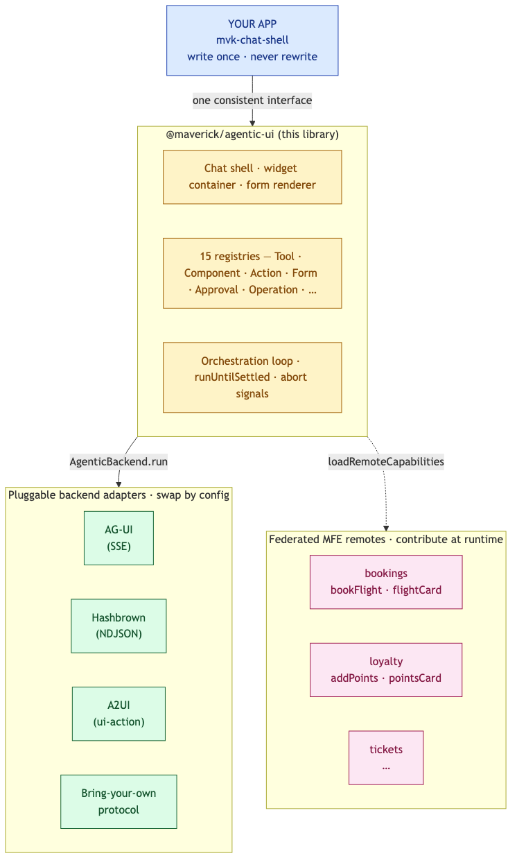
5 · THE LIBRARY
FOR ARCHITECTS
Architecture at a glance — the picture
Four bands. Your app at the top, never rewritten. The library in the middle (chat shell + 15 registries + orchestration). Pluggable adapters below — swap by config, not by chat-shell rewrite. Federated remotes at the bottom, contributing tools and widgets at runtime.
5 · The library
Maverick — Agentic UI for Angular
17 / 62
Notes:
This is the same diagram as the README's architecture image.
Anchor on the dashed `loadRemoteCapabilities` edge — that's the federation entry point that turns 'one team's chat shell' into 'every team's chat shell'.

Slide 18
05 · ARCHITECTURE
FOR ARCHITECTS
End-to-end picture — one prompt, all layers
User types a prompt → arrows show every hop until widgets land back in the chat.
BROWSER · ANGULAR HOST
AGENT SERVER · NODE
LLM PROVIDER · GEMINI
User prompt
/agents/coordinator/run
gemini-2.5-flash
<mvk-chat-shell>
OrchestratorAgent (router)
injectAgenticChat()
Tool-call schema
Specialist (review/production/…)
keywordToolFilter (top-12)
Streamed completion
GeminiAgent · system prompt
AgUiBackend
Generative-UI components
ThreadStateStore (sticky)
ToolRegistry · ComponentRegistry
LEGEND
Request path
Response · widgets · text deltas
Registry read · DI cross-cut
5 · The library
Maverick — Agentic UI for Angular
18 / 62
Notes:
Single-slide architecture summary. Trace one prompt: User → ChatShell → ToolFilter (reads ToolRegistry) → AgUiBackend → server route → Orchestrator → Specialist → Gemini → events stream back.
Use this slide as the framing for the rest of the architecture deck.

Slide 19
5 · THE LIBRARY
FOR ARCHITECTS
15 registries — hub & spokes
All 15 implement one Registry<TDef> — same MFE-aware teardown, same signal contract, same conformance test surface, plus setScopePolicy(...) for per-persona filtered reads (1.1).
Capability
Component
Backend
Tool
Mfe
Registry<TDef>
Schema
Action
Layout
Intent
Persistence
Form
Validation
DataSource
Operation
Approval
Core (M1–M3)
Extended (M4–M5)
Seams
5 · The library
Maverick — Agentic UI for Angular
19 / 62
Notes:
Hub-and-spoke shows the architectural unity — the base class is the hub, every registry is a spoke with the same shape.
Tier 1 is required for any agentic UI; tiers 2 and 3 are opt-in.

Slide 20
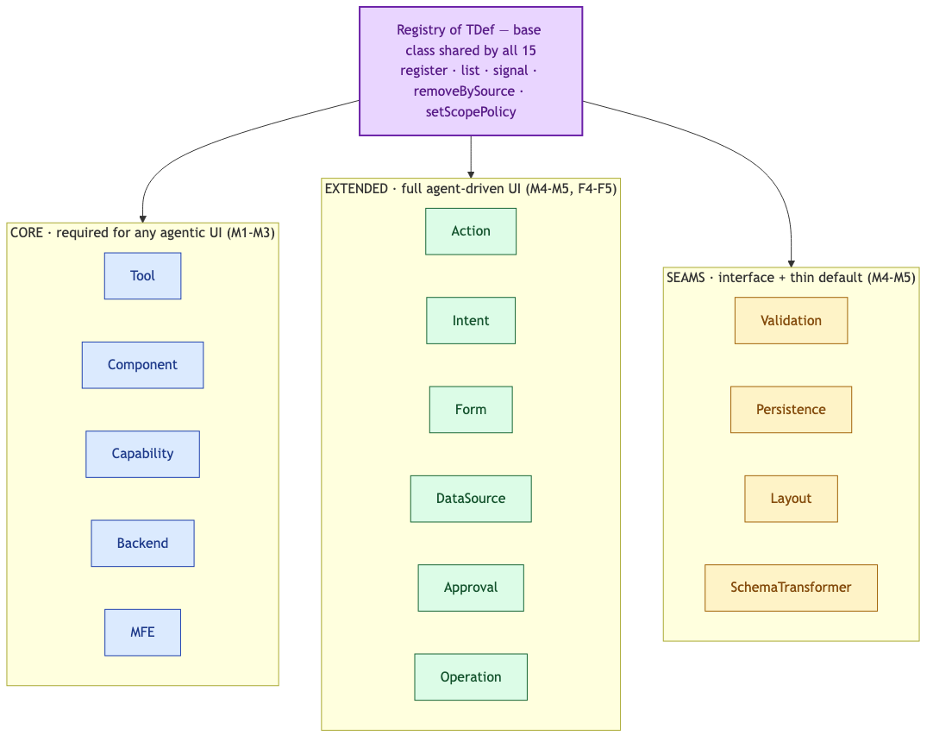
5 · THE LIBRARY
FOR ARCHITECTS
15 registries · one base · three tiers
Every registry inherits Registry<TDef> — same register / list / signal / removeBySource / setScopePolicy semantics. Core (5) are required for any agentic UI. Extended (4) lift it to full agent-driven. Seams (4) are interfaces with a thin default; you plug in your own.
5 · The library
Maverick — Agentic UI for Angular
20 / 62
Notes:
Lead with the base class — all 15 registries are the same primitive with different value shapes.
Adding a domain-specific registry (e.g. MetricRegistry, AlertRegistry) is ~30 LOC of base-class extension and gets MFE teardown + persona scope policy + conformance suite for free.

Slide 21
5 · THE LIBRARY
FOR ARCHITECTS
Capability handoff — sequence diagram
Host shell
MfeRegistry
Federation
Remote
Registries
discover(env)
RemoteSpec[]
loadRemoteCapabilities({remote, loader})
import './Capability'
module.apply(injector)
registerAll(tools, components)
next chat turn → ToolRegistry.signal()
user prompt fires; agent sees new tools
Each remote is another row in this sequence — registries are the single seam every remote writes through.
5 · The library
Maverick — Agentic UI for Angular
21 / 62
Notes:
Sequence diagram for federation handoff. Five actors, eight messages.
Note the last message — ToolRegistry's signal notifies the chat shell on the next turn, mid-session, with no reload.

Slide 22
5 · THE LIBRARY
FOR ARCHITECTS
One handler, three surfaces
The same ToolDef literal powers the chat shell, the MCP server (Claude Desktop / Cursor), and the standalone-mode UI inside each remote — without any code duplication.
<mvk-chat-shell>
MCP server
Standalone UI
Browser · Angular host user ↔ LLM in-app
Claude Desktop · Cursor · Zed analyst workstations
Visit :4302 / :4303 directly technical sanity check
ToolDef
agenticTool({ name, schema, handler })
single source of truth · framework-agnostic
Tool result · widgets · markdown
MCP UI blocks (text/html)
Same handler, same audit entry
5 · The library
Maverick — Agentic UI for Angular
22 / 62
Notes:
This slide is the architectural payoff. Three surfaces from one handler — that's why ToolDef is framework-agnostic data.
Demo the eDiscovery review tool: same code path, three viewers see the same custodian card.

Slide 23
5 · THE LIBRARY
FOR DEVELOPERS
AgenticBackend — the abstraction
export interface AgenticBackend {
readonly id: string;
readonly capabilities: {
streaming: boolean;
clientTools: boolean;
generativeUi: boolean;
uiActions: boolean; // A2UI
};
run(input: AgenticRunInput): AsyncIterable<AgenticEvent>;
reset?(threadId: string): Promise<void>;
}
// 12 events: run-started, text-delta, tool-call-*, widget-render, ui-action, …
export type AgenticEvent =
| { type: 'run-started'; threadId: string; runId: string }
| { type: 'text-delta'; messageId: string; delta: string }
| { type: 'tool-call-result'; toolCallId: string; result: unknown }
| { type: 'widget-render'; widgetCallId: string; name: string; props: unknown }
| { type: 'ui-action'; actionId: string; op: string; payload: unknown }
| … ;
The chat shell sees ONLY this surface. AgUiBackend, HashbrownBackend, A2uiBackend implement it — capability flags drive feature-detection in the UI.
5 · The library
Maverick — Agentic UI for Angular
23 / 62
Notes:
Show this slide to engineers. The chat shell is protocol-agnostic; only the backend adapter knows the wire format.
Adding a new protocol is implementing this one interface.

Slide 24
5 · THE LIBRARY
FOR ARCHITECTS
Microfrontend federation — capability handoff
• Discover. MfeRegistryClient.discover(env) — Spring Boot or static-JSON adapter.
• Lazy-load. loadRemoteModule({ remoteName, exposedModule: './Capability' }).
• Register. Remote's defineCapabilityModule pushes into ToolRegistry / ComponentRegistry / ActionRegistry.
• Teardown. removeBySource('remote:bookings') runs across every registry in one pass; signals notify subscribers.
Native Federation (default)
Module Federation (peer)
— Backed by @angular-architects/native-federation
— esbuild-compatible — Angular CLI default
— Smaller bundle, faster cold start
— Backed by @module-federation/runtime
— webpack — for teams already on it
— Same CapabilityModule format · same capabilities.json
5 · The library
Maverick — Agentic UI for Angular
24 / 62
Notes:
Both federation paths are first-class — neither is a side branch.
Switch via `ng add @maverick/agentic-ui --federation=native` vs `--federation=module-federation`.

Slide 25
5 · THE LIBRARY
MCP integration — analyst workstation reach
@maverick/agentic-ui-mcp — the same ToolDefs power Claude Desktop, Cursor, Zed.
One handler, multiple surfaces
• agenticTool({ ... }) — same factory the chat shell uses
• mcpToolBridge(tools) — exposes them as an MCP server with a Node binary
• MCP UI: tool results carry html field → text/html;profile=mcp-app blocks
• Per-user MCP server pattern — beforeCall stub auth → real OIDC swap-in
• Cookbook: paralegal privilege review in Claude Desktop using the eDiscovery toolset
Result: agents that work in your web app AND in your analysts' IDE — same audit trail, same governance.
5 · The library
Maverick — Agentic UI for Angular
25 / 62
Notes:
Big win for regulated industries — MCP brings agentic UI into Claude Desktop where many analysts already live.
Demonstrate by walking through demo-mcp-server then opening Claude Desktop.

Slide 26
5 · THE LIBRARY
FOR ARCHITECTS
Observability — OTel from M1
Distributed tracing for chat shell → backend → SSE route → agent → LLM → tool execution.
Span
Kind
Key attributes
agentic.run
INTERNAL
thread_id, run_id, backend.id
agentic.backend.stream
CLIENT
http.url, http.status_code, traceparent
agentic.tool_call
INTERNAL
tool.name, tool.source, success
agentic.federation.load
INTERNAL
remote_name, version, federation, load_ms
agentic.registry.register
INTERNAL
registry.name, source
W3C traceparent propagated across the SSE boundary — one trace covers UI to LLM.
5 · The library
Maverick — Agentic UI for Angular
26 / 62
Notes:
Default sink is no-op; consumer opts in to OTel via @maverick/agentic-ui/otel.
Bundle impact: zero unless they import the otel entry — measured in CI.

Slide 27
5 · THE LIBRARY
FOR DEVELOPERS
Schematics — ng add → fully wired app
@maverick/agentic-ui-schematics — six generators ship with the package.
$ ng add @maverick/agentic-ui \
--backend=ag-ui \
--mfe=host --federation=native \
--registry=spring-boot \
--server=mastra \
--telemetry=otel
Patches app.config.ts · seeds tools/widgets · scaffolds federation ·
wires Mastra agent server · adds OTel collector config
Per-artefact generators
• ng g …:tool *.tool.ts with Zod schema scaffold; auto-registers
• ng g …:widget Standalone component + Zod props schema
• ng g …:backend Custom AgenticBackend with FakeAgenticBackend test
• ng g …:mfe-capability Federation expose + capabilities.json manifest
• ng g …:agent-server Mastra agent + AG-UI SSE route + memory store
• ng g …:chat-shell Routed component using <mvk-chat-shell>
5 · The library
Maverick — Agentic UI for Angular
27 / 62
Notes:
Show this slide to developers — the schematics are the value-multiplier.
ng add takes a fresh Angular app to running chat in <2 minutes.

Slide 28
5b · USE CASES
FOR SENIOR EXECUTIVES + ARCHITECTS
Ten use cases · one library
Each row maps a real user-facing scenario to the library seam that handles it. Pick a row, jump to the slide; the User Guide has the full code walkthrough.
USE CASE
LIBRARY SEAM
AUDIENCE
SECTION
1. Generative UI — agent picks the component
ComponentRegistry · widget-container
Dev
§ 5b
2. Tool calling with state mutation
ToolRegistry · tool-call-* events
Dev
§ 5b
3. Federating MFE remotes
defineCapabilityModule · loadRemoteCapabilities
Arch
§ 5b
4. Per-persona entitlement
RegistryBase.setScopePolicy
Exec
§ 5b
5. Backend swap (AG-UI ↔ Hashbrown ↔ A2UI)
AgenticBackend interface
Arch
§ 5b
6. Multi-agent orchestration · sticky routing
OrchestratorAgent · ThreadStateStore
Arch
§ 5b
7. Per-turn tool budget at scale
provideToolFilter · keywordToolFilter
Dev
§ 5b
8. MCP — same tools power analyst desktops
@maverick/agentic-ui-mcp
Exec
§ 5b
9. Observability — distributed tracing
AgenticTelemetrySink · /otel
Arch
§ 5b
10. Audit trail · chain-of-custody
Pattern: prevHash / chainHash + telemetry
Exec
§ 5b
5b · Use cases
Maverick — Agentic UI for Angular
PRIMARY AUDIENCE
Dev
Arch
Exec
28 / 62
Notes:
Strategic view. Use this slide to set up the rest of the deck — every row has a 'home' slide deeper in.
Highlight that 4 (persona scope) and 10 (audit) are differentiators — that's what makes this deployable in regulated domains.
If pressed for time, pick three rows the audience cares about and skip directly to those slides.

Slide 29
5b · USE CASES
FOR ARCHITECTS + DEVELOPERS
Use case 1 · Generative UI — agent picks the component
"Show me the flight options" → no prose. The agent emits widget-render and a typed Angular component mounts with validated props.
EVENT FLOW
WIRING
LLM
decides which component
import { agenticWidget } from '@maverick/agentic-ui';
import { z } from 'zod';
export const flightCard = agenticWidget({
name: 'flight-card',
component: FlightCardComponent,
propsSchema: z.object({
flightId: z.string(),
from: z.string().length(3),
to: z.string().length(3),
price: z.number().positive(),
}),
});
Backend adapter
translates to widget-render
ComponentRegistry
resolves name · validates props
WHY IT MATTERS
widget-container
*ngComponentOutlet mounts it
✓ Agent owns content; UI owns presentation
✓ Zod schemas double as the LLM's tool contract
✓ Same component works under any backend (use case 5)
If props don't match the Zod schema, the container shows a placeholder — never crashes the chat.
5b · Use cases
Maverick — Agentic UI for Angular
29 / 62
Notes:
This is the headline. 'Generative UI' is a buzzword; the diagram makes it concrete.
Emphasise the Zod schema is the single contract — the agent sees it as a tool schema, the renderer uses it for validation, the cookbook generates types from it.
Compare to text-only LLM apps: this is what makes agentic UI different from a fancy chat box.

Slide 30
5b · USE CASES
FOR ARCHITECTS + DEVELOPERS
Use case 2 · Tool calling with state mutation
Agent runs bookFlight against your backend, threads the result back into the next turn, and the user can hit Esc to abort mid-execution.
ONE TOOL CALL · LIFECYCLE
HANDLER
tool-call-start
name + toolCallId reach the host
agenticTool({
name: 'bookFlight',
description: 'Book a flight, return id.',
schema: z.object({ flightId: z.string() }),
handler: async ({ flightId }, ctx) => {
ctx.signal.throwIfAborted();
const r = await fetch('/api/bookings', {
method: 'POST',
body: JSON.stringify({ flightId }),
signal: ctx.signal, // forwards abort
});
return await r.json();
},
});
tool-call-args
streamed JSON · Zod-validated incrementally
tool-call-end
args complete · handler invoked
handler(args, ctx)
ctx.signal threads abort to fetch()
FOR FEDERATED TOOLS
tool-call-result
payload becomes the next-turn input
• executeIn: 'remote' — handler runs in the remote's injector
• ToolRegistry tags entries with source: 'remote:<name>'
User hits Esc → AbortController fires → handler's fetch cancels → tool-call-result emits an error event.
5b · Use cases
Maverick — Agentic UI for Angular
30 / 62
Notes:
Walk through the four lifecycle events end-to-end — show that mid-stream abort is built in.
Emphasise that the handler is just a function; tools aren't proprietary objects.
If audience is paranoid about agents triggering destructive operations: combine with use case 4 (persona scope) for input gating + server-side check for the trust boundary.

Slide 31
5b · USE CASES
FOR ARCHITECTS + DEVELOPERS
Use case 3 · Federating MFE remotes
Bookings team owns its tools, widgets, and routes; ships independently. Host loads the remote at runtime and the agent's tool list updates within the same turn.
CAPABILITY HANDOFF
REMOTE
MfeRegistry
discover(env) → RemoteSpec[]
// remote/src/app/capability.ts
export default defineCapabilityModule({
tools: [bookFlight, cancelFlight],
widgets: [flightCard],
});
loadRemoteCapabilities
import './Capability'
CapabilityModule
registerAll(tools, widgets) · source
HOST
provideAgenticUi({
mfe: {
federation: 'native',
remotes: [{ remoteName: 'bookings',
remoteEntry: '/remoteEntry.json' }],
},
});
Registries
signal() emits → next chat turn
On unload
removeBySource('remote:<n>') everywhere
Both Native Federation (esbuild) and webpack Module Federation are first-class — same CapabilityModule shape.
Or: provideSpringBootMfeRegistry({ url }) for runtime discovery.
5b · Use cases
Maverick — Agentic UI for Angular
31 / 62
Notes:
This is the MFE story — five steps, no surprises.
Emphasise that registries are the only shared state; remotes never call each other directly.
On unload, all 15 registries drop entries with that source in one pass — in-flight runs continue but next turn excludes them.

Slide 32
5b · USE CASES
FOR SENIOR EXECUTIVES + ARCHITECTS
Use case 4 · Per-persona entitlement
Vendor Reviewer must only see read + tag tools — never markPrivileged, never createProductionSet. The agent shouldn't even consider tools the active user can't invoke. Library handles input + output gating; server still verifies.
THREE LAYERS OF RESPONSIBILITY
WIRING (1.1.0)
LIBRARY
function installPersonaScopePolicy() {
return provideAppInitializer(() => {
const persona = inject(PersonaService);
const tools = inject(ToolRegistry);
tools.setScopePolicy((entry) =>
persona.canInvoke(
persona.active(),
entry.name));
});
}
Filters list() / get() / signal() reads through your scope policy. Tools the persona can't invoke never reach the LLM.
APPLICATION
Your PersonaService decides which entries each role is allowed to read. The library calls your predicate with each RegistryEntry.
AGENT SERVER
WHAT YOU GET
Re-verifies entitlement from the trusted session. Client-claimed personas are an UX hint, not a security boundary.
✓ Sidebar tool-count drops live on persona switch
✓ Same predicate works on every registry
✓ Composes with use case 7 (keyword filter)
getRaw / listRaw bypass the policy on purpose — for governance UIs that show the unfiltered set.
5b · Use cases
Maverick — Agentic UI for Angular
32 / 62
Notes:
Phase 8 / 1.1.0 ship. Address the question that comes up in every regulated-industry pitch.
Three-layer split is the architectural take-away: library enforces, app authorises, server verifies.
Cross-reference: e2e/specs/05-persona-scope.spec.ts validates ordering live without an LLM.

Slide 33
5b · USE CASES
FOR ARCHITECTS
Use case 5 · Backend swap (AG-UI ↔ Hashbrown ↔ A2UI)
v1 ships against AG-UI for SSE-streaming. v2 you want Hashbrown for client-side LLM. The chat shell never sees the protocol — only the AgenticBackend interface.
ONE INTERFACE · THREE ADAPTERS
BOOT-TIME PICK
AgUiBackend
HashbrownBackend
A2uiBackend
provideAgenticUi({
backend: provideAgUiBackend({
url: '/api/ag-ui',
}),
});
AgenticBackend.run(input) → AsyncIterable<AgenticEvent>
RUNTIME SWITCH (DEBUG)
const backends = inject(BackendRegistry);
backends.register({
id: 'ag-ui', factory: () => agUi,
label: 'AG-UI · SSE',
});
backends.register({ id: 'hashbrown', ...});
<mvk-chat-shell> · unchanged code, swap providers
Each adapter announces capability flags (clientTools / generativeUi / uiActions) — the shell feature-detects.
Conformance suite in /testing runs the same tests against every adapter — drift fails CI.
5b · Use cases
Maverick — Agentic UI for Angular
33 / 62
Notes:
Vendor agnosticism story. Useful for execs uncomfortable with picking a not-yet-1.0 protocol.
Capability flags are the seam that makes feature-detection clean — no if/else by adapter id in the shell.
Tie back to ADR-0001 — backend abstraction was the first decision and carries every other one.

Slide 34
5b · USE CASES
FOR ARCHITECTS + DEVELOPERS
Use case 6 · Multi-agent orchestration · sticky routing
One chat panel for the whole matter. Custodian question → collection specialist; privilege flag → review; Bates assignment → production. Routing stays sticky so users can say 'what about that one?' without naming a specialist.
ROUTING LOOP
SERVER-SIDE WIRING
User turn
free text into the chat shell
new OrchestratorAgent('coordinator', {
apiKey, model: 'gemini-2.0-flash',
subAgents: [
{ id: 'collection',
description: 'custodians, holds',
examples: ['Add Sarah as a custodian'],
factory: (id) => new GeminiAgent(id, ...) },
{ id: 'review', ... },
{ id: 'production', ... },
{ id: 'search', ... },
],
});
Orchestrator
classifies via LLM · descriptions + examples
ThreadStateStore
stamps last specialist · per-thread
Specialist runs
GeminiAgent with its own tool subset
Sticky next turn
follow-ups replay specialist unless switched
ThreadStateStore: in-memory default · Redis adapter in cookbook for horizontal scaling.
From the host's view it's still ONE AgenticBackend — the shell never knows there are 4 agents under it.
5b · Use cases
Maverick — Agentic UI for Angular
34 / 62
Notes:
This is what makes a scale-out story credible — multiple teams own specialists, one chat interface.
Sticky routing is the UX win. Without it, every follow-up question would risk being routed to a different specialist mid-thread.
The 'Routed to **review** specialist.' banner in the demo is just the orchestrator emitting a text-delta when routing changes — not state.

Slide 35
5b · USE CASES
FOR ARCHITECTS
Use case 7 · Per-turn tool budget at scale
50+ tools across federated remotes blow your context budget. Solution: extract keywords from the prompt, score each tool, send the top-K to the LLM. Composes with persona scope.
WITHOUT FILTERING
WITH KEYWORD FILTER
✗ All 50 tools sent each turn. 12k tokens of schema + descriptions before the user prompt.
✗ Latency. Gemini 2-3s slower per turn at the upper end.
✗ Cost. Roughly 4x token spend on tool definitions alone.
✗ Hallucination risk. More plausible-sounding wrong tools to choose from.
✓ Top-12 tools per turn. Keyword match against the latest user message.
✓ Floor of 5 'core' tools always present. Search, list, status — never filtered out.
✓ ~70% smaller prompt. Measured in eDiscovery's 18-tool inventory.
✓ Composes with persona scope. Filter runs after setScopePolicy — both layers stack.
provideAgenticUi({ providers: [
provideToolFilter(keywordToolFilter({ maxTools: 12, floor: 5 })),
installPersonaScopePolicy(), // runs first; the keyword filter narrows the scoped set
] });
5b · Use cases
Maverick — Agentic UI for Angular
35 / 62
Notes:
Architect framing. The tool inventory grows linearly with federated remotes; without this, you'd hit Gemini's context cap by remote #4.
Order matters: persona scope filters first (governance), keyword filter narrows further (efficiency).
Bring up tunability: keywordToolFilter is just an example; ToolFilter is a one-line interface, swap it for embedding-similarity if you have an embeddings service.

Slide 36
5b · USE CASES
FOR SENIOR EXECUTIVES + ARCHITECTS
Use case 8 · MCP — same tools power analyst desktops
Your tool definitions are valuable IP. Make them callable from your chat shell, Claude Desktop, Cursor, and Zed via the Model Context Protocol — one source of truth, three surfaces.
ONE TOOLDEF · THREE SURFACES
MCP SERVER WIRING
<mvk-chat-shell>
Claude Desktop
import { createMcpServer }
from '@maverick/agentic-ui-mcp';
const mcp = createMcpServer({
name: 'ediscovery-paralegal',
tools: [searchDocuments,
markPrivileged, tagDocument],
});
app.route('/mcp', mcp);
ToolDef[]
Zod schema · handler
TRANSPORTS
• stdio · for Claude Desktop's spawn-and-pipe
• SSE · streaming over HTTP
• text/html;profile=mcp-app · in-browser
Cursor / Zed (MCP)
Persona scope from use case 4 still applies — MCP also reads through ToolRegistry.
5b · Use cases
Maverick — Agentic UI for Angular
36 / 62
Notes:
Multi-surface story. Resonates with execs who see their tools as IP.
Reach: paralegal can drive the same review flow from Claude Desktop without using your web app.
Persona scope still gates — that's the 'hub' story for compliance.

Slide 37
5b · USE CASES
FOR ARCHITECTS + DEVELOPERS
Use case 9 · Observability — distributed tracing per chat turn
One user prompt fans out into LLM calls, tool calls, widget renders, persistence writes. You want one trace covering all of them, with traceparent propagating across the SSE boundary.
ONE TRACE · END-TO-END
WIRING
agentic.run
INTERNAL
thread_id, run_id, backend.id
import { provideAgenticTelemetry }
from '@maverick/agentic-ui/otel';
telemetry: provideAgenticTelemetry({
serviceName: 'demo-shell',
exporter: 'otlp-http',
endpoint: 'http://collector:4318/...',
sampler: { kind: 'ratio', ratio: 0.1 },
redaction: {
argsAllowList: ['flightId','docId'],
},
});
agentic.backend.stream
CLIENT
http.url, status, traceparent
[ SSE boundary — traceparent ]
agentic.tool_call
INTERNAL
tool.name, tool.source, success
agentic.federation.load
INTERNAL
remote_name, version, load_ms
agentic.persistence.write
INTERNAL
adapter, bytes
Default sink is no-op — apps that don't import /otel pay zero bytes.
Default: tool args / message bodies are NEVER captured — only sizes + stable hashes. Opt-in field-by-field.
5b · Use cases
Maverick — Agentic UI for Angular
37 / 62
Notes:
Observability seam was baked in from M1 — emit points exist whether or not the OTel exporter is wired.
Privacy story is conservative by default — that's what makes this deployable in regulated domains.
Demo with Tempo or Jaeger — show one trace covering chat shell, SSE, server, LLM, tool, federation load.

Slide 38
5b · USE CASES
FOR SENIOR EXECUTIVES + ARCHITECTS
Use case 10 · Audit trail · chain-of-custody
Regulated domain. Every state-mutating tool call must land in an immutable audit log: who, what, when, before, after. A hash chain makes any tamper attempt visibly break the chain.
TAMPER-EVIDENT CHAIN
PATTERN — NOT CORE LIB
HOLD-001 issued
function appendAudit(event) {
const prev = audit.list().at(-1);
audit.append({
...event,
timestamp: new Date().toISOString(),
prevHash: prev?.chainHash ?? null,
chainHash: hash({
...event,
prevHash: prev?.chainHash,
}),
});
}
actor: eleanor · prevHash: null
DOC-789 marked priv
actor: associate · prevHash: hash(HOLD)
PROD-A1B2 created
actor: paralegal · prevHash: hash(DOC)
THREE-PIECE COMPLIANCE STACK
PROD-A1B2 delivered
✓ Use 4 — who CAN do it (persona scope)
✓ Use 9 — what HAPPENED (telemetry / OTel)
✓ Use 10 — verifiable WHO DID IT (this slide)
actor: lead · prevHash: hash(PROD-c)
Audit Trail page verifies the chain on render — green badge if hashes match end-to-end, red if tamper detected.
5b · Use cases
Maverick — Agentic UI for Angular
38 / 62
Notes:
Compliance close. Together with use cases 4 and 9 this is the three-piece story regulated buyers ask for.
Note: audit chain is shown as a pattern in the demo's mock data layer — not part of the core lib because every domain expresses 'who/what/when' differently.
If asked: yes the prevHash design is a Merkle-style chain; verifying is O(n) on render but acceptable up to ~100k entries; for larger systems, split into time-windowed sub-chains with each sub-chain's root committed to a parent chain.

Slide 39
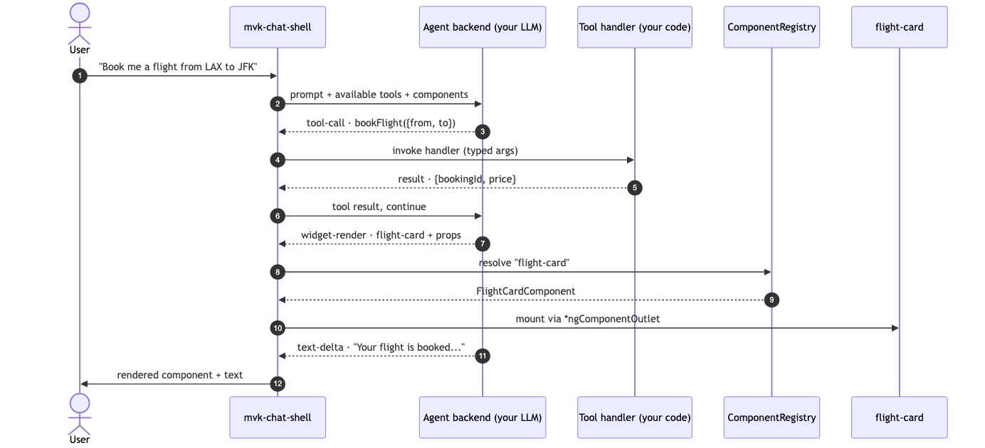
06 · IN ACTION
FOR ARCHITECTS + DEVELOPERS
One user prompt → five things
Sequence: 1 prompt → LLM picks tool → handler runs → LLM picks UI component → host mounts it (Zod-validated props) → LLM closes with text. Each arrow is a library seam you can swap, scope, or instrument.
5b · Use cases
Maverick — Agentic UI for Angular
39 / 62
Notes:
Use this slide to walk a developer through what 'agentic UI' actually means.
Highlight that no piece of this is bespoke per app: tool, handler, component, registry — all interchangeable.
The same diagram appears at the top of the README; it's the canonical mental model for new contributors.

Slide 40
6 · EXAMPLES
FOR DEVELOPERS
Five demos in this repo
Demo
What it shows
Library features exercised
demo-monolith
Single-app AG-UI parity
M1 baseline · same shape as flights42
demo-feature-tour
All 15 registries in one app
ActionRegistry, FormRegistry, IntentRegistry, DataSource, Approval, Operation
demo-shell + remotes
Native Federation host + bookings/loyalty/support
Capability handoff · prefetchCapabilities
demo-multi-agent
OrchestratorAgent + specialists
Sticky routing · ThreadStateStore
demo-mcp-server
Tools as MCP server
Claude Desktop · MCP UI · per-user instances
demo-ediscovery
Enterprise reference app
Federated review remote · audit trail · 5 personas
6 · Examples
Maverick — Agentic UI for Angular
40 / 62
Notes:
Six demos. Pick one for each audience.
demo-ediscovery is the headline — full enterprise pattern with federation + audit + multi-persona.

Slide 41
06 · CASE STUDY
FOR SENIOR EXECUTIVES
An enterprise reference app
A federated eDiscovery shell — the demo we use to validate every library feature against a recognisable, regulated, complex domain.
8
18
3 + 1
15
✓
phases shipped
tools · 4 specialists
MFE remotes + MCP server
registries exercised
tamper-evident audit
WHAT THE DEMO SHIPS
LIBRARY SEAMS PUT TO WORK
• Custodian intake · legal-hold lifecycle
• Document review with privilege workflow
• Production assembly: create → bates → export
• Search + TAR classifier across the matter
• Tamper-evident chain-of-custody report
• MCP server for Claude Desktop / Cursor / Zed
• Persona-scoped tool surface (5 roles)
• ToolRegistry · ComponentRegistry · CapabilityRegistry
• ActionRegistry — click-through navigation from widgets
• FormRegistry — productionConfigForm
• ValidationRegistry — Bates pattern conformance
• DataSourceRegistry — pluggable documentIndex
• Telemetry — every tool call audit-logged
6 · Examples
Maverick — Agentic UI for Angular
41 / 62
Notes:
The eDiscovery reference is the headline asset.
Open with the four stat cards — those are the talking points executives remember.

Slide 42
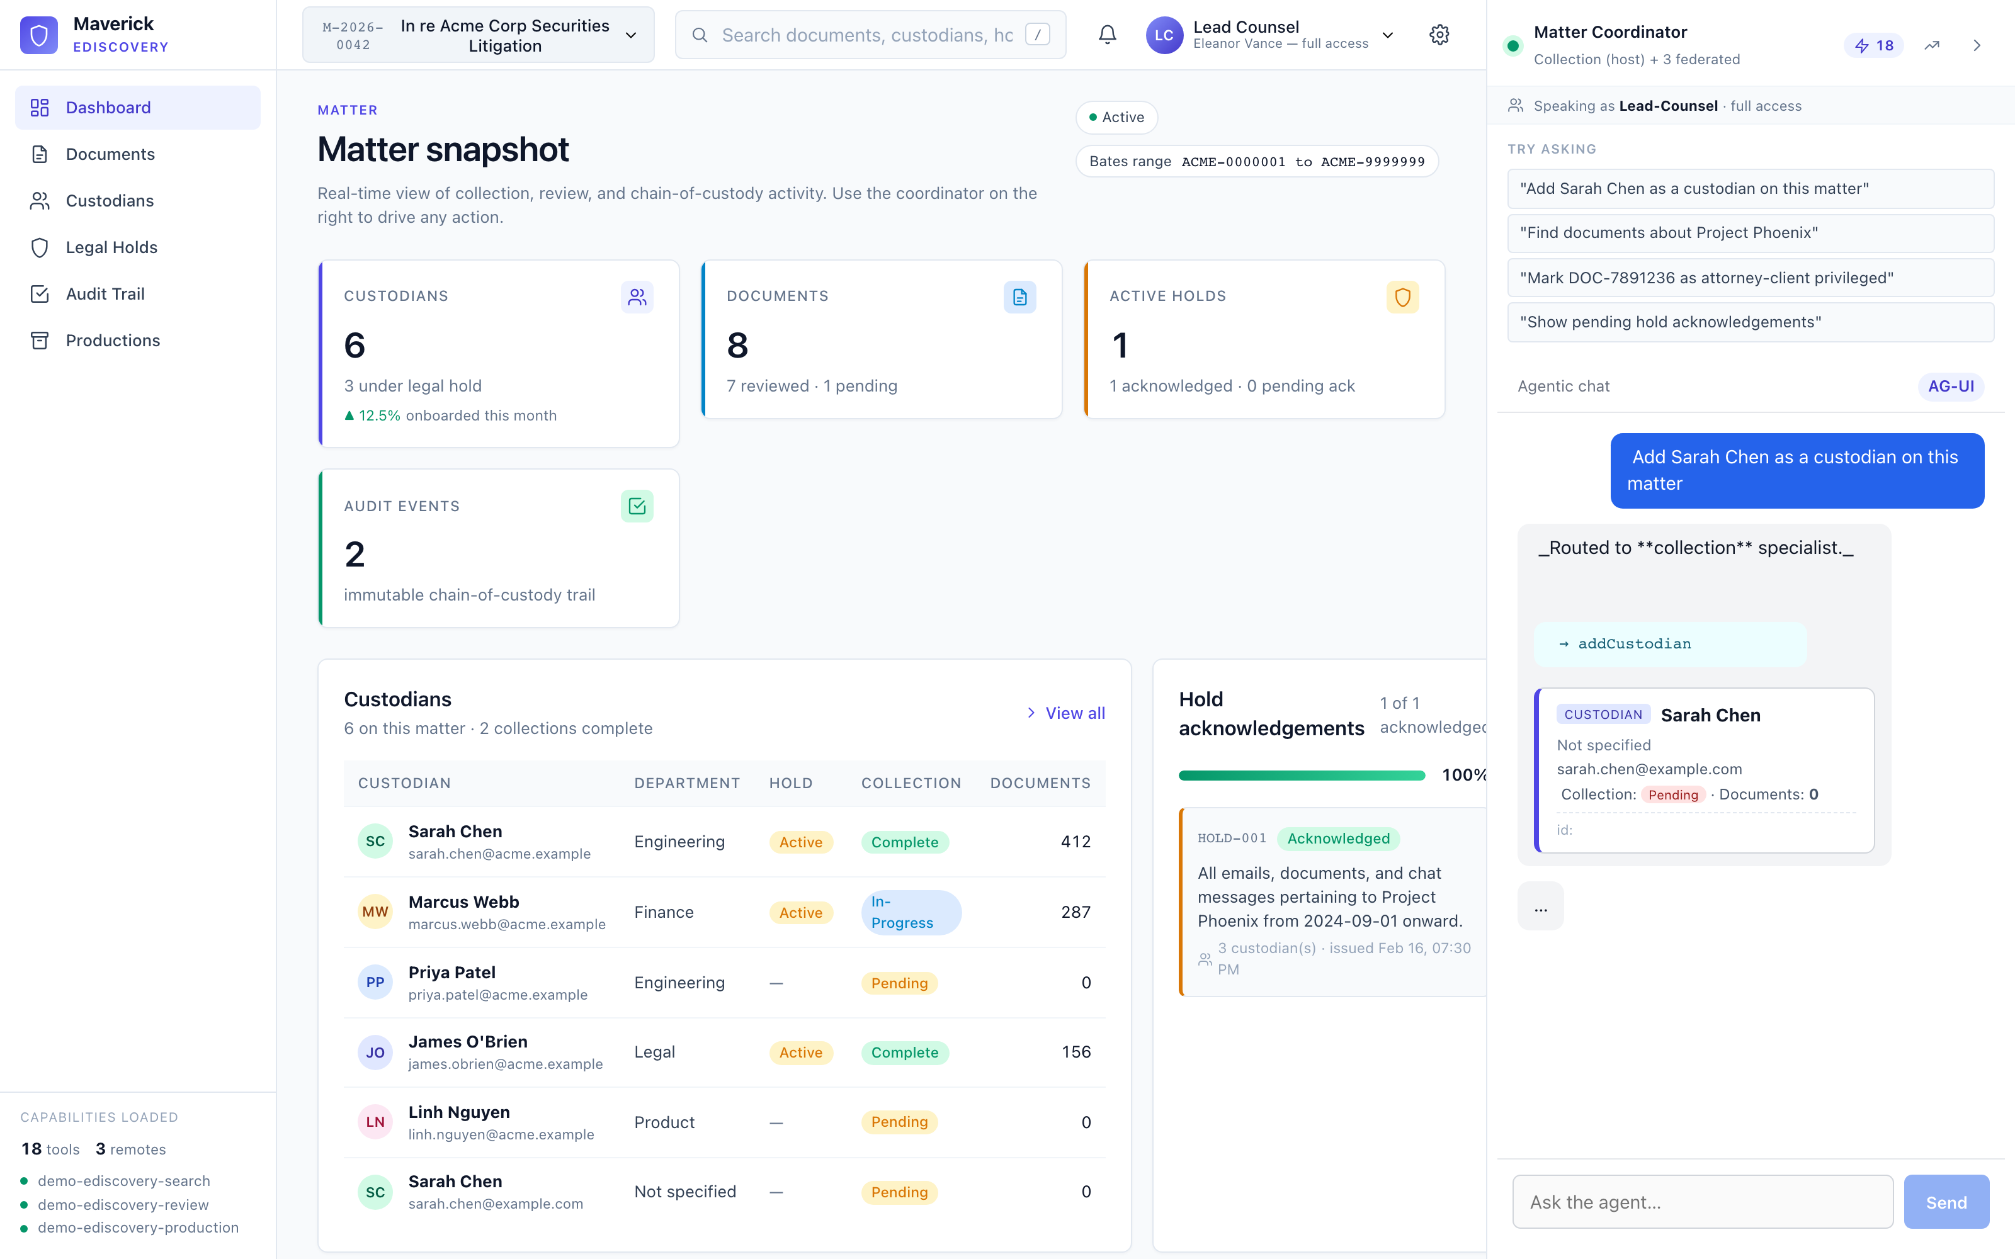
06 · IN ACTION
FOR ALL AUDIENCES
What the library actually produces
Live capture: user typed "Add Sarah Chen as a custodian" → orchestrator routed to the collection specialist → addCustodian tool ran → ComponentRegistry resolved app-custodian-card → host mounted it. None of that flow is hard-coded.
6 · Examples
Maverick — Agentic UI for Angular
42 / 62
Notes:
This is the screenshot that takes the abstract pitch and makes it concrete.
Walk through the three highlighted areas: the chat with the rendered widget on the right; the dashboard responding live (KPI counts) on the left; the sidebar showing 18 tools registered + 3 federated remotes loaded.
Pause on the routing banner ('Routed to **collection** specialist'): that's the orchestrator, not an LLM hallucination — multi-agent under one chat.

Slide 43
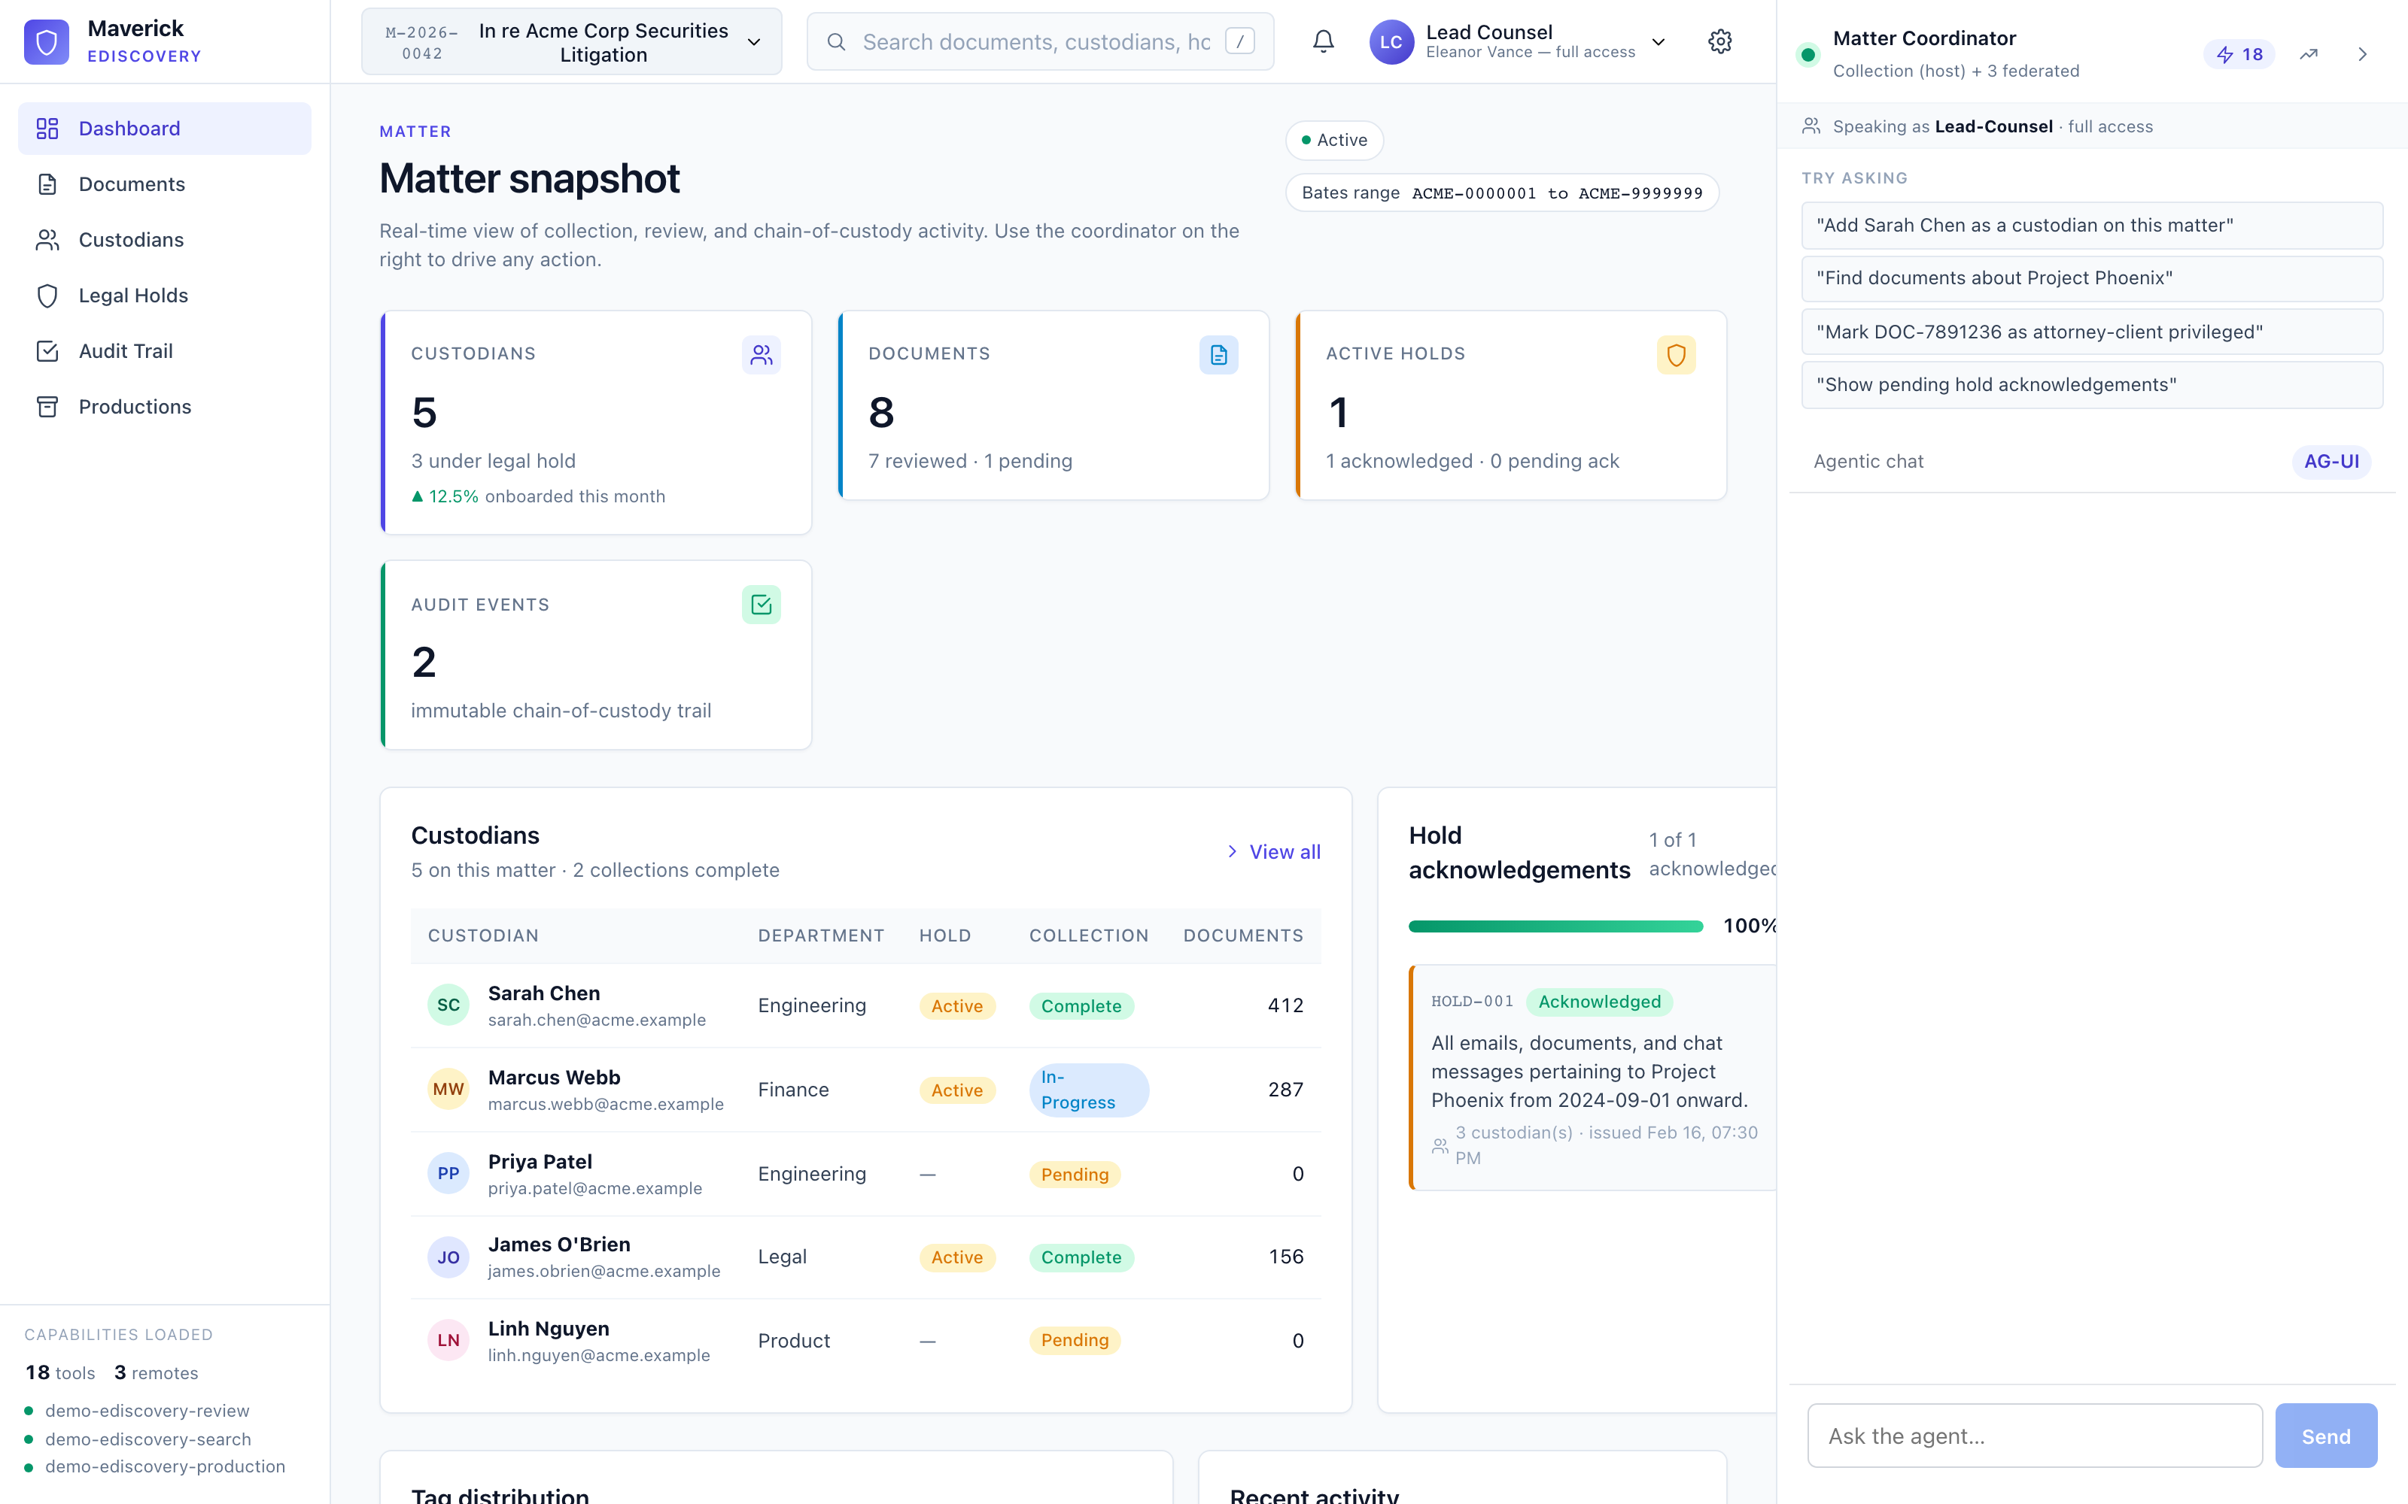
06 · IN ACTION
FOR SENIOR EXECUTIVES
The reference app's dashboard
The host's matter snapshot. KPI cards (Custodians · Documents · Active holds · Audit events) update reactively as tool calls mutate state. Federated remotes register their capabilities at boot — sidebar shows '18 tools · 3 remotes'.
6 · Examples
Maverick — Agentic UI for Angular
43 / 62
Notes:
Senior-exec slide. Use to communicate scope, not technical depth.
The reference is enterprise-grade: dashboard, audit, custodians, holds, productions. This is what 'production-shaped' looks like — not a chat box bolted onto an empty page.

Slide 44
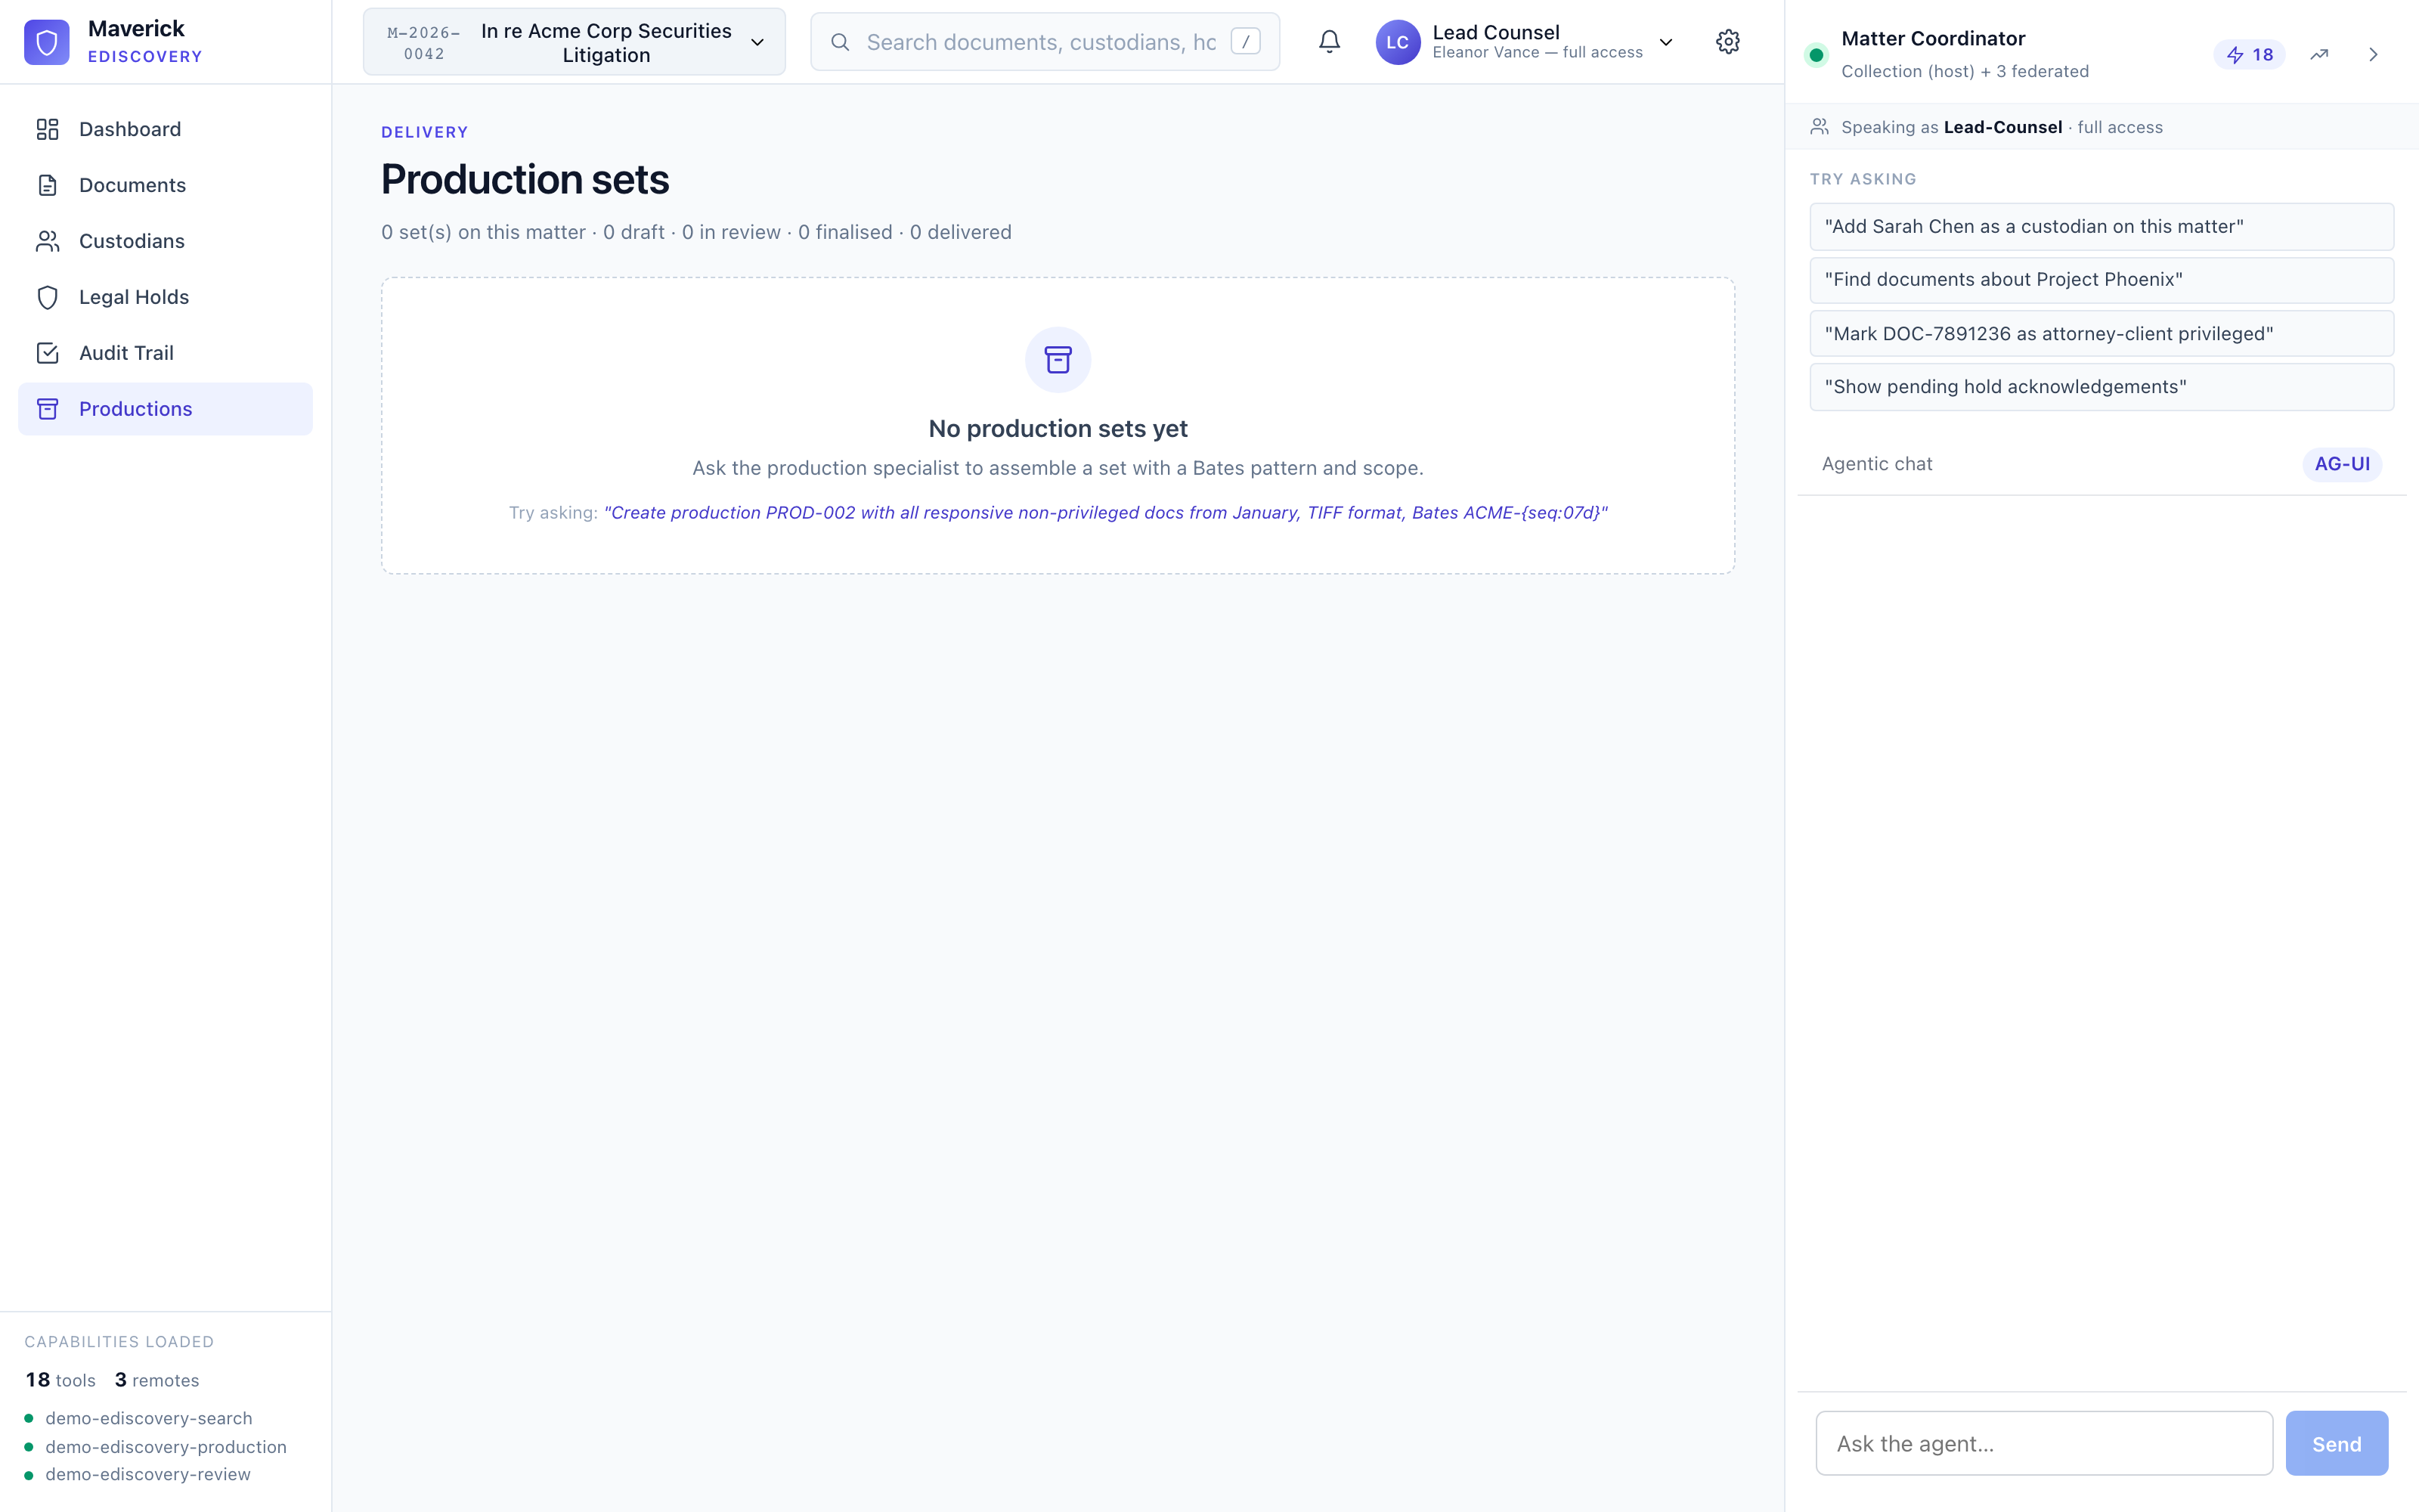
06 · IN ACTION
FOR ARCHITECTS
Productions — agent-created, master-detail
Master list on the left (every production set the agent has assembled), detail panel on the right (Bates range, lifecycle status, document table). The agent's createProductionSet tool wrote here via the production specialist — no separate UI for assembly.
6 · Examples
Maverick — Agentic UI for Angular
44 / 62
Notes:
Show this when a developer asks 'where does the agent's tool output land?' — the answer is anywhere your data layer routes it; the page itself is just an Angular component reading the same store.

Slide 45
6 · EXAMPLES
FOR DEVELOPERS
eDiscovery — production chain (Phase 3)
One prompt drives a 4-step chained tool call · each step renders its own widget · ActionRegistry navigates on click.
1
createProductionSet
2
redactDocument*
3
assignBatesNumbers
4
exportProductionSet
scope filter · format · Bates pattern Validation: pattern conformance
page · bbox · reason (* optional, repeatable)
stamp sequential ids per pattern start = 1 (default)
deliver: true (irreversible) requires audit reason
→ productionSummary widget status: draft
→ redactionEditor widget canvas overlay
→ batesPreview + summary status: review
→ productionSummary status: delivered
Library seams exercised
ToolRegistry
4 tools registered via federation
ComponentRegistry
3 widgets contributed by remote
FormRegistry
productionConfigForm — schema-driven
ValidationRegistry
Bates pattern conformance check
ActionRegistry
openProduction — click-to-navigate
Audit log
every step appends an event
6 · Examples
Maverick — Agentic UI for Angular
45 / 62
Notes:
This is THE slide for the eDiscovery case study — shows the chained-tool-call pattern with widget feedback at every step.
Six seams in one workflow. That's why we needed registries — each seam is independently extensible.

Slide 46
06 · CASE STUDY
FOR DEVELOPERS
Run sequence — step 1 of 4
Click through frames 1 → 4 to see one chat turn play out across five actors. Each frame highlights the active arrow.
User
ChatShell
Coordinator
Specialist
ToolRegistry
prompt
filter ToolRegistry → top 12
12 ToolDefs
POST /agents/coordinator/run (SSE)
classify → 'production' specialist
tool_call: generateChainOfCustodyReport
execute handler → audit hash chained
tool_result
widget_render: chainOfCustodyReport
Frame 1 — user prompt fires. Tool filter scores 17 tools, sends top 12 to Gemini.
rendered card visible
6 · Examples
Maverick — Agentic UI for Angular
46 / 62
Notes:
Step 1 of 4. Click forward to advance. The four slides build up the same diagram so the audience sees the message flow accumulate.
Use F5 to start full-screen → space-bar to advance.

Slide 47
06 · CASE STUDY
FOR DEVELOPERS
Run sequence — step 2 of 4
Click through frames 1 → 4 to see one chat turn play out across five actors. Each frame highlights the active arrow.
User
ChatShell
Coordinator
Specialist
ToolRegistry
prompt
filter ToolRegistry → top 12
12 ToolDefs
POST /agents/coordinator/run (SSE)
classify → 'production' specialist
tool_call: generateChainOfCustodyReport
execute handler → audit hash chained
tool_result
widget_render: chainOfCustodyReport
Frame 2 — orchestrator classifies and routes the run to the production specialist.
rendered card visible
6 · Examples
Maverick — Agentic UI for Angular
47 / 62
Notes:
Step 2 of 4. Click forward to advance. The four slides build up the same diagram so the audience sees the message flow accumulate.
Use F5 to start full-screen → space-bar to advance.

Slide 48
06 · CASE STUDY
FOR DEVELOPERS
Run sequence — step 3 of 4
Click through frames 1 → 4 to see one chat turn play out across five actors. Each frame highlights the active arrow.
User
ChatShell
Coordinator
Specialist
ToolRegistry
prompt
filter ToolRegistry → top 12
12 ToolDefs
POST /agents/coordinator/run (SSE)
classify → 'production' specialist
tool_call: generateChainOfCustodyReport
execute handler → audit hash chained
tool_result
widget_render: chainOfCustodyReport
Frame 3 — specialist returns a tool call. Handler runs; audit event lands in the chain.
rendered card visible
6 · Examples
Maverick — Agentic UI for Angular
48 / 62
Notes:
Step 3 of 4. Click forward to advance. The four slides build up the same diagram so the audience sees the message flow accumulate.
Use F5 to start full-screen → space-bar to advance.

Slide 49
06 · CASE STUDY
FOR DEVELOPERS
Run sequence — step 4 of 4
Click through frames 1 → 4 to see one chat turn play out across five actors. Each frame highlights the active arrow.
User
ChatShell
Coordinator
Specialist
ToolRegistry
prompt
filter ToolRegistry → top 12
12 ToolDefs
POST /agents/coordinator/run (SSE)
classify → 'production' specialist
tool_call: generateChainOfCustodyReport
execute handler → audit hash chained
tool_result
widget_render: chainOfCustodyReport
Frame 4 — widget renders below the assistant message. Round-trip complete.
rendered card visible
6 · Examples
Maverick — Agentic UI for Angular
49 / 62
Notes:
Step 4 of 4. Click forward to advance. The four slides build up the same diagram so the audience sees the message flow accumulate.
Use F5 to start full-screen → space-bar to advance.

Slide 50
06 · COMPLIANCE
FOR SENIOR EXECUTIVES
Chain of custody — every action, every actor, hashed
Phase 5. Each tool call writes one audit event; each event links to the previous via a chain hash. Tampering anywhere in the chain breaks verification.
Event #1 — issued
Event #2 — tagged
Event #3 — exported
actor: eleanor.vance@firm action: hold.issued target: HOLD-001 ts: 2026-02-16T14:00Z
actor: paralegal-1@firm action: document.tag.added target: DOC-7891234 ts: 2026-04-21T09:14Z
actor: associate-2@firm action: production.delivered target: PROD-A1B2 ts: 2026-04-30T16:55Z
prev: 0000…
chain: a3f8d2
prev: a3f8d2
chain: b7e1f4
prev: b7e1f4
chain: c2d5a1
✓ CHAIN VERIFIED — 3 of 3 hashes recompute · head c2d5a1
If any event were edited or deleted, the next event's `prev` link would fail to recompute and the integrity badge on the Audit Trail page would flip to broken.
WHY THIS MATTERS
Defensibility is the unit of trust opposing counsel and regulators measure. The chain is built into every tool call — Claude Desktop and the web app both contribute to the same chain. No second system to reconcile.
6 · Compliance
Maverick — Agentic UI for Angular
50 / 62
Notes:
Hash function is FNV-1a in the demo (deterministic for testing); SHA-256 + HSM-backed HMAC is the prod swap.
Phase 5 ships 1 tool (generateChainOfCustodyReport), 1 widget, the chainHash field, and the integrity badge on the Audit Trail page.
The defensibility story lands here for execs — chain integrity = a deliverable for opposing counsel.

Slide 51
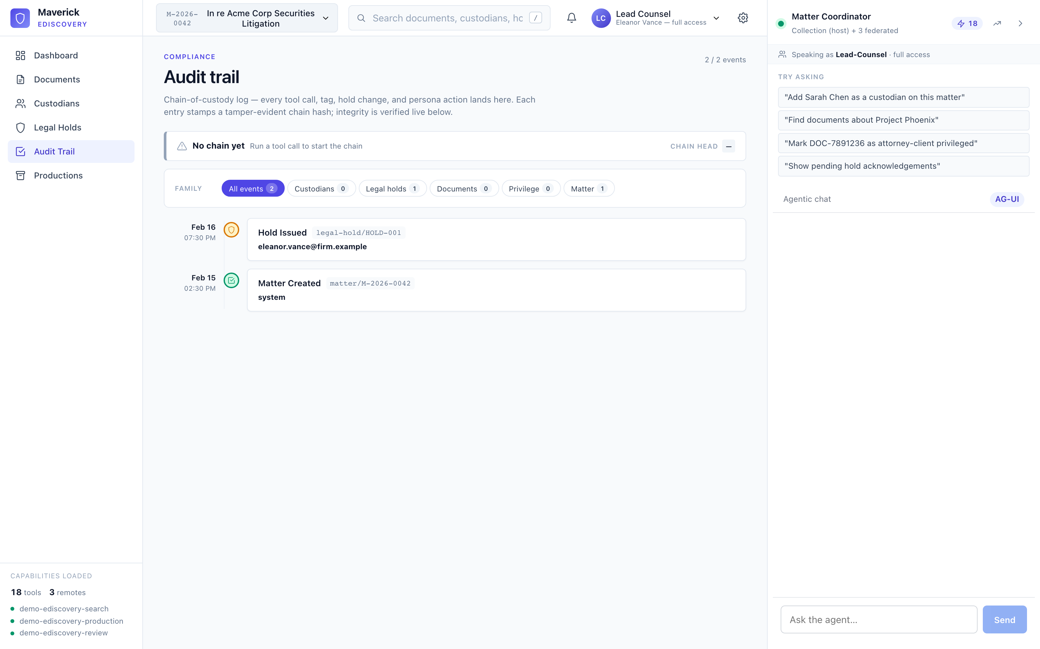
06 · IN ACTION
FOR SENIOR EXECUTIVES + ARCHITECTS
Chain-of-custody, verified on render
Tamper-evident audit chain — each event hashes prevHash + payload, linking into a Merkle-style tail. The page recomputes the chain on render and shows a verified / broken badge in the top-right. Required posture for regulated domains.
6 · Compliance
Maverick — Agentic UI for Angular
51 / 62
Notes:
This is the slide that lands compliance reviewers. Audit grade isn't a feature flag — it's woven through the data layer.
Pair this with the persona-scope slide — together they're the 'who can do what + did do what' two-piece compliance story.

Slide 52
07 · MCP REACH
FOR ARCHITECTS
One toolset. Three surfaces. One audit log.
Phase 6. Paralegals run privilege review from Claude Desktop / Cursor / Zed without opening the web app — same handlers, same audit chain (Phase 5).
Web app
Claude Desktop
Cursor / Zed
<mvk-chat-shell> @ :4300 NgComponentOutlet widgets
Stdio MCP server text/html;profile=mcp-app
Same MCP server MCP-UI HTML cards
SHARED
ToolDef[]
5 review tools · framework-agnostic literals
ONE AUDIT CHAIN — Phase 5 hash links every event regardless of surface
appendAudit(...) auto-stamps chainHash + prevHash. The chain-of-custody report covers Claude-Desktop-driven mutations and web-app-driven mutations as one.
WHERE IT MATTERS — analysts who already live in Claude Desktop don't switch contexts to do privilege review.
7 · MCP reach
Maverick — Agentic UI for Angular
52 / 62
Notes:
ToolDef literals are framework-agnostic — no Angular at MCP runtime.
Per-user attribution via env vars (MVK_USER, MVK_MATTER) is the cookbook pattern for spawning one MCP server per user.
Show this slide right after the chain-of-custody slide — the punchline lands when execs see two surfaces feeding one chain.

Slide 53
08 · GOVERNANCE
FOR ARCHITECTS
Persona scopes — from consumer shim to library primitive
Phases 7 → 8. The role allow-list moved from chat-shell-only filter to a registry-base policy that filters every read.
PHASE 7 · CONSUMER-SIDE SHIM
PHASE 8 · LIBRARY API
TOOL_FILTER + useFactory composition
RegistryBase.setScopePolicy
{ provide: TOOL_FILTER,
useFactory: () =>
personaToolFilter(
inject(PersonaService),
keywordToolFilter({
maxTools: 12,
floor: 5,
}),
),
}
// app.config.ts
provideAppInitializer(() => {
const persona = inject(PersonaService);
inject(ToolRegistry).setScopePolicy(
(entry) =>
persona.canInvoke(
persona.active(),
entry.name,
),
);
});
15
~30
1
✓
registries gain scope filtering
lines of consumer code deleted
policy installs once at boot
every reader sees the same view
8 · Governance
Maverick — Agentic UI for Angular
53 / 62
Notes:
Phase 7 shipped a chat-shell-only filter. Phase 8 lifts it to RegistryBase so 15 registries share the seam.
The diff was about -30 LOC in the consumer for a one-line setScopePolicy call.
ADR-008 documents the trade-offs: filter on read (not register) so federated remotes stay portable.

Slide 54
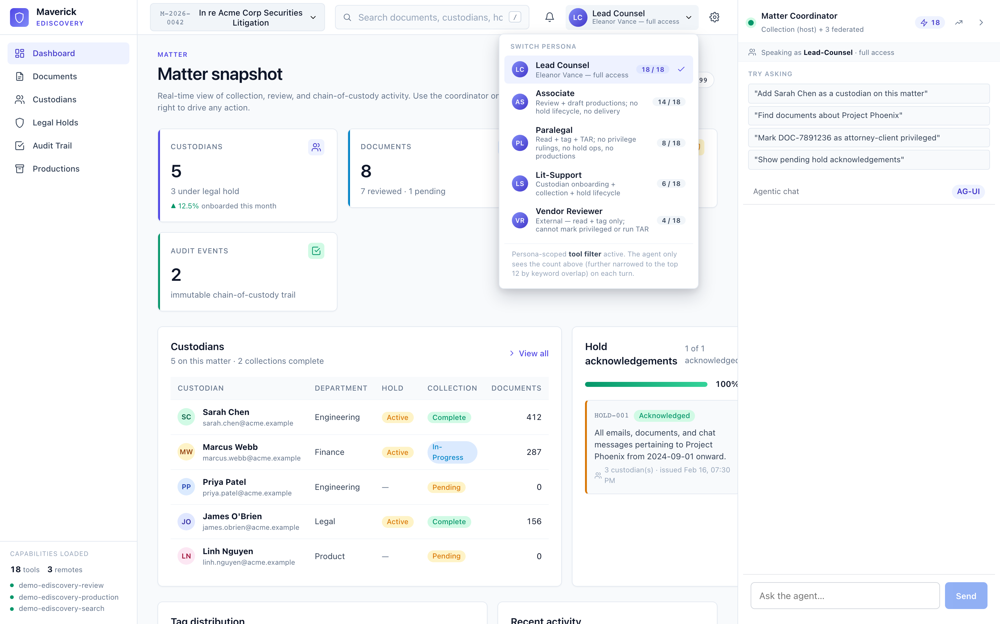
8 · GOVERNANCE
FOR SENIOR EXECUTIVES + ARCHITECTS
Per-persona scope — live in the UI
Phase-8 RegistryBase.setScopePolicy in action. Each role's tool count shifts live — Lead Counsel sees 18 / 18, Vendor Reviewer sees 5 / 18. The LLM never sees tools the active persona can't invoke (the ToolRegistry filter applies before the system prompt is composed).
8 · Governance
Maverick — Agentic UI for Angular
54 / 62
Notes:
Concrete demonstration of the scope-policy seam from the governance section.
Mention the 5 RPM quota / 5 personas badge layout — this is what the e2e test 05-persona-scope asserts on (and it passes deterministically without the LLM).

Slide 55
09 · ENTERPRISE READINESS
FOR SENIOR EXECUTIVES
Four phases, four governance primitives
Each row pairs a regulated-domain need with the library primitive that addresses it — already shipped.
Tamper-evident audit
Chain hash on every event · live integrity verifier
Phase 5 · `appendAudit` + `verifyAuditChain`
Analyst-desktop reach
Same toolset in Claude Desktop / Cursor · same audit log
Phase 6 · `@maverick/agentic-ui-mcp`
Persona-scoped tool surface
Hide tools the role can't invoke before the LLM ever sees them
Phase 7 · consumer-side filter, then…
Registry-wide scope policy
15 registries (Tool / Action / Form / DataSource / Approval / Operation / …) share one filter
Phase 8 · `RegistryBase.setScopePolicy(policy)`
9 · Enterprise readiness
Maverick — Agentic UI for Angular
55 / 62
Notes:
Closing the compliance section — read top-to-bottom, each row stands on its own.
Use this slide if you're tight on time and skipping the chain-of-custody / MCP / scope-policy graphics.

Slide 56
7 · DECISIONS
When to use what — a guide
Use case
Reach for
Single-app · regulated · audit-heavy
AG-UI
Multi-provider eval · rapid prototype
Hashbrown
Agent navigates / fills forms / mutates store
A2UI (over AG-UI base)
Multiple teams · independent deploys
MFE federation
Analyst desktops · IDE-native agents
MCP server
Compliance + chain of custody
Telemetry sink → audit log
7 · Decisions
Maverick — Agentic UI for Angular
56 / 62
Notes:
Don't try to pick one protocol. Pick by use case — the library lets you mix.

Slide 57
8 · BENEFITS
FOR SENIOR EXECUTIVES
For senior executives
• Faster time-to-pilot. ng add → working chat in 2 minutes. 6 months of in-house plumbing avoided.
• Vendor agnosticism. AG-UI today, Hashbrown tomorrow, A2UI when it ships v1 — same UI, swap the backend.
• Regulated-domain ready. Audit-grade telemetry, persona scopes, MCP for analysts — built in, not bolted on.
• Microfrontend native. Multiple teams contribute capabilities into one chat — federation is a first-class seam.
• Open license. Apache 2.0 — explicit patent grant, enterprise-friendly. No SaaS lock-in; internal forking encouraged.
• Reference implementations. Six demos including a full eDiscovery app. Blueprint, not a brochure.
8 · Benefits
Maverick — Agentic UI for Angular
57 / 62
Notes:
Exec talk track. Six bullets, nothing technical — focus on derisking and time-to-value.

Slide 58
8 · BENEFITS
FOR ARCHITECTS
For architects
• Clean seams. AgenticBackend, MfeRegistrySource, Registry<TDef>, AgenticTelemetrySink — every contingency leans on one already in place.
• Conformance-tested adapters. /testing entry runs the same suite against every backend; capability flags drive feature-detection.
• Conflict policies + onDispose. Multiple teams may register the same tool name; namespace policies coexist; cleanup is automatic.
• Observability by default. Distributed tracing across SSE; metrics; logs with trace_id correlation; opt-in OTel exporter.
• Two federation paths. Native + Module Federation — no second-class citizen; same CapabilityModule shape; pick by bundler.
• ADRs documented. Six ADRs cover backend abstraction, MCP, federation, conflict policies — context for future decisions.
8 · Benefits
Maverick — Agentic UI for Angular
58 / 62
Notes:
Architect framing. Highlight that every risk in §11 of the plan has a documented detection signal + contingency.

Slide 59
8 · BENEFITS
FOR DEVELOPERS
For developers
• Schematics. ng add bootstraps an entire workspace. ng g …:tool/widget/backend cuts hours of typing per artefact.
• Signal-first APIs. ToolRegistry.signal(), CapabilityRegistry.signal() — reactive everywhere; OnPush by default.
• Strict TypeScript. Zod-anchored payloads; tool args + props inferred; no any in the public API surface.
• Testing harness. FakeAgenticBackend + harnessChat() in /testing; in-memory AgenticTelemetrySink with custom matchers.
• Cookbook entries. Every milestone ships a how-to guide — federation at scale, MCP server, observability, persona scopes.
• Live reload across MFEs. Both Native + Module Federation play nice with the dev server.
8 · Benefits
Maverick — Agentic UI for Angular
59 / 62
Notes:
Dev framing. Show the schematics demo at the end — typically the moment that lands the pitch.

Slide 60
10 · ROADMAP
FOR ARCHITECTS
Library milestones · validated by eDiscovery
Each library milestone has a corresponding eDiscovery phase that exercised it under enterprise load.
M
Theme
Ships
Validated by
M1
AG-UI parity + ChatShell + /testing
ToolRegistry, ComponentRegistry, BackendRegistry
P0–P1
M2
Schematics + ng-add
tool, widget, backend, agent-server, snapshot tests
—
M3
MFE federation + A2UI + MCP server adapter
CapabilityRegistry, MfeRegistry, both federation paths
P2, P6
M4
Extended registries + Validation + DataSource
Action, Intent, Form, Validation, DataSource
P2–P4
M5
Compliance + scope governance
Tamper-evident audit chain, RegistryBase.setScopePolicy
P5, P7–P8
All five milestones shipped. The eDiscovery flagship is the proof-shape under load.
9 · Roadmap
Maverick — Agentic UI for Angular
60 / 62
Notes:
Updated for v5 — every milestone is now shipped (was M1-M3 done / M4-M5 in flight).
The 'validated by' column ties library work to the eDiscovery phase that put it under load.

Slide 61
10 · CALL TO ACTION
Where you can plug in
Three concrete next steps — pick the row that matches your role.
01
EXECUTIVES
Authorise a two-week pilot.
Agentic chat retro-fit into your most-used internal app, Apache 2.0 licensed.
02
ARCHITECTS
Read ADR-006 (MCP) + ADR-007 (eDiscovery). Spike a remote in your repo.
Conformance suite + cookbook ship in /testing.
03
DEVELOPERS
ng add @maverick/agentic-ui. ng g …:tool. ng serve.
30 minutes from clone to running chat — schematics scaffold the rest.
Repository · examples · cookbook · ADRs included Questions? Reach the team.
Notes:
Close. Three asks, one per audience.
Tone matches the deck — restrained, navy, no decoration.

Slide 62
RESOURCES
Where to go from here
Repository layout
Recommended reading order
ag_ui_maverick/
├── projects/
│ ├── agentic-ui/ # publishable lib
│ ├── agentic-ui-server/ # Node companion
│ └── agentic-ui-mcp/ # MCP adapter
├── examples/
│ ├── demo-monolith/
│ ├── demo-shell/ (host)
│ ├── demo-remote-bookings/
│ ├── demo-multi-agent/
│ ├── demo-mcp-server/
│ └── demo-ediscovery-{shared,server,shell,review}/
├── docs/
│ ├── adr/ # decision records
│ ├── cookbook/ # how-to guides
│ └── architecture/ # system docs
└── PLAN.md # full roadmap
• README.md 5-minute orientation
• PLAN.md Full architecture + 5-tier registry model
• ADR-006 MCP server-side adapter design
• docs/cookbook/ How-to guides for federation, MCP, OTel
• examples/demo-feature-tour All 15 registries in one app
• examples/demo-ediscovery Enterprise reference
• @maverick/agentic-ui/testing Conformance suite + harness
Resources
Maverick — Agentic UI for Angular
62 / 62
Notes:
Last slide. Hand-off to the audience — every box on the left has its own README.

