Slide 1



Introduction to Height and Weight Calculation
Knowing your height and weight is important for understanding your overall health and well-being. These key measurements can provide insights into your body composition and help guide you towards a healthy lifestyle.
By Justin Raj

Slide 2
Understanding Body Mass Index (BMI)
What is BMI?
Calculating BMI
BMI Ranges
BMI is a simple calculation that uses your height and weight to determine if your weight is within a healthy range.
The formula is: BMI = weight (in kg) / height (in m)^2. You can also use online BMI calculators for convenience.
A BMI under 18.5 is considered underweight, 18.5-24.9 is healthy, 25-29.9 is overweight, and 30+ is obese.

Slide 3
Factors Affecting Height and Weight
1
Genetics
2
Age and Gender
Your genes play a significant role in determining your natural height and weight range.
Height and weight changes occur at different stages of life and vary between men and women.
3
Lifestyle Factors
4
Medical Conditions
Diet, exercise, sleep, and stress levels can all impact your height and weight.
Certain health issues like thyroid disorders can also influence height and weight.

Slide 4
Healthy Weight Ranges
Underweight
Healthy
A BMI under 18.5 may indicate you need to gain weight to be in a healthy range.
A BMI between 18.5 and 24.9 is considered the optimal weight range for most adults.
Overweight
Obese
A BMI of 25 to 29.9 means you are carrying extra weight that could be unhealthy.
A BMI of 30 or higher indicates you have an unhealthy amount of excess body fat.

Slide 5
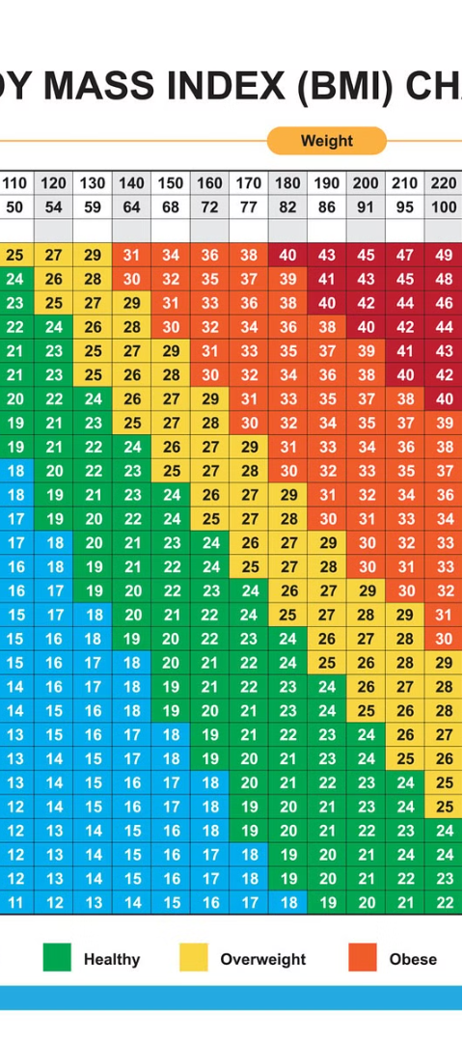



Calculating Your BMI
Measure
Obtain your height and weight measurements.
Calculate
Use the BMI formula or an online calculator.
Interpret
Refer to the healthy weight ranges to understand your result.

Slide 6




Interpreting BMI Results
Underweight
Healthy
Overweight
Obese
Seek advice from a healthcare professional to gain a healthy amount of weight.
Maintain your current healthy habits to keep your weight in the optimal range.
Consider making lifestyle changes to lose excess weight and improve your health.
Work closely with a doctor to develop a safe and effective weight loss plan.

Slide 7
Tips for Maintaining a Healthy Weight
Balanced Diet
Regular Exercise
Hydration
Focus on whole, nutrient-dense foods like fruits, vegetables, lean proteins, and whole grains.
Aim for at least 150 minutes of moderate activity or 75 minutes of vigorous activity per week.
Drink plenty of water throughout the day to stay hydrated and support bodily functions.

Slide 8
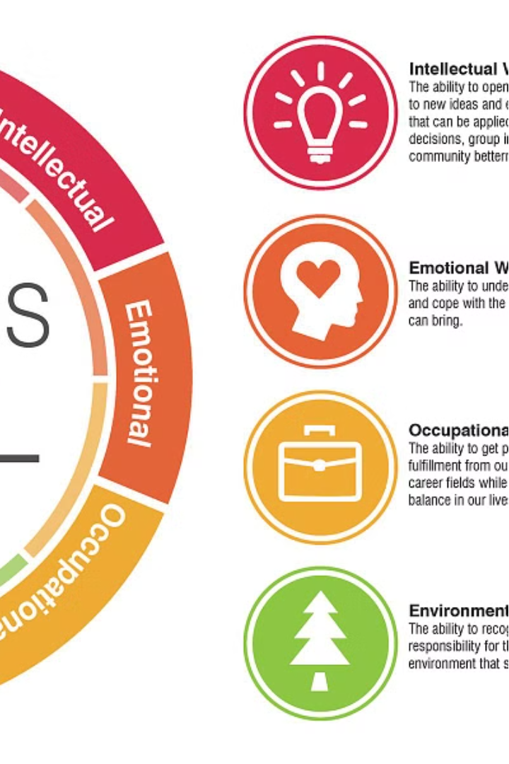
Conclusion and Resources
Understanding your height, weight, and BMI can provide valuable insights into your overall health. Remember to consult with a healthcare professional for personalized guidance and support. Additional resources are available online and through community programs.

