Slide 1

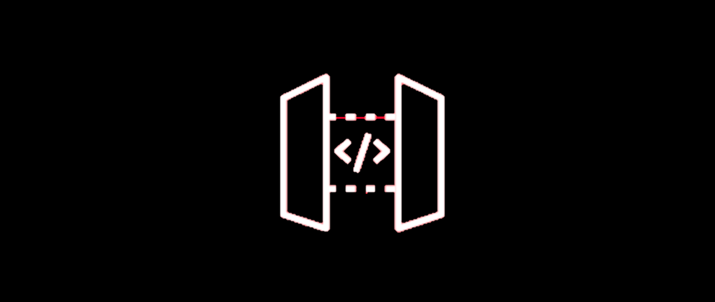
AWS API & Event Driven Architecture
www.herovired.com

Slide 2

API & Event-Driven Architecture Fundamentals
Learning Objectives
Understand API-driven vs Event-driven communication
Identify when to use synchronous vs asynchronous patterns
Explore common API & EDA patterns
Learn how to implement these patterns on AWS
Review anti-patterns & best practices

Slide 3
The Evolution of Modern Architecture Design
Monolith
Single deployable unit
Tightly coupled
Scalability limited
Long release cycles
Microservices
Independent deployable services
Technology flexibility
Can communicate via APIs or events
Reduces blast radius but introduces distributed complexity
Event-Driven Microservices
Services communicate through asynchronous events
Highly decoupled
Reactive, scalable, resilient

Slide 4
Introduction to API Architecture
What is an API?
Application Programming Interface
Contract between services
Enables communication between systems
Synchronous request-response pattern
Client waits for immediate response
Basic Flow:
Client -> API Endpoint -> Backend Logic -> Database -> Response

Slide 5
Common API Architecture Patterns
Pattern 1: Basic Request-Response
Client -> API Endpoint -> Service -> DB -> Response
Characteristics:
Client waits for immediate response
Tight coupling between client and server
Simple to understand and implement
Ideal for user-facing real-time interactions
Use Cases:
User login/authentication
Fetching user profile
Search functionality
Real-time pricing queries
CRUD operations on business entities
Pattern 2: API Gateway Aggregation
Multiple Clients -> API Gateway -> Multiple Backend Services
Characteristics:
Single unified entry point for all clients
Handles authentication/authorization
Rate limiting, throttling, caching, request/response transformation
Decouples clients from the underlying microservices
Use Cases:
Mobile apps needing aggregated backend responses
APIs consumed by external partners/vendors
Microservices-based applications with many backend services

Slide 6
API Architecture on AWS
ALB -> EKS/ECS/EC2 -> RDS / DynamoDB
Client -> ALB -> EKS / ECS tasks / EC2 -> RDS / DynamoDB
Characteristics
Path or host-based routing (ALB)
Works natively with container workloads (ECS/EKS)
Sticky sessions, WAF, and built-in auth (ALB) available
Fully API-driven
2) API Gateway -> Lambda (Serverless pattern)
Client -> API Gateway -> Lambda -> DB/Services
Characteristics
Fully serverless, no infra to manage
Built-in throttling, auth, request/response transforms
Pay-per-invocation billing model
3) API Gateway -> ALB / NLB -> EC2 / ECS / EKS
Client -> API Gateway (Rest API) -> ALB/NLB -> EC2 / ECS / EKS -> DB
Characteristics
API Gateway stays the public entry (auth, throttling, analytics)
ALB / NLB perform the actual service routing inside VPC
Combine API Gateway features (authorization, stages, throttling) with LBs
Keep backend services private (not exposed directly)

Slide 7
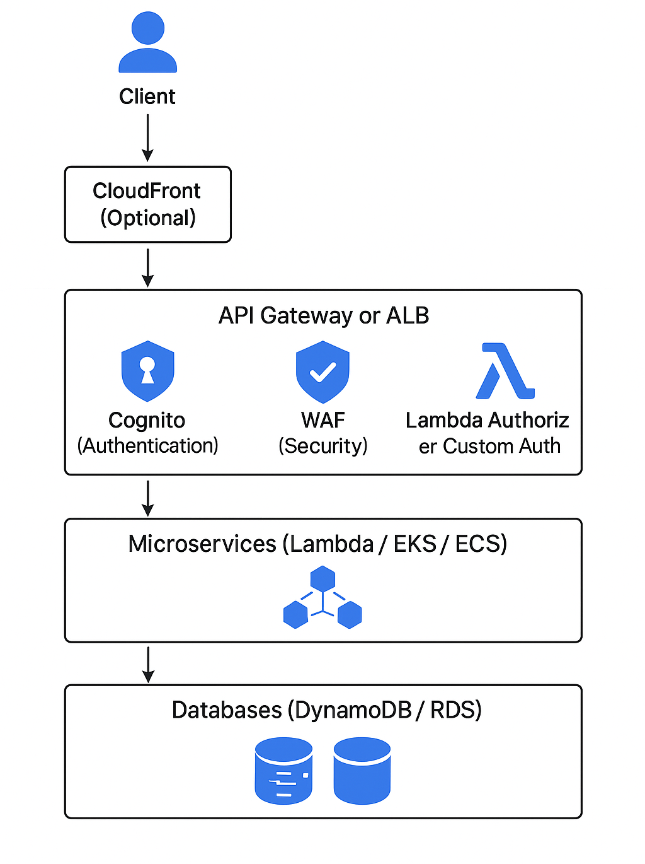
Production-Grade API Architecture on AWS
Key Characteristics:
CloudFront improves global performance and caches API responses when applicable.
API Gateway or ALB serves as the unified API front door depending on use case (serverless vs containers).
Cognito provides secure user authentication (OAuth2, JWT tokens).
WAF protects against common web attacks (OWASP Top 10).
Lambda Authorizers or custom auth services allow fine-grained authorization logic.
Microservices can run on Lambda, ECS/Fargate, or EKS based on compute needs.
Databases store application state, using DynamoDB for serverless or RDS for relational workloads.

Slide 8
Introduction to Event-Driven Architecture (EDA)
What is Event-Driven Architecture?
Systems communicate through events
Producers emit events, consumers react
Decoupled components
Asynchronous by nature
Core Concepts
Event an immutable fact (“OrderPlaced”, “UserRegistered”)
Producer emits event, unaware of consumers
Consumer listens & reacts
Event Bus/Broker routes events (EventBridge, SNS, SQS)

Slide 9
Benefits of Event-Driven Architecture
Loose Coupling
  Services don't need to know about each other
  Easy to add/remove consumers
  Changes don't cascade
Scalability
  Scale producers and consumers independently
  Handle traffic spikes with queues
  Parallel processing
Resilience
  Failures isolated to individual components, No cascading failures
  Retry mechanisms built-in
Flexibility
  Easy to add new features
  Multiple consumers can react differently

Slide 10
Common Event-Driven Architecture Patterns
1. Pub/Sub (Publish-Subscribe) Pattern: Notify multiple services of an event.
Publisher -> Topic/Event Bus -> Multiple Subscribers
Characteristics:
One-to-many communication
Publishers don't know subscribers
All subscribers receive all messages
Real-time delivery
Example:
Order Service (Producer) publishes “OrderPlaced” event & subscribers receives it and work as per their business req:
Inventory Service (updates stock)
Email Service (sends confirmation)
Analytics Service (tracks metrics)
Shipping Service (creates label)
2. Fan-Out Pattern: Execute multiple parallel processing tasks from one event.
Single Event -> Multiple Parallel Processors
Characteristics:
Parallel processing
Independent consumers
Each consumer has own queue
No blocking
Example:
Image Upload Event triggers following processing in parallel:
Thumbnail Generator
Metadata Extractor
Virus Scanner
ML Image Classifier

Slide 11
AWS EDA Reference Architectures
1) Central Event Bus Architecture (EventBridge)
Flow:
Producers -> EventBridge Bus -> Rules / Filtering -> Consumers (Lambda, Step Functions, SQS, API Destinations, etc.)
Characteristics
Centralized event routing and governance
Supports event filtering, transformation, schema registry
Loose coupling between producers and consumers
Native integration with most AWS services
Enables multi-account event ingestion using EventBridge Bus policies
Ideal for large-scale enterprise event-driven communication
2) SNS -> SQS Fan-Out Pattern
Flow:
SNS Topic -> Multiple SQS Queues -> Multiple Consumers (Lambda / ECS / EKS)
Characteristics
Classic fan-out pattern
High throughput and simple to implement
Reliable delivery with SQS decoupling
Each consumer gets its own copy of the event (guaranteed isolation)
Supports retries, buffering
Ideal for parallel processing, broadcast notifications, async workloads

Slide 12
Cont..
3) Pub/Sub Pattern with SNS (Notification Pattern)
Flow:
Producer (Lambda Order Service) -> publishes "OrderPlaced“ event to SNS Topic -> All subscribers (Inventory Service Lambda, Email Service Lambda, Analytics Service Lambda) receives the event
Characteristics
Broadcast that something happened
Services need the same message but with different logic
Real-time processing is acceptable

Slide 13
Knowledge Check - When to Use Each Pattern
Requirement | API (Sync) | Event-Driven (Async) | Hybrid
Need immediate response | Yes | No | -
Long-running process (>30s) | No | Yes | Sync ack + async processing
Multiple consumers | Possible | Better | API + internal events
Simple CRUD | Yes | Overkill | -
Loose coupling needed | Possible | Better | -
Real-time updates | Possible | Possible | WebSocket + Events
Background processing | No | Yes | -
DB Transaction | Yes | Overkill | -

Slide 14
Synchronous vs Asynchronous Pattern Decision Guide
Scenario | Synchronous (API/Request-Response) | Asynchronous (Event-Driven) | Hybrid (Best Practice) | Recommended
User needs immediate result | ✅ Return data directly | ❌ Can't wait for result | - | Sync
Quick operation (<3 sec) | ✅ Simple, direct | ⚠️ Unnecessary complexity | - | Sync
Medium operation (3-30 sec) | ⚠️ User waits (bad UX) | ✅ Return job ID, process later | ✅ Ack + async process | Hybrid
Long operation (>30 sec) | ❌ Timeout issues | ✅ Background processing | ✅ Job ID + status polling | Hybrid
Simple CRUD (Create/Read/Update/Delete) | ✅ User needs confirmation | ⚠️ Overkill | - | Sync
Multiple systems need same data | ⚠️ Must call each system | ✅ Publish once, N subscribers | ✅ API + publish event | Async or Hybrid
Loose coupling required | ⚠️ Caller knows callee | ✅ Decoupled via events | - | Async
Tight coupling acceptable | ✅ Direct call | ⚠️ Unnecessary | - | Sync
Order/sequence matters | ✅ Step 1 → Step 2 → Step 3 | ✅ Event ordering (SQS FIFO) | ✅ Sync orchestration + async steps | Any (depends)
Parallel processing needed | ❌ Sequential only | ✅ Fan-out pattern | ✅ Trigger parallel async tasks | Async
User needs real-time updates | ⚠️ Polling (inefficient) | ⚠️ Push via WebSocket | ✅ WebSocket + async events | Hybrid
Background job (user doesn't wait) | ❌ Wrong pattern | ✅ Perfect fit | - | Async
Retry needed on failure | ⚠️ Client must retry | ✅ Queue handles retries | ✅ Best of both | Async
Transaction (single database) | ✅ ACID transaction | ⚠️ Overkill | - | Sync
Predictable, steady load | ✅ Simple, direct | ⚠️ Added complexity | - | Sync
Cost optimization | ⚠️ Must handle all traffic | ✅ Process at own pace | ✅ Buffer with queue | Async
Guaranteed delivery | ⚠️ Network issues lose data | ✅ Persisted in queue | - | Async
Immediate consistency required | ✅ See result immediately | ❌ Eventually consistent | - | Sync
Eventual consistency acceptable | ⚠️ Unnecessary wait | ✅ Process when ready | - | Async

Slide 15
Anti-Patterns to Avoid
Using events for everything
Simple queries don't need events
Adds unnecessary complexity
Harder to debug
Using synchronous APIs for long processes
Timeouts
Poor user experience
Resource waste
Mixing patterns without clear boundaries
Confusing architecture
Hard to maintain
Debugging nightmare

Slide 16
Knowledge Check - Suggest Possible Architecture
Hybrid Order Workflow
User places order (API synchronous) -> Return order confirmation immediately
Microservices in EKS / ECS
Order placed event from order MS
Either SQS / SNS captures the event
Order placed event emitted (Event-driven)
  Inventory service updates stock
  Payment service processes payment
  Shipping service creates label
  Email service sends confirmation
Event-Driven Workflow
User creates post -> Event: "PostCreated"
Multiple consumers react:
  Feed service updates followers' feeds
  Notification service alerts mentioned users
  Moderation service scans content
  Search service indexes post
API Workflow
User requests profile data
API returns data immediately
No background processing needed
Simple, fast, predictable

Slide 17
Sample Solution: Hybrid Order Workflow
Option A: Serverless hybrid
Flow 1 - Synchronous (Immediate Order Confirmation):
Client -> API Gateway -> Lambda (validate + persist order)
Lambda writes to DynamoDB/RDS
Lambda Returns confirmation to user
Flow 2 - Asynchronous (Background Processing):
Lambda publishes OrderPlaced event to SNS
SNS fans out the event to multiple SQS queues
Each SQS queue triggers its own Lambda consumer:
  SQS Queue: Inventory -> Inventory Lambda (reserve stock)
  SQS Queue: Payment -> Payment Lambda (process payment)
  SQS Queue: Shipping -> Shipping Lambda (create label)
  Email Notifications -> SNS Email (direct push)
Each SQS queue has its own Lambda -> enabling independent scaling and retries
SNS Email push is supported
Option B: Container-based hybrid
Flow 1- Synchronous:
Client -> ALB -> EKS orders service -> RDS
ALB routes requests to the orders service running on EKS.
Orders service validates and persists the order in RDS, then returns confirmation immediately.
Flow 2 – Asynchronous:
EKS Orders Service -> put OrderPlaced event -> EventBridge
EventBridge rules -> SQS (Inventory) / SQS (Payment) / SQS (Shipping)
Each SQS -> Worker pods on EKS consume and process
Optional: EventBridge -> Lambda for Email or Analytics target

Slide 18
Sample Solution: Event Driven Workflow
Option A: EventBridge Centric
Flow:
Client -> API Gateway -> Lambda (create post record in DB) -> publish PostCreated to EventBridge
EventBridge rules -> targets:
  -> Lambda Feed Service (updates followers feeds)
  -> Lambda Notification Service (push)
  -> Lambda Moderation Service (content scan)
Event: Lambda emits a PostCreated event to EventBridge with detail containing postId, authorId, content, mentions, tags, createdAt.
EventBridge rules evaluate the event payload (source, detail-type, detail fields) and route to multiple targets.
Multiple Lambda targets for Feed, Notification, Moderation: immediate processing.
Option B: SNS to SQS fan-out
Flow:
PostCreated -> SNS Topic -> multiple SQS queues -> separate Lambda / ECS workers
  -> SQS FeedQueue -> Feed Worker (Lambda/ECS)
  -> SQS NotificationQueue -> Notification Worker
  -> SQS ModerationQueue -> Moderation Worker (may run ML)
SNS receives the PostCreated publish call and fans out copies to each subscribed SQS queue.
Each SQS queue provides durable buffering, retries, DLQs, visibility timeout configuration, and independent scaling.
Workers poll SQS and process messages; failures are retried automatically until maxReceiveCount then moved to DLQ.
Use FIFO SQS with MessageGroupId = postId if ordering per post is required (and throughput fits FIFO limits).

Slide 19
Sample Solution: API Workflow
Option A: Serverless (Recommended for simple/profile reads)
Flow:
Client -> API Gateway -> Lambda -> DynamoDB (read profile) -> Response
API Gateway receives the HTTP request and invokes a small Lambda that reads the profile from DynamoDB and returns it.
Auto-scales end-to-end (API Gateway + Lambda + DynamoDB). Ideal for unpredictable or bursty traffic.
Option B: Container-based (Recommended for relational/complex queries)
Flow:
Client -> ALB -> EKS/ECS -> RDS -> Response
ALB routes the request to a containerized profile service running in EKS/ECS.
The service queries RDS (Postgres/MySQL) and returns the profile.
Good for complex relational queries, joins, and transactions. Predictable latency when services are warm.
Scale via pod/Task autoscaling and RDS sizing/replicas; better for steady, high-throughput workloads but requires cluster/DB capacity planning.

Slide 20

Thank You
www.herovired.com
Wait Nahi, Great Kar!

