Slide 1
End-to-End BI Automation:
Excel + SQL + Power BI + Fabric + Gateway
GLOBAL SALES ANALYTICS
Saheb Rafique
Data Analyst & Business Intelligence Analyst

Slide 2
Project Summary
Goal
Automate Power BI dashboard updates by connecting MySQL to Microsoft Fabric through an On-Premises Gateway.
The objective was to create a seamless pipeline where new sales records automatically update all dashboards without manual intervention.
Why Automation Was Needed
Manual refreshes were slow, repetitive, and error-prone
Dashboards often became outdated before stakeholder reviews
Increased data volume made manual processes unsustainable
Analysts spent more time maintaining reports instead of analyzing insights
Outcome
Dashboard now auto-refreshes when new countries or records are inserted into MySQL
New regions like Saudi Arabia and UAE appeared instantly after SQL upload
All visuals update automatically, providing real-time insights
The BI workflow is now stable, scalable, and suitable for production environments

Slide 3
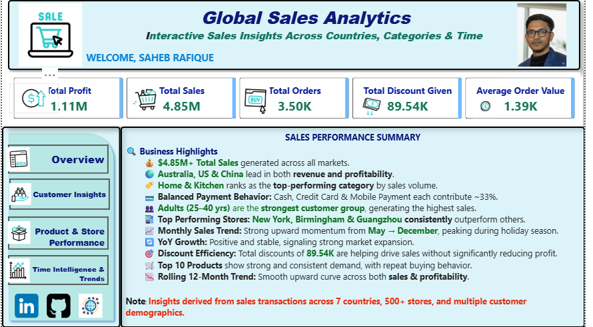
BEFORE Refresh – Dashboard Summary

Slide 4
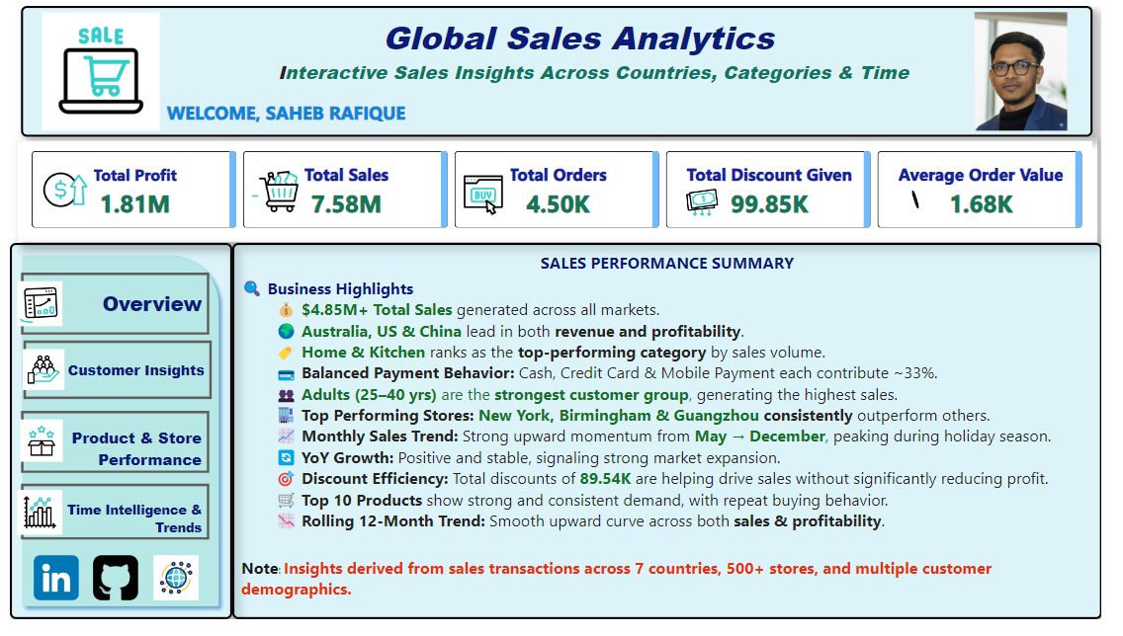
AFTER Refresh – Dashboard Summary

Slide 5
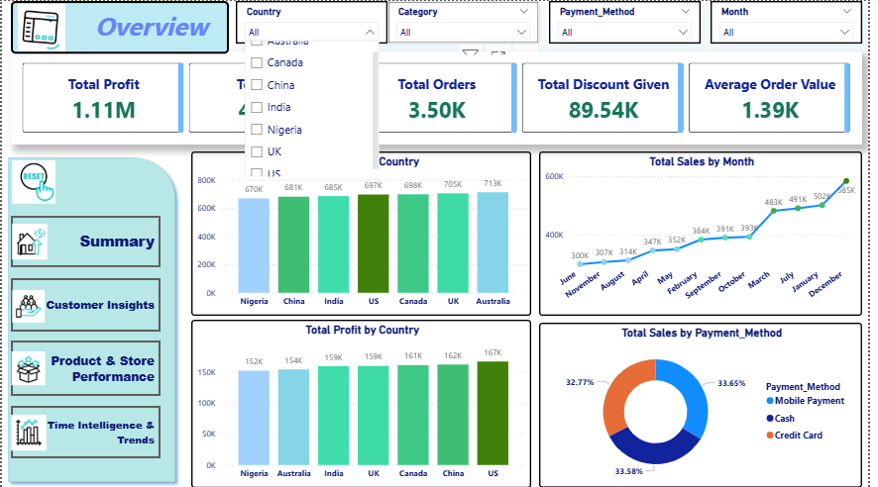
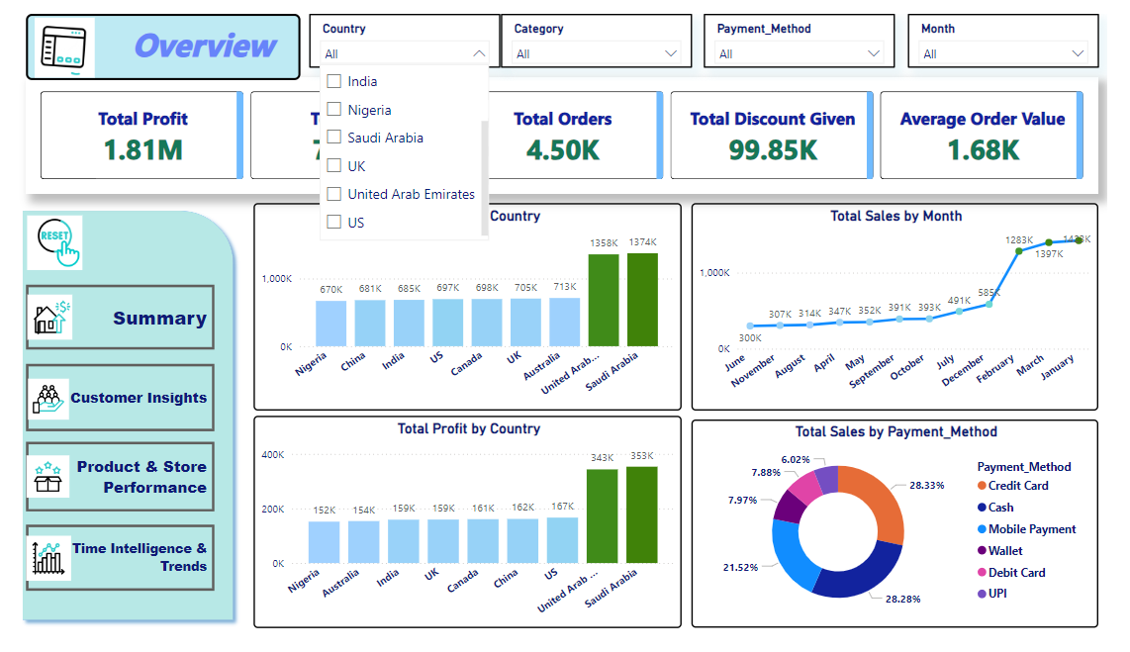
Before and After Refresh – Country Filter
Before
After

Slide 6
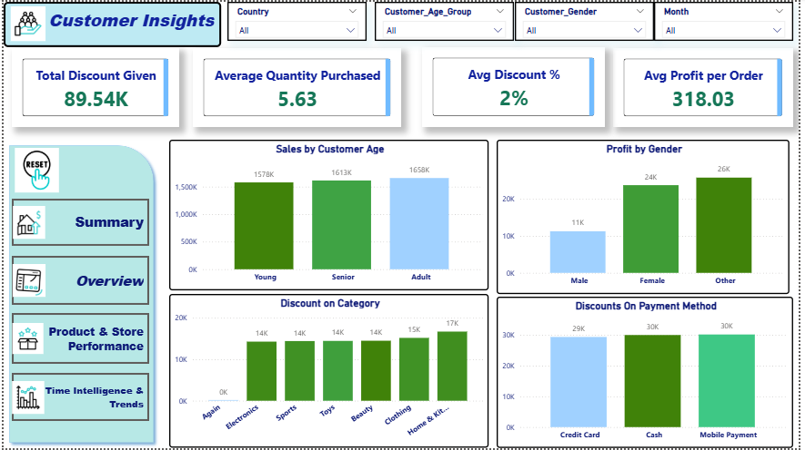
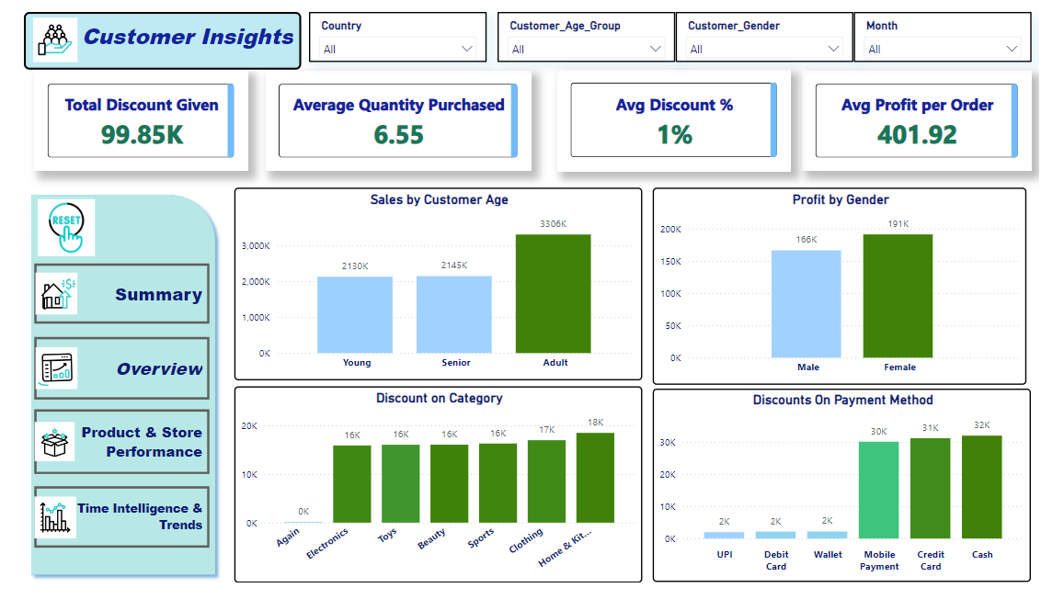
Before and After Refresh – Customer Insights
Before
After

Slide 7
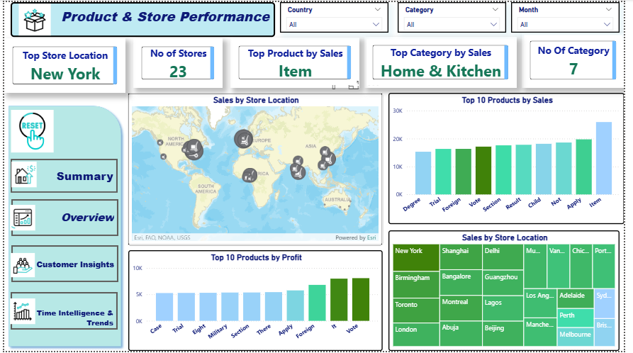
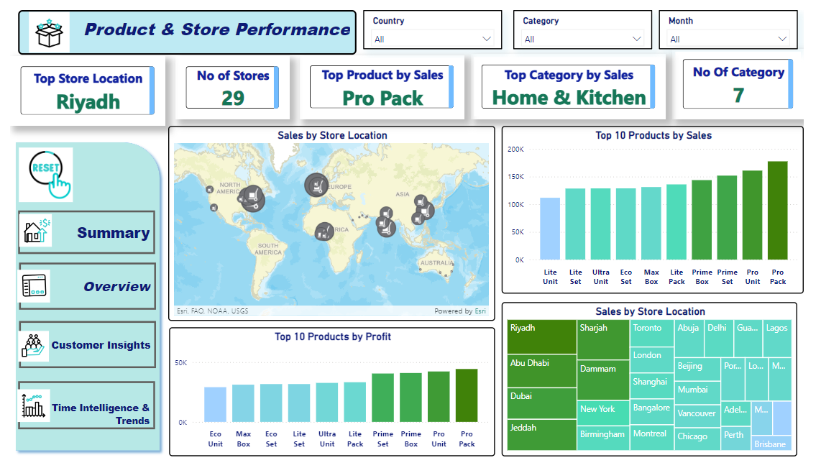
Before and After Refresh – Product and Store Performance
Before
After

Slide 8
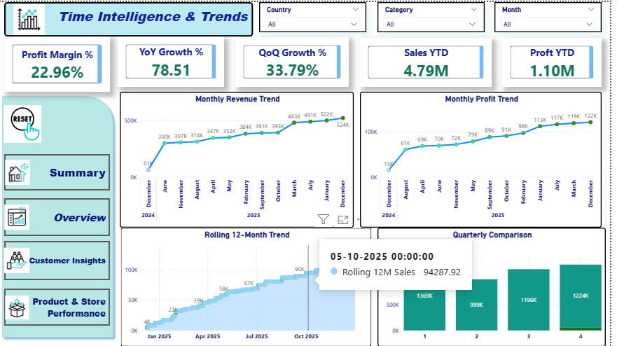
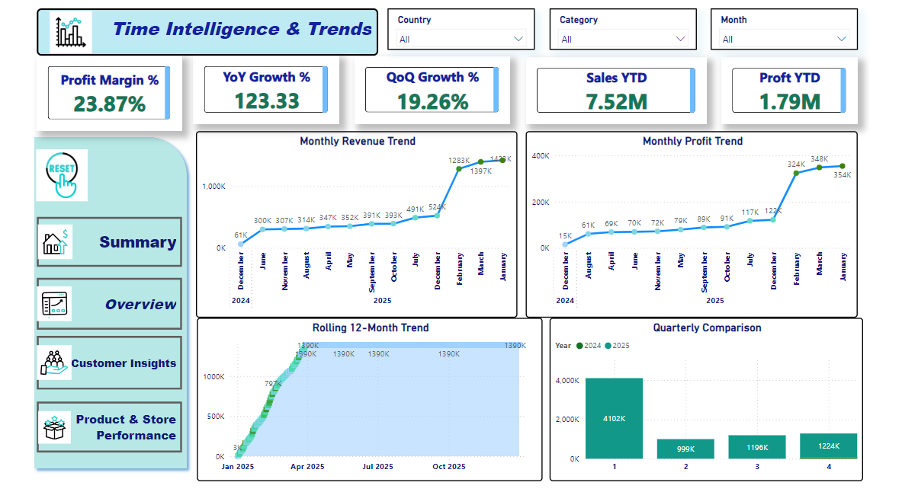
Before and After Refresh – Time Trends
Before
After

Slide 9
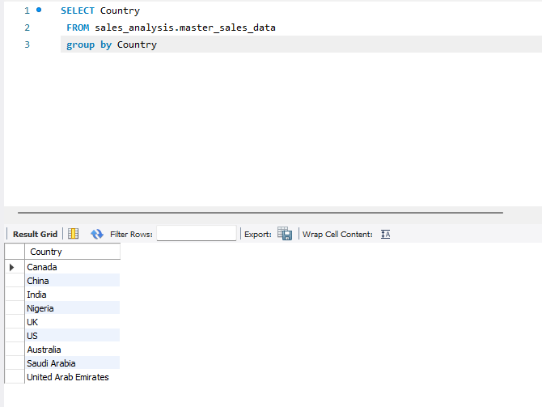
SQL & Data Update Process
• Inserted Saudi Arabia & UAE records into MySQL master table.
• Updated Profit & Total Amount calculations.
• Ensured consistent schema and formatting for Power BI ingestion.

Slide 10
Fabric - Gateway Automation
Successfully connected Microsoft Fabric to the MySQL database using the On-Premises Data Gateway, enabling secure, real-time access to local data from the cloud environment.
Configured, mapped, and validated the semantic model connection to ensure Power BI/Fabric could correctly read and query the updated MySQL tables.
Set up a scheduled refresh cycle so the dashboard automatically updates on a daily basis without manual intervention, ensuring stakeholders always see the latest sales insights.
Performed a manual on-demand refresh to confirm the gateway connection, refresh pipeline, and semantic model were functioning correctly before full automation.

Slide 11
Why We Used Gateway Instead of Direct-Query in Power BI
MySQL does not support Direct-Query natively in Power BI Service
Power BI Desktop can connect to MySQL,
but Direct-Query mode is not supported for refresh in Power BI Service.
Without Direct-Query, publishing the report would not allow real-time queries.
🔹 To enable automatic updates, we used the On-Premises Data Gateway
The Gateway securely connects Power BI Service with the local MySQL Server.
It allows Power BI to refresh the dataset on a schedule or manually.
No need to republish the PBIX file every time the database changes.
🔹 Gateway enables enterprise-grade data refresh
Supports encrypted credential storage.
Automatically refreshes the semantic model from MySQL.
Ensures the dashboard always reflects the latest sales records.
🔹 Result
After adding Saudi Arabia & UAE data to MySQL,
the Power BI dashboard updated automatically after Gateway refresh
— demonstrating successful automation.

Slide 12
Key Outcomes
• Dashboard updated instantly with new regions.
• Fully automated BI workflow achieved.
• No manual imports needed.
• Scalable for future countries and datasets.

Slide 13
Final Remarks
This project demonstrates a complete Data Analytics + BI pipeline:
Excel → SQL → Transformation → Fabric Gateway → Power BI Automation.
A strong showcase of automation, modeling, and professional dashboard development.

