Slide 1

SMARTSHELF
A Web-Based Library Management System
PROJECT PROPOSAL REPORT
HDIT 21193
User Experience & Interface Design
Year 2 · Semester 1
HTML · CSS · JS · PHP · MySQL
Notes:
Welcome the panel and introduce SmartShelf as a complete, working web-based library management system built from core web technologies — no frameworks. Note the module (HDIT 21193, User Experience and Interface Design) and that this is a full application, not a mock-up.

Slide 2


INTRODUCTION
From Paper Registers to a Modern System
Traditional libraries still lean on manual, paper-based routines — printed catalogues, hand-written loan registers and fines worked out at the counter.
These methods work, but they no longer match what readers expect: instant search, self-service access and automatic reminders across every device.
SmartShelf brings the entire borrowing lifecycle into one secure, responsive web application — built directly with core web technologies to demonstrate real command of how the web works.
The manual way
Slow retrieval · error-prone counts
Missed reminders · no digital access
The SmartShelf way
Instant search · live availability
Automatic fines · eBooks anywhere
SmartShelf · Library Management System
1
Notes:
Set the scene: manual library processes are familiar but increasingly inadequate. Contrast the manual way with the SmartShelf way. Emphasise the deliberate choice to build with core web technologies (HTML, CSS, JS, PHP, MySQL) rather than a framework — this shows genuine understanding and full control.

Slide 3






PROBLEM STATEMENT
Six Problems With Conventional Practice
Inefficient searching
Manual inventory
Weak overdue tracking
Titles located by hand cause long delays.
Hand-kept counts drift and become inaccurate.
Fines mis-calculated; reminders rarely sent.
Limited interaction
Poor reporting
No digital services
No reservations, history or online reading.
Little insight into how the collection is used.
Members must attend in person to borrow.
SmartShelf · Library Management System
2
Notes:
Walk through the six recurring deficiencies of traditional systems. Stress that each was treated as a firm design requirement, not an optional extra. These six problems map directly to the features shown later.

Slide 4

AIM & OBJECTIVES
What the Project Sets Out to Achieve
AIM Design and build a secure, responsive and genuinely usable library system that modernises borrowing for members and staff alike.
Efficient searching, borrowing, reserving and reading of materials.
Automated inventory with availability accurate in real time.
1
2
Automatic fine calculation with timely deadline notifications.
Clear dashboards and reporting for librarians and administrators.
3
4
Modern extras: QR codes, recommendations and a digital library.
Secure, accessible and fully responsive on every device.
5
6
SmartShelf · Library Management System
3
Notes:
State the single overarching aim, then run through the six objectives. Point out that the objectives correspond one-to-one with the problems on the previous slide — every problem has a matching objective.

Slide 5


SCOPE
What the System Does — and Doesn't
Within scope
Outside scope (future work)
Registration, authentication & role-based access
Catalogue management and classification
Full issue-and-return workflow, live availability
Reservation queue for on-loan titles
Automatic fines and notifications
Administrative reporting & dashboards
Digital library — read and download eBooks
Public browsing pages for prospective members
Online payment gateways for fine settlement
Links to national / inter-library networks
Dedicated native mobile applications
The responsive web interface already serves mobile users well; these are natural next steps, not gaps.
SmartShelf · Library Management System
4
Notes:
Clarify boundaries. Everything in the borrowing lifecycle is in scope. The three exclusions were deliberate choices to keep the project focused and achievable, and each is a sensible direction for future development.

Slide 6



USERS & ROLES
Three Roles, Cumulative Access
Member
Librarian
Administrator
Search & browse catalogue
Borrow, return & reserve
Read & download eBooks
History, fines & reviews
All member actions, plus:
Issue & return at the desk
Manage reservations & catalogue
QR scanning at the counter
All librarian actions, plus:
Manage user accounts
Inspect the activity log
Access analytics & reports
Access is cumulative — each higher role inherits every capability of the roles beneath it.
SmartShelf · Library Management System
5
Notes:
Explain the three roles and the cumulative access model: librarians can do everything members can, administrators everything librarians can, plus extra privileges. Mention that access control is enforced throughout and unauthorised requests are redirected.

Slide 7




FUNCTIONAL FEATURES
Core Functionality
Borrow & return
Reservation queue
Available copies adjust the instant a transaction happens.
The next member is notified automatically on return.
Automatic fines
Profiles & reviews
Recalculated at each login, so figures are always current.
Personal history, plus ratings and reviews of titles.
SmartShelf · Library Management System
6
Notes:
Cover the four core capabilities. Highlight two design decisions: available-copy counts update in real time, and fines are recalculated at every login so the member always sees an accurate figure.

Slide 8





FUNCTIONAL FEATURES
Advanced Features That Go Beyond
Smart search & filters
Recommendations
QR-code identification
Instant results by title, author or ISBN.
Suggested from history and overall popularity.
Fast issuing and returns at the counter.
Digital library
Automated alerts
Analytical dashboards
Selected titles read and downloaded on screen.
Due dates, overdue items and ready reservations.
Trends, popular titles and top borrowers.
Plus light & dark display modes, remembered between sessions.
SmartShelf · Library Management System
7
Notes:
These features lift the system above the merely functional. Call out QR-code identification, the recommendation engine and the digital library as the three that go well beyond the assignment requirements.

Slide 9
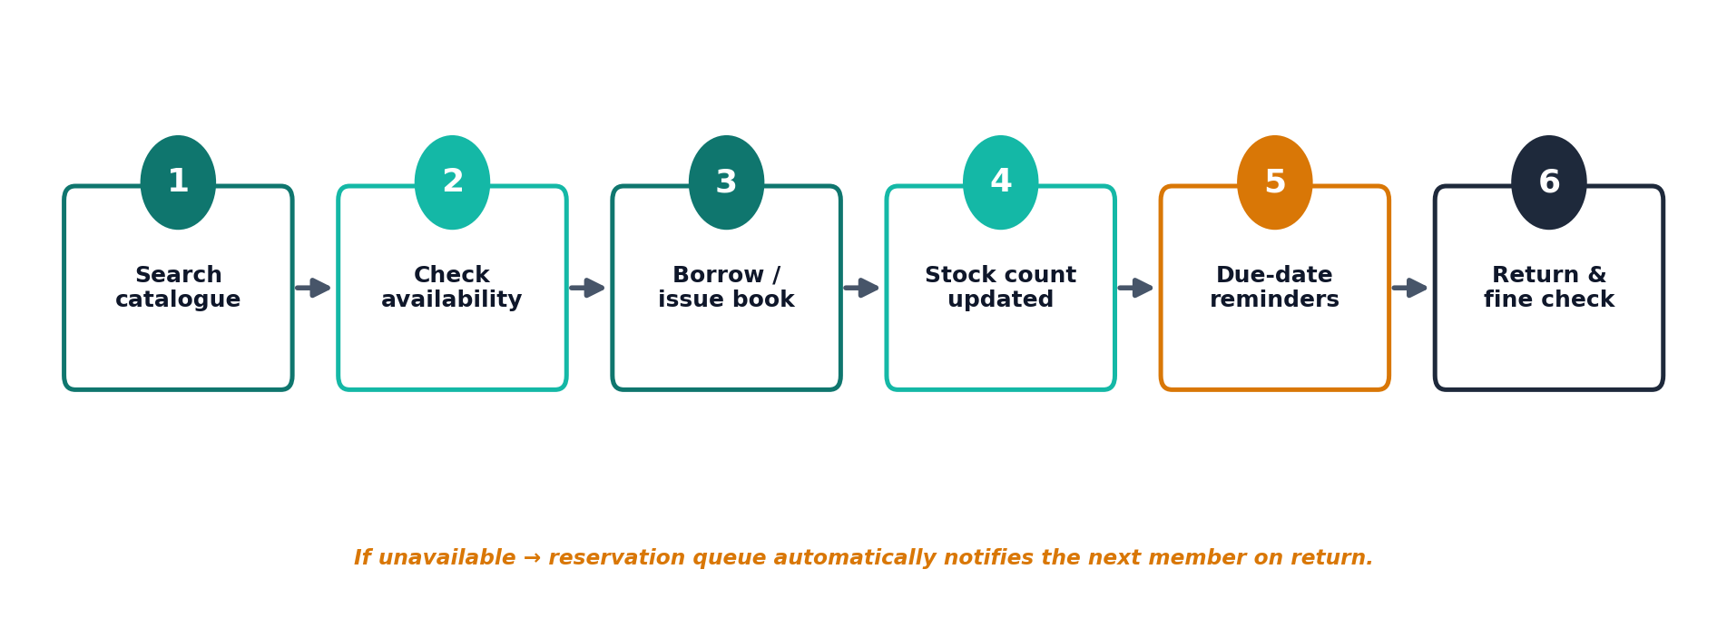
HOW IT WORKS
The Core Borrowing Workflow
A reservation queue closes the loop: if a title is unavailable, the next member is notified the moment it is returned.
SmartShelf · Library Management System
8
Notes:
Trace the borrowing journey end to end: search, check availability, issue, stock update, reminders, return and fine check. Emphasise that these steps are fully automated and that the reservation queue handles the unavailable case.

Slide 10
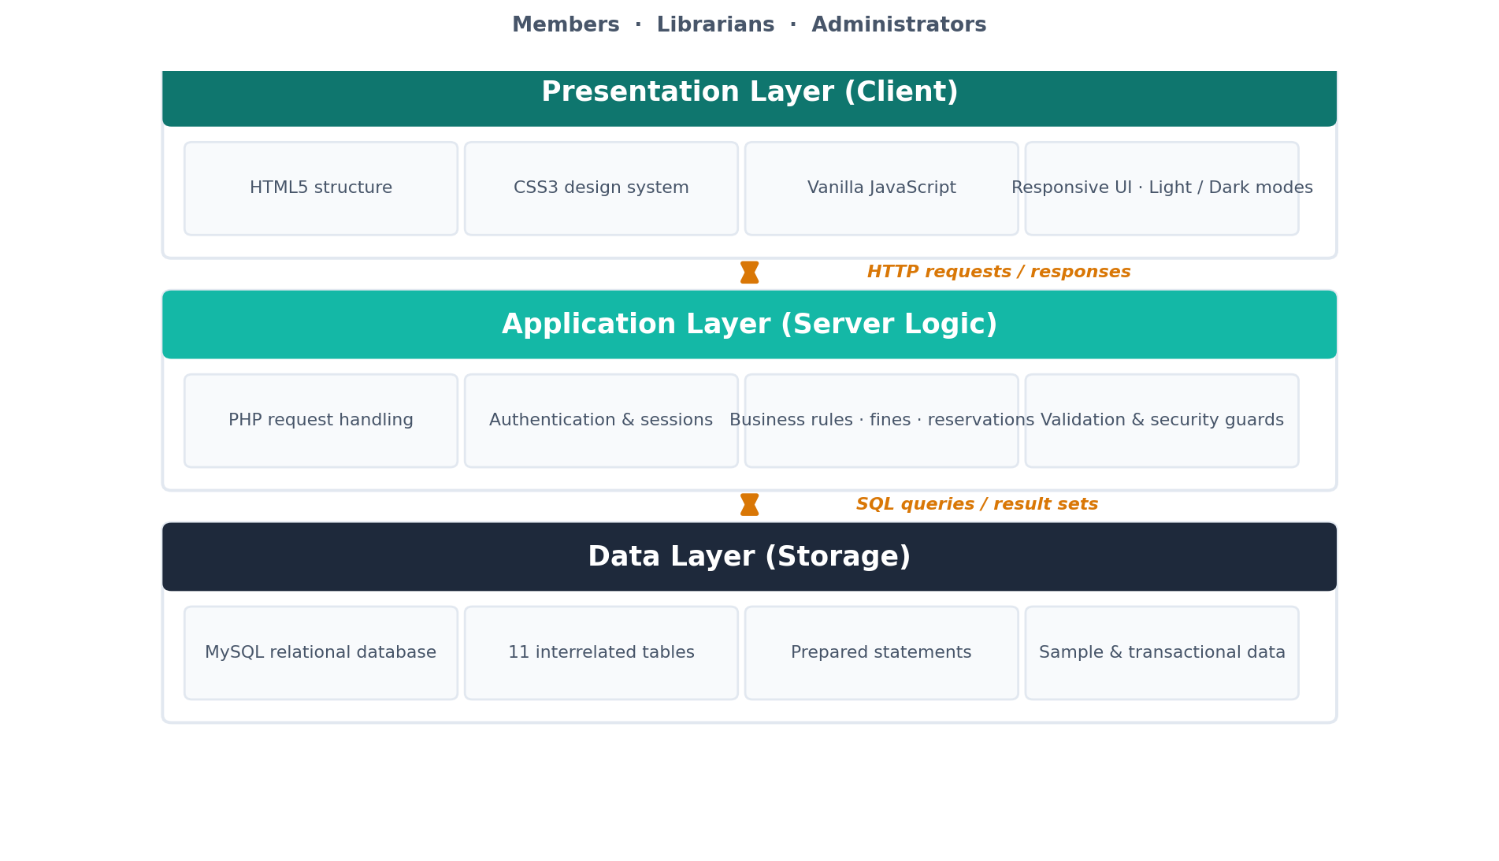



SYSTEM ARCHITECTURE
A Clean Three-Tier Design
Presentation
What the user sees — HTML, CSS and JavaScript.
Application
The rules and logic, handled in PHP.
Data
Where everything is stored — MySQL.
Each tier is independent — one can change without disturbing the others.
SmartShelf · Library Management System
9
Notes:
Explain why a three-tier architecture matters: presentation, logic and data are kept independent, so each can change without disturbing the others. This separation makes the system easier to maintain and reason about.

Slide 11






TECHNOLOGY STACK
Core Web Technologies — No Frameworks
HTML5
CSS3
JavaScript
PHP
MySQL
Structure
Design system · themes
Client logic (vanilla)
Server logic
Relational storage
Why no framework? Building from first principles demonstrates real understanding of the web and keeps every component fully under our control.
SmartShelf · Library Management System
10
Notes:
Walk left to right through the five technologies and the layer each serves. Then land the key message in the banner: choosing no framework was deliberate — it proves genuine understanding and gives full control over every part of the system.

Slide 12
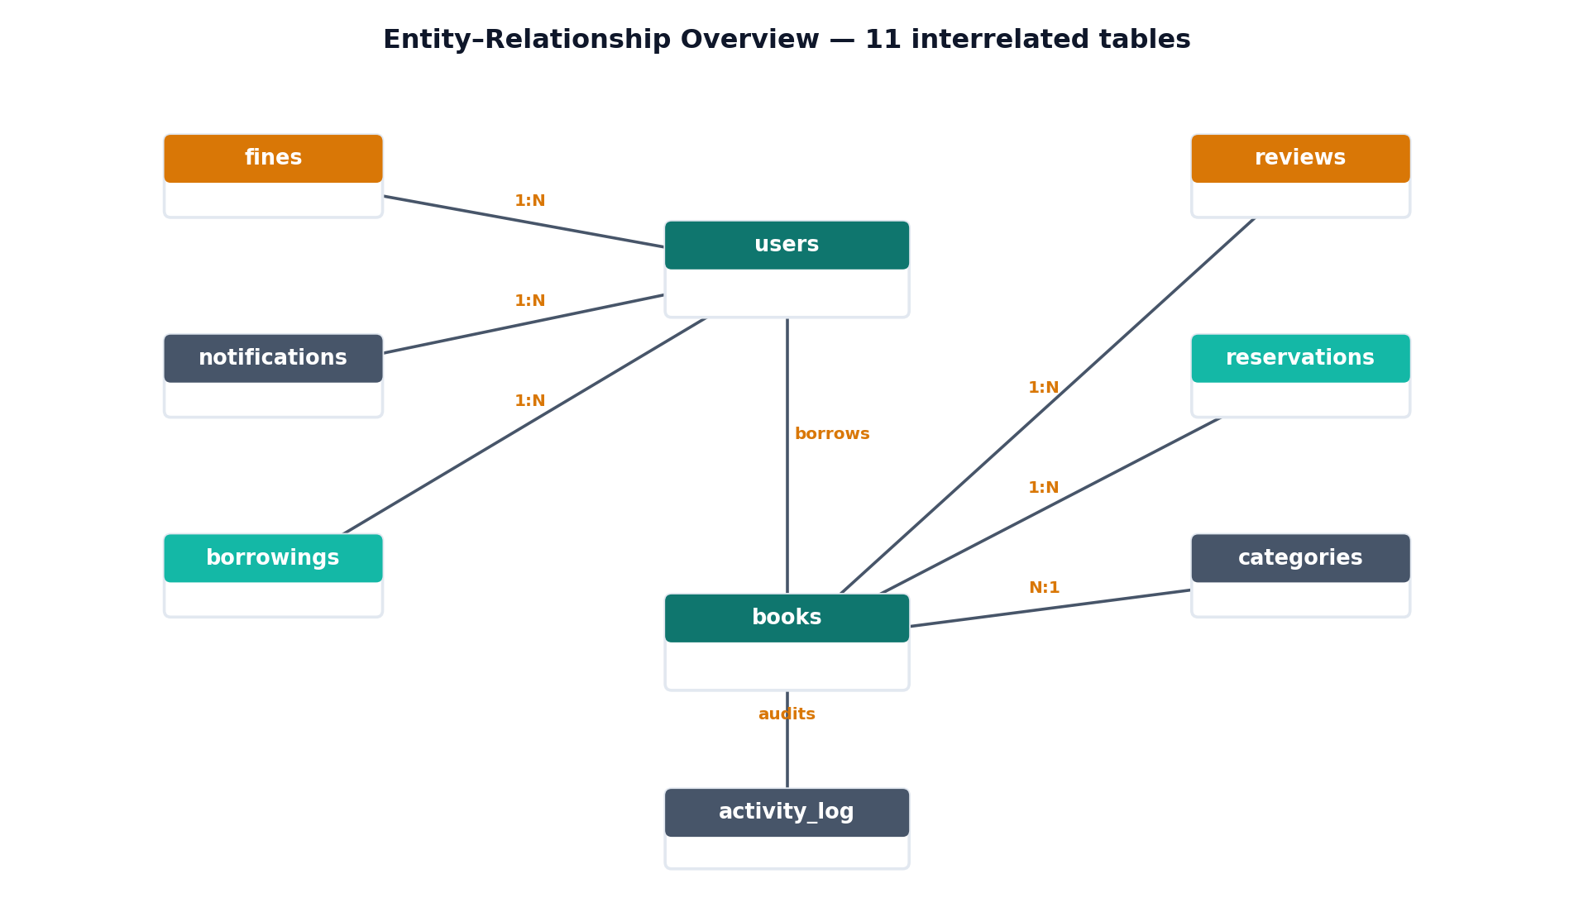
DATABASE DESIGN
Eleven Interrelated Tables
11
relational tables
3+
normalised design
Live
sample data by import date
SmartShelf · Library Management System
11
Notes:
The relational schema has eleven tables — well beyond the three required. Data is normalised so each fact is stored once. Highlight the neat touch: borrowing dates are generated relative to import date, so the demo data always looks current and overdue detection works immediately.

Slide 13




SECURITY
Built In From the Start
Password hashing
SQL injection
password_hash() / verify() — never plain text.
Prepared statements on every query.
XSS protection
CSRF tokens
Input sanitised in, escaped out.
Every form validated; bad tokens rejected.
Session security
Access control
HttpOnly / SameSite cookies; ID regenerated.
Page-level guards confine each role.
Validation runs on both sides: JavaScript for instant feedback, PHP as the authoritative safeguard.
SmartShelf · Library Management System
12
Notes:
Security was a foundation, not an afterthought, because the system holds personal accounts. Run through the six measures against the most common web threats. Close with the point about client- and server-side validation, PHP being authoritative.

Slide 14



INTERFACE & EXPERIENCE
Designed With Care
Bespoke design system
Fully responsive
Light & dark modes
A consistent palette, spacing, type and reusable components applied across every page.
From a wide desktop dashboard to a single-column mobile layout with a collapsible menu.
Animated stats, hover effects, scroll transitions and a live password-strength meter.
SmartShelf · Library Management System
13
Notes:
Because this is a UX & interface design module, emphasise the deliberate design work: a bespoke design system for coherence, a fully responsive layout, and thoughtful interactive details plus light/dark modes for comfort and accessibility.

Slide 15


SIGNIFICANCE
What Sets SmartShelf Apart
Complete & working
Beyond requirements
End-to-end tested
No placeholders — every function runs in a standard XAMPP setup.
Adds QR codes, recommendations and a digital library.
Verified against a live database, from login to reporting.
“Complete, secure and responsive — ready to be deployed in a real library, not a demonstration that stops at the surface.”
SmartShelf · Library Management System
14
Notes:
Summarise the three things that distinguish SmartShelf: it is genuinely complete, it exceeds the requirements, and it has been tested end to end against a live database. This is a deployable system, not a surface-level demo.

Slide 16

Conclusion
SmartShelf replaces slow, manual routine with a single, secure and responsive application — meeting every requirement and going beyond them with modern, thoughtfully chosen features.
Thank you — questions welcome.
SmartShelf · A Web-Based Library Management System · HDIT 21193
Notes:
Close by restating the core message: SmartShelf modernises library management in one secure, responsive, complete application that meets and exceeds the brief. Thank the panel and invite questions.

