Slide 1
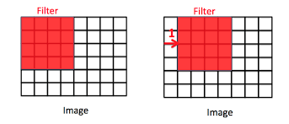
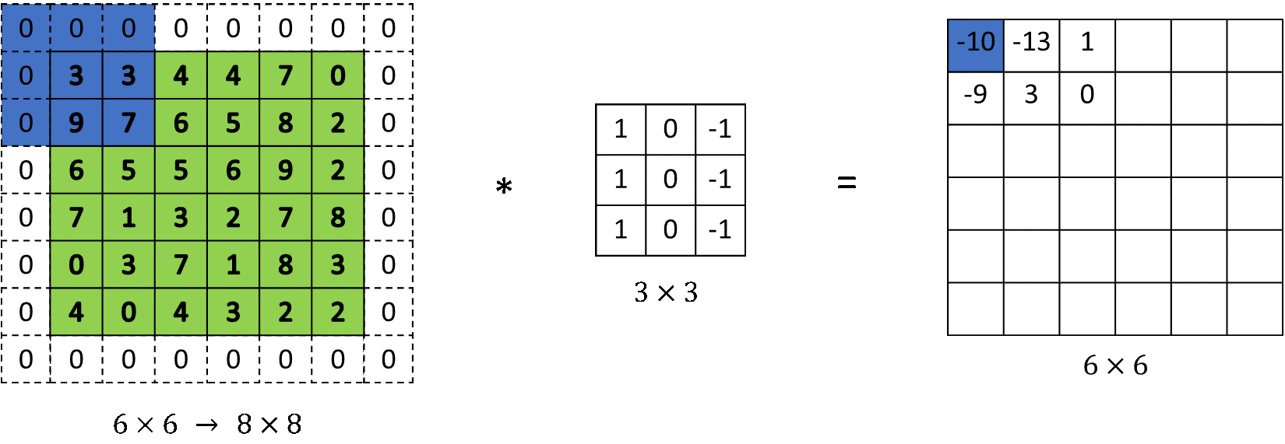
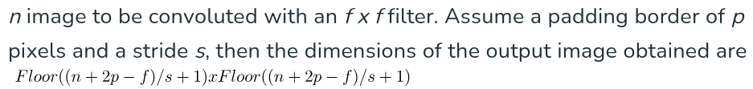
Effect of stride,padding and pooling

Slide 2
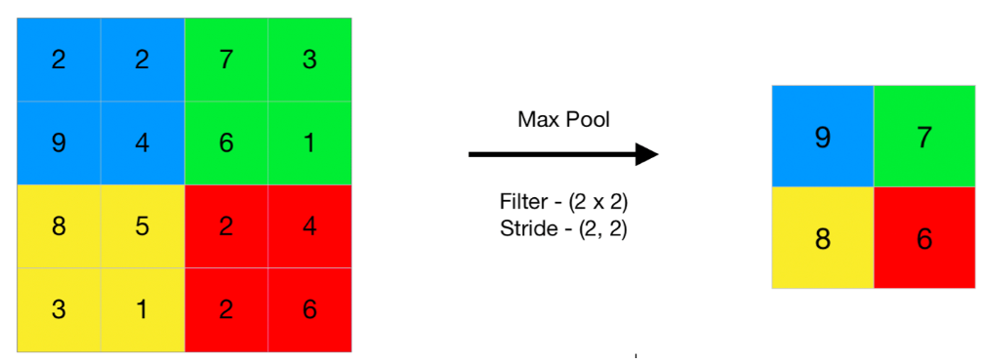
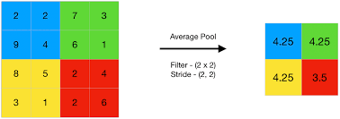
Pooling
Max pooling
Selects the maximum value from the pooling window
Use Case: Commonly used to enhance the most dominant patterns, such as edges or textures, while reducing the spatial dimensions of the feature map.
Max pooling
Average pooling
It computes the average of all values in the pooling window.
Use Case: Often used when preserving background information or reducing noise is important.
Average pooling

Slide 3
Example
Consider an MNIST image of size 28 × 28 with:
Convolution Layer:
Kernel size = 3 × 3
Stride = 1
Padding = 1
Max Pooling Layer:
Pool size = 2 × 2
Stride = 2
Step 1: Convolution Layer Calculation
The formula to calculate the output size after a convolution layer is:
Output Size=(W−K+2P)S+1
For the convolution layer:
Output Size = (28−3+2×1)1+1 =28
Image size ; 28 x 28
Step 2: Pooling Layer Calculation
For pooling layers (e.g., MaxPool), the formula is:
Output Size=(W−K)/S+1
For the pooling layer:
Output Size = (28−2)/2+1 = 14
Image size : 14 x 14

Slide 4
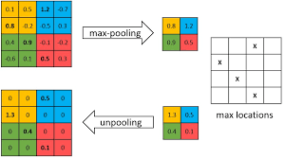
Backpropagation in through pooling layer
Max-pooling layer : Pass the gradient corresponding to max value cell and pass 0 as gradient for others

Slide 5
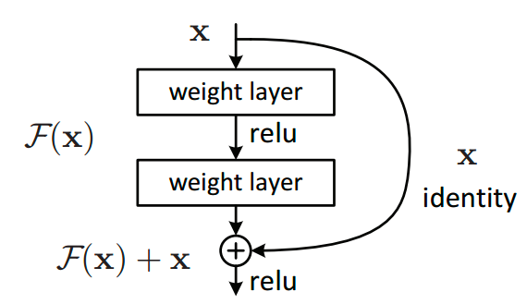
Resnet
Skip connections to tackle vanishing gradient problem

Slide 6
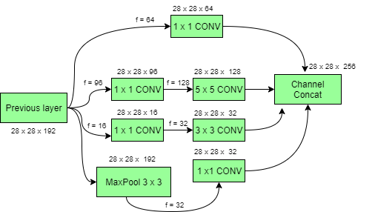
Inception net(Googlenet)
We often can't determine the optimal filter size, as the features extracted vary with the filter size. To address this, the model employs multiple filter sizes in parallel to capture diverse features.

Slide 7
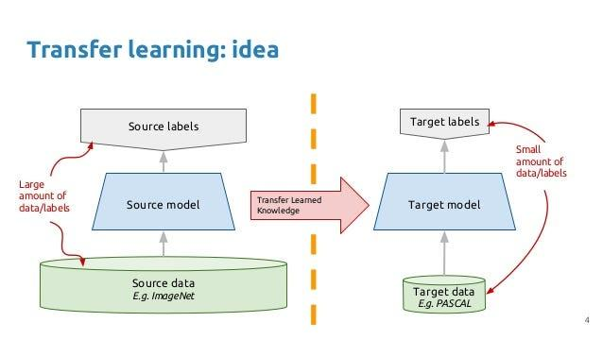
Transferability of initial layers
Initial Layers Learn General Features:
Early layers in a CNN capture low-level features such as edges, textures, and simple patterns.
These features are often universal across different vision tasks, making them transferable.
In ssl, you will study about in which cases this transfer of initial layers is feasible i.e useful and provides good results. Factors can be like domain matching can effect the results.

Slide 8
Revision : CNN property
Local Feature Detection:
CNNs detect patterns using small receptive fields (local regions) rather than analyzing the entire image at once (unlike Transformers, which focus on global dependencies).
This local approach makes CNNs efficient for tasks like edge detection, texture recognition, etc.
Result of this local detection : Translation invariance and Rotation variance:
CNNs exhibit translation invariance due to shared weights and pooling layers, meaning the network can recognize the same feature even if it shifts slightly.
However, CNNs are not inherently rotation invariant, meaning a rotated feature may appear unfamiliar unless rotation-specific augmentations or architectures like Capsule Networks are used.

