Slide 1
Customer Churn Prediction
Machine Learning Project

Slide 2
Introduction
Customer churn refers to the rate at which customers stop doing business with a company.
It's a critical metric for businesses, especially those in industries with subscription-based or recurring revenue models, like telecommunications, banking, and e-commerce.
Predicting customer churn is important because it allows companies to take proactive measures to retain customers, thereby reducing revenue loss and maintaining a stable customer base.

Slide 3
Advantages of churn prediction
Retention: By identifying customers who are likely to churn, companies can take proactive steps to retain them. This could include offering discounts, improving customer service, or providing personalized offers.
Cost savings: Acquiring new customers is often more expensive than retaining existing ones. Predicting churn allows companies to focus their resources on retaining current customers, which can lead to cost savings in the long run.
Customer satisfaction: Predicting churn and taking steps to prevent it can lead to higher levels of customer satisfaction. Satisfied customers are more likely to remain loyal and recommend the company to others.
Revenue stability: Churn prediction helps companies maintain a stable revenue stream by reducing the impact of customers leaving. This is particularly important for businesses with recurring revenue models.

Slide 4
Overall Approach
Exploratory Data Analysis
Data Preprocessing
Machine Learning Model Development
Model Evaluation
Predicting Churn
Feature importance
Recommendations

Slide 5
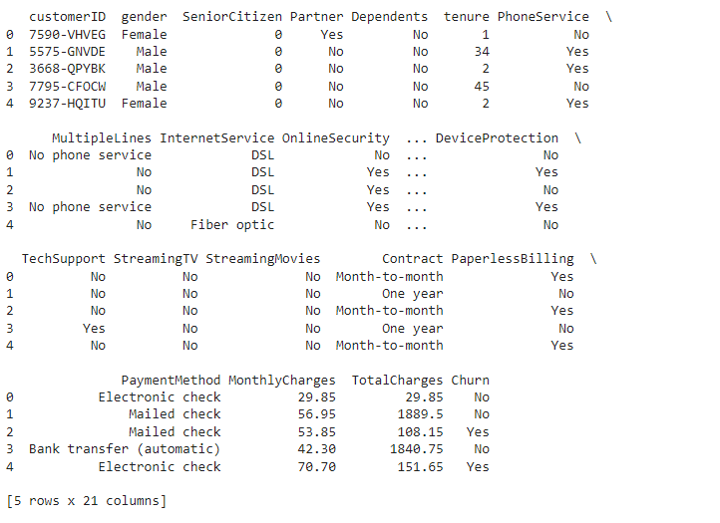
Approach
Imported the dataset and required libraries for manipulation on data.
Libraries such as pandas, matplotlib, seaborn, accuracy_score etc.
Started with loading our dataset into a data frame.

Slide 6
Approach
Checked the dataset’s information i.e the data types and column names. (21 columns and dtypes: float64(1), int64(2), object(18))
Checked if there are any null columns. (none)
Checked the distribution of the target variable 'Churn’.
Yes = 1869
No = 5174

Slide 7
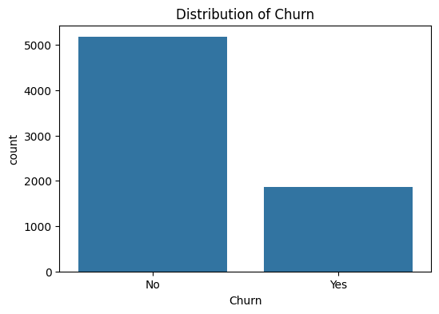
EDA

Slide 8
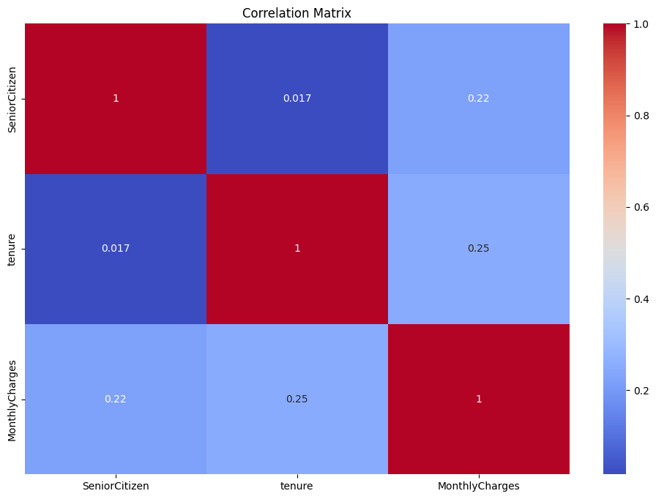
EDA

Slide 9
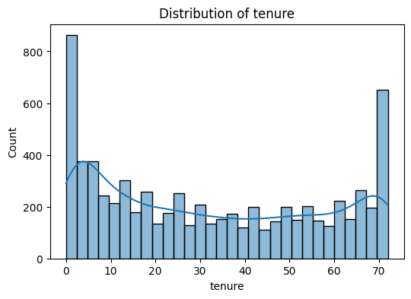
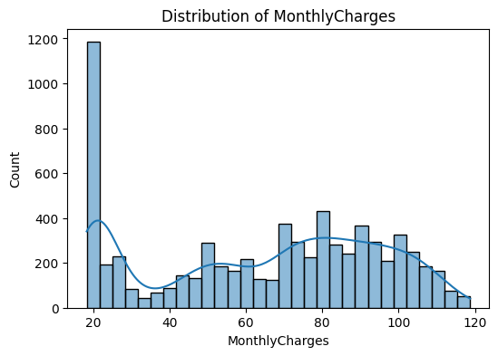
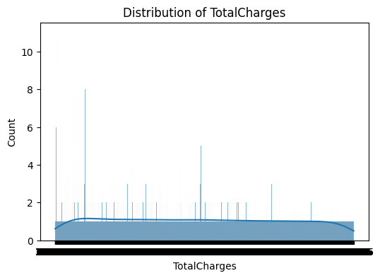
EDA

Slide 10
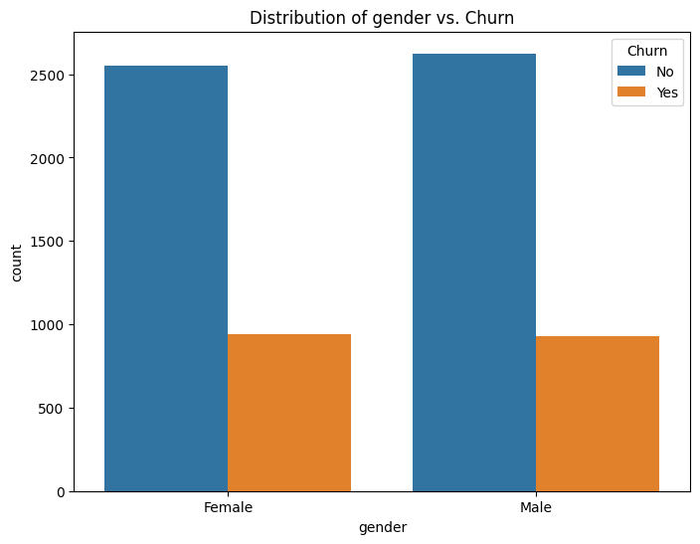
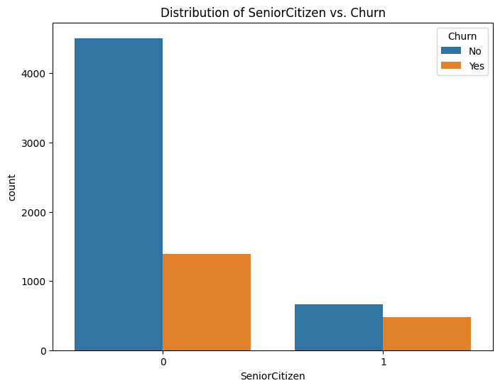
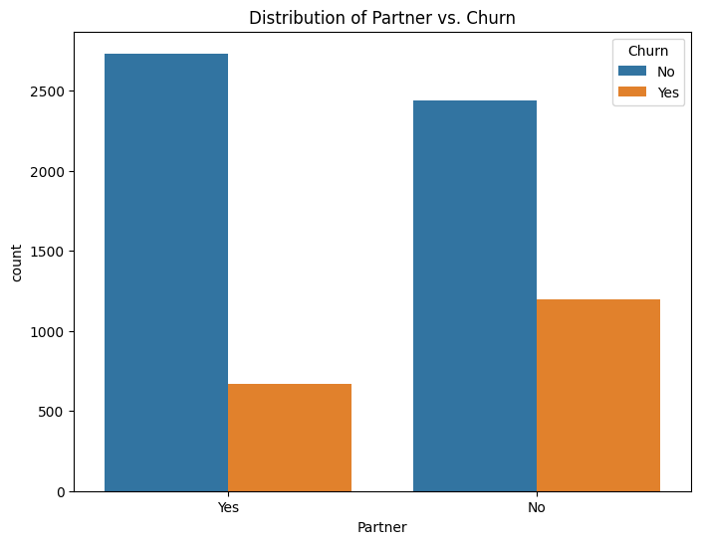
EDA

Slide 11
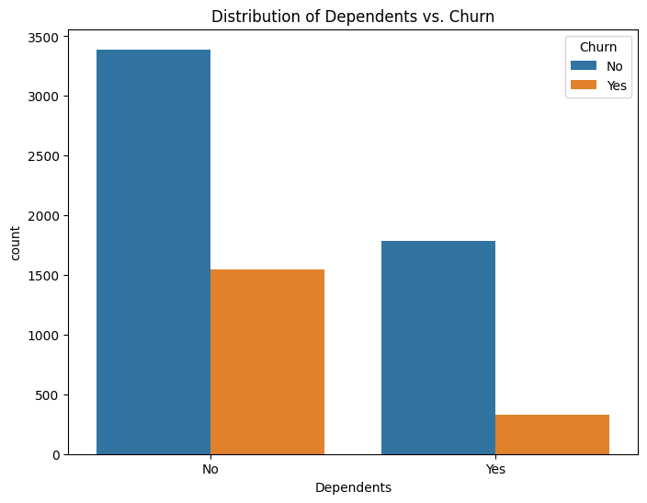
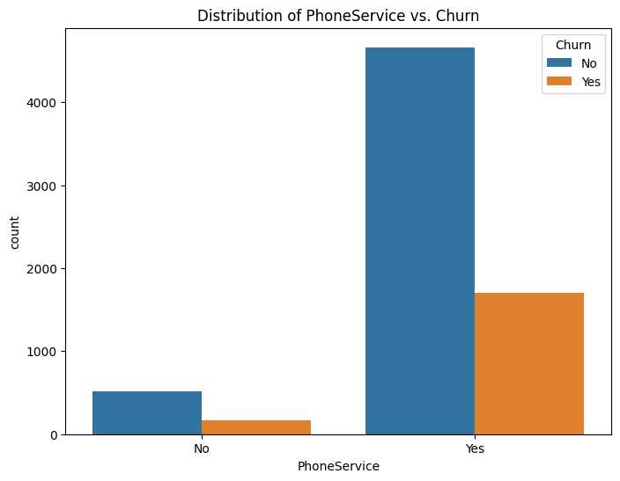
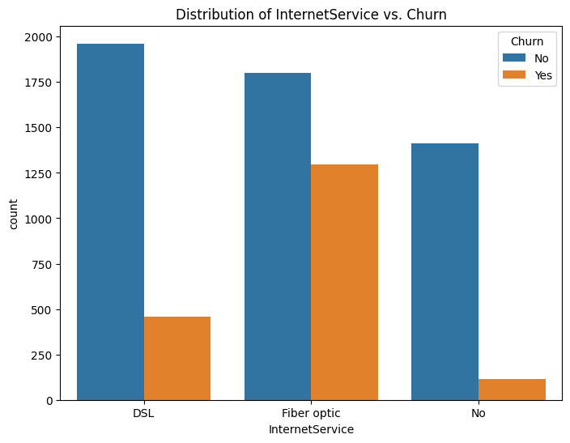
EDA

Slide 12
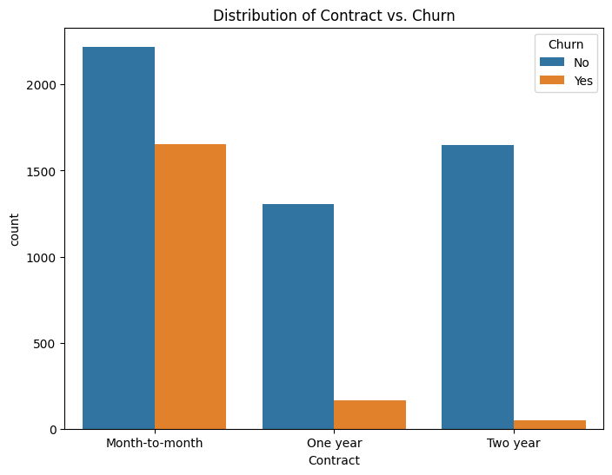
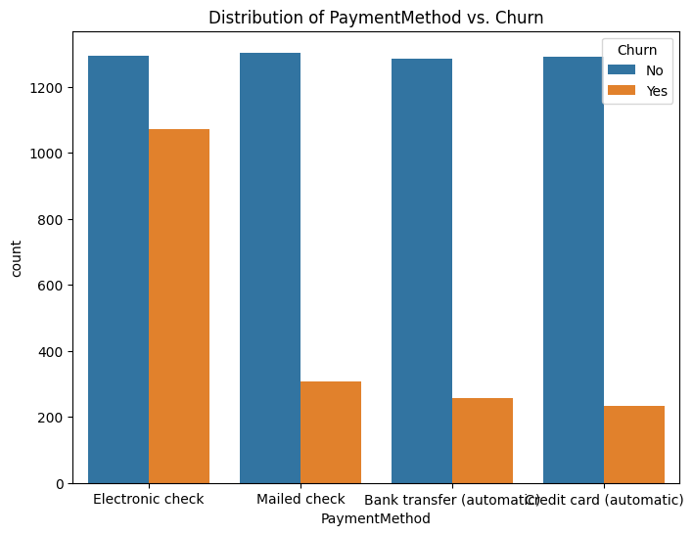
EDA

Slide 13
Approach
Split the data set into train and test sets.
Scaled and encoded the features that required scaling and encoding using standard scalar and one hot encoded functions.
Train the datasets using Logistic Regression, Decision Trees, Random Forest, Gradient Boosting and AdaBoost.
Used Accuracy, Precision, Recall, F1 Score and Roc Auc Score as evaluation Matrix.
Evaluated the models on the test set.

Slide 14
Results
Metrics | Logistic Regression | Decision Tree | Random Forest | Gradient Boosting | AdaBoosting
Accuracy | 0.825 | 0.778 | 0.794 | 0.814 | 0.813
Precision | 0.701 | 0.597 | 0.664 | 0.704 | 0.665
Recall | 0.592 | 0.501 | 0.450 | 0.512 | 0.592
F1 Score | 0.642 | 0.545 | 0.536 | 0.593 | 0.626
Roc Auc Score | 0.861 | 0.689 | 0.843 | 0.863 | 0.857

Slide 15
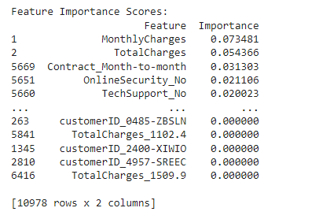
Approach
Checked the feature importance

Slide 16
Recommendations
Dataset is highly imbalanced, we can go for approaches like oversampling, undersampling etc.
To entice consumers with greater monthly or total charges to stay, provide lower rates or exclusive promotions.
Provide perks like lowered prices or more services to entice clients to move to longer-term agreements.
Improve tech support and internet security while informing consumers about their significance.
To guarantee general client happiness and retention, keep an eye on and handle difficulties pertaining to the less significant aspects.

