Slide 1

CREDIT CARD FRAUD
Insights

Slide 2
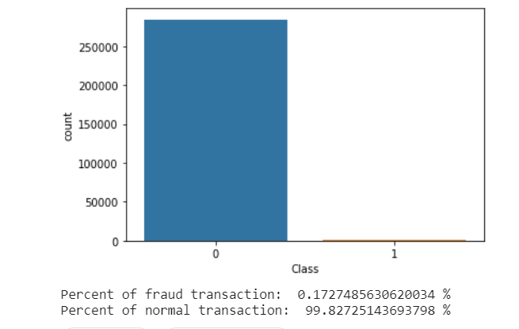
VALID V/S FRAUD TRANSACTION
For the two days of transactions, out of 284,807 transactions, 492 transactions (0.17%) were detected as fraud.
Amount wise, valid transactions was around 25M EUR and fraud transactions was around 60K EUR, 0.24% of total amount.

Slide 3
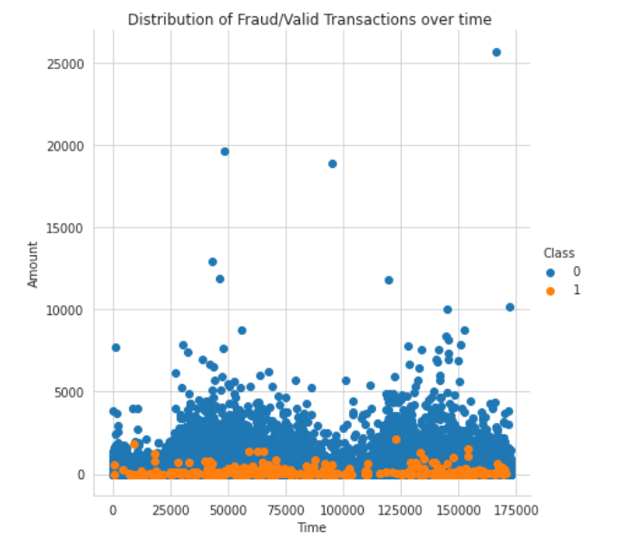
DISTRIBUTION OF TRANSACTIONS OVER SECONDS
Fraudulent transactions are occurring randomly over the two days analyzed.

Slide 4
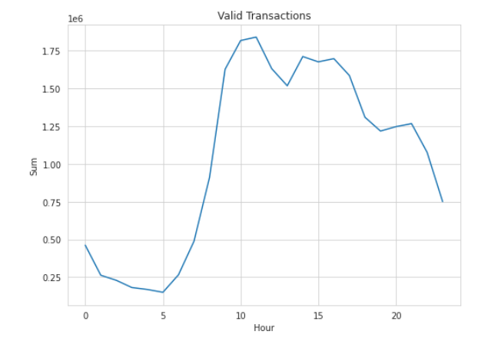
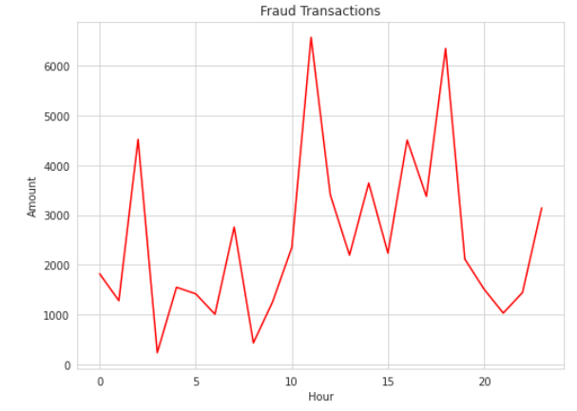
DISTRIBUTION OF TRANSACTIONS OVER HOUR
Genuine transaction are happening during day-time (9 to 21 hours).
Unlike genuine transactions, fraud transactions doesn’t have a clear pattern over hour of the day.

Slide 5
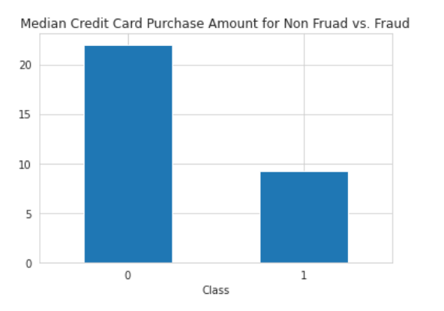
AMOUNT PATTERN – MEDIAN
50% of fraud transactions were below 10 EUR
50% of valid transactions were below 22 EUR

Slide 6
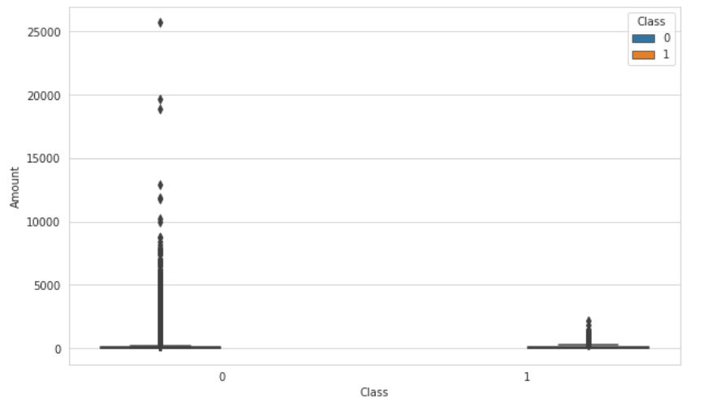
AMOUNT PATTERN – MAX AMOUNT
Max Fraud transaction amount was 2,125 . Highest valid transaction was 25,691, around 100 times higher than max fraud transaction.

