Slide 1
Online Retail Store Expansion Strategy
Creating Effective Visuals
Sahid Anwar
July 2025

Slide 2
Executive Summary
• This report provides answers to key questions posed by the CEO and CMO.
• The visuals support better business decisions regarding expansion and customer targeting.
• The data was cleaned and visualized using Jupyter Notebook and Power BI.
• Recommendations are based on revenue trends, customer behavior, and international demand.

Slide 3
Q1 – Monthly Revenue Trend (2011)
• Clear seasonal peaks observed in November.
• Lowest sales recorded in January and December.
• Tuesday and Thursday emerged as highest revenue weekdays.
• Trend helps forecast and prepare for seasonal demand.

Slide 4
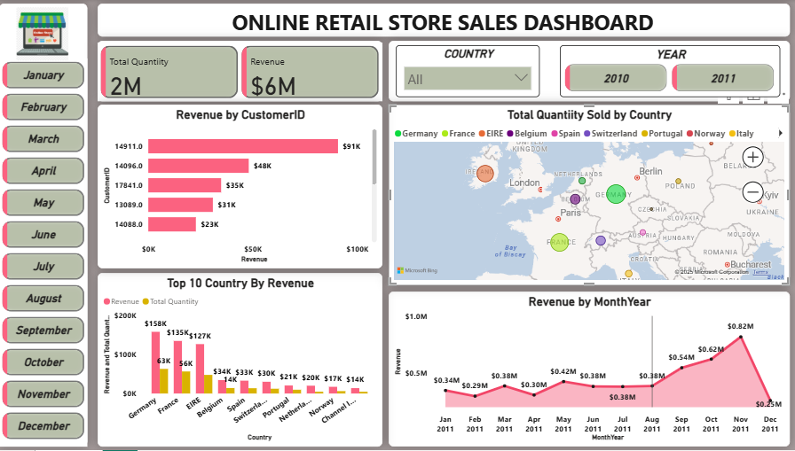
Monthly Revenue Trend (2011)Line Chart

Slide 5
Q2 – Top Countries by Revenue (Excl. UK)
• Germany, France, and Netherlands lead in international revenue.
• Germany generated the highest sales after UK.
• Quantity sold follows similar pattern with consistent demand.
• Indicates strong international expansion opportunities.

Slide 6
Top Countries by Revenue Chart (Excl. UK)

Slide 7
Q3 – Top 10 Customers by Revenue
• Revenue distribution follows the Pareto principle (80/20).
• Top 10% customers contribute over 60% of sales.
• High-value customers can be retained using loyalty strategies.
• Personalized offers may improve long-term engagement.

Slide 8
Top 10 Customers by Revenue Chart

Slide 9
Q4 – Country-Wise Product Demand (Excl. UK)
• Strong demand in Germany, Netherlands, France, and Switzerland.
• Consistency in monthly purchase patterns across these markets.
• Demand concentration useful for prioritizing expansion targets.
• Opportunity to launch region-specific campaigns.

Slide 10
Country-Wise Product Demand Chart (Excl. UK)
• Strong demand in Germany, Netherlands, France, and Switzerland.
• Consistency in monthly purchase patterns across these markets.
• Demand concentration useful for prioritizing expansion targets.
• Opportunity to launch region-specific campaigns.

Slide 11
Recommendations & Next Steps
• Expand operations in Germany, France, and Netherlands.
• Focus on loyalty and retention programs for top 10% customers.
• Monitor seasonal trends for demand-based inventory planning.
• Continue cleaning and tracking KPIs using dashboards.

