Slide 1
Customer Data Analysis and Predictive Modeling to Optimize Term Deposit Subscriptions in a Portuguese Banking Institution
Presented by
Md sk Sahidulla
m.Tech
Iit kanpur

Slide 2
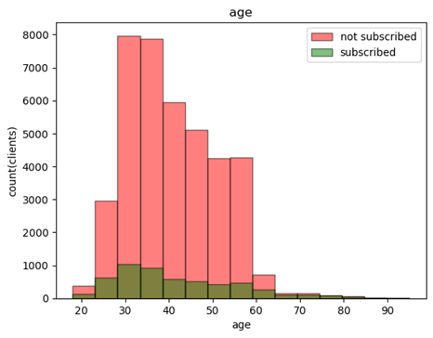
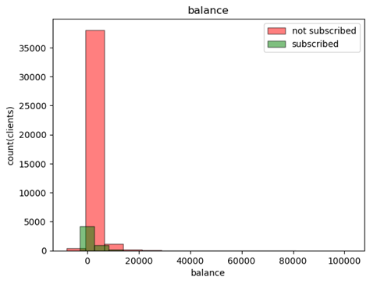
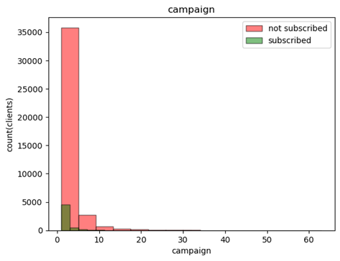
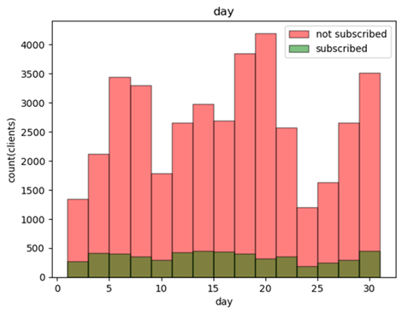
Analysis of numerical features
Youngest client is 18 years old and oldest one is 95 years old.
90% of clients are less than 56.0 years old.
Minimum balance is -8019 rupees and maxium is 102127 rupees.
50% of clients have less than 448.5 rupees balance.
90% of clients have balance less than 3574 rupees.
Minimum no of contacts were performed one time and maximum is 63 times. 50% of clients were contacted either one or two times.

Slide 3
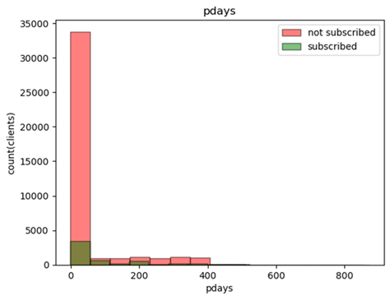
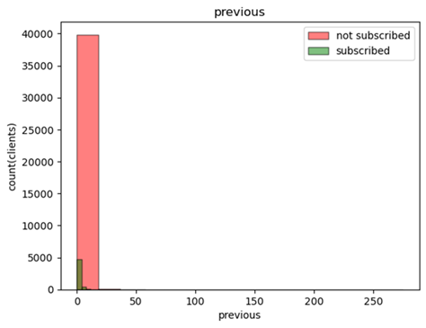
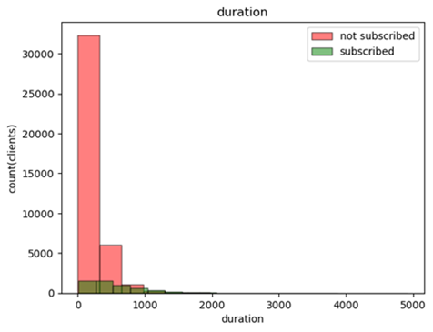
Analysis of numerical features
Among 45216 clients, 36956 no of clients were not contacted previously.
For some clients, 871 days has been passed since last contacted.
For 8260 clients, total no of 26255 contact were done before this campaign.
In the last contact, minimum duration was 0 sec and maximum was 4918 sec. However, for 90% of clients, it was less than 547.5 sec.

Slide 4
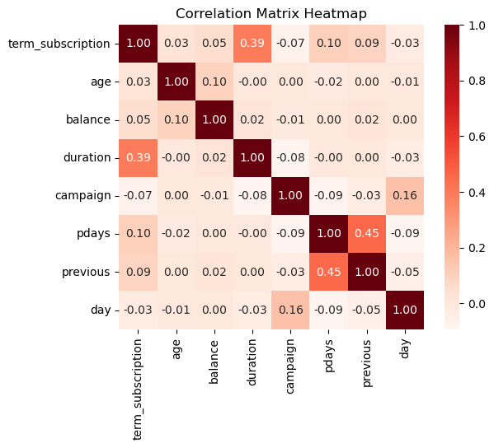
Correlation between Numerical features & target
Here term subscription is greatly correlated with duration of the last contact (duration).
After that it is less correlated with no of days since last contacted (pdays) and no of contact performed before this campaign (previous).
No of contacts during this campaign (campaign) is a little correlated with term subscription.
Age of the clients (age) and last contact day of the month (day) are not correlated with term correlation.

Slide 5
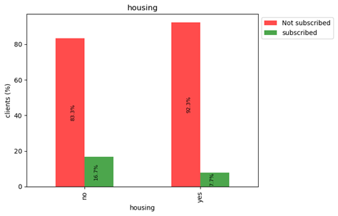
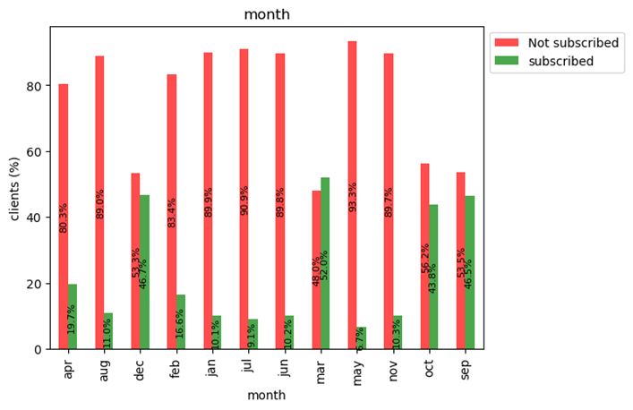
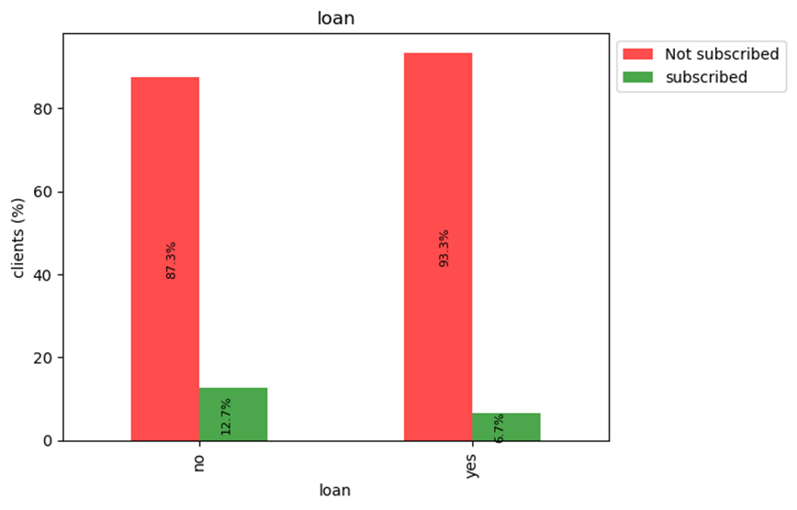
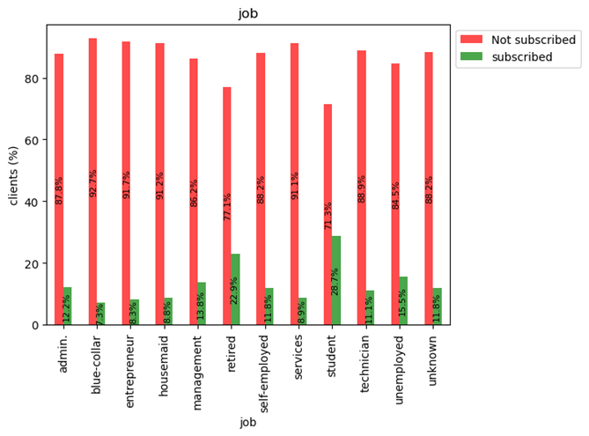
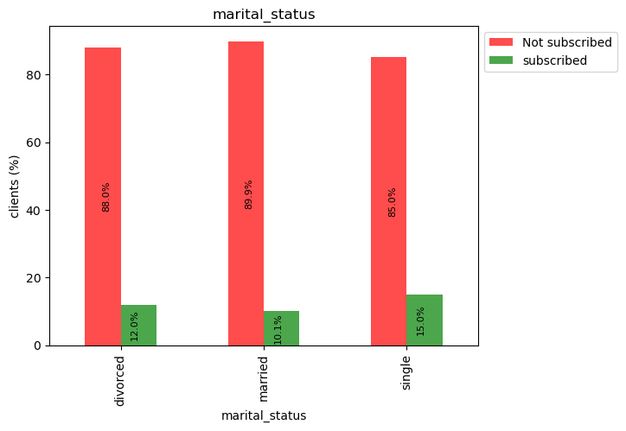
categorical features vs target
25130 clients have housing loans. Those without a housing loan subscribed to the term deposit more than those with a housing loan.
7244 clients have personal loans. Those without a personal loan subscribed to the term deposit more than those with a personal loan.
More than half of the clients are married. But single clients subscribed to the term deposit more than divorced clients.
Married clients are least interested to subscribe a term deposit.
In may, most of the contacts were happened. But it is the least successful month.
Very less clients are contacted in march, September, October and December. But these are the successful months in terms of term deposit subscription.
Most of the clients are technician,management and blue-collar. But Students & retired person are more interested for subscription.

Slide 6
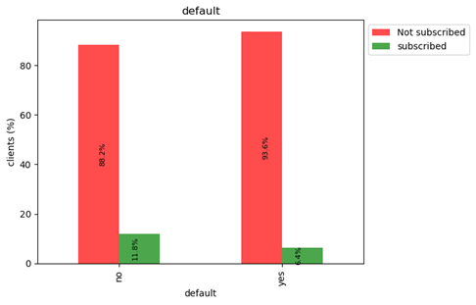
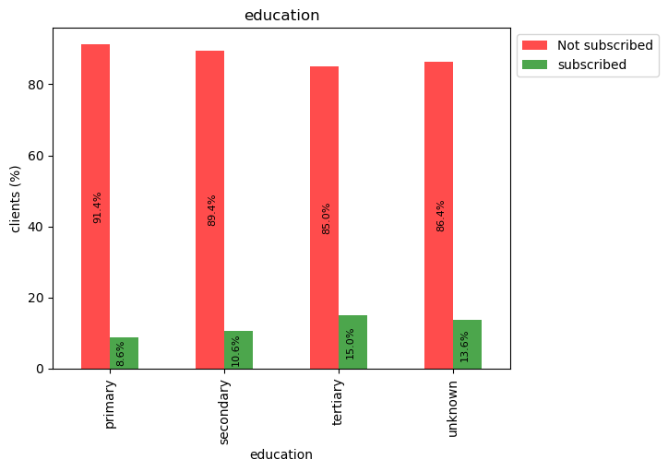
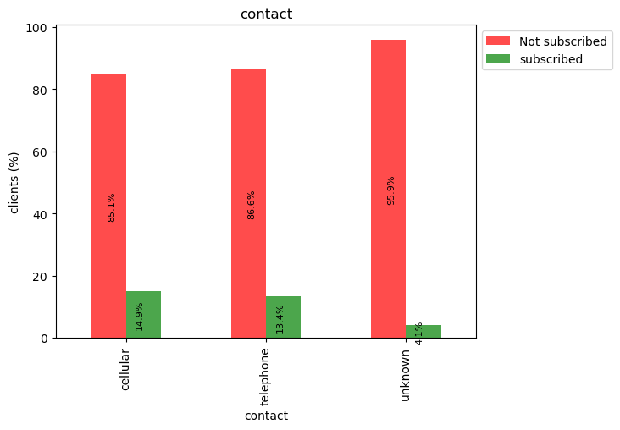
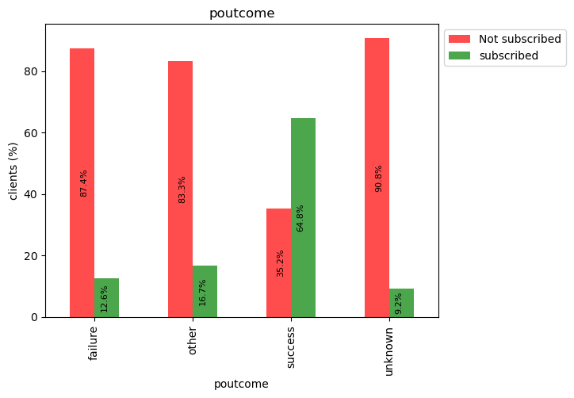
categorical features vs target
The clients whose credit is not in default are more interested for subscriptions.
More than half of the clients are secondary qualified.
Clients with higher education are more interested to subscribe a term deposit.
Subscriptions are not dependent on contact.
Previous successful campaigns are more effective for subscription a term deposit.

Slide 7
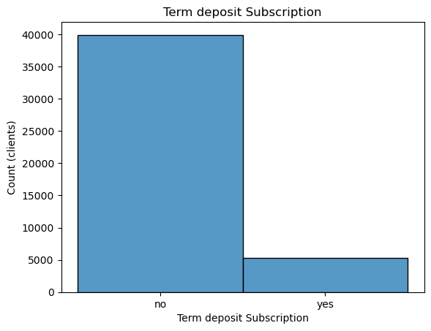
Target Analysis
11.71% of clients subscribed a term deposit.
So There is a data imbalance.

Slide 8
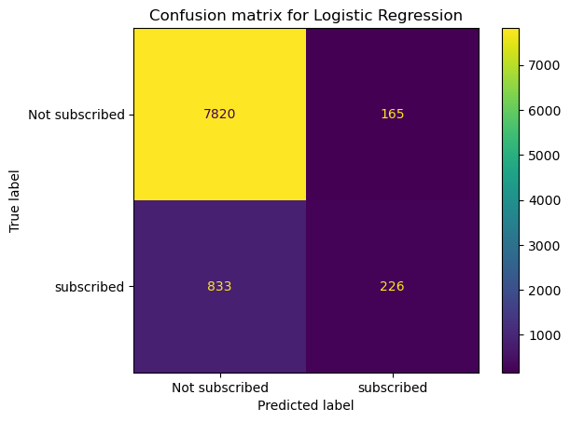
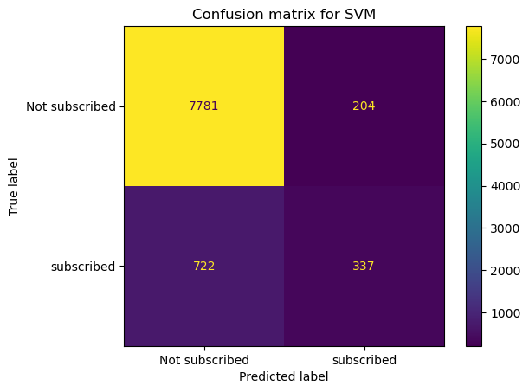
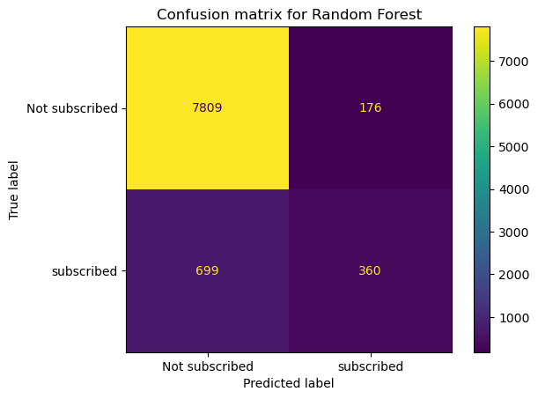

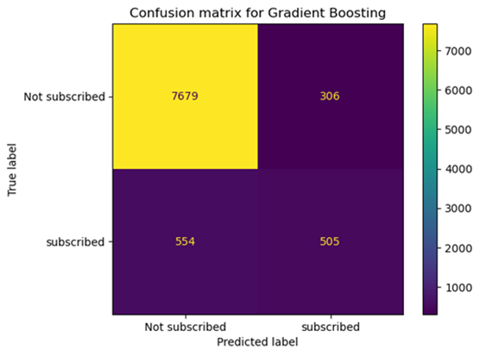
Confusion matrix for various models
vjjugg

Slide 9
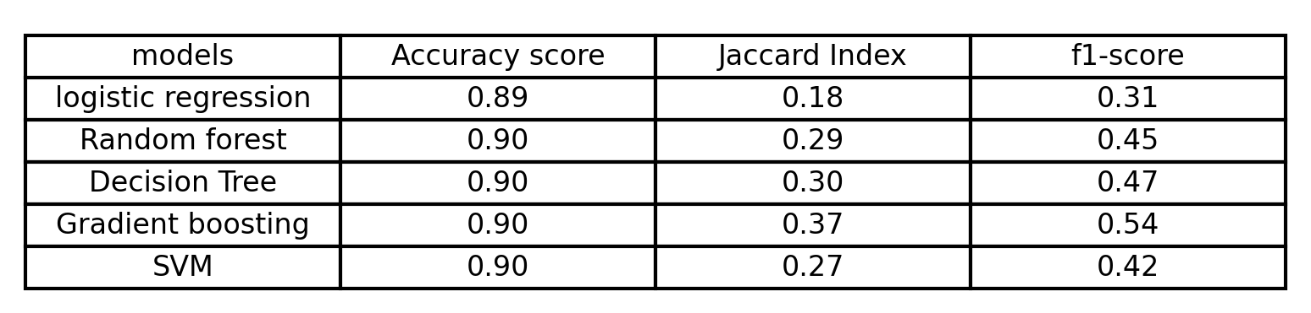
Model Evaluation
Gradient boosting gave us best result. Decision tree and Random forest also gave good results.
These tree based models worked well because they are effective for non-linear and imbalanced data. Gradient boosting and decision tree also give importance to the highly correlated features. And also Gradient boosting algorithm can handle the large datasets efficiently.
Logistic regression and SVM didn't work well because of imbalanced, non-linear large datasets.

Slide 10
Thank you

