Slide 1
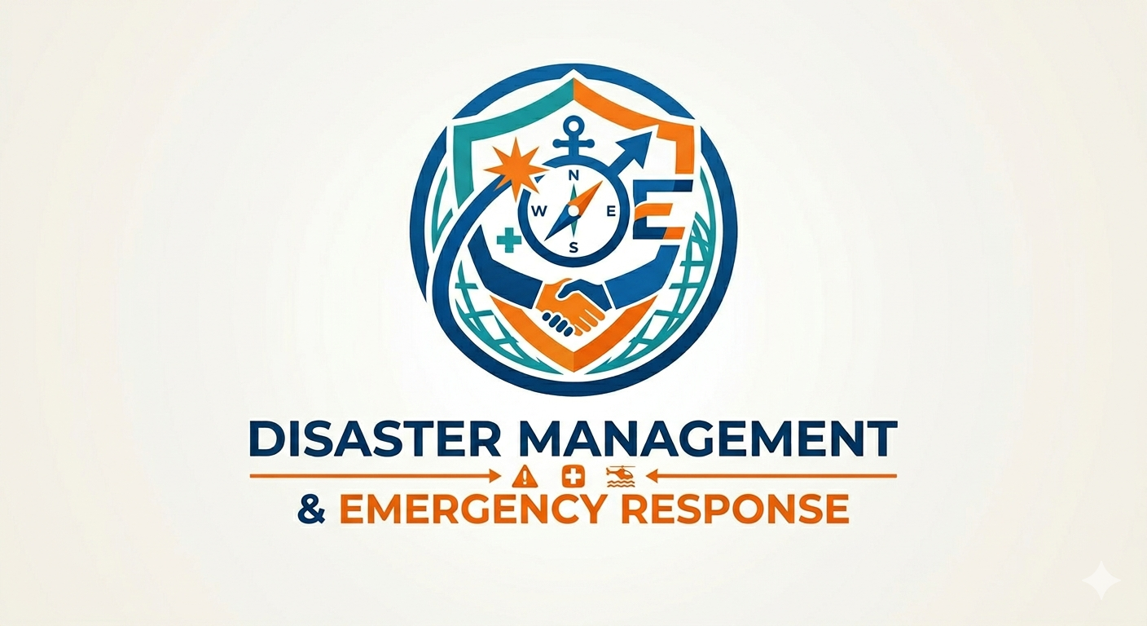

Disaster Management & Emergency response
Prepared by STF, Kolkata Police

Slide 2
Contents
Introduction
Types of Disasters
Causes and Effects
Earthquake
Fire
Cyclone
Human made Disasters
Disaster Emergency Kit
Response and Recovery
Safety Measures
Community Awareness
Conclusion

Slide 3
Types of Disasters
Disaster management refers to planning, preparedness, response, and recovery activities to reduce the impact of disasters on life and property.
Natural disasters
Earthquakes, Floods, Cyclone, Tsunamis, Landslides, Droughts.
Technological/industrial disasters
Chemical spills, Nuclear accidents, Dam failures, major fires.
Human made disasters
Terrorism, Armed conflict, Mass-casualty incidents.

Slide 4
Causes of Disasters
Natural hazards
Earthquakes, hurricanes/cyclones, floods, tsunamis, volcanic eruptions, landslides, droughts, extreme heat, wildfires.
Geological processes
Tectonic plate movement, soil erosion, subsidence, volcanic activity.
Biological hazards
Disease outbreaks, pest infestations, invasive species.
Human error and negligence
Unsafe building practices, poor land-use planning, lack of maintenance (dams, levees, infrastructure).
Technological/industrial failures
Chemical spills, explosions, nuclear accidents, pipeline ruptures, fires.
Infrastructure collapse
Bridge, building, or dam failure due to design flaws, age, or overload.
Climate change and environmental degradation:
Sea-level rise, altered rainfall patterns, increased storm intensity, deforestation, loss of wetlands.
Socioeconomic factors
Poverty, overcrowding, weak governance, limited emergency services, lack of resilience and preparedness.
Conflict and violence
Armed conflict, terrorism, civil unrest causing humanitarian crises.
Cascading/compound events
One event triggering others (earthquake → tsunami → industrial spill; storm → power outage → critical-service failure).

Slide 5
Effects of Disasters
Loss of life and injuries; long-term physical and mental health impacts.
Damage to homes, buildings, and critical infrastructure (roads, bridges, utilities).
Displacement and homelessness; disruption of community cohesion.
Economic losses: business interruption, job loss, reduced income, high reconstruction costs.
Disruption of essential services: electricity, water supply, sanitation, healthcare, transport, communications.
Food and water insecurity; supply chain breakdowns.
Environmental damage: pollution, habitat loss, soil erosion, coastal erosion.
Public health risks: outbreaks of disease, contamination, poor sanitation, malnutrition.
Education interruption: school closures and loss of learning time.
Psychological and social effects: trauma, anxiety, depression, increased domestic stress and social tensions.
Increased vulnerability and poverty, especially for marginalized groups.
Strain on emergency services and humanitarian systems; resource scarcity.
Governance and institutional stress: weakened capacity, delayed recovery, policy and planning challenges.
Cultural loss: damage to heritage sites, loss of cultural artifacts and community identity.
Long-term development setbacks and reduced investor confidence.

Slide 6
Earthquake
Safety Measures
Before an earthquake
Secure home: anchor heavy furniture/appliances
Strengthen structure: repair cracks, reinforce walls, bolt foundation if needed.
Plan & practice: set meeting points, evacuation routes; run Drop–Cover–Hold On drills.
Know utilities: locate and label gas/water/electric shutoffs; keep a wrench nearby.
Prepare communications: designate out-of-area contact; save emergency numbers on paper.
Emergency kit ready: water, food, first-aid, flashlight, radio, power bank, cash, important documents.
Vehicle readiness: keep fuel topped; park away from buildings when storm predicted.
After an earthquake
Ensure safety: expect aftershocks; move to open areas if building unsafe.
Check people: perform quick triage; treat injuries; call EMS for serious cases.
Assess hazards: smell for gas, check for fires, downed power lines, and structural damage.
Utilities & fires: shut off gas only if leak suspected; avoid using flames; report hazards.
Building inspection: do not re-enter until officially declared safe.
Basic needs: use emergency kit supplies; avoid contaminated water; follow boil-water advisories.
Support & security: assist neighbors (elderly/disabled); secure property where possible; report looting.

Slide 7
Do’s & Don’ts during Earthquake
Do’s
Do Drop–Cover–Hold On during shaking.
Do move to open areas only after shaking stops if indoors feels unsafe.
Do keep emergency kit accessible and practice plans regularly.
Do check for hazards (gas, electrical, structural) and report to authorities.
Do help neighbors and vulnerable persons; coordinate with community responders.
Don’ts
Don’t run outside during shaking (risk of falling debris).
Don’t use elevators.
Don’t light matches or use open flames if gas leak suspected.
Don’t re-enter damaged buildings until professionally inspected.
Don’t rely solely on mobile networks have alternative communication plans.

Slide 8
What To Do in Case of Fire
Raise alarm and call emergency number immediately; alert others nearby.
If safe, attempt to extinguish small fire with appropriate extinguisher; if not, evacuate.
Stay low to avoid smoke; crawl if necessary.
Use stairs, not elevators, during evacuation.
Close doors behind you to slow fire spread; do not lock them.
Meet at prearranged assembly point and report missing persons to authorities.
Do not re-enter the building until fire service declares it safe.
Smoke safety
Cover nose and mouth with a cloth (preferably damp) to reduce inhalation.
Stay below smoke layer; smoke rises so cleaner air is lower.
If trapped, seal gaps around doors with clothing/tape and signal from window.
Avoid breathing directly from fire area; seek medical help for smoke
inhalation.

Slide 9
Evacuation procedure & Safety Precautions
Evacuation procedure
Know and follow primary and secondary exit routes.
Quickly check room doors for heat with back of hand before opening.
Assist children, elderly, and disabled; use evacuation chairs if needed.
Close but do not lock doors; take essential items only if immediately available.
Head to assembly point; account for all occupants and inform incident commanders.
Emergency contacts
Police (100 dial) or inform local PS
Local fire department (emergency number)
Local ambulance
Fire safety precautions
Install and maintain smoke detectors; test monthly and change batteries yearly.
Keep escape routes clear and well-lit; post evacuation maps.
Store flammable materials in approved containers and designated areas.
Maintain electrical systems; avoid overloaded sockets and damaged cords.
Conduct regular fire drills and staff training.

Slide 10
Handling flammable materials & Fire equipment awareness
Handling flammable materials
Store fuels, solvents, and gases in cool, ventilated, labeled, fire-rated cabinets.
Keep ignition sources (open flames, sparks, hot work) away from storage areas.
Use bonding/grounding when transferring flammable liquids to prevent static sparks.
Follow MSDS/SDS instructions for handling, PPE, and disposal.
Limit quantities on-site to minimum needed and isolate from occupied areas.
Fire equipment awareness
Know locations of fire extinguishers, hoses, alarms, exits, and assembly points.
Learn extinguisher types and use: PASS — Pull, Aim, Squeeze, Sweep.
Ensure fire doors close properly and are not propped open.
Keep fire blankets, breathing apparatus, and first-aid kits accessible where required.
Report faulty equipment immediately and log maintenance checks.

Slide 11
Fire safety Do’s & Don’ts
Fire safety Do’s
Do evacuate promptly when alarm sounds.
Do call emergency services early.
Do assist vulnerable people and follow evacuation leader instructions.
Do use appropriate extinguisher for small fires only if trained and safe.
Do keep exits and fire equipment unobstructed.
Fire safety Don’ts
Don’t hide or return for belongings.
Don’t use elevators during evacuation.
Don’t fight large or rapidly spreading fires alone.
Don’t open hot doors without checking for heat.
Don’t store flammables near heat sources or exits.

Slide 12
Cyclone - Safety Precautions
Monitor weather alerts and warnings; follow official evacuation orders immediately.
Secure loose outdoor items (furniture, signage, debris) to prevent flying hazards.
Close and lock windows and doors; board up windows or use storm shutters if available.
Move vehicles to higher ground and away from trees, power lines, and low-lying areas.
Fill fuel tanks and charge phones, power banks, and essential devices.
Store at least 3 days of water and nonperishable food per person; include medicines.
Prepare an emergency kit with flashlight, batteries, radio, first-aid kit, cash, important documents in waterproof bag.
Identify nearest safe room or strongest interior room (no windows) on lowest level for shelter.
Keep evacuation routes and assembly points known to all family/household members.
Stay indoors during the cyclone; avoid windows and sit in the designated safe room.
If flooding begins, move to higher floors but avoid attics without escape routes; go to roof only as last resort and signal for help.
Report hazards (downed lines, gas smell, major damage) to emergency services and utility companies.
Check on neighbors, especially elderly, disabled, or those with young children; offer assistance where safe.

Slide 13
Do’s & Don’ts during Cyclone
Do’s
Do follow official evacuation and safety instructions without delay.
Do secure property and move to the safest interior location.
Do keep emergency contacts and documents accessible and waterproofed.
Do keep radios/phones charged and conserve battery power.
Do assist vulnerable neighbors and coordinate with community response.
Don’ts
Don’t wait until the last minute to evacuate if ordered.
Don’t go outside during high winds or while debris is flying.
Don’t drive through flooded or debris-blocked roads.
Don’t use candles or open flames indoors if gas leaks are possible.
Don’t touch downed power lines or enter flooded electrical areas.

Slide 14
Human-Made Disasters
Terrorism
Riots
War
Cyber attacks
Environmental pollution
Industrial accidents
Chemical leakage
Nuclear hazards

Slide 15
DISASTER EMERGENCY KIT READY
Battery-operated torch with extra batteries
Battery-operated radio
First aid kit and manual
Emergency food (dry items) and water (packed and sealed)
Candles and matches in a waterproof container
Knife
Chlorine tablets or powdered water purifiers
Can opener
Essential medicines
Cash and credit cards
Thick ropes and cords
Sturdy shoes

Slide 16
Disaster Preparedness and Community Participation
Risk awareness
Map local hazards, vulnerable groups, critical buildings, and evacuation routes.
Community plan:
Develop a clear, simple emergency plan with roles, meeting points, and communication methods.
Local leadership:
Appoint and train ward/block/neighborhood coordinators and backup leaders.
Public education:
Run regular awareness campaigns, workshops, and school programs on risks and safety actions.
Drills and exercises:
Conduct frequent community drills (evacuation, sheltering, first aid) and review lessons learned.
Volunteer teams:
Form and train local response teams for first aid, light search & rescue, rapid assessment, and logistics.
Resource inventory:
Maintain a community register of skills, equipment, vehicles, tools, and available shelters.
Emergency kits:
Promote household kits and provide templates/checklists for families and vulnerable households.
Communication networks:
Establish redundant channels (phone trees, SMS lists, radio, social media, community notice boards).
Stockpiling & supply chains:
Pre-position essentials (water, blankets, food, medicines) and plan distribution priorities.
Coordination with authorities:
Establish liaison with police, fire, health, municipal services, and NGOs for support and referrals.
Financial readiness:
Set up community emergency funds, micro-insurance options, or cash-transfer plans for rapid relief.

Slide 17
Emergency Response & Recovery and Rehabilitation
Emergency Response
Search and rescue
Medical aid
Relief distribution
Communication support
Recovery and Rehabilitation
Reconstruction of infrastructure
Financial assistance
Counseling support
Livelihood restoration

Slide 18
Conclusion
Saves lives and reduces injuries.
Limits damage to property and infrastructure.
Speeds up restoration of essential services (water, power, health).
Enables faster, more organized delivery of aid and relief.
Reduces long-term economic losses and recovery costs.
Strengthens community resilience and preparedness for future events.
Requires coordinated roles: police, fire, medical, NGOs, and citizens.
Depends on early warning systems, clear communication, and regular drills.
Relies on prevention and mitigation (safe buildings, land use, infrastructure).
Benefits from investing in training, equipment, and contingency planning.

Slide 19


