Slide 1


Cyber Awarenes & Social Media Sensitivity
Prepared by STF, Kolkata Police

Slide 2
Contents
Introduction & Objectives
Major Types of Cyber Frauds
Social Media Cyber Crimes
Financial & Banking Frauds
Device & Malware Threats
Cyber Safety Tips
How to Report Cyber Crime
Social Media Sensitivity
Conclusion

Slide 3
Objectives of Cyber Awareness
Create awareness regarding common cyber threats and online frauds.
Educate users about fraud techniques used by cyber criminals.
Prevent financial frauds and identity theft.
To reduce risks of hacking, malware, and data breaches.
To safeguard children, women, and senior citizens from online exploitation.
To encourage safe use of social media platforms.
To create awareness about cyber crimes and online threats. To educate people.
Provide preventive safety measures and cyber hygiene practices.
Encourage safe digital behavior and reporting of cybercrime.

Slide 4
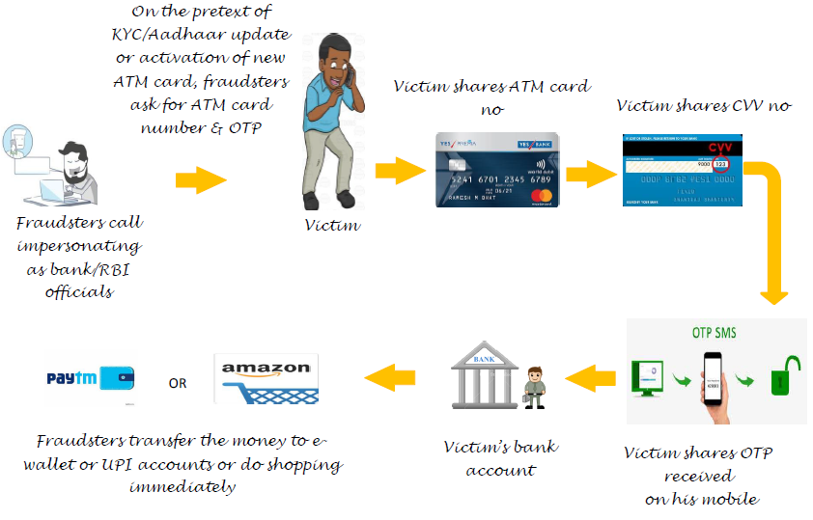
CVV/OTP Sharing Fraud
Fraudsters impersonate bank/RBI officials.
Victims are asked to share card number, CVV and OTP.
Money is immediately transferred from victim accounts.
Example: Fake KYC update call.
Tip: Never share OTP, CVV or PIN with anyone.

Slide 5
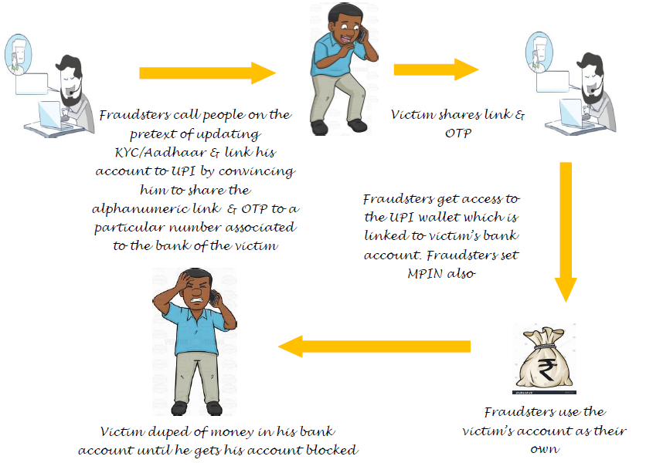
UPI & QR Code Fraud
Fraudsters send fake payment request links or QR codes.
Victims think they are receiving money but actually pay money.
Common in Google Pay, PhonePe and Paytm scams.
Example: Fake cashback or refund offers.
Tip: UPI PIN is needed only to send money, not receive it.

Slide 6
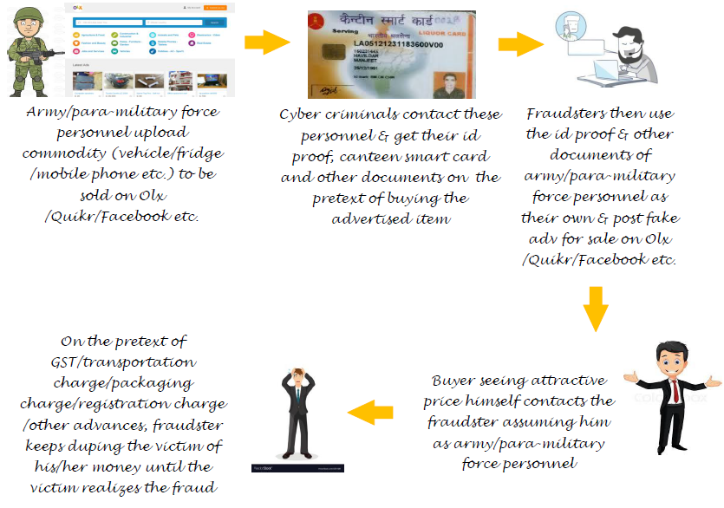
OLX / E-Commerce Fraud
Fake advertisements are posted at attractive prices.
Victims pay advance charges for delivery or registration.
Fraudsters disappear after payment.
Example: Fake army officer selling products.
Tip: Never pay advance without verifying seller and product.

Slide 7
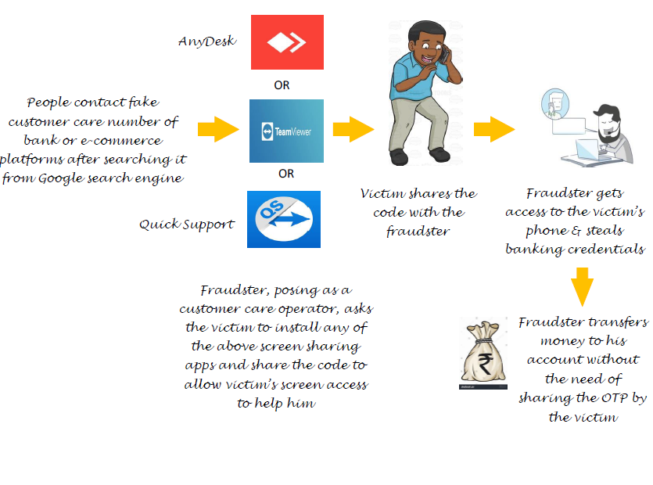
Screen Sharing App Fraud
Victims are asked to install AnyDesk, TeamViewer etc.
Fraudsters gain remote access to the victim device.
Banking credentials are stolen.
Tip: Never install remote access apps on instructions from strangers.

Slide 8
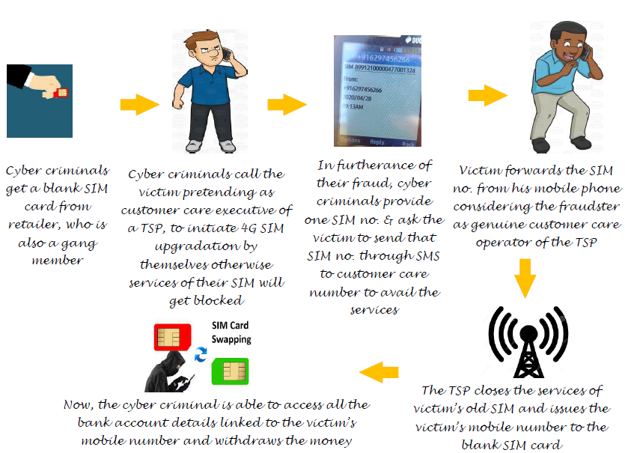
SIM Swapping Fraud
Fraudsters obtain duplicate SIM cards.
OTP and banking alerts are diverted.
Victims lose access to mobile network temporarily.
Tip: Contact telecom operator immediately if SIM stops working.

Slide 9
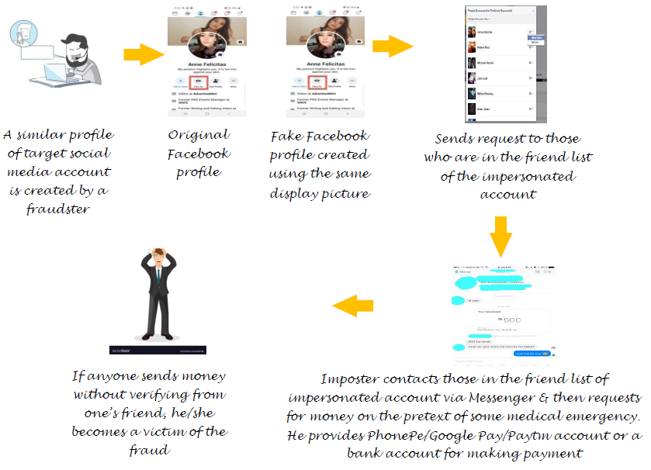
Fake Social Media Account Fraud
Fake profiles impersonate real people.
Friends are asked to send money during emergencies.
Victims trust the fake identity.
Tip: Verify requests by direct phone calls.

Slide 10
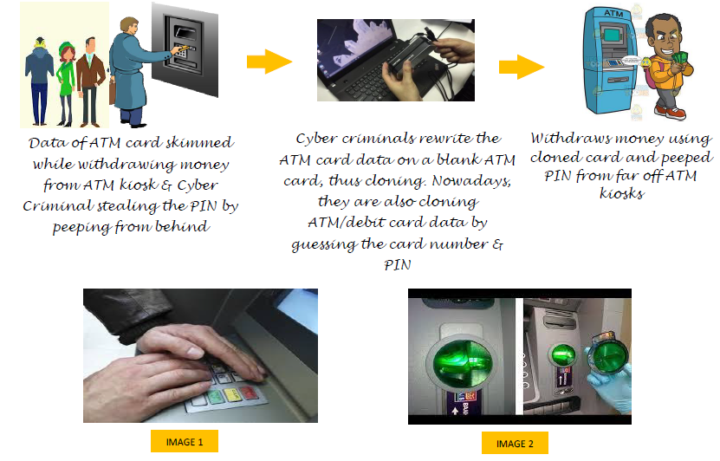
ATM/Debit Card Cloning
Skimming devices copy card information.
Hidden cameras capture ATM PINs.
Fraudsters clone cards and withdraw money.
Tip: Cover keypad while entering PIN.

Slide 11
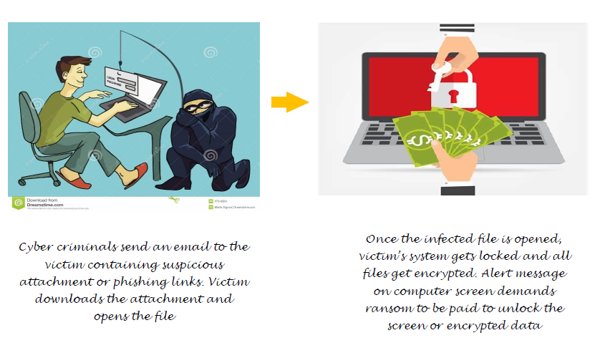
Ransomware & Device Hacking
Malicious emails or downloads infect systems.
Files get encrypted and ransom is demanded.
Hackers steal or destroy personal data.
Tip: Use antivirus and avoid suspicious links.

Slide 12
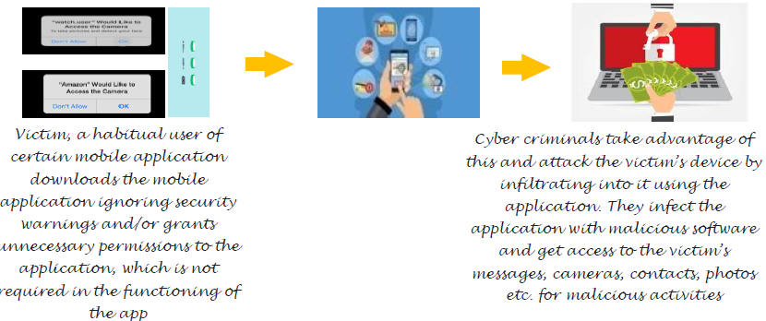
Mobile App Fraud
Fake apps gain access to contacts and banking data.
Example: Apps asking unnecessary permissions.
Tip: Install apps only from trusted stores.

Slide 13
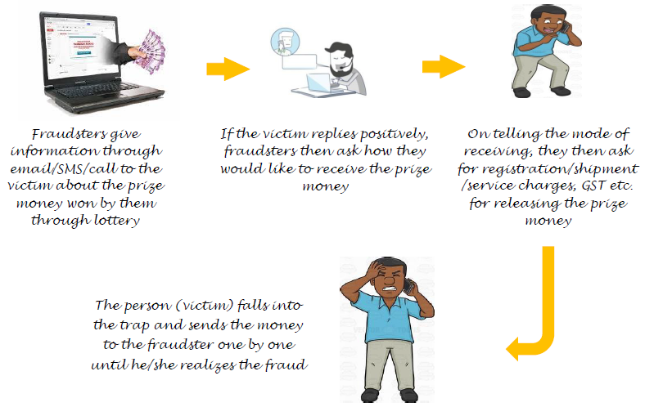
Lottery & Online Job Fraud
Victims receive fake lottery or job offers.
Fraudsters demand registration or processing fees.
Victims lose money without receiving benefits.
Tip: Never pay advance money for prizes or jobs.

Slide 14
General Cyber Safety Tips
Use strong passwords and enable two-factor authentication.
Keep antivirus, operating systems and apps updated.
Avoid clicking suspicious links or downloading unknown files.
Do not share personal information on social media.
Use official websites and trusted applications only.
Regularly monitor banking and wallet transactions.

Slide 15
Safety Tips for Children, Parents & Women
Children should avoid sharing personal details online.
Parents should monitor children's online activities.
Women should maintain strict privacy settings on social media.
Avoid accepting requests from unknown people online.
Report harassment and cyber bullying immediately.

Slide 16
How to Report Cyber Crime
Online complaints can be lodged at "cybercrime.gov.in" or call 1930.
Cybercrime complaints can be filed at nearest Police Station.
Preserve screenshots, URLs, transaction details and suspicious messages.
Report fraud quickly to improve chances of recovery.

Slide 17
Social Media Sensitivity
Think before posting or sharing anything online.
Respect others’ privacy, opinions, and feelings on social media.
Avoid posting offensive, abusive, or misleading content.
Do not share fake news or unverified information.
Be careful while sharing personal photos and videos.
Maintain polite and responsible online behavior.
Avoid cyber bullying, trolling, and online harassment.
Use privacy settings to protect personal information.
Do not accept friend requests from unknown people.
Report harmful, fake, or suspicious social media activities. Understand that online actions can have real-life consequences.
Promote positive and safe digital communication.

Slide 18
Conclusion
Cyber awareness is the first line of defense against cybercrime.
Most frauds succeed because of negligence or lack of awareness.
Safe digital practices can prevent financial and personal loss.
Cyber awareness helps protect against online frauds and cyber crimes.
Safe internet practices reduce risks of hacking and data theft.
Never share personal, banking, or confidential information online.
Strong passwords and privacy settings improve online security.
Avoid fake links, unknown friend requests, and suspicious messages.
Respect others online and maintain digital ethics.
Timely reporting of cyber crimes helps prevent further frauds.
Awareness and vigilance are key to a safe digital life.
Stay alert, stay informed and report suspicious activities

Slide 19
Thank You

