Slide 1
Considerations for car purchase in India
As a Product Manager, your role is to analyze the car-buying process, identify pain points, and propose strategies to enhance Cars24’s value proposition as a buying platform.
Your response should cover the following:
What are the reasons for Vehicle Purchase?
What is the Buyer’s Journey of purchasing car ?
What are the key decision-making factors when purchasing a car ?
What are the major pain points and uncertainties buyers face?

Slide 2
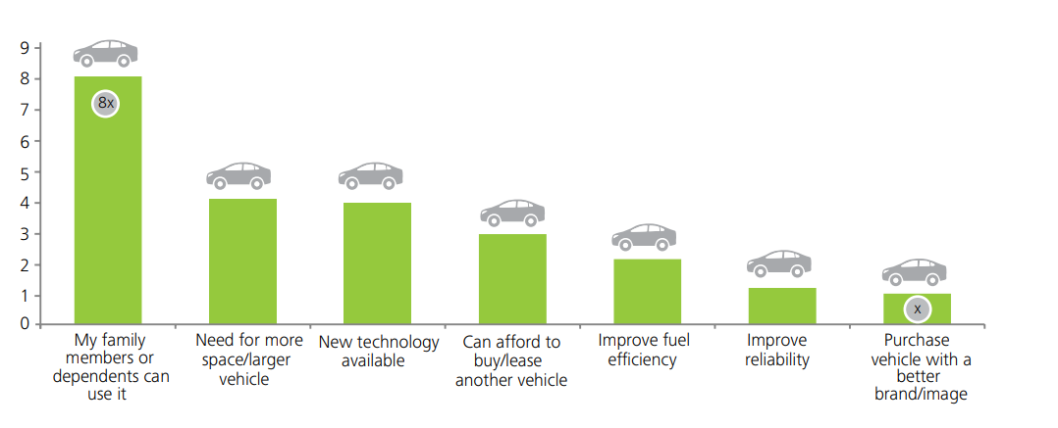
Why user purchase car

Slide 3
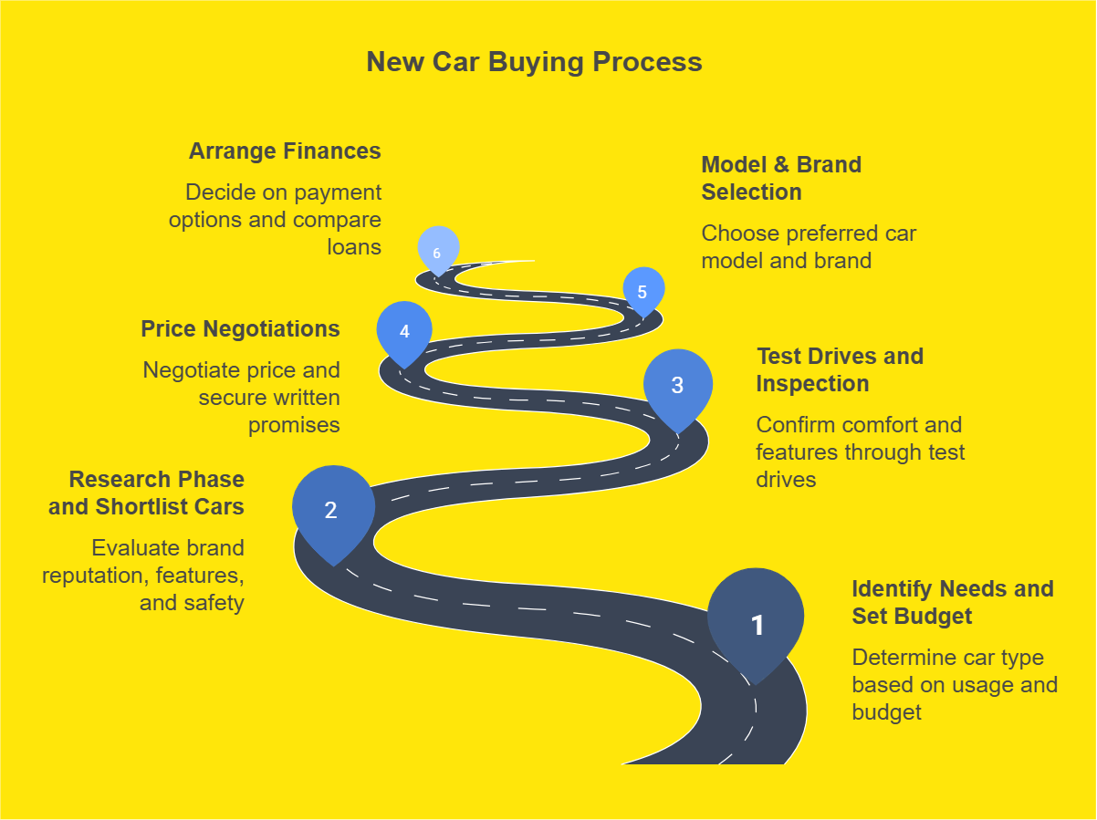
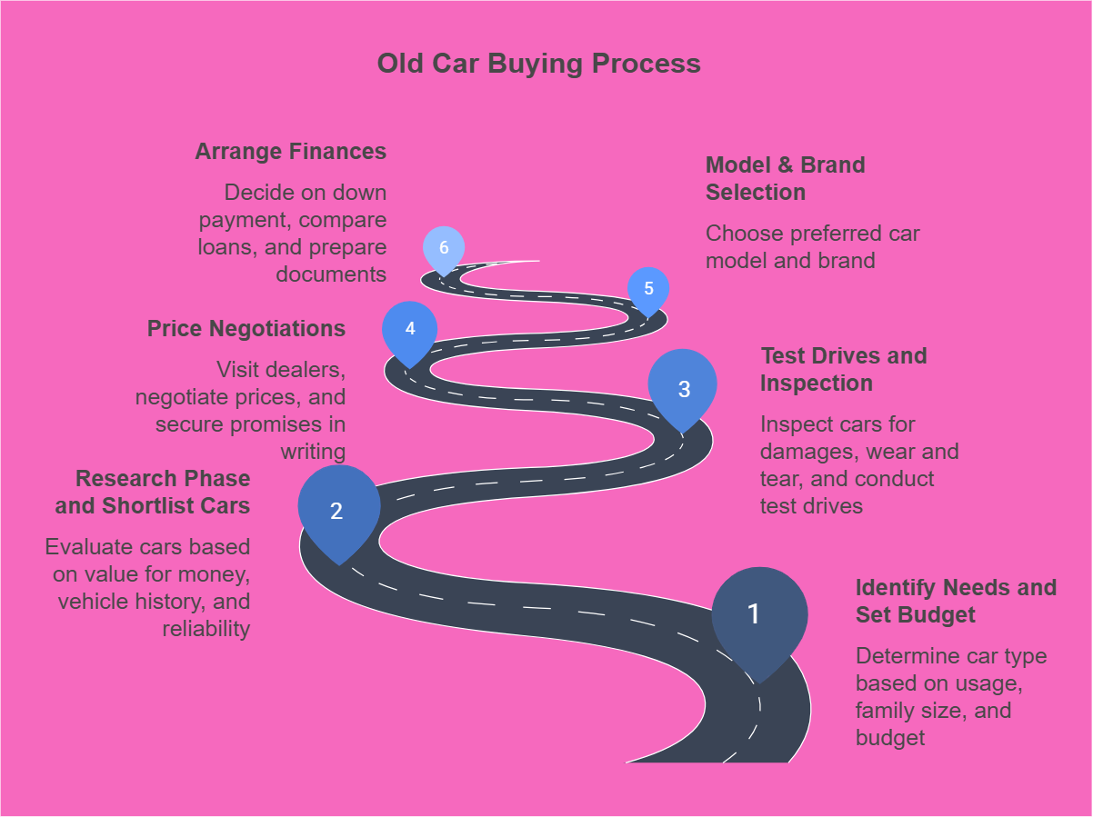
User Journey

Slide 4
Key decision-making factors
Fuel Efficiency
Performance & Handling
Quality and Reliability
Technology features
Price
Interior
Safety
Brand
Resale value
Design and Style

Slide 5
Pain points buyers face
Financial Considerations
High upfront costs influenced by taxes (GST, road tax) and rising fuel prices.
Price transparency issues with discrepancies between advertised and on-road prices.
Hidden charges such as registration fees, insurance, and dealer add-ons.
Financing hurdles: strict loan eligibility, high interest rates, and lengthy approval processes.
Resale value anxiety and uncertainty about depreciation, especially for newer brands and EVs.
Product Selection Challenges
Overwhelming variety of brands, models (e.g., Tata Punch vs. Hyundai Creta), and fuel types (petrol, diesel, CNG, EV).
Difficulty in comparing technical specifications, reliability, and maintenance costs.
Safety concerns due to inconsistent safety features and limited awareness of Bharat NCAP ratings.
EV vs. ICE dilemma: uncertainties over charging infrastructure, battery longevity, and evolving government policies.
Discrepancies between advertised fuel efficiency and real-world mileage, particularly in heavy traffic.
Market Dynamics
Frequent new model launches and seasonal discount uncertainties, adding pressure on timing the purchase.
Online buying risks with fraud and misrepresentation concerns.
Influence of family preferences causing conflicts between practicality (fuel efficiency) and status (luxury brands)
Impact of sudden policy changes on EV subsidies

