Slide 1
Spatial Trends in Parking Traffic in North America
Sahil Singh, Dohyun Lee

Slide 2
Background
The purpose of this study is to investigate spatial patterns and trends of areas within a city where drivers experience difficulty finding parking in North America at the continental, country, and city levels.
We utilize R and a Google Maps API to create data visualizations, such as bar-plots, box-plots, and histograms, and implement Spatial Autocorrelation, Clustering, and Kriging to geospatially visualize and elicit insight on parking difficulty during the initial onset of COVID-19.
Given that we are interested in the time it takes a driver to find parking in a given area, the Null Hypothesis driving our study is that high parking times are randomly distributed, which is tested using Global Moran’s I and Geary’s C.
Key Questions:
What will mapping parking times at the continental, country, and city levels reveal? Is it harder to find parking in one country versus another or one state versus another?
What cities are the most prevalent in the dataset? How is the data for these points distributed and what are their means?
Are high or low parking times random chance occurrences and can spatial predictions be made given our data?

Slide 3
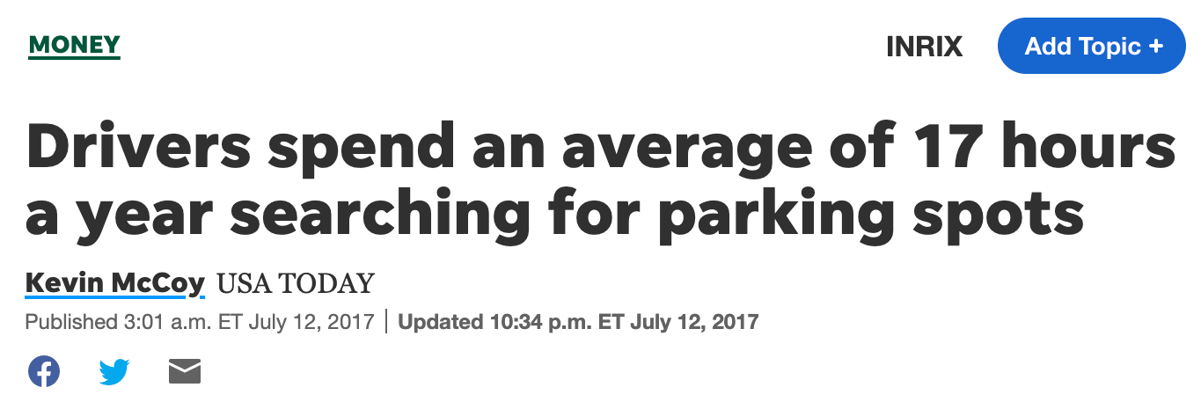
About the Dataset
Contains aggregated parking statistics dating from April 2020 to October 2020
Variables include the specific parking location represented as point data with latitudinal and longitudinal coordinates, average time taken to search for parking, total number of drivers searching for parking, and percentages of different types of vehicles with parking issues
Only cities with a population of more than 100,000 people are included.

Slide 4
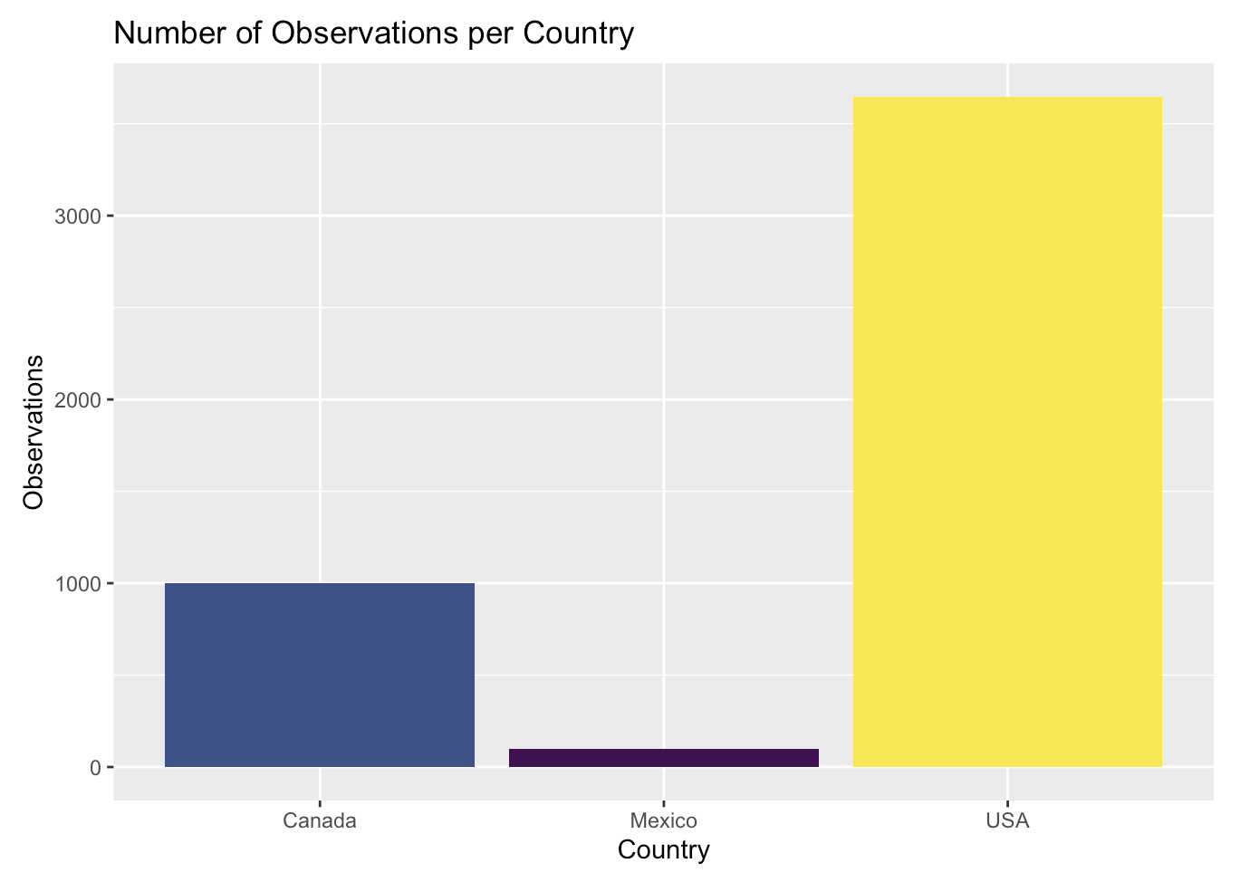
Some Data Exploration
No. of observations:
Canada: 1002
Mexico: 101
USA: 3647
There isn’t enough data for Canada and Mexico so we chose to focus on USA for our analysis

Slide 5


Slide 6
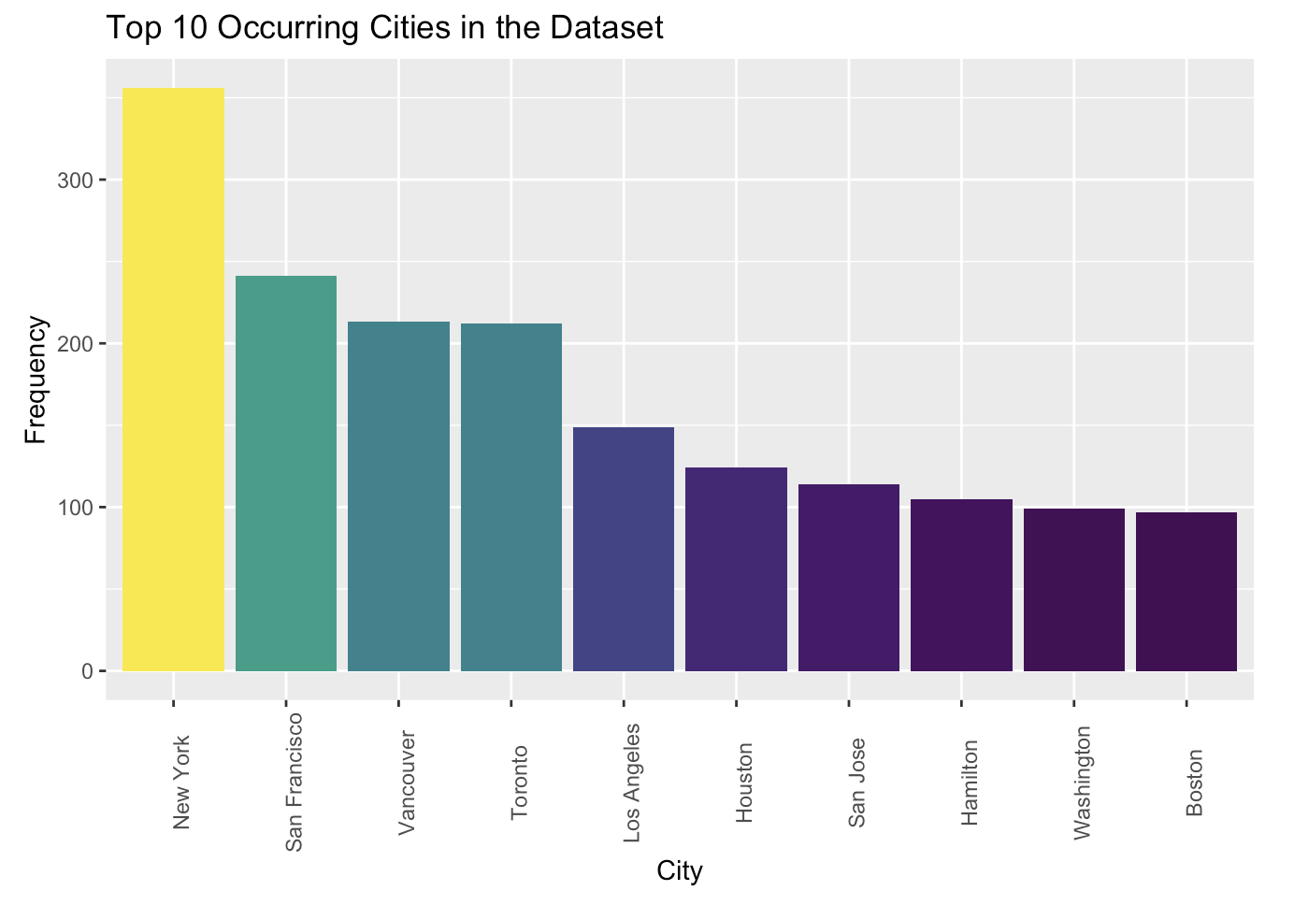
New York has the most observations (=356)
New York leads San Francisco (2nd most occurring city) by a high margin of 115 observations

Slide 7
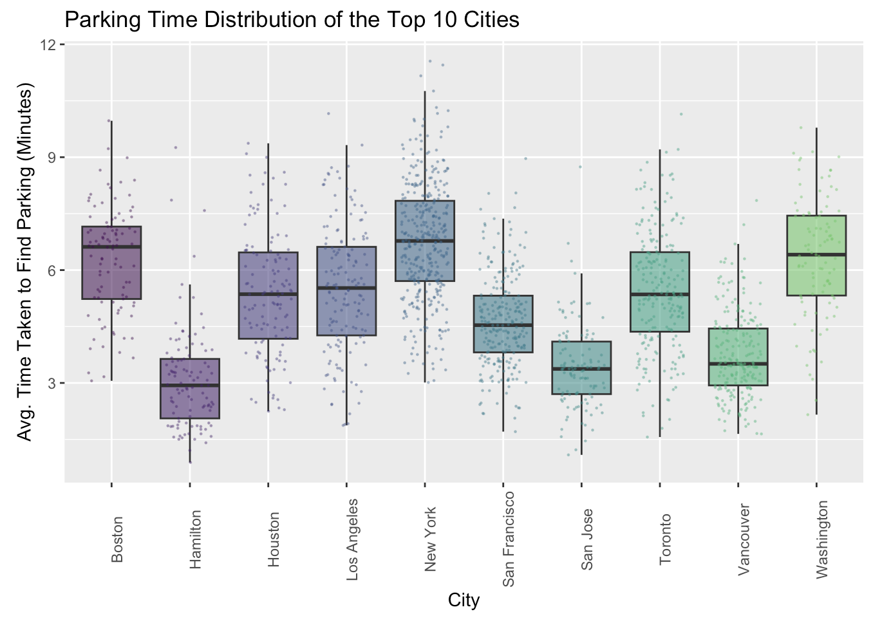
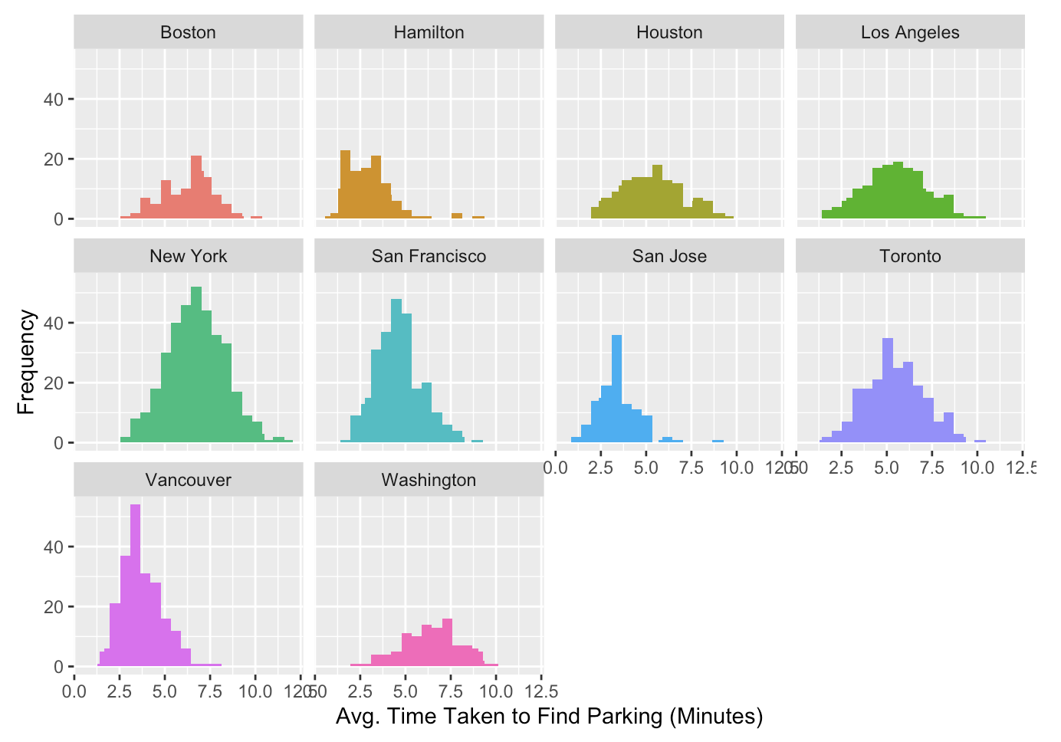
It takes lesser time to find parking in cities like Hamilton, San Jose, Vancouver
New York, Boston, Washington are worst in time taken to find parking

Slide 8
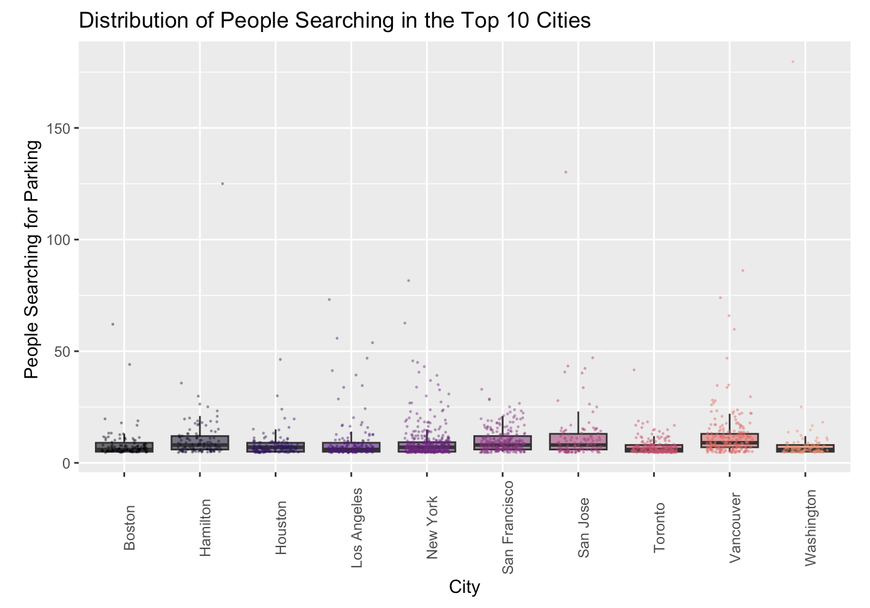
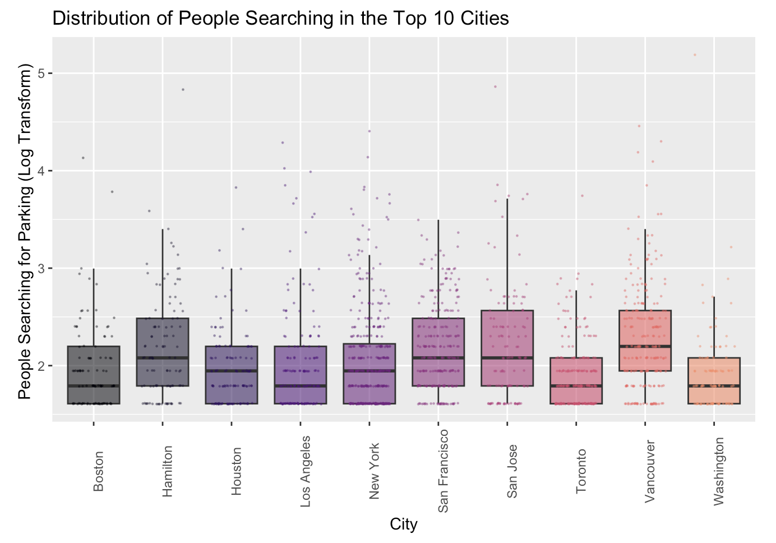
Plotting the original dataset (left) is not ideal to visually compare the differences in mean number of people searching for parking in top cities since data points are extremely crammed together
The plot with the log transformation of the data (right) makes it easier to see differences.
We can see there are more people searching for parking in Vancouver, San Francisco, San Jose but the differences among cities is still low.

Slide 9
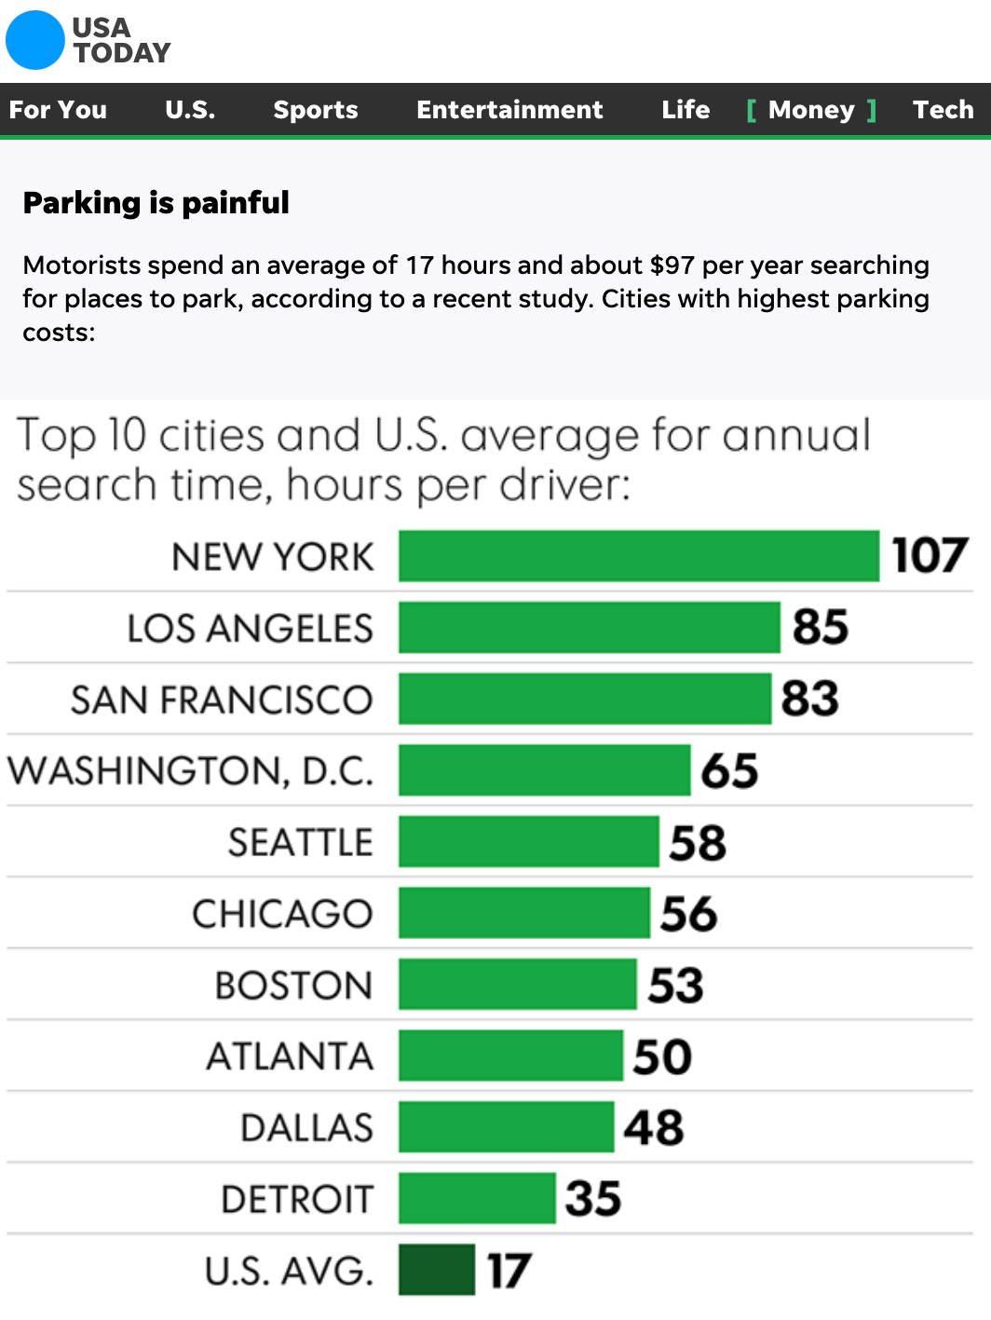
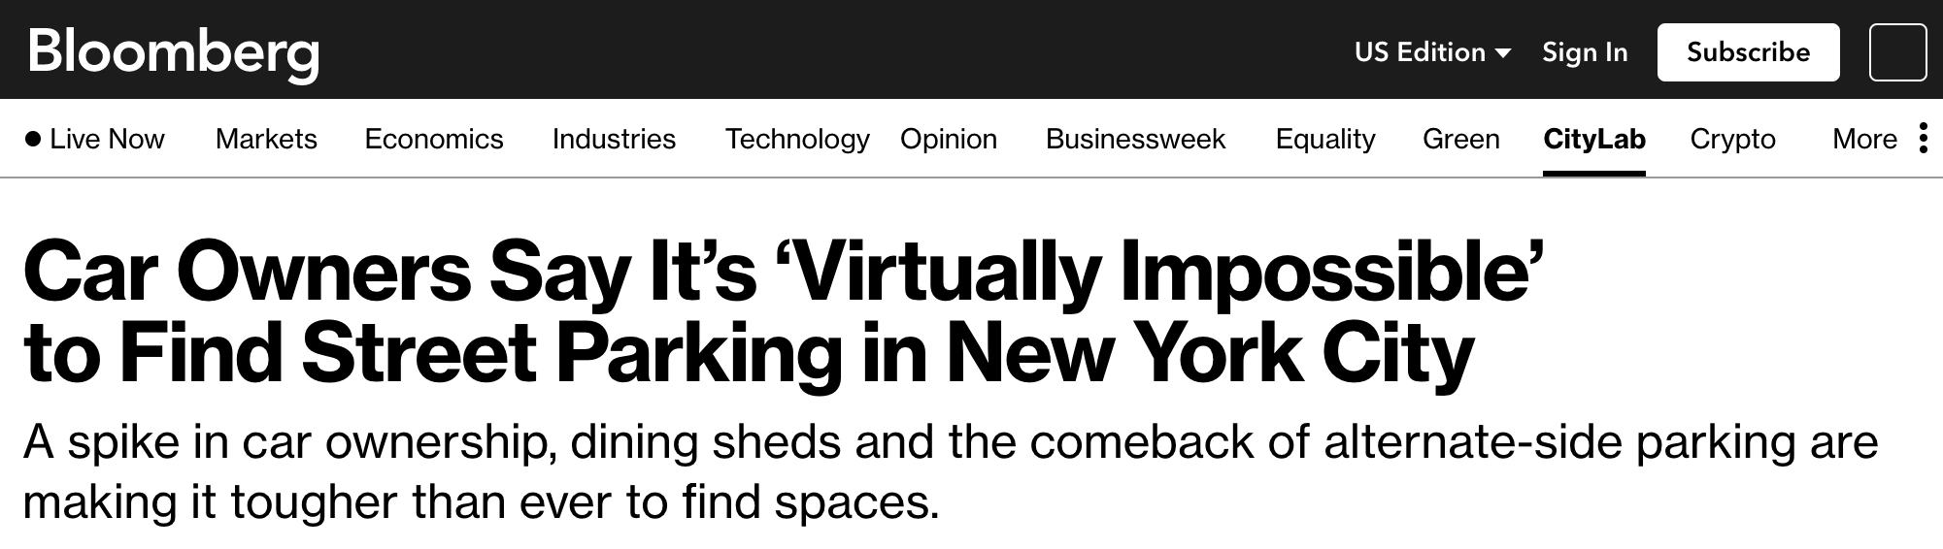
Spatial Trends in New York City Parking Traffic
We chose to focus on New York City exclusively to find spatial trends in the parking traffic patterns of the city. This was done for the following reasons:
New York City had the most observations (n = 356)
Data exploration revealed it has the worst parking time in major US cities
Online research points towards a real parking problem in New York City
Hence, exploring New York City might show us more interesting spatial insights

Slide 11
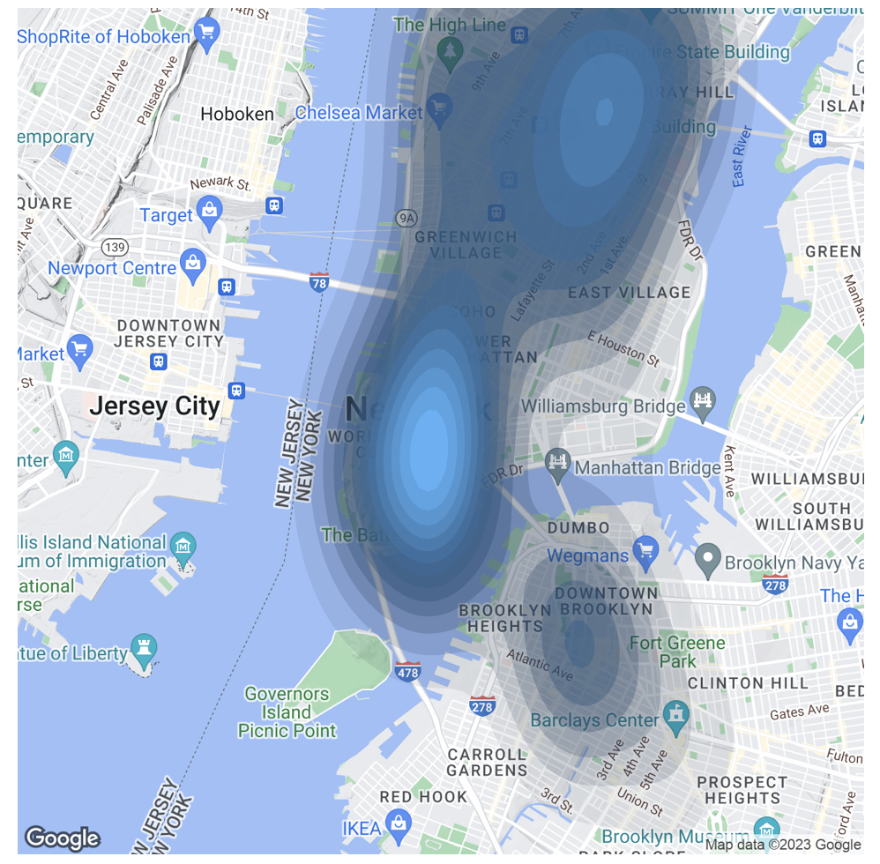
Kernel Density Mapping Over NYC
We can see signs of spatial clustering, especially in Manhattan
A little difficult to pinpoint what specific areas are difficult to park in
Still does a good job at showing the insight we are interested in

Slide 12
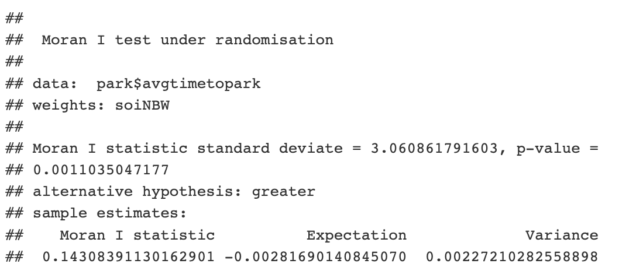
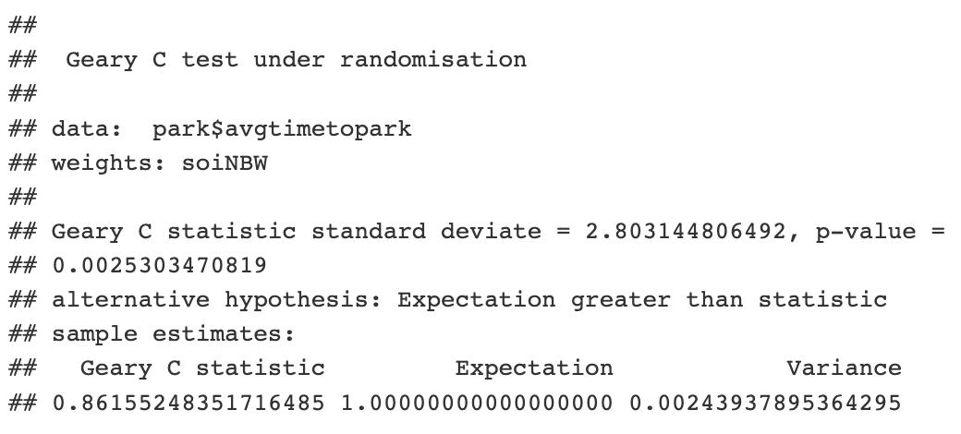
Global Moran’s I and Geary’s C
< 0.05
< 0.05
Positive I → Positive Autocorrelation
C is closer to 0 than to 2 → Positive Autocorrelation
Reject the null hypothesis – conclude that parking times in New York are not randomly distributed and that they are not a random chance spatial process. In other words, locations that observe longer times for parking are more likely to be clustered together.

Slide 13
Local Moran’s I
Locations with higher Local Moran’s I values have longer parking times thus are clustered together (darker orange indicates a higher Local Moran’s I value)
Similarly, locations with lower Local Moran’s I values have lower parking times and surround each other more.

Slide 14
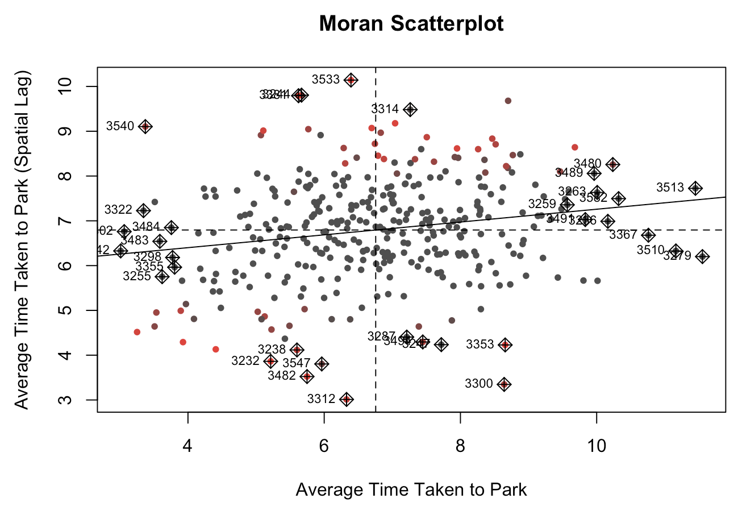
Moran Scatterplot
Points in the upper right and lower left quadrants are those in which there is a positive association between the location and the spatially lagged counterparts
There is positive spatial autocorrelation which does agree with the global metrics

Slide 15
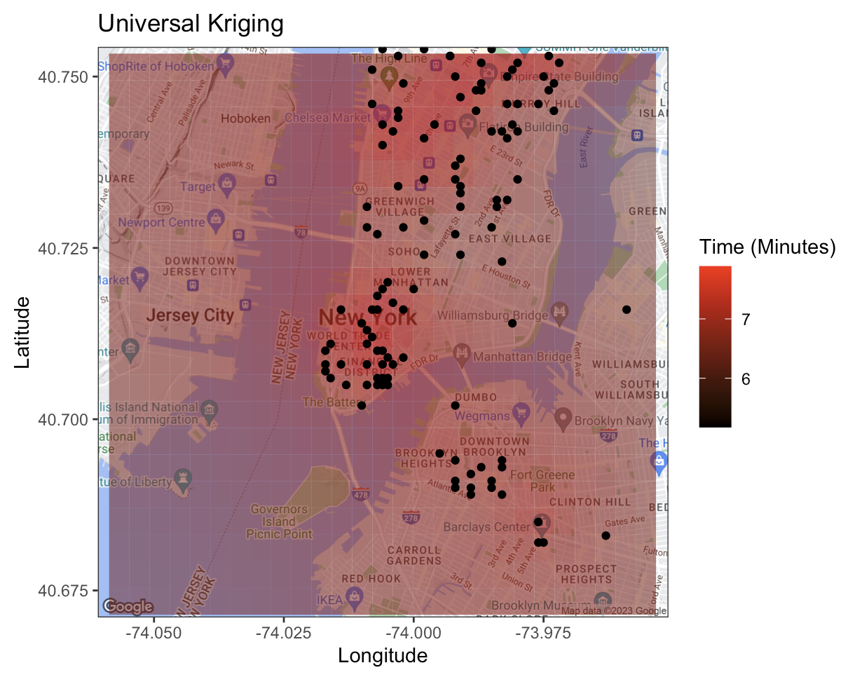
Kriging for Spatial Prediction
The algorithm uses universal kriging – input data is already marked by an overriding trend of higher times in points where there is more clustering
Areas surrounding main clusters of points are predicted to have higher parking times; areas farther away are predicted to have lower times thus less difficulty parking
Predicted time to find parking in the clustered Manhattan points is around 7 to 7.5 minutes – consistent with the mean time we observed from our plots earlier.

Slide 16
Conclusion
By narrowing down our case study to focus on New York City traffic, we discovered that the amount of time it takes to find parking is not randomly distributed and that there is positive spatial autocorrelation.
Spatial clustering occurs in areas with higher observed parking times. As a result, we were able to use kriging to make predictions of parking times in the surrounding areas, which ended up being consistent with what we derived in the initial data exploration process.
Going forward, we would like to gather parking data from the present day and even before the pandemic and conduct the same analyses to see how traffic and search times compare – this can offer meaningful information on a spatiotemporal level, help predict future traffic outcomes, and contribute to urban planning to accommodate the needs of the inhabiting communities.

Slide 17
References
https://www.kaggle.com/datasets/terenceshin/searching-for-parking-statistics-in-north-america
https://www.bloomberg.com/news/articles/2022-08-16/where-to-park-in-nyc-rise-in-new-cars-outdoor-dining-deepen-nightmare
https://www.usatoday.com/story/money/2017/07/12/parking-pain-causes-financial-and-personal-strain/467637001/

