Slide 1
PROJECT
HOST BEHAVIOR ANALYSIS
(CANADA)

Slide 2
OVERVIEW OF PROJECTS
Performed data cleaning and preprocessing to enhance data quality.
Utilized NLP techniques to generate a word cloud, highlighting important patterns.
Leveraged SQL queries to extract valuable insights from the data.
Created visually appealing dashboards using Tableau for intuitive data presentation.
HOST BEHAVIOR ANALYSIS
(CANADA)

Slide 3
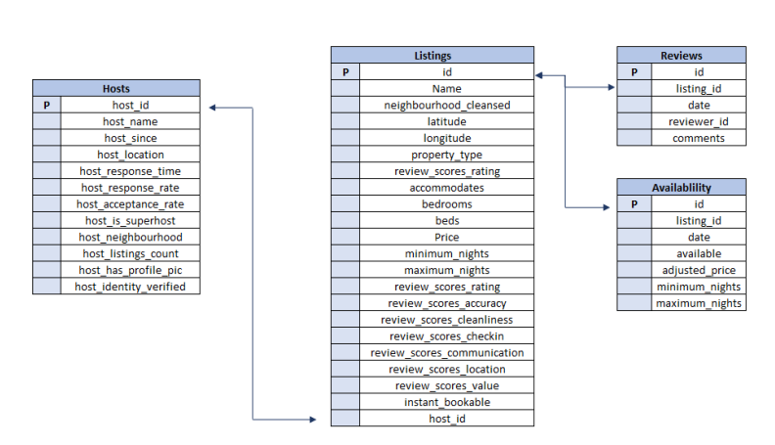
DATASETS AND ITS VARIABLES

Slide 4
INSIGHTS OF PROJECT
HOST BEHAVIOR ANALYSIS
(CANADA)

Slide 5
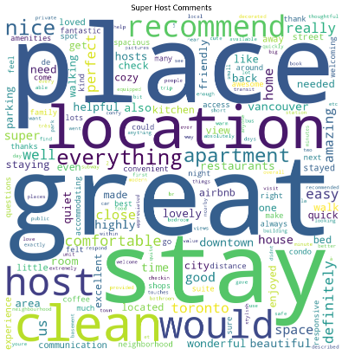
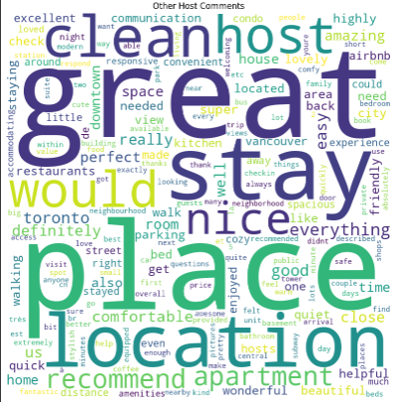
Word Cloud

Slide 6
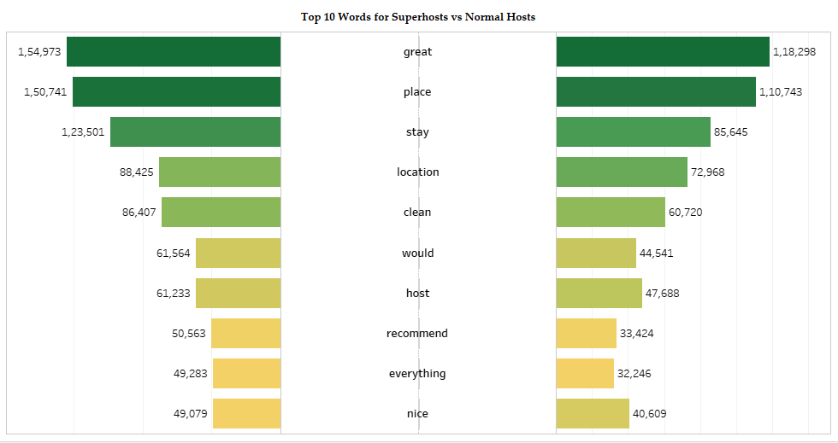

Slide 7
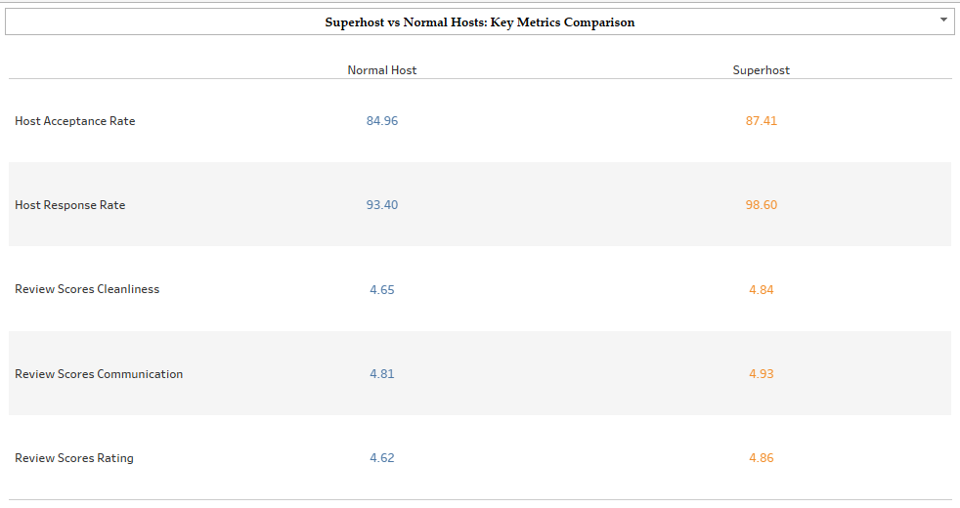

Slide 8
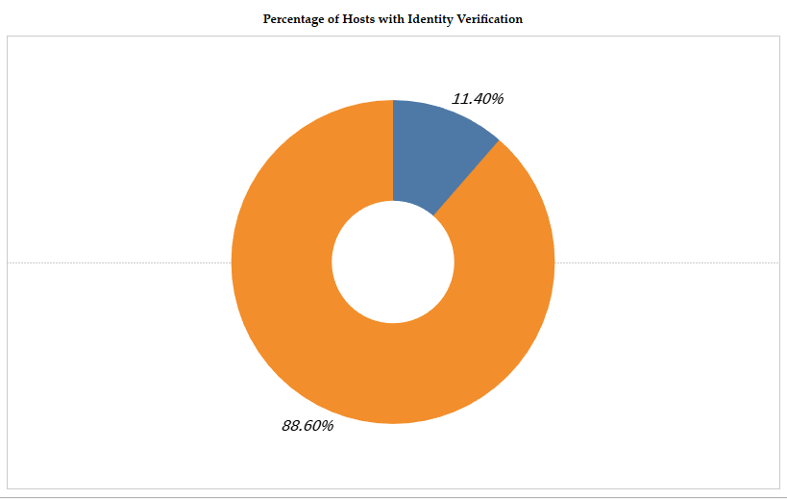

Slide 9
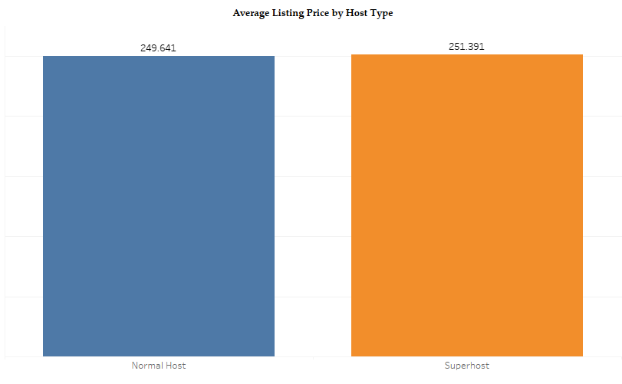

Slide 10
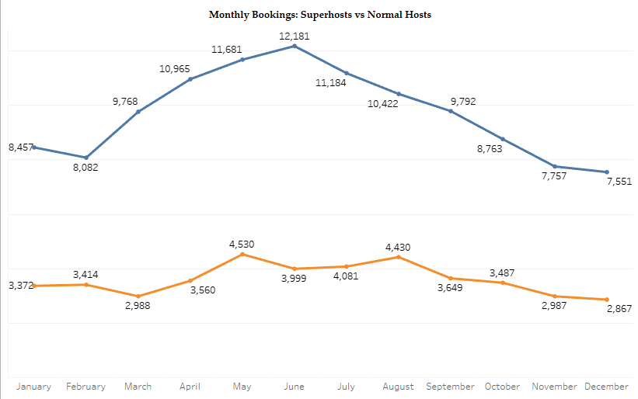


Slide 11
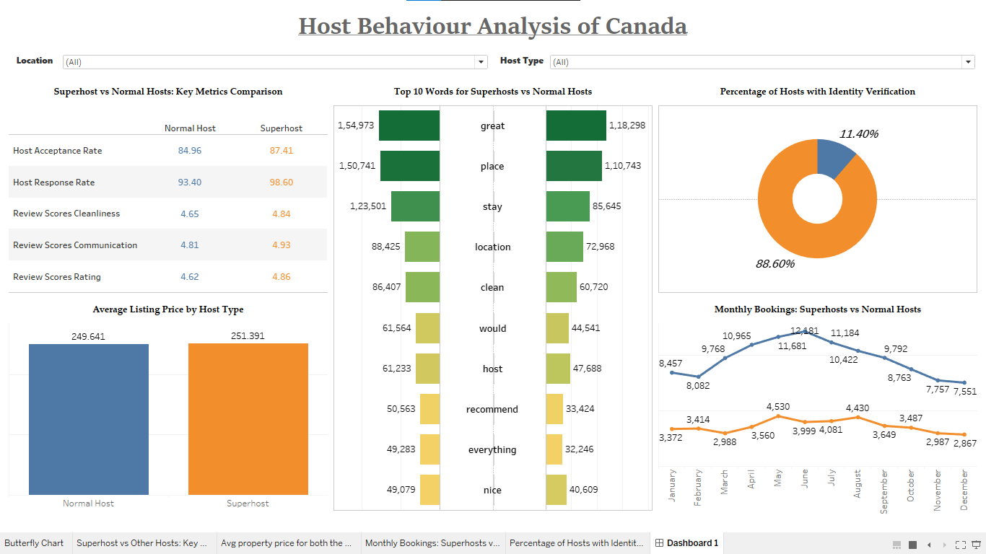
THANK YOU.

Slide 12
Conclusion And Findings
To become a Superhost, prioritize guest satisfaction and maintain high ratings. Superhosts may have higher prices and fewer bookings, but they prioritize quality over quantity. Offer exceptional accommodations and services, set competitive pricing based on value, and focus on guest satisfaction to stand out in the market and achieve Superhost status. Quality and guest satisfaction are essential for success as a Superhost.
HOST BEHAVIOR ANALYSIS
(CANADA)

