Slide 1
GREETING
WELCOME

Slide 2
PROJECT
HOST BEHAVIOR ANALYSIS
(CANADA)

Slide 3



INTRODUCTION OF TEAM MEMBERS
ADITYA SARKAR (PD15_128)
SAHIL JAMWAL (PD15_193)
BISHNUBRATA MOHANTY (PD15_226)
HOST BEHAVIOR ANALYSIS
(CANADA)

Slide 4
OVERVIEW OF PROJECTS
HOST BEHAVIOR ANALYSIS
(CANADA)

Slide 5
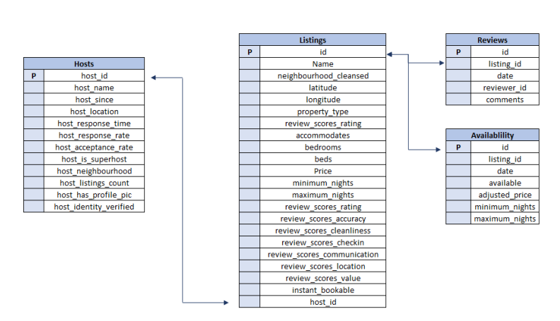
DATASETS AND ITS VARIABLES

Slide 6
INSIGHTS OF PROJECT
HOST BEHAVIOR ANALYSIS
(CANADA)

Slide 7
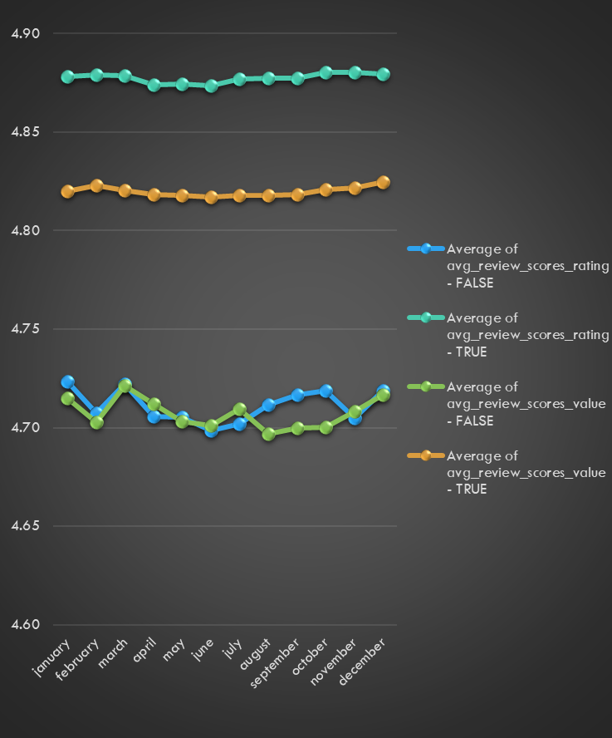
Average Review Rating Scores for Super Host is always higher every month of different Years from Other Host.
Average Review Scores Value for Super Host is always higher every month of different years from other Host.
HOST BEHAVIOR ANALYSIS
(CANADA)

Slide 8
THE AVERAGE OF THE HOST ACCEPTANCE RATE FOR SUPER HOST FOR EVERY MONTH OF DIFFERENT YEARS IS ALWAYS HIGHER THAN OTHER HOST.
THE AVERAGE OF HOST RESPONSE RATE FOR SUPER HOST FOR EVERY MONTH OF DIFFERENT YEARS IS ALWAYS HIGHER THAN OTHER HOST.
HOST BEHAVIOR ANALYSIS
(CANADA)

Slide 9
THE SUM OF THE TOTAL BOOKING OF THE SUPER HOST FOR EVERY MONTH OF DIFFERENT YEARS IS ALWAYS HIGHER THAN OTHER HOST.
HOST BEHAVIOR ANALYSIS
(CANADA)

Slide 10
Average Rating of Scores Communication Reviews of Super Host for different years is always higher than other Host in both the Cities of CANADA.
HOST BEHAVIOR ANALYSIS
(CANADA)

Slide 11
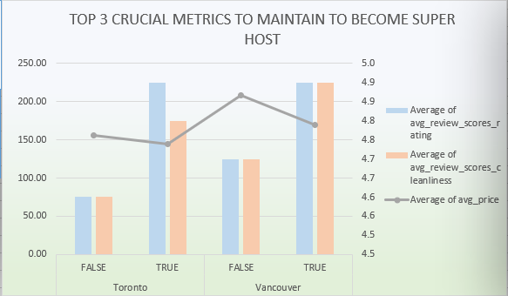
ONE OF THE TOP CRUCIAL METRIC TO BECOME A SUPER HOST IS THAT SUPER HOSTS ALWAYS HAVE HIGH REVIEW SCORE RATINGS.
ANOTHER TOP CRUCIAL METRIC TO BECOME A SUPER HOST IS THAT SUPER HOST REVIEW SCORE CLEANLINESS IS ALWAYS HIGH.
ONE MORE TOP CRUCIAL METRIC TO BECOME A SUPER HOST IS THAT SUPER HOST AVERAGE PRICE IS ALWAYS LOWER THAN OTHER HOST.
HOST BEHAVIOR ANALYSIS
(CANADA)

Slide 12
OTHER HOST TEND TO HAVE MORE PROPERTY TYPE THAN SUPER HOST.
HOST BEHAVIOR ANALYSIS
(CANADA)

Slide 13
CONCLUSION and FINDINGS
SUPER HOST SCORE RATINGS AND RESPONSE OR ACCEPTANCE RATE IS ALWAYS HIGHER THAN OTHER HOSTS AND THE AVERAGE PRICE IS ALWAYS LOWER THAN OTHER HOST AND REVIEWS ARE ALWAYS BETTER THAN OTHER HOST BUT THE NUMBER OF LARGE PROPERTY TYPE OWNED BY SUPER HOST AND OTHER HOST ARE MORE OR LESS SAME.
HOST BEHAVIOR ANALYSIS
(CANADA)

Slide 14
THANK YOU.

