Slide 1
ECHOHUB
SHREE UTTAR GUJARAT BBA & BCA COLLAGE
Semester : 5
Student Name
SAHIL KANOJIYA
Student Roll No
115

Slide 2
INDEX
SR No | CHAPTER
1 | Introduction
2 | Hardware and Software Requirements
3 | Technology Used
4 | Project Modules
5 | Advantages
6 | Scope and Objectives
7 | Data Dictionary
8 | Data Flow Diagram
9 | Output Design
10 | Drawbacks
11 | Conclusion
12 | Reference

Slide 3
INRODUCTION
  1.1 Project Description
  Purpose:
    Echohub is a social media platform designed to connect people and facilitate content sharing.
  Core Functionality:
    Users can create,view, and interact with posts, images, and videos.
  Engagement Features:
    Includes likes, comments, view.
  User Experience:
    Aims to provide a seamless, intuitive interface for easy navigation and interaction.
  Security:
    Focuses on user privacy through robust security measures.

Slide 4
Hardware Requirement :
Processor | Latest Is Good For Performance
RAM | 8 GB
Hard Disk | 259 GB
Disk Space | 10 GB Minimum
Software Requirement:
Operating System | Microsoft Windows 11
Frontend | ReactJs
Backend | Java
Scripting Language | Javascript
DataBase | MongoDB

Slide 5
Technologies Used :
Frontend | Html,css,Bootstrap,Reactjs
Backend | Java (Spring Boot)
Scripting Language | Javascript
DataBase | MnogoDB

Slide 6
PROJECT MODULE
The Echohub project is divided into several core modules that work together to create a fully functional social media platform. Each module has its own responsibilities and functions within the system.
Core Modules
1) Admin Management
  Profile Creation: Admins can create profiles with credentials for managing the platform.
  Login and Password Management: Admins can log in to the system securely, managing their own passwords and access levels.
2) User Management
  User Operations: Admins can manage user accounts, including searching and deleting users when necessary.
  Reported Posts Management: Admins can view reported posts, including how many times each post has been reported, and take action to delete them if necessary.

Slide 7
3) User Side Features
  1) User Registration: Users can create an account by registering with a username, email, and password.
  2) User Login: Registered users can log into the platform to access their accounts.
  3) Post Creation: Users can create and publish posts that can be viewed by their followers.
  4) Like Posts: Users can like posts made by others to express appreciation or agreement.
  5) Delete Posts: Users can delete their own posts when they wish to remove content from the platform.
  6) View Posts: Users can browse and view posts from other users, which can include images, text, or links.
  7) Follow Users: Users can follow other users to receive updates on their posts.
  8) Comment on Posts: Users can comment on posts to engage in discussions and share their thoughts.
  9) Change Profile Settings: Users can update their profile information, including bio, profile picture, and other personal details.
4) Analytics and Reporting Module
  1) User Analytics: Track user activities such as engagement rates, post interactions, and follower growth.
  2) Platform Metrics: Admins can view real-time analytics on user count, post count, and general platform performance trends.

Slide 8
ADVANTAGES
Robust User Management:
The platform provides comprehensive user management capabilities, including features for user registration, login, profile management, and content moderation. Administrators can efficiently oversee user activities, ensuring a safe and engaging environment for all users.
User-Friendly Interface:
Echohub offers an intuitive and easy-to-navigate design, making it accessible for users of all ages. This user-centric approach promotes higher engagement and ensures that users can effortlessly explore and utilize the platform’s features.
Engagement Features:
Echohub allows users to create posts, like content, comment on discussions, and follow other users. These interactive features foster community interaction and encourage active participation, creating a vibrant social atmosphere.
Analytics and Reporting:
Echohub includes powerful analytics tools that track user activity and engagement metrics. This data-driven approach enables administrators to make informed decisions for platform improvements and understand user preferences.

Slide 9
Scope and Objectives
Scope:
User Interaction: Facilitate content creation, sharing, and engagement.
Content Management: Enable user-generated content with moderation tools.
Analytics and Reporting: Track user engagement and activity metrics.
User Management: Streamline registration and profile management.
Community Building: Foster connections and relationships among users.
Privacy and Security: Ensure data protection and user safety.
Objectives:
Enhance User Engagement: Promote active participation through intuitive features.
Efficient Content Moderation: Maintain a safe environment for all users.
Utilize Analytics: Drive continuous improvement based on user data.
Support Community Building: Encourage meaningful interactions.
Ensure User Privacy: Prioritize data protection and transparency.

Slide 10
Data Dictionary
Tables Overview:
Table Name : User
Column Name | Data Type | Description | Column Name
_id | ObjectId | Unique identifier for the user | _id
Username | String | Username or email of the user | Username
Fullname | String | Full name of the user | Fullname
Email | String | Email address of the user | Email
Password | String | Encrypted password (hashed using bcrypt) | Password

Slide 11
Table Name : Posts
Column Name | Data Type | Description | Default Value
_id | ObjectId | Unique identifier for the post. | _id
user.id | ObjectId | Unique identifier of the user. | user.id
content | String | The text content of the post. | content
image_url | String | URL of the image associated with the post. | image_url
Video_url | String | URL of video associated with the post. | Video_url
created_at | Date | Timestamp indicating when the post was created. | created_at

Slide 12
Table Name :Reports
Column Name | Data Type | Description | Default Value
_id | ObjectId | Unique identifier for the report | auto
post_id | String | ID of the associated post | null
reported_by | String | ID of the user who reported the post | null
reason | String | Reason for reporting | ""
created_at | Date | Timestamp when the report was created | Current Timestamp

Slide 13
Table Name :Comments
Column Name | Data Type | Description | Default Value
_id | ObjectId | Unique comment identifier | Auto
post_id | String | Associated post ID | ""
user | Reference | Creator of the comment | null
content | String | Text of the comment | ""
created_at | Date | Text of the comment | Current Timestamp
likes | Array | Comment creation timestamp | []

Slide 14
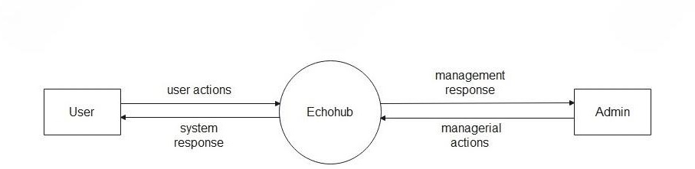
DATA FLOW DIAGRAM
0 level- Context level:

Slide 15
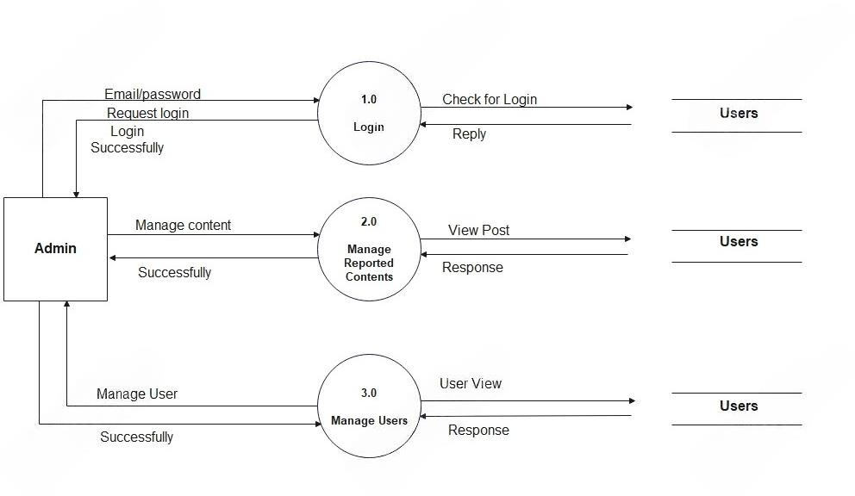
1 level- Admin level:

Slide 16
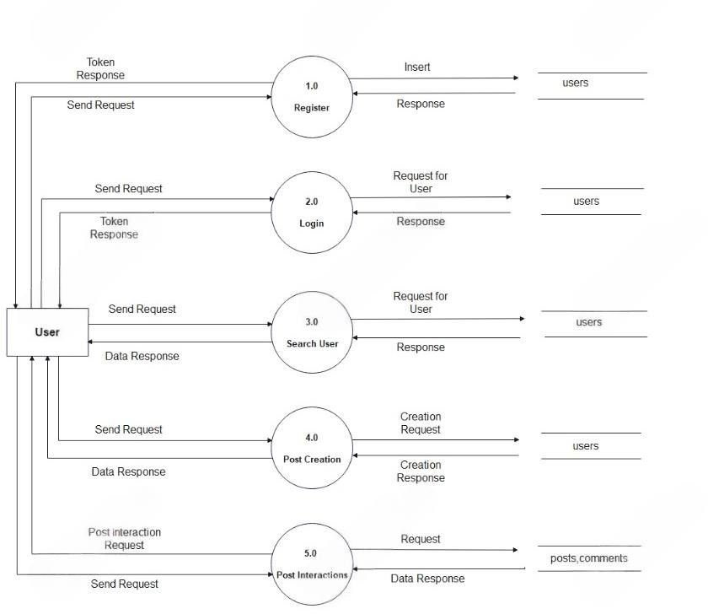
2 level- Operator level:

Slide 17
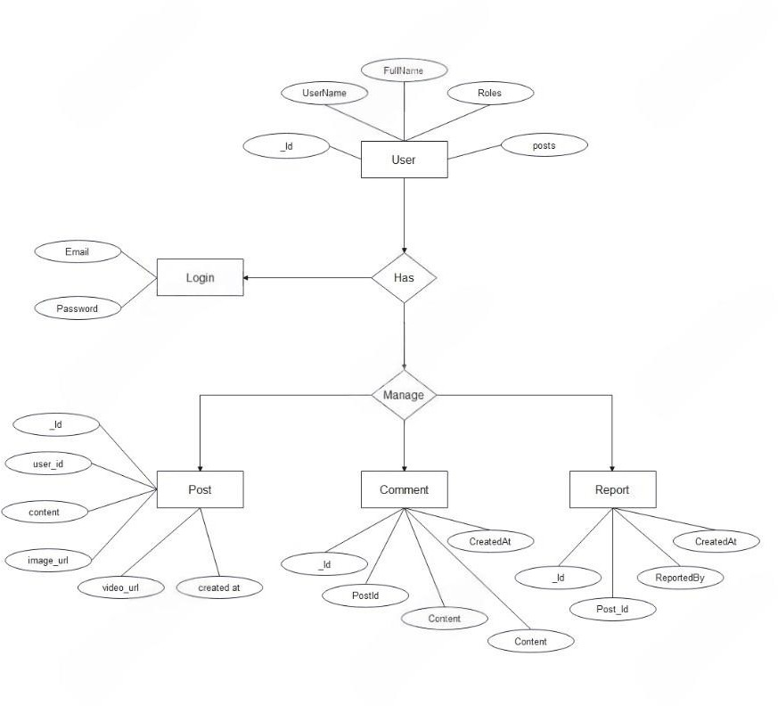
ENTITY-RELATIONSHIP DIAGRAM

Slide 18
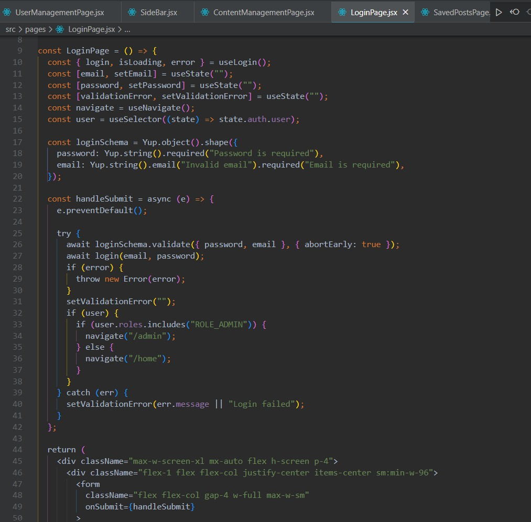
INPUT DESIGN
LogIn.js:

Slide 19
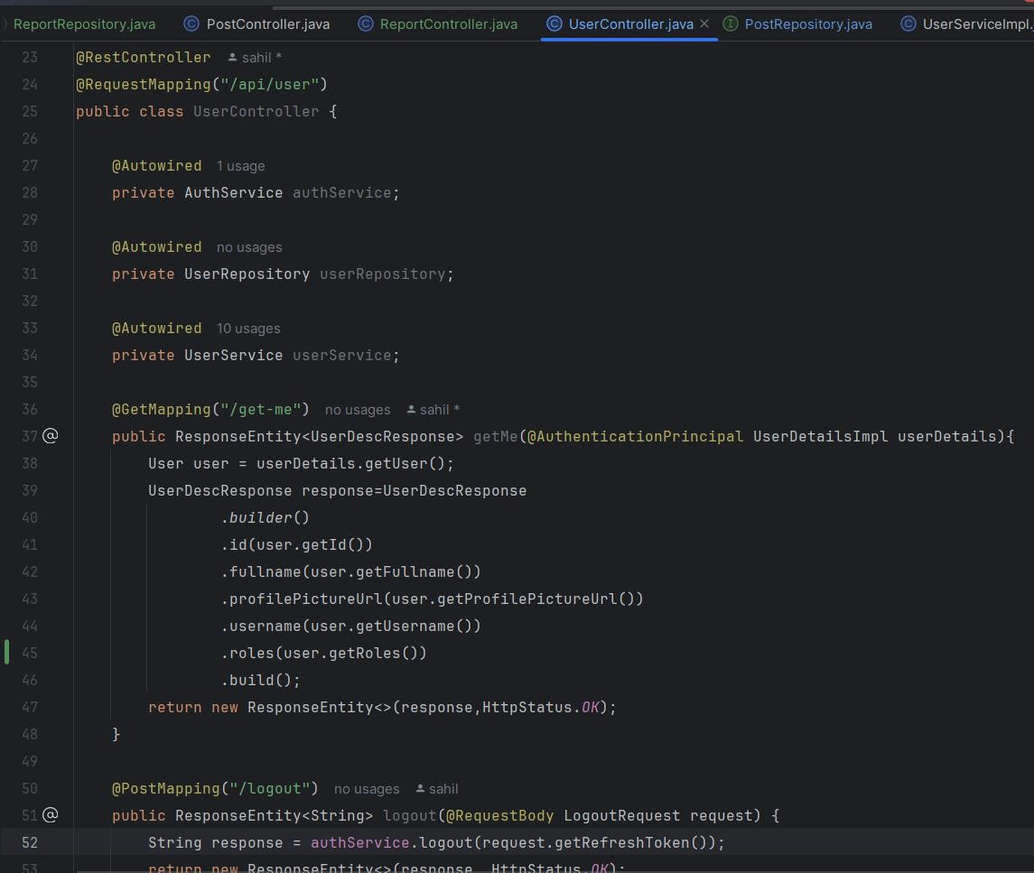
User level

Slide 20
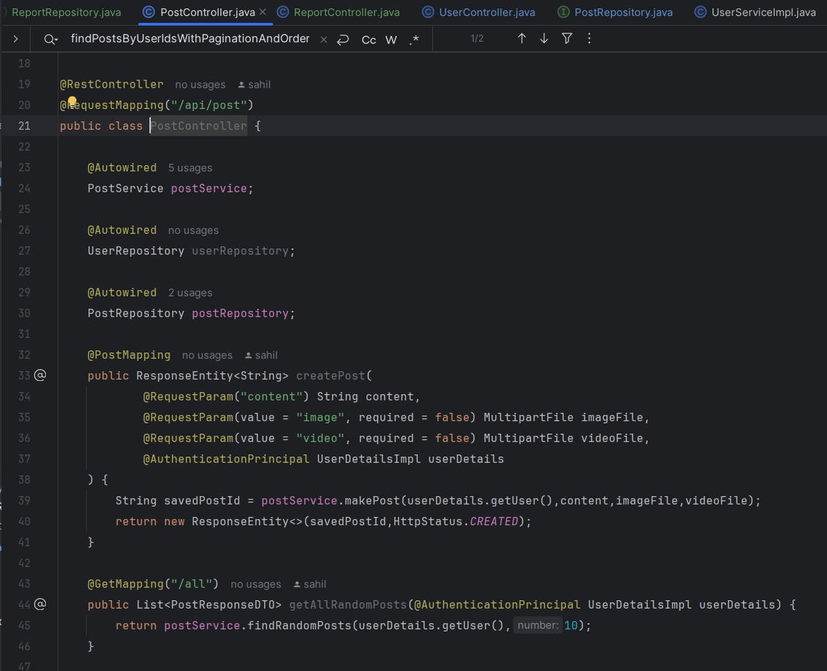
Post Controller

Slide 21
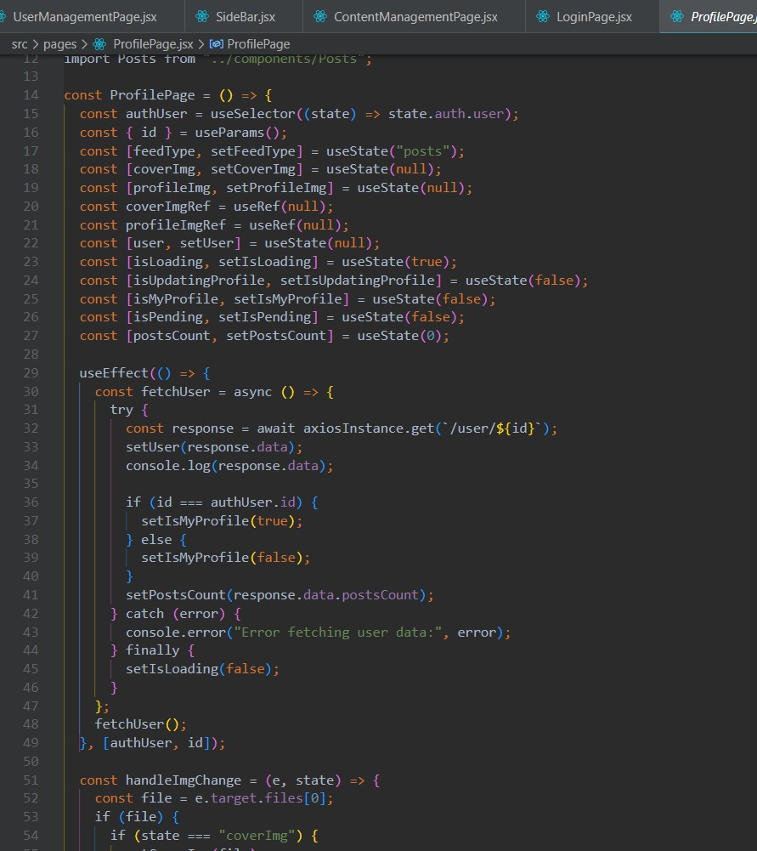
Profile Page

Slide 22
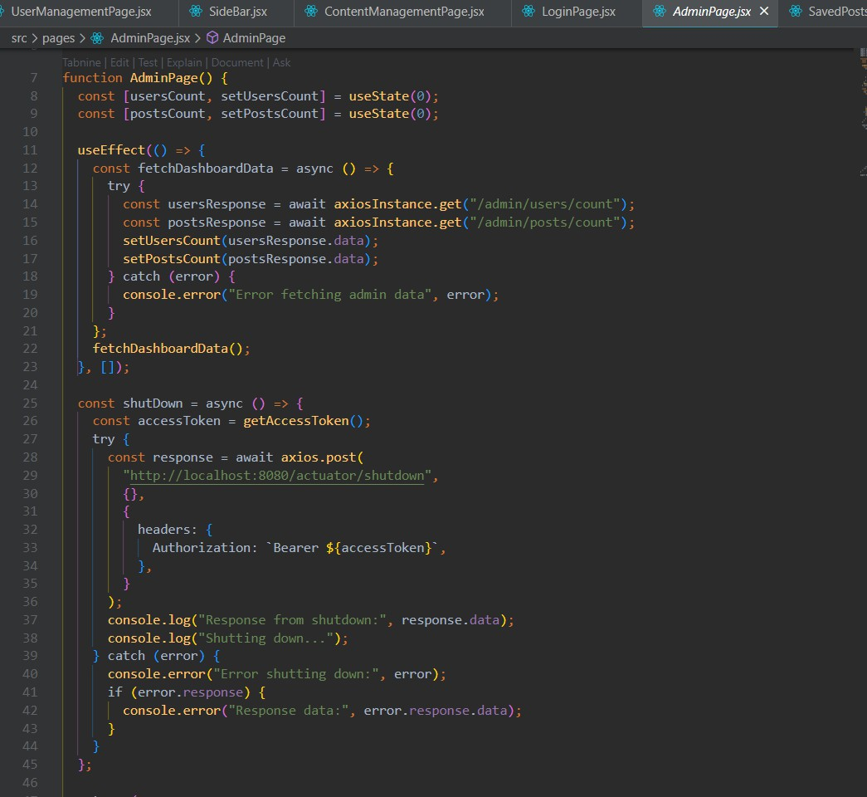
Admin Page:

Slide 23
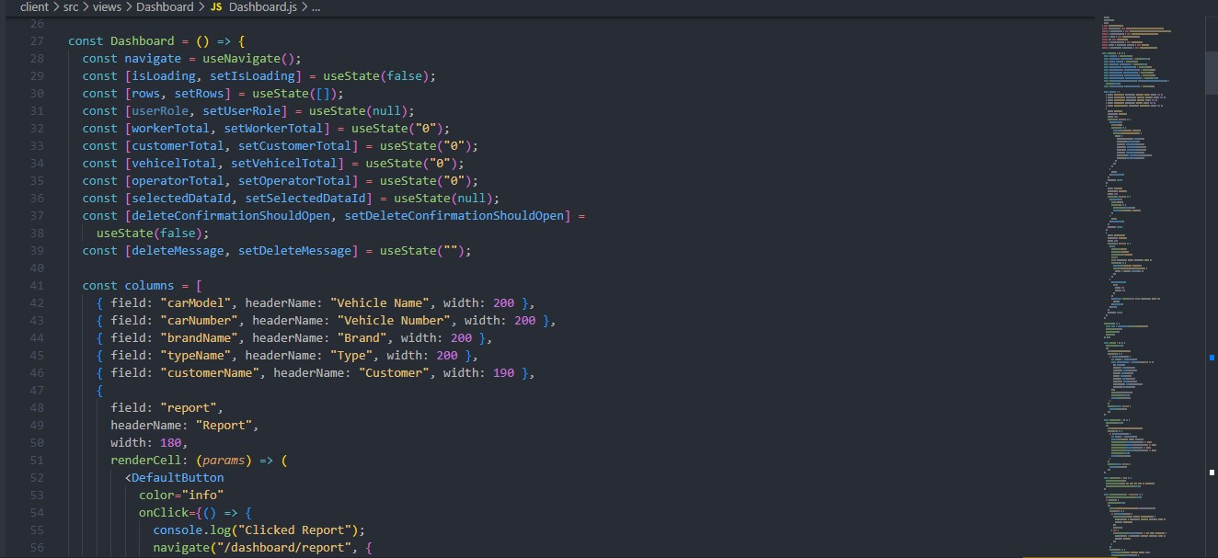
DashBoard.js:

Slide 24
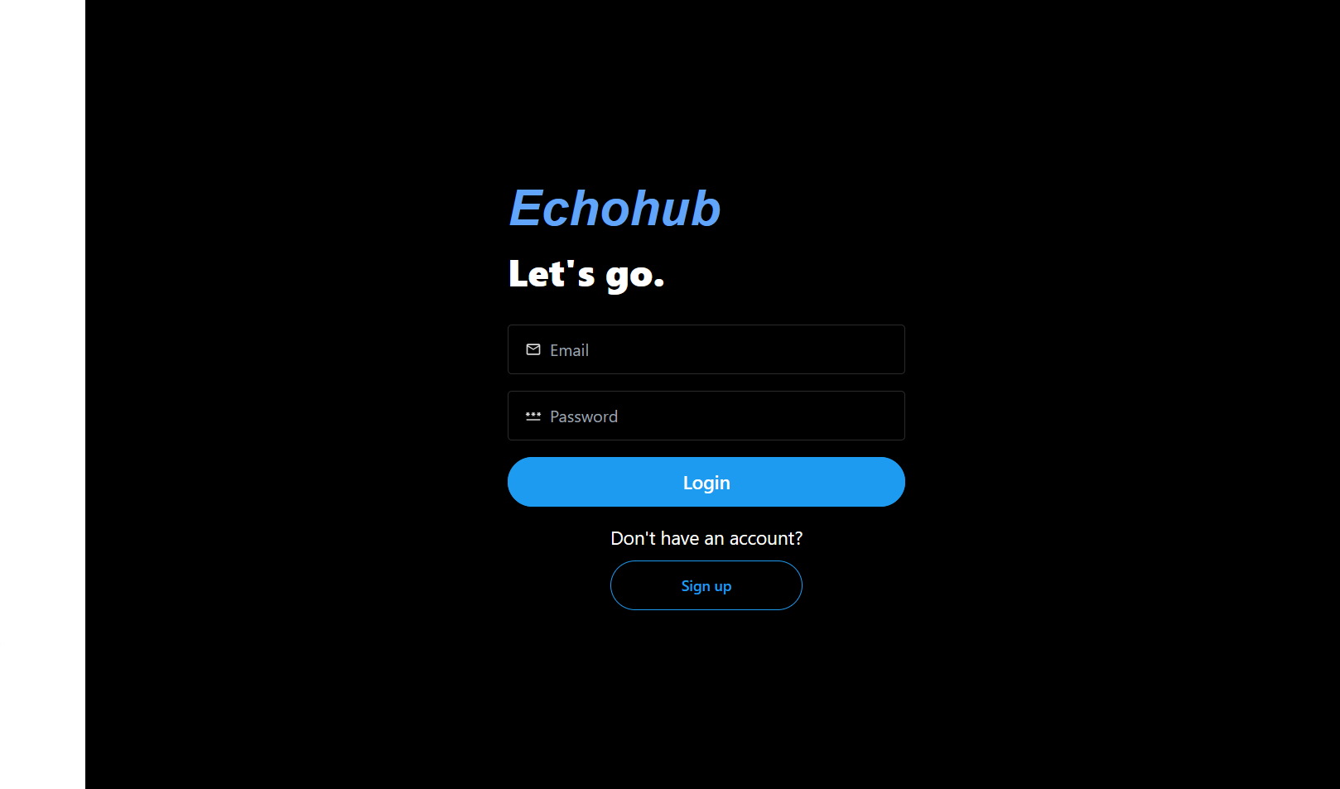
OUTPUT DESIGN
Login.js:

Slide 25
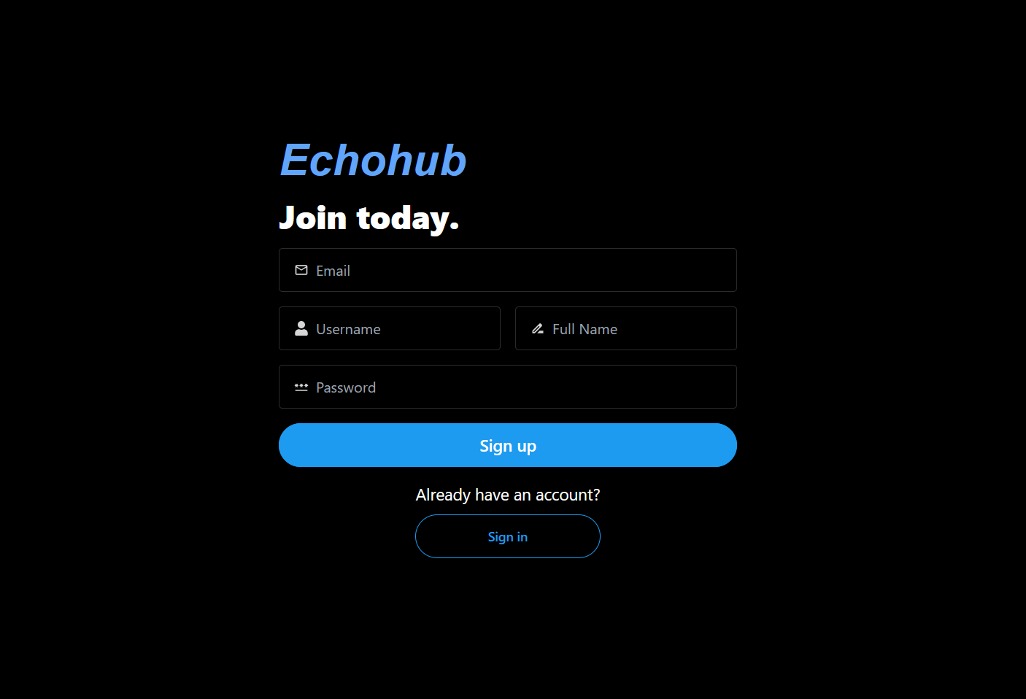
    Register Page:

Slide 26
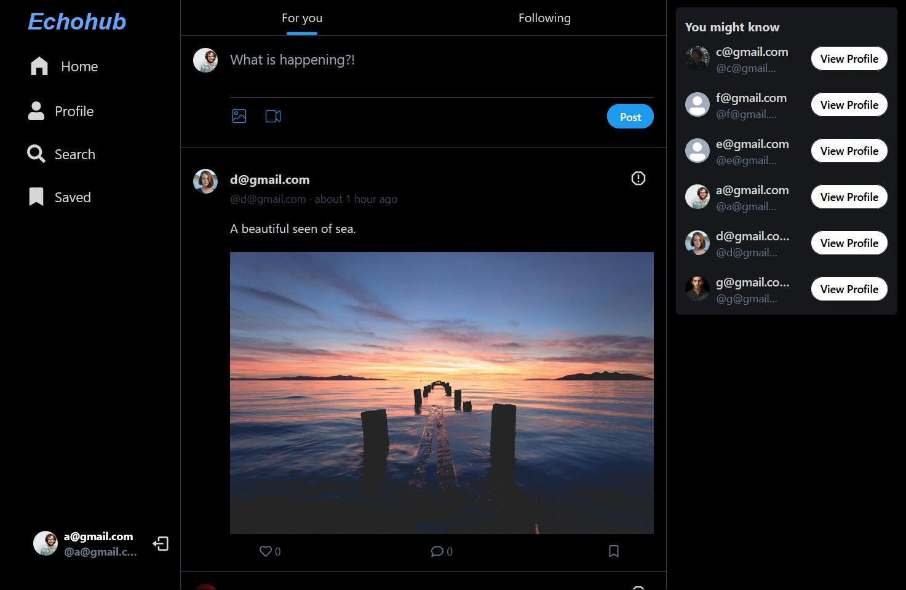
    Home Page:

Slide 27
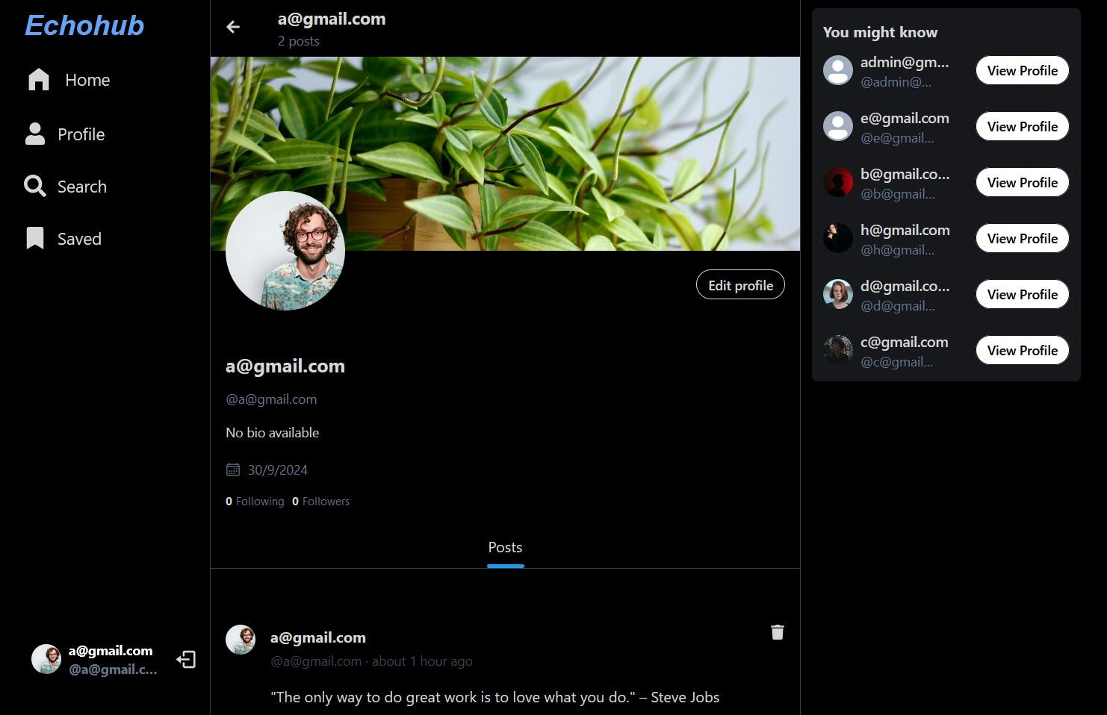
    Profile Page:

Slide 28
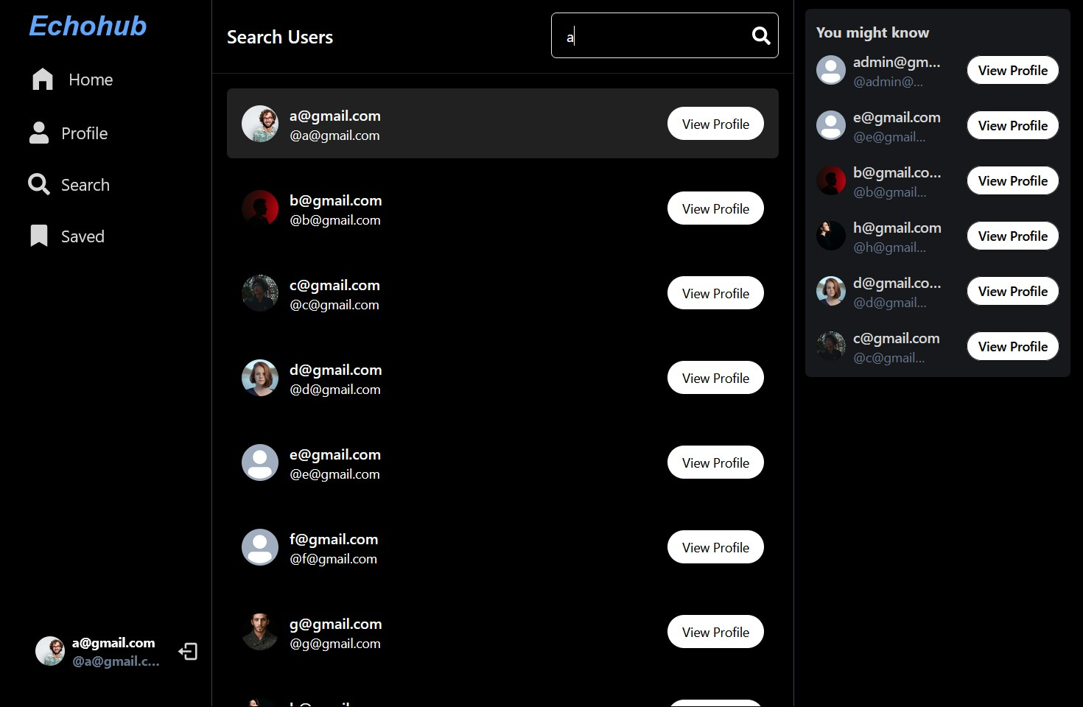
    Search Page:

Slide 29
DRAWBACKS
Drawbacks of Echohub
Public Availability of User Posts:
User-generated content, including images and posts, is publicly accessible, which may raise privacy concerns. Users might be apprehensive about sharing personal or sensitive information, knowing it can be viewed by anyone on the platform.
Lack of Real-Time Notification System:
The absence of a real-time notification system can hinder user engagement. Users may miss important updates, such as comments, likes, or messages, which could lead to decreased interaction and participation on the platform.
No Real-Time Chat Feature:
Without a real-time chat feature, users are limited in their ability to communicate instantly with others. This can affect community building and user interaction, as users may prefer quick and direct messaging options rather than relying solely on comments or posts.

Slide 30
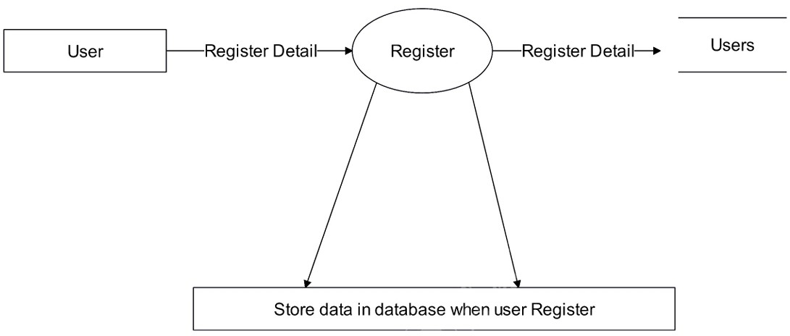
PROCESS SPECIFICATION
Register Process:

Slide 31
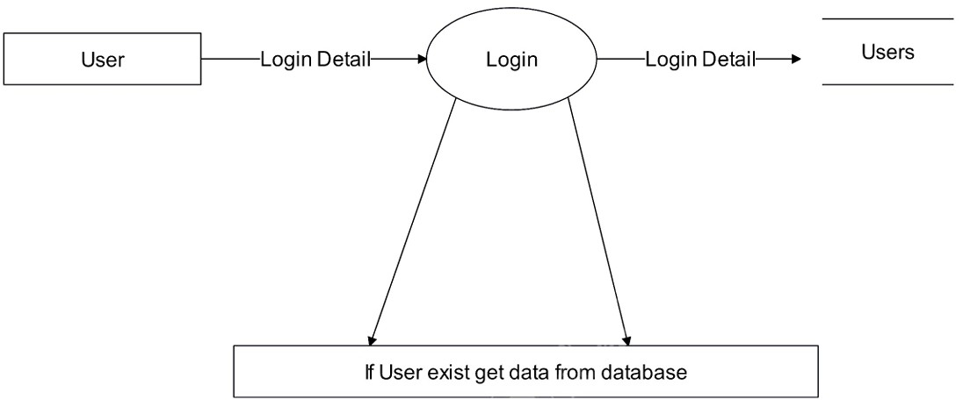
Login Process:

Slide 32
Conclusion
User Experience:
The project significantly enhances user experience by providing a streamlined and intuitive interface.
User Interface:
The system's design ensures ease of navigation and accessibility, making it simple for users to manage posts and interact with posts.
Role-Based Login:
The implementation of role-based login provides secure and personalized access.

Slide 33
REFERENCES
For ReactJs:
https://react.dev/
https://www.w3schools.com/REACT/
For NodeJs:
https://nodejs.org/en
https://www.w3schools.com/nodejs/
For MongoDB:
https://www.mongodb.com/
https://www.w3schools.com/mongodb/

Slide 34
Thank You So Much…

