Slide 1

RAILCAR CARE

Slide 2

GROUP MEMBERS
GANESH KARNATI
HARSHITHA ENUMULA
SAHIL RAVURI
VAMSI KRISHNA ROLLA

Slide 3

OUTLINE
INTRODUCTION
HISTORY OF TRAINS
OUR PROPOSAL
IMPACT AND BENEFITS
DEMO
FUTURE ENHANCEMENTS
Q&A

Slide 4
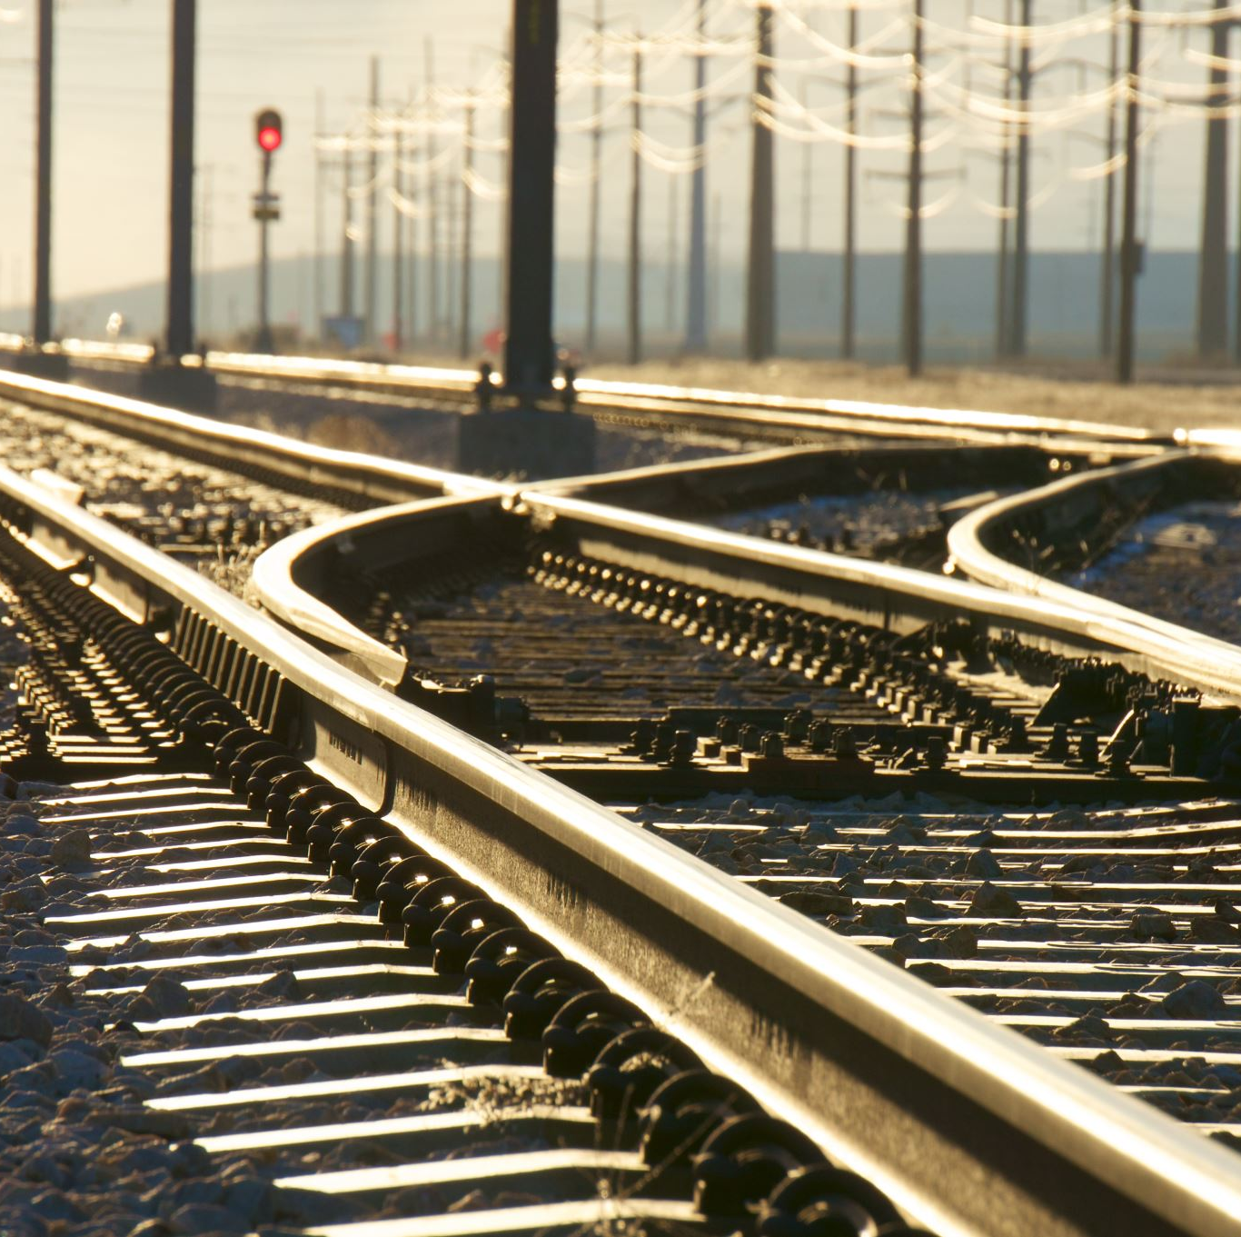
INTRODUCTION
Nowadays, the railroad industry serves as a crucial link in contemporary transport , communicating with people and objects across great distances.
However, below the seamless tour in between these exciting moments and the clean whiff of the commodities, there is a tough net of railroads, locomotives, rails, and related facilities which requires constant attention and dedication

Slide 5
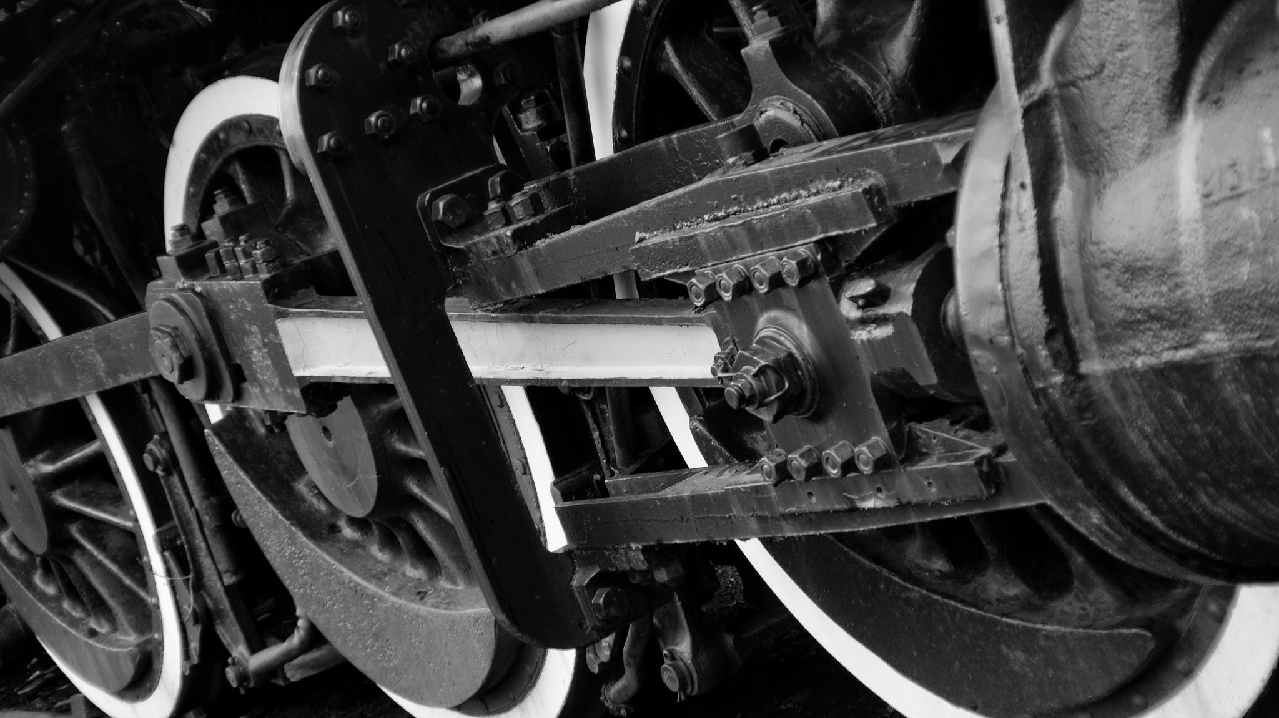
HISTORY OF TRAINS
Ancient Origins: Early experimentation with rudimentary tracks in ancient civilizations.
Wagonways (17th Century): Introduction of wooden wagonways for more efficient transport in mines.
Steam Revolution (Early 19th Century): Game-changing era with the advent of steam locomotives.
19th Century Railway Boom: Global expansion of railways contributing to the Industrial Revolution.
Transcontinental Connectivity (19th Century): Completion of transcontinental railways connecting vast territories.
Colonial Expansion (Late 19th - Early 20th Centuries): Railway investments for economic and strategic reasons.
Electrification and Modernization (Late 19th - Early 20th Centuries): Adoption of electrification and technological advancements.
High-Speed Rail (20th Century Onward): Introduction of high-speed rail systems revolutionizing long-distance travel.
21st Century Globalization: Continued significance of railways in global transportation and trade.

Slide 6

OUR PROPOSAL
Our proposal gives a succinct outline on why servicing and rebuilding are crucial to the rail industry, which underscores their inherent nature as a necessity. Observing the various difficulties faced by rail operators and their aftermath.
This serves to highlight the importance of preventive approach as opposed to neglecting the maintenance.
The protection practices and techniques used to ensure long lasting and reliable railway systems. By this, such means as carrier and renewal strategies would give light how well they could enhance performance.
Every passenger and freight rail service, especially to a more sustainable and dependable alternative transportation.

Slide 7
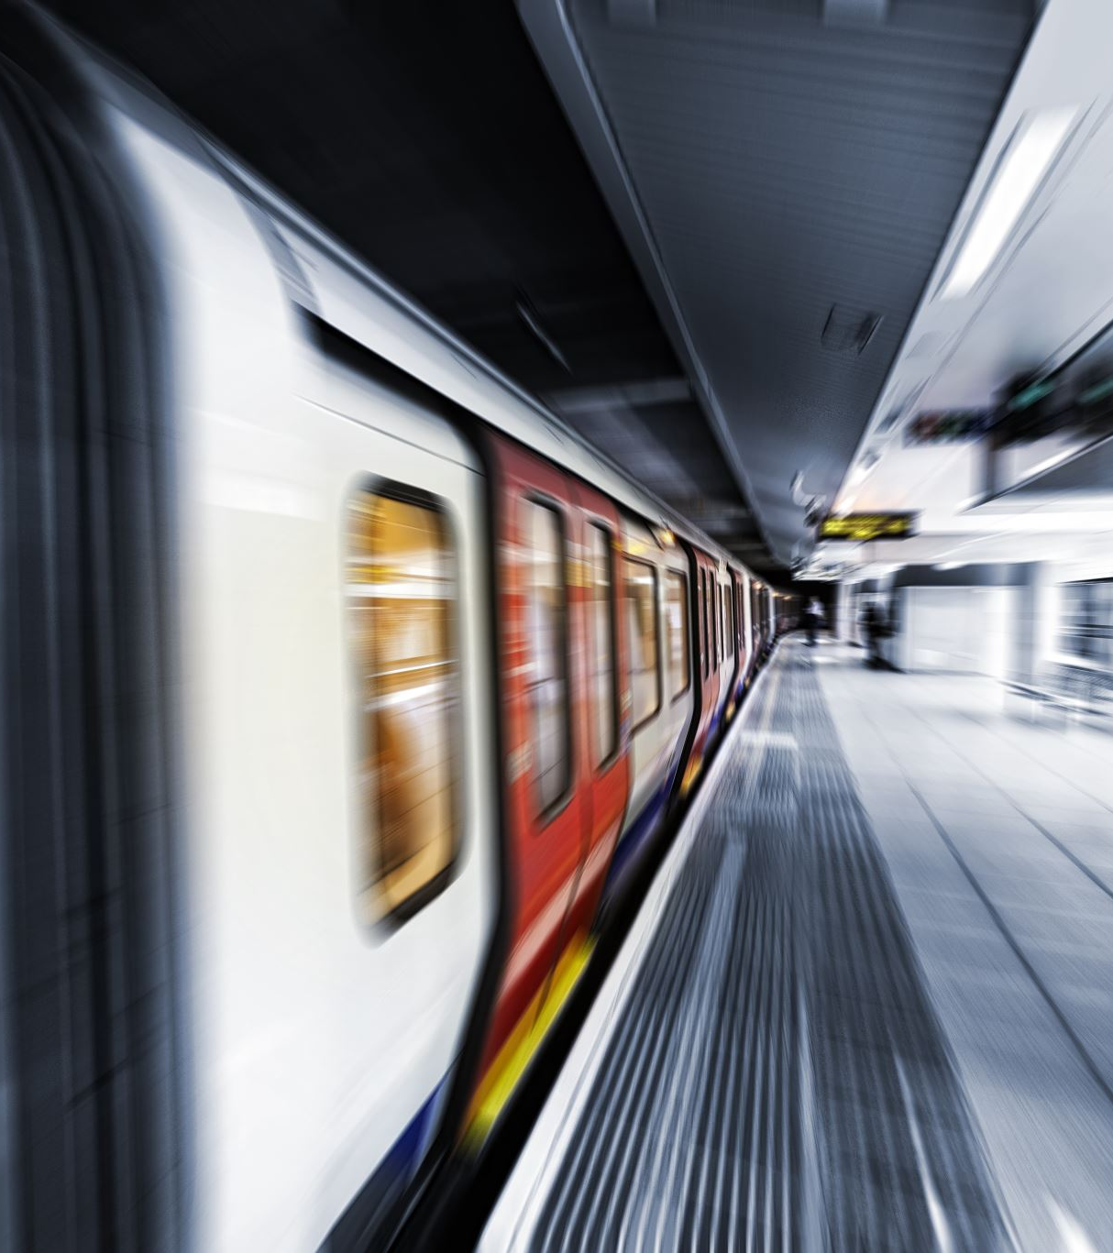
IMPACT AND BENEFITS
Enhanced Safety: Safe, reliable.
Reliability Boost: Minimally interrupted.
Operational Efficiency: Reduced downtime.
Longevity and Resilience: Infrastructure preserved.
Improved Passenger Experience: Smoother journeys.
Optimized Freight Services: Efficient cargo.
Sustainability: Eco-friendly maintenance.
Cost Savings: Long-term economy.

Slide 8

DEMO

Slide 9

FUTURE ENHANCEMENTS
ANYTHING IS POSSIBLE
Predictive Maintenance
IoT Connectivity
Automated Inspection Technologies:
Energy-Efficient Solutions
Enhanced Passenger Experience
Environmental Sustainability
Digital Twins and Simulation

Slide 10

Q&A

Slide 11

THANK YOU

