Slide 1
Earshot
Same goal: buy 250 g of coffee, whole bean
Product
Grind
Cart
Checkout
Review
Order
Seeing
Rules don’t fail customers.
Journeys do.
Blind
What each agent gets at the grind picker
Two AI agents shop the same store with the same goal. One sees the page. One only hears it, through the accessibility tree a screen reader uses. Where they split, Earshot names the WCAG failure, writes a fix and proves it with a fresh blind run.
Seeing [Whole bean] [Espresso]
[Filter] [French press]
Blind StaticText "Whole bean"
StaticText "Espresso"
StaticText "Filter"
StaticText "French press"
No button, no role, nothing to press. The blind agent stalls here.
Vultr Agent Rush · Challenge 1: Blast Radius Zero · November 2026
Notes:
Earshot. Accessibility checkers test rules; Earshot tests journeys. Two agents, same model, same prompt, same goal. The only difference is their senses. On our demo store the seeing agent buys the coffee; the blind agent hears three pieces of text where the grind buttons should be, and stops. That split is a real bug, and it is the whole idea of the product.

Slide 2
For 43 million blind people, a web page is a list of words
43.3M
A screen reader reads each control’s role and name. When the name is missing, this is the whole checkout:
“button. button. link. image.”
people were blind in 2020. Another 295 million live with moderate or severe vision impairment.
What screen-reader users rank as most problematic
1
CAPTCHA
61M
blind people expected by 2050
1.3B
people, 1 in 6, live with a significant disability
2
Menus, tabs and dialogs that don’t behave as expected
3
Links and buttons that make no sense out of context
The top of that list has barely moved in 14 years of surveys.
Sources: GBD 2019 Blindness & Vision Impairment Collaborators / Vision Loss Expert Group, The Lancet Global Health 9(2), 2021 · WHO, Global report on health equity for persons with disabilities, 2022 · WebAIM, Screen Reader User Survey #10, 2024 (via A. Roselli, Feb 2024)
Notes:
Scale first. 43.3 million blind, 295 million with moderate or severe vision impairment, rising to 61 million blind by 2050 as populations age. WHO counts 1.3 billion people with a significant disability. Blind users meet the web through a screen reader, which reads roles and names. A button without a name is just "button". In WebAIM's survey, CAPTCHA, misbehaving menus and dialogs, and meaningless links and buttons top the problem list, as they have for years.

Slide 3
94.8% of the top million home pages fail WCAG
Average detected WCAG errors per home page
Failures that stop a blind shopper cold
48.2%
of home pages have form fields with no label
The field is silent: name, email, card?
45.4%
have empty links
Heard as “link”
29.6%
have empty buttons
Heard as “button”
Online shops are worse than the web average: up to 67% more errors on Magento.
Source: WebAIM, The WebAIM Million: 2025 report on the accessibility of the top 1,000,000 home pages (webaim.org/projects/million/2025). Automated scan of home pages only, so it counts a subset of real failures.
Notes:
WebAIM scans the top million home pages every year. In 2025, 94.8% had detectable WCAG failures, 51 errors per page on average. E-commerce platforms are worse: Shopify 69.6, WooCommerce 75.6, Magento 85.4. The failures that matter most to a blind shopper are the ones Earshot targets: unlabeled fields, empty links, empty buttons. And these are only what automated tools can see on a home page, not what breaks deeper in a checkout.

Slide 4
Ignoring it costs twice: in court and at checkout
In court
At checkout
5,114
US lawsuits over inaccessible websites, apps and video in 2025. About 70% hit e-commerce; 45% of federal suits hit companies already sued.
69%
of disabled shoppers with access needs leave a site that is hard to use.
€100k
Top fine per serious breach under Germany’s BFSG. The European Accessibility Act applies to online shops since 28 June 2025.
8%
tell the site owner. The rest leave silently, so the bug never reaches a ticket.
$1M
FTC order against overlay vendor accessiBe (2025) for claiming its widget made sites WCAG compliant. A widget is not a fix.
£17.1B
UK online spend lost each year to inaccessible sites, in one country alone.
Sources: UsableNet, 2025 Year-End Digital Accessibility Lawsuit Report · Directive (EU) 2019/882 (EAA) · BFSG § 37(2) · FTC, “FTC Approves Final Order Requiring accessiBe to Pay $1 Million”, 22 Apr 2025 · Click-Away Pound Survey 2019 (clickawaypound.com)
Notes:
Two costs. Legal: over five thousand US digital accessibility suits in 2025, mostly e-commerce, and almost half against repeat defendants, so a single audit does not protect you. In the EU the Accessibility Act has applied to online shops since June 2025; Germany can fine up to 100,000 euros per serious breach. And the quick fix of an overlay widget earned its best-known vendor a one-million-dollar FTC order. Commercial: 69% of disabled shoppers just leave, only 8% complain, so teams never learn the checkout is broken.

Slide 5
Shops selling in the EU now need proof, not a badge
$18T+
 | Rule checkers | Overlays | Manual audit | Earshot
Tests a whole purchase journey | No | No | Yes | Yes
Names the step a blind user gets stuck on | No | No | Yes | Yes, with WCAG rule
Writes the fix | No | Claims to | Advice only | Attribute patch
Proves the fix worked | No | No | Re-audit | Fresh blind rerun
Time to an answer | Seconds | Instant | Weeks | ~2 minutes
spending power of the global disability market. Not a niche: 1 in 6 people.
Who buys
E-commerce teams in scope of the EAA and ADA
Agencies that build and audit shops
Platforms that want a release gate for checkout journeys
Rule checkers see elements. Only a journey shows that a blind customer cannot pay.
Sources: Return on Disability Group, The Global Economics of Disability 2024 · WHO, Global report on health equity for persons with disabilities, 2022. Comparison is our assessment of each tool category.
Notes:
The market is large and now regulated. The disability market carries over 18 trillion dollars of spending power. The buyers are e-commerce teams that fall under the EAA and ADA, the agencies that build their shops, and platforms that want a gate before release. Today they choose between rule checkers that do not test journeys, overlays that do not fix anything, and manual audits that take weeks. Earshot tests the journey, names the blocker with its WCAG rule, writes a patch and proves it in about two minutes.

Slide 6
Same model, same goal. Only the senses differ
Goal: buy one 250 g bag of Ethiopia Guji, whole bean, at Kaffeebohne Roasters (our demo store with planted bugs)
Product
Grind
Cart
Checkout
Review
Order
Seeing
sees screenshots
Blind
hears the accessibility tree
split
Confirm
Patch
Retry
Verified
A fresh inspector sandbox replays the seeing agent to the split and runs deterministic checks: in the tree, name, role, keyboard, label, axe-core. No failing check, no finding.
The model may return only a JSON attribute patch (role, aria-*, tabindex). A fixed template applies it. Model output never becomes code.
A new blind agent starts from the beginning in a new sandbox, with every accepted patch applied.
Only if the blind agent now gets past the blocked step. Listen plays the page as a screen reader would, before and after.
Notes:
How it works. Both agents run the same model and prompt. The seeing agent gets screenshots; the blind agent gets only the accessibility tree. The first milestone the seeing agent reaches and the blind agent does not is the split. Then four stages: confirm the blocker with deterministic checks, so a model mistake never becomes a finding; generate an attribute-only patch applied by a fixed template; rerun a fresh blind agent from scratch; and call it verified only if that rerun passes the step.

Slide 7
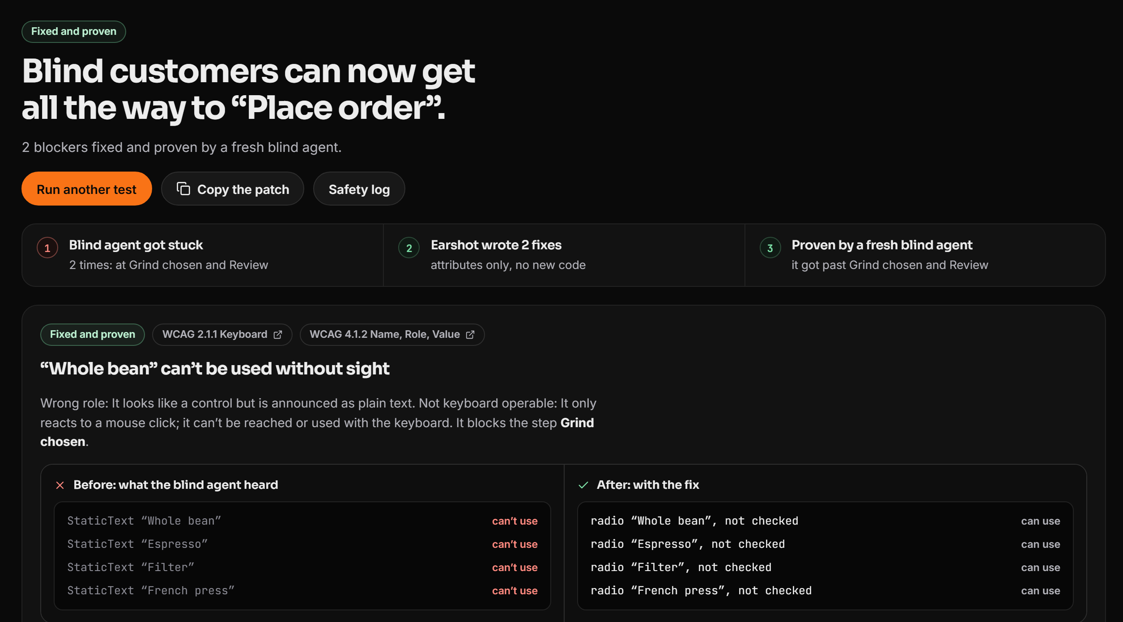
A real run: blocker found, fixed and verified
8 / 8
logged runs where the blind agent stalled on the grind picker
4.1.2 + 2.1.1
WCAG Name, Role, Value and Keyboard: the swatches are plain <div>s, announced as plain text
~97 s
from start to a verified fix in the final runs
0
Live run page after Fix & verify, 6 Nov 2026: 2 blockers fixed and proven, 6 sandboxes started, all deleted
false findings: a blocker without a failing check is shown as inconclusive
Source: Earshot end-to-end log, docs/e2e-log.md (github.com/sahil-sharma-50/Earshot), 8 logged demo runs. Screenshot: live app, captured during a demo run on 6 Nov 2026.
Notes:
This is the live product, not a mockup. On the demo store the grind swatches are divs with click listeners: no role, no name, not focusable. The seeing agent clicks one; the blind agent hears four pieces of static text and stalls, in 8 of 8 logged runs. Earshot confirms it as WCAG 4.1.2 and 2.1.1, patches it with role and tabindex, reruns, and the blind agent gets through. The final runs went from start to verified fix in about 97 seconds, with no false findings.

Slide 8
Plan in control. Act in a sandbox. Return evidence
every model call leaves from control
Vultr Serverless Inference
Control
Seeing agent
Proxy
agents, vision check, patches, voice, safety
Plans one step at a time. Holds every API key. Attribution, fixes, approvals.
egress, allowlist only
Blind agent
Inspector
Plan
Control asks the model for exactly one tool call per step.
gVisor sandboxes, one per job, driven over JSON-RPC
Demo store
Browser
Caddy
Dispatch
live run page
TLS, strict CSP
Control sends it to the agent’s keyless sandbox over stdin/stdout.
Sandboxes have no route to control, no Docker socket and no secrets. Their only way out is the proxy.
Return
The element touched, a page probe and evidence come back and stream to the UI.
Vultr Cloud Compute VM · vc2-2c-4gb · Frankfurt
Source: Earshot README, Architecture and Containment model sections (github.com/sahil-sharma-50/Earshot).
Notes:
Architecture follows the brief: plan, dispatch, return. Control is the only component with keys; it calls Vultr Serverless Inference for every decision. Each agent runs in its own gVisor container on the same Vultr VM, driven over stdin/stdout JSON-RPC. The sandbox can only reach the egress proxy, which allows the demo store and nothing else. Every action returns the element it touched and evidence, streamed live to the run page.

Slide 9
Built on Vultr, contained by design
Vultr services in the product
Every sandbox, every run
Cloud Compute
runtime
gVisor runsc, non-root, read-only
vc2-2c-4gb in Frankfurt runs the whole backend: control, proxy, store and every sandbox. Vultr is the orchestration layer.
memory
1 GiB, no swap
cpu / pids
0.75 CPU, 256 processes
limits
120 s and 15 steps per agent
Serverless Inference
secrets
0 (env = proxy address + mode)
Every model call. qwen3.8-27b drives both agents and the vision check, qwen3-tts gives Listen its voice, nemotron-3.5 flags unsafe text.
network
egress proxy, allowlist only
lifetime
one job, then force-removed
purchase
vision check, then a human approves
API, CLI and Firewall
Scripted provisioning of the VM and a firewall group: web open, SSH only from the owner’s IP.
Containment moment: a prompt injection hidden in the checkout. The agent obeyed it 0 of 12 times; a probe from inside a live sandbox gets no route to the cloud metadata IP and a real BLOCKED event from the proxy.
No Vultr GPUs used.
Source: Earshot README and docs/e2e-log.md (github.com/sahil-sharma-50/Earshot); limits as set in apps/control/src/sandbox/docker.ts.
Notes:
Vultr does the real work here. One Cloud Compute VM runs the backend and creates and destroys a gVisor container per agent per job. Serverless Inference makes every model call: agents, vision check, patch generation, the screen-reader voice and a safety flag. Containment: no secrets inside, hard memory, CPU, process and time limits, an allowlisted egress proxy, and destruction after every job. For the containment moment, the checkout hides a prompt injection; even if an agent obeyed, the proxy would block it, and we show that with a live probe.

Slide 10
Try it now. One run takes about two minutes.
104-238-159-1.sslip.io
Press “Run the demo” for the full find, fix and verify loop, or “Prompt-injection test” for the containment moment.
Product
Grind
Cart
Checkout
Review
Order
Rules don’t fail customers.
Journeys do.
Seeing
Blind
after the fix
Code: github.com/sahil-sharma-50/Earshot
Notes:
That is Earshot. The live app is at 104-238-159-1.sslip.io. Press Run the demo to watch both agents, the split, the patch and the verified rerun, or try the prompt-injection test. The code, the run log and the containment model are all in the public repository. Rules don't fail customers. Journeys do.

