Slide 1
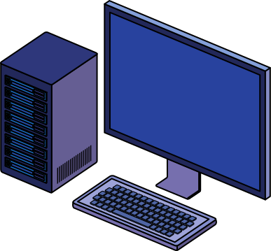


Deploying .NET Applications
SAHIL MAKVANA - 8023058064 (ROLL NO:12)

Slide 2
Introduction
Deployment refers to distributing a .NET application so users can run it on their machines or servers.
.NET applicationscan be deployed in different ways depending on the type:
Console Applications (Command-line apps)
Web Applications (ASP.NET apps, APIs)
Desktop Applications (WinForms, WPF, MAUI)
Choosing the right deployment method depends on platform, dependencies, and target audience.

Slide 3
Deploying .NET Console Applications
Console apps are lightweight and don’t need a GUI.
Can be deployed as:
Self-Contained Deployment (SCD) – Includes .NET runtime
Framework-Dependent Deployment (FDD) – Requires .NET installed on the machine
Steps to Publish a Console App
Deployment Methods:
✅ Copying Executables – Simple for small apps
✅ Creating an Installer – Makes it easy for end users

Slide 4

Deploying .NET Web Applications
Web apps built with ASP.NET Core can be deployed on:
IIS (Windows Server) – Used for enterprise apps
Azure Web App – Cloud-based hosting
Docker Containers – For scalability
Linux with Nginx/Apache
Self-Hosting (Kestrel) – Directly run via dotnet run
Steps to Publish a Web App:
✅ Environment Variables for configurations
✅ CI/CD Pipelines for automated deployment

Slide 5
Deploying .NET Desktop Applications
Desktop apps are typically WinForms, WPF, or MAUI apps.
Can be deployed using:
MSIX Packaging – Modern Windows installer
ClickOnce Deployment – Simple auto-updating installer
Standalone Executables – Publish as a single .exe file
Steps to Publish a WinForms/WPF App:
✅ Dependency Bundling – Ensure required libraries are included
✅ Code Signing – Prevents security warnings

Slide 6
Self-Contained vs Framework-Dependent Deployment
Deployment Type | Pros | Cons
Self-Contained | No need for .NET runtime on the machine | Larger file size
Framework-Dependent | Smaller size | Requires .NET installed
Use Self-Contained for standalone apps.
Use Framework-Dependent for enterprise environments.

Slide 7
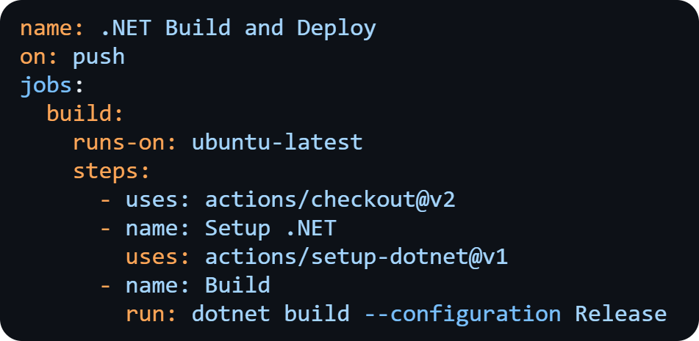
Deployment Automation (CI/CD)
CI/CD automates deployment using tools like:
GitHub Actions
Azure DevOps Pipelines
Jenkins
Example GitHub Action for .NET Deployment:

Slide 8
Cloud Deployment (Azure, AWS, Docker)
ure App Service – For web apps
AWS Elastic Beanstalk – Auto-scales web apps
Docker Containers – Deploy cross-platform apps
Deploying to Azure Example:

Slide 9

Security Considerations
HTTPS & SSL Certificates – Encrypt web traffic
Environment Variables – Never store secrets in code
App Signing – Prevents tampering with executables
Regular Updates – Patch security vulnerabilities

Slide 10
Conclusion
🔹 Console Apps – Deploy as .exe or via script
🔹 Web Apps – Host on IIS, Azure, or Containers
🔹 Desktop Apps – Use MSIX, ClickOnce, or standalone .exe
🔹 CI/CD Pipelines – Automate deployments
🔹 Security & Cloud Considerations

Slide 11


