Slide 1

E-COMMERCE PRODUCT RECOMMENDATION SYSTEM
Submitted By -
AUM SHAH : RA2011003010872
MOKKAPATI SHIV PRASAD SAHIL : RA2011003010879
SHEETAL JATAV : RA2011003010885
Submitted To -
Mrs. M. RAJALAKSHMI
Assistant Professor

Slide 2
WHAT IS A RECOMMENDATION SYSTEM?
A system that creates a similarity mapping between the user and items and exploits the similarity between user/item to make recommendations.

Slide 3
WHAT CAN IT SOLVE ?
It can help the user to find the right product.
It can increase the user engagement. For example, there's 40% more click on the google news due to recommendation.
It helps the item providers to deliver the items to the right user. In Amazon , 35 % products get sold due to recommendation.
It helps to make the contents more personalized. In Netflix most of the rented movies are from recommendations.

Slide 4
TYPES OF RECOMMENDERS
Popularity Based
Clustering Models Based
Content Similarity Based
Collaborative Filtering

Slide 5
DATASET DESCRIPTION

Slide 6
Amazon Electronics Dataset ​
Has 4 attributes ​
7824482 entries​
Total number of unique Users : 4201696 ​
Total number of unique Products : 476002

Slide 7
EXPLORATORY DATA ANALYSIS

Slide 8
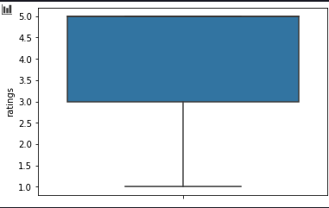
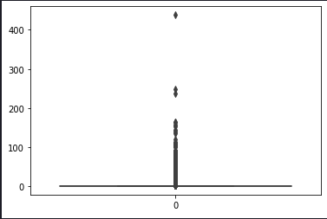
Boxplot of Ratings showing that most of the ratings lie between 3.0 and 5.0
Boxplot of per user rating count showing there are few users who rate many items but majority rate very few items

Slide 9
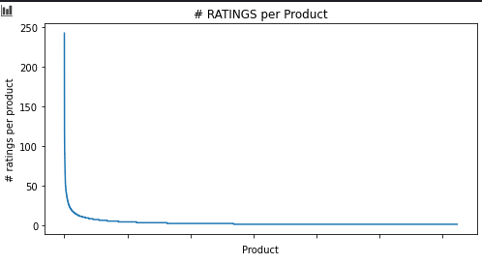
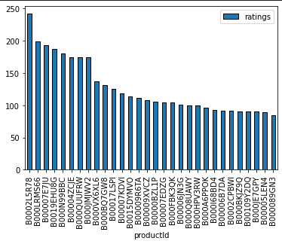
Majority of the products having very few ratings
Top 30 most popular Products

Slide 10
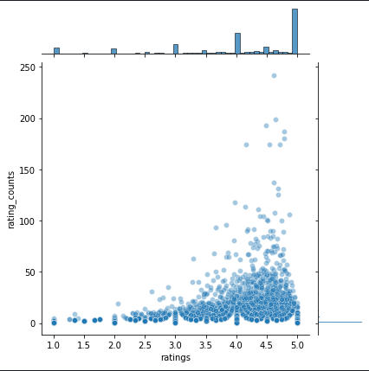
Jointplot showing that popular products ( higher ratings) tend to be rated more frequently, majority have rated products in the higher range.

Slide 11
MODEL BUILDING & EVALUATION

Slide 12
USED MODELS | RMSE
Popularity Based (manual) | 1.226
Popularity Based (turicreate) | 1.2385
Item Similarity Based Collaborative Filtering | 4.35
User Based Collaborative Filtering (Matrix Factorization) | 1.268
Clustering Based Models (KNN) | 1.11
Matrix Factorization Based Model (NMF) | 1.28
Matrix Factorization Based Model (SVD) | 1.05
Matrix Factorization Based Model (SVDpp) | 1.04
Collaborative Filtering (Co-clustering) | 1.17
Collaborative Filtering (Slope One) | 1.13
For this task I ran the dataset through several types of recommender models. A table of their respective performances is given below :

Slide 13
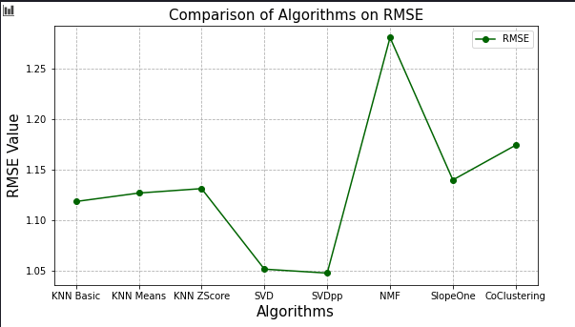
In terms of RMSE, SVD and SVDpp performs best and they both yield very close results

Slide 14
GRID SEARCH ON BEST MODELS

Slide 15
RMSE of SVD after grid search : 1.04
Best Parameters : {'n_epochs': 20, 'lr_all': 0.009, 'reg_all': 0.6}
RMSE of SVDpp after grid search : 1.04
Best Parameters : {'n_epochs': 20, 'lr_all': 0.009, 'reg_all': 0.6}
Grid Search didn't substantially improve the performance of the best models.

Slide 16
OBSERVATIONS

Slide 17
The Popularity-based recommender system is a non-personalized recommender system and these are based on frequency counts, which may be not suitable to the user.
Model-based Collaborative Filtering is a personalized recommender system, the recommendations are based on the past behavior of the user and it is not dependent on any additional information.
Item Similarity Based model performed worse than even simple popularity based models. Best performing models is SVDpp (RMSE : 1.04%)
Hyper parameter tuning with GridSearch didn't improve model performance

Slide 18
THANK YOU!

