Slide 1
Predicting Nifty trend for next day with Decision Tree and Random Forest

Slide 2
Contents
1 Introduction
2 Data preprocessing
3 EDA
4 feature engineering
5 training and evaluating the Decision Tree model
6 training and evaluating Random Forest classifier

Slide 3
Introduction
In financial markets there are a lot of hidden patterns which can be converted in profitable trading ideas .but we don't know them. And they are hard to find as there millions of permutation and combination of the hypothesis that can be tested to find whether they work or not. And coming up with this hypothesis is a time-consuming task. but what if we could let the machine learning model do that job of finding patterns. we help the model by giving features and the model can try to find patterns in.there is no limit to the extent of what features than can be created only thing needed is creativity. So one can create any features that they think might help model in giving better predictions. And if the model is able to find some patterns we can use those patterns to form a profitable trading strategy.that is what this project is about.

Slide 4
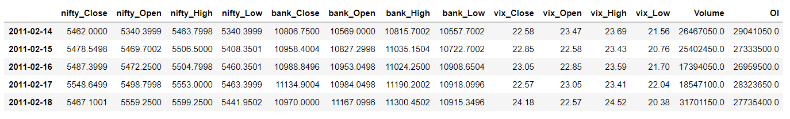
Data preprocessing
Before we can start doing anything need to get the data ready.
So for that, I am using 1min in freq data for the following assets listed below:
nifty index cash data
Nifty futures data to get Open interest and Volume
Bank Nifty index cash data
India Vix data
Once data is loaded I am resampling the data to Daily freq from 1 min. Then combine all assets data into one CSV.
below is snapshot of dataframe when all above mentioned data is combined and resampled to daily frequency
Note: raw data can not be shared due to copyright issues

Slide 5
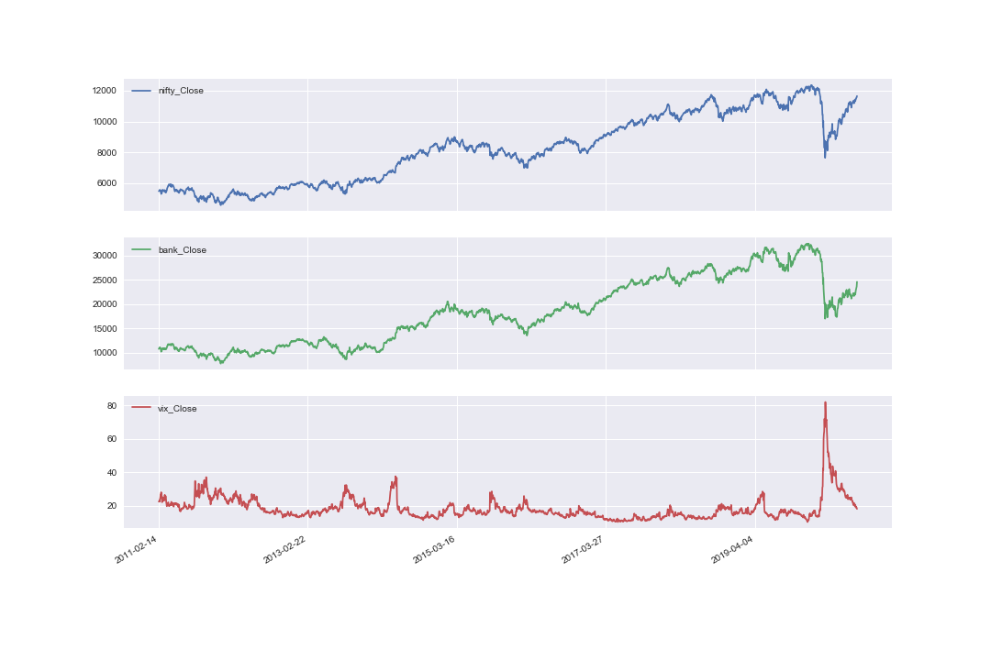
Eda
In EDA I am keen to know how the variables interact with each other.
Nifty ,Bank Nifty and India Vix Close prices

Slide 6
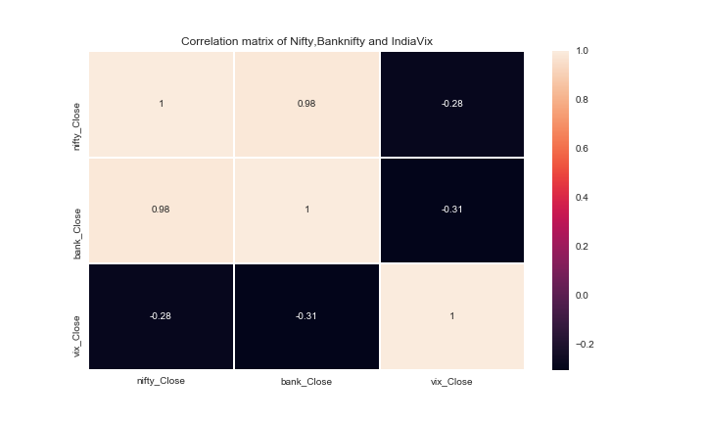

Slide 7
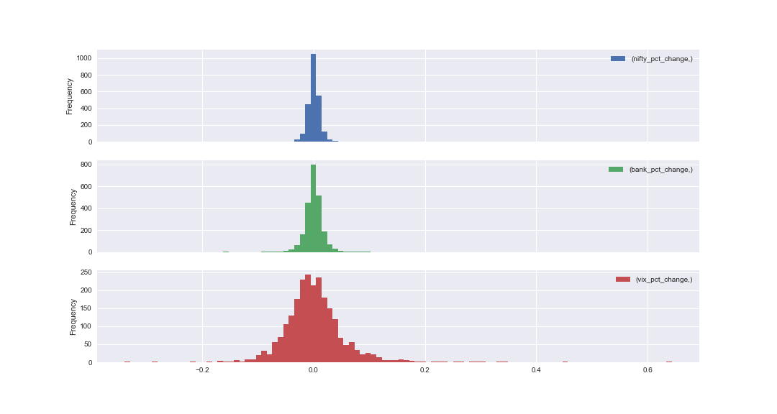
Distribution of Daily PCT change

Slide 8
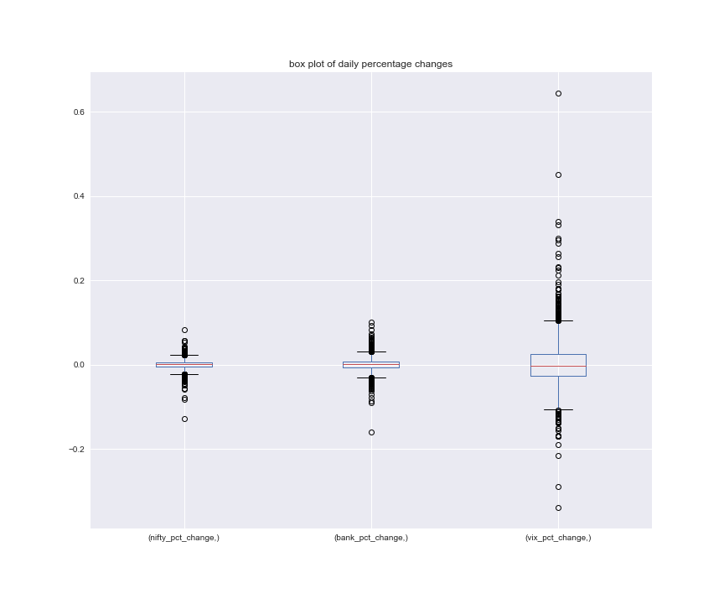
Box plot of daily pct change

Slide 9
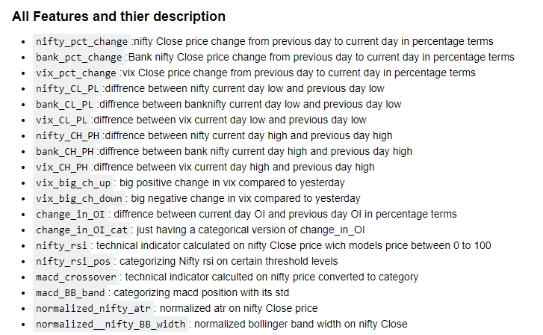
Feature engineering
Now once we have all the data loaded into data frame we can create multiple I am creating features which ever think can help model make find some patterns and make better predictions
For the calculations of these features please refer to jupyter notebook

Slide 10
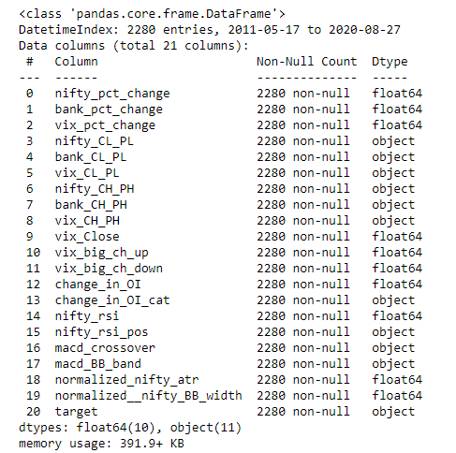
Data set after feature creation

Slide 11
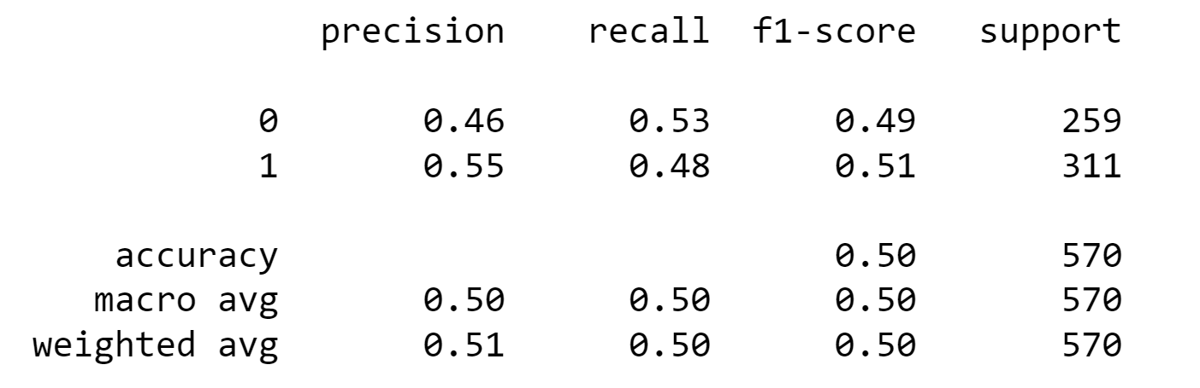
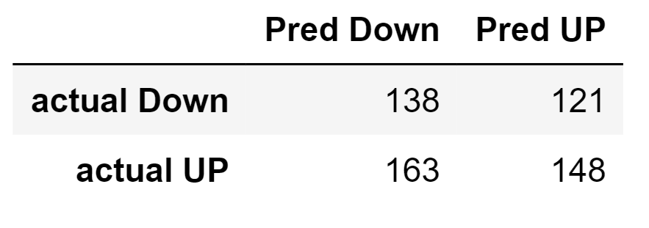
Training and testing decision tree classifier with default hyper parameters
Confusion matrix
Classification report
So the model is not performing well on default hyperparameters
Accuracy is the most important metric for this problem which is 0.50 which equivalent to a coin toss
fivefold cross-validation mean accuracy of the model is also not good: 0.5026315789473685

Slide 12
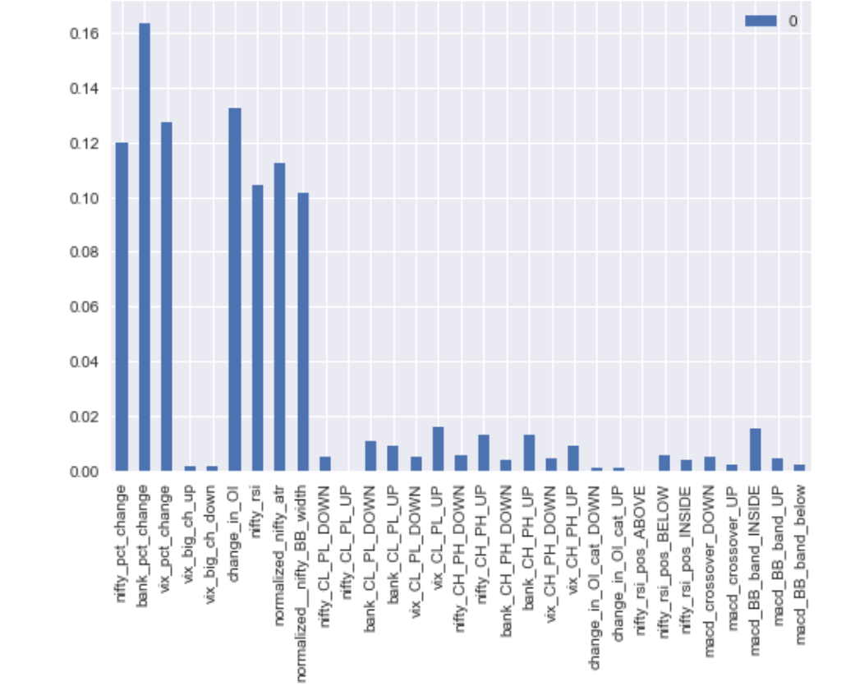
Feature importance from default decision tree

Slide 13
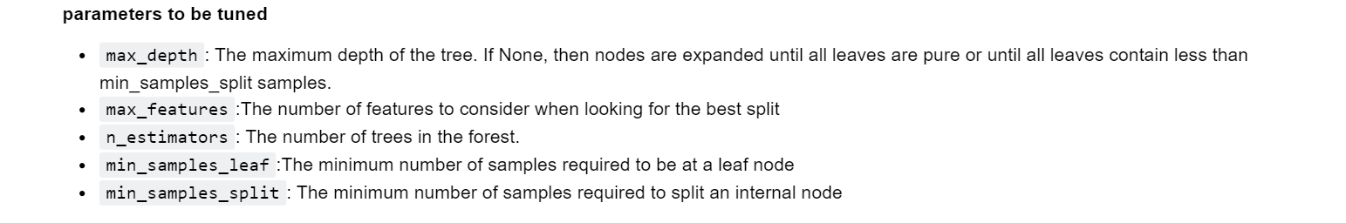
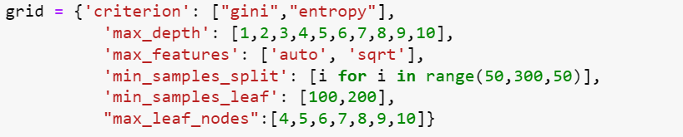
Optimizing decision tree hyper parameters with random search cv

Slide 14
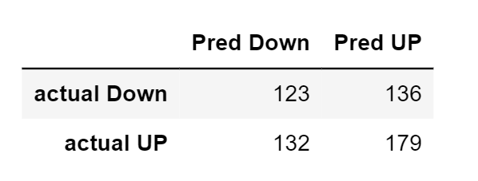
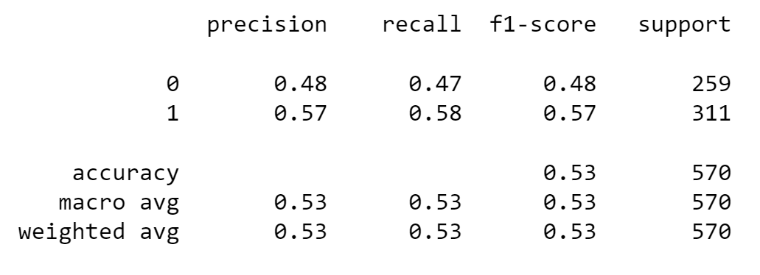
Optimized decision tree model performance
So the model is not performing well on optimized hyperparameters as well.
Accuracy is the most important metric for this problem which is 0.53 which also closely equivalent to a coin toss

Slide 15
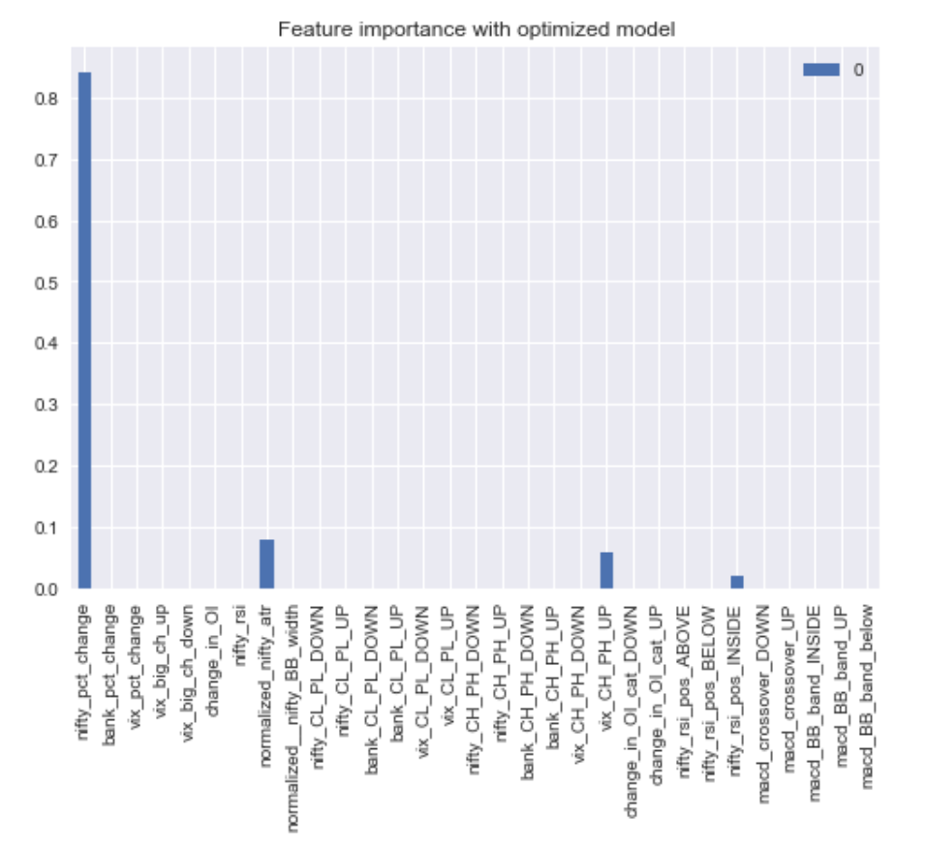
Feature importance from optimized decision tree in randomized search cv

Slide 16
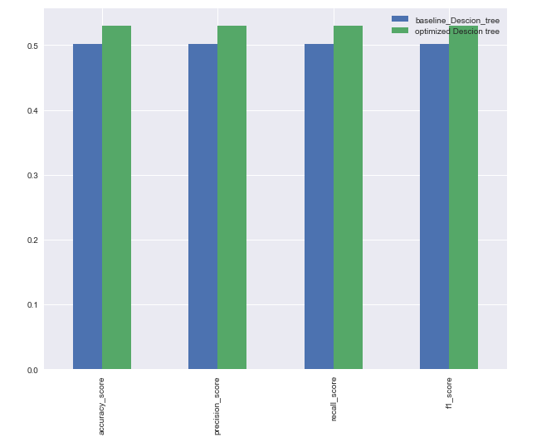
Metric comparison between baseline decision tree and optimized decision tree
We can see the optimized decision tree is performing slightly better than baseline decision tree no significant improvement in performance.

Slide 17
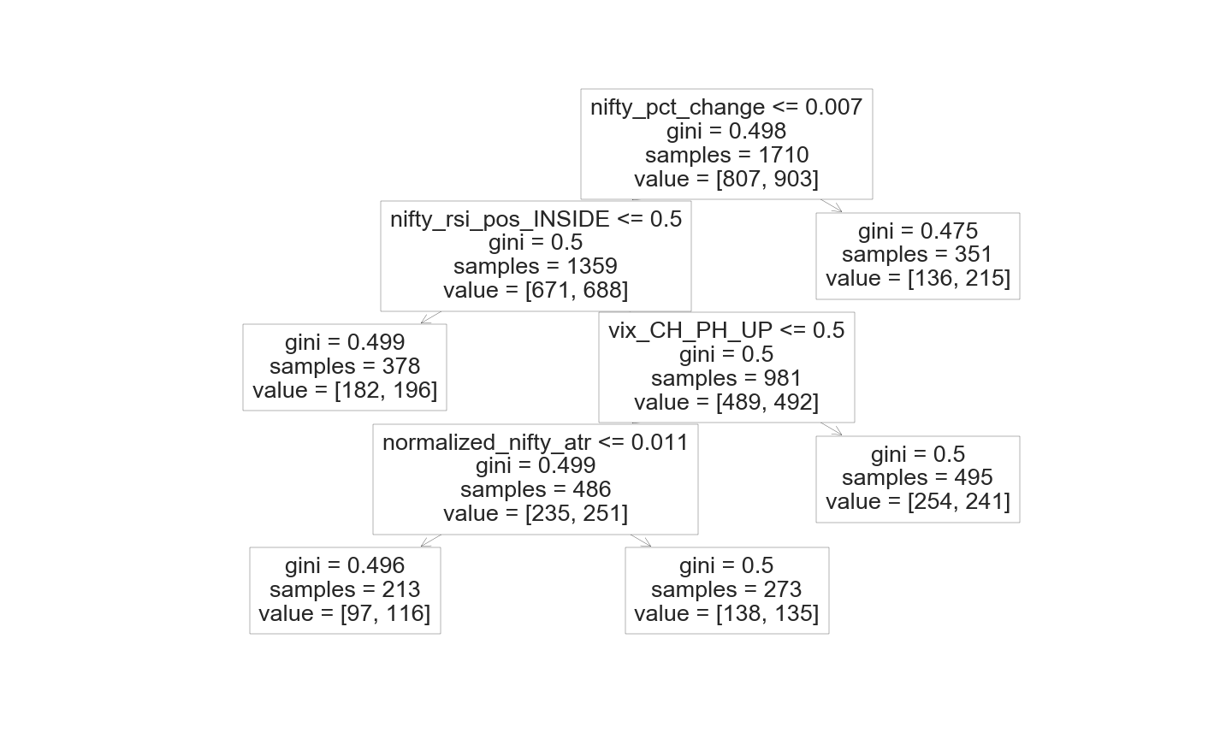
Plotting optimized decision tree

Slide 18
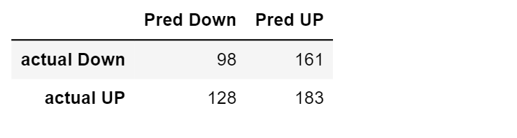
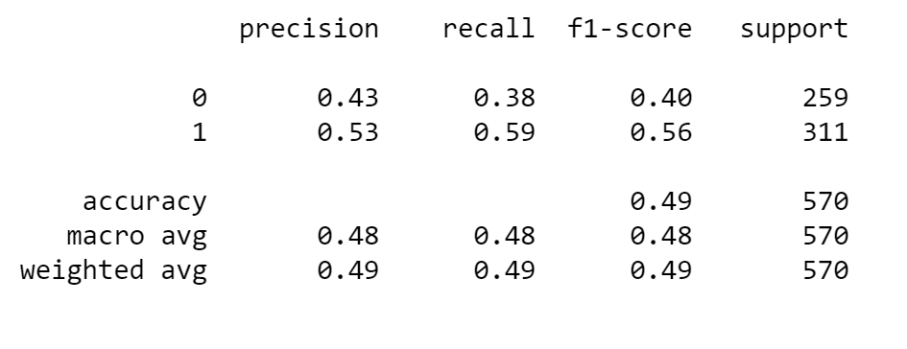
Training and Testing random forest with default parameters
Confusion matrix
Classification report
Baseline Random forest accuracy is 0.49 which is not good which is as good as guessing.

Slide 19
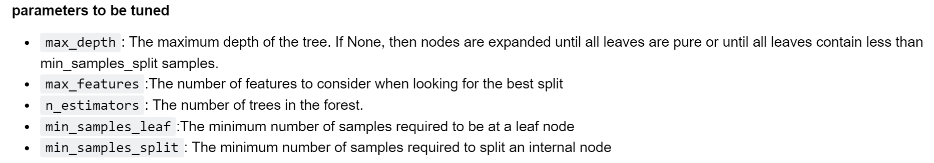
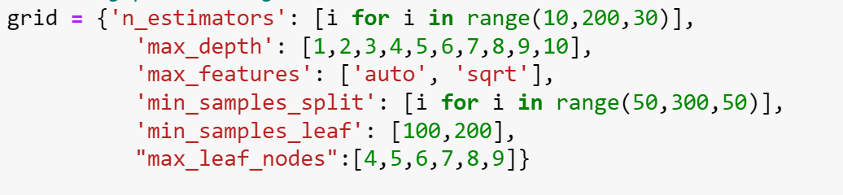
Tuning hyperparameters for random forest with randomized search cv

Slide 20
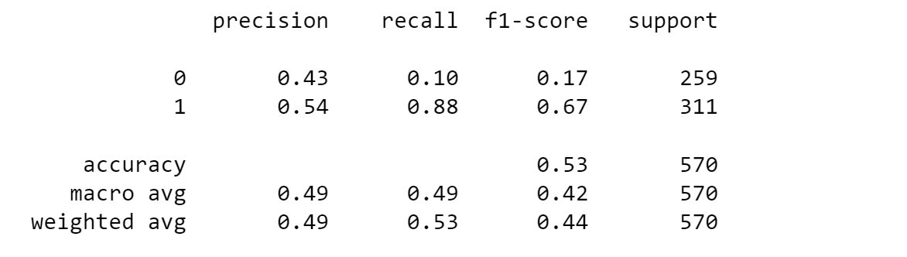
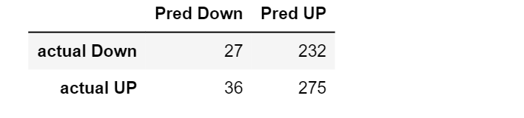
Optimized random forest
Insert confusion matrix
Classification report
Optimized random forest is only performing slightly better than the baseline random forest
The overall accuracy of the model is still very low at 0.53

Slide 21
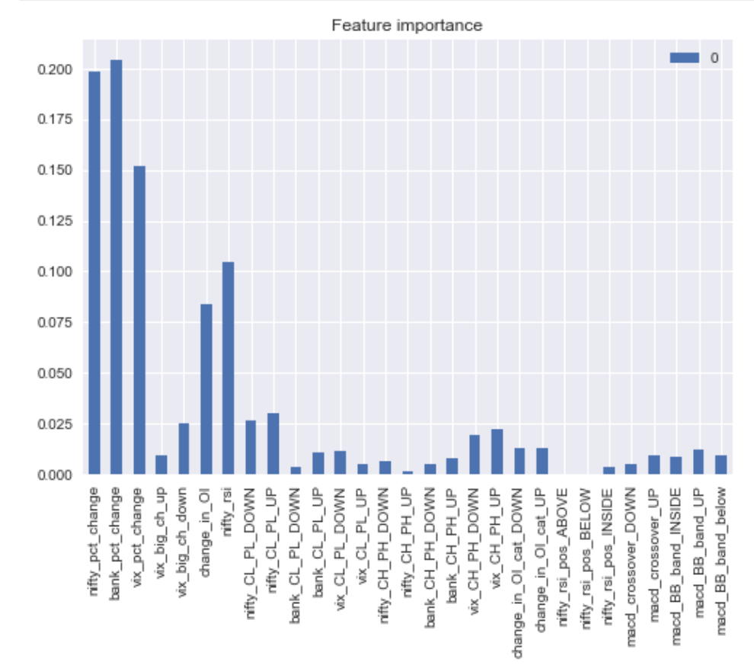
Feature importance from the optimized random forest

Slide 22
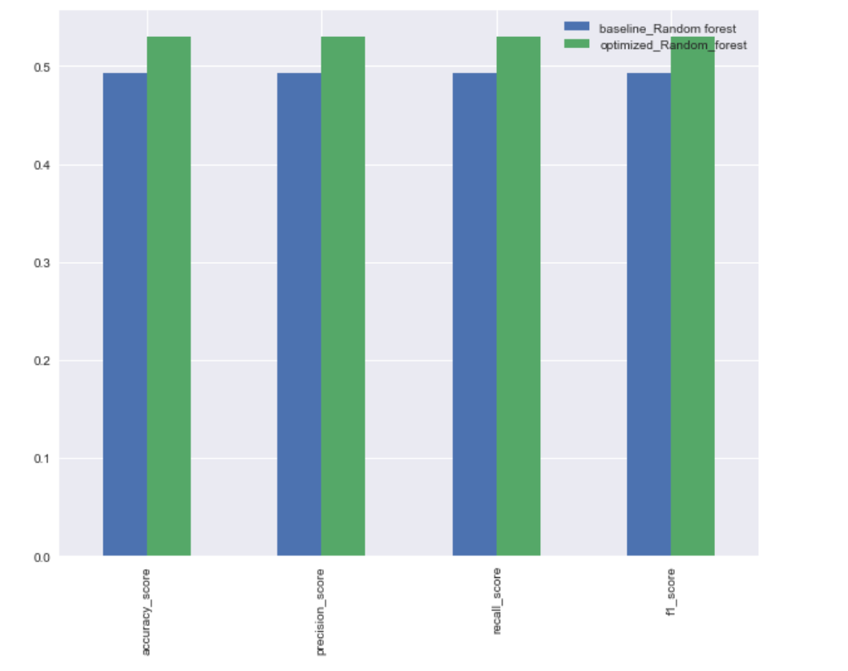
Metric comparison between baselines random forest and optimized random forest

Slide 23
Conclusions
Overall after trying Decision tree and Random forest. Still couldn't get any significant results. So for further research can be applied with creating more features.using this research as a template

