Slide 1




SuRakshak
Su[perwoman] Rakshak System
Protecting women against any safety threats

Slide 2
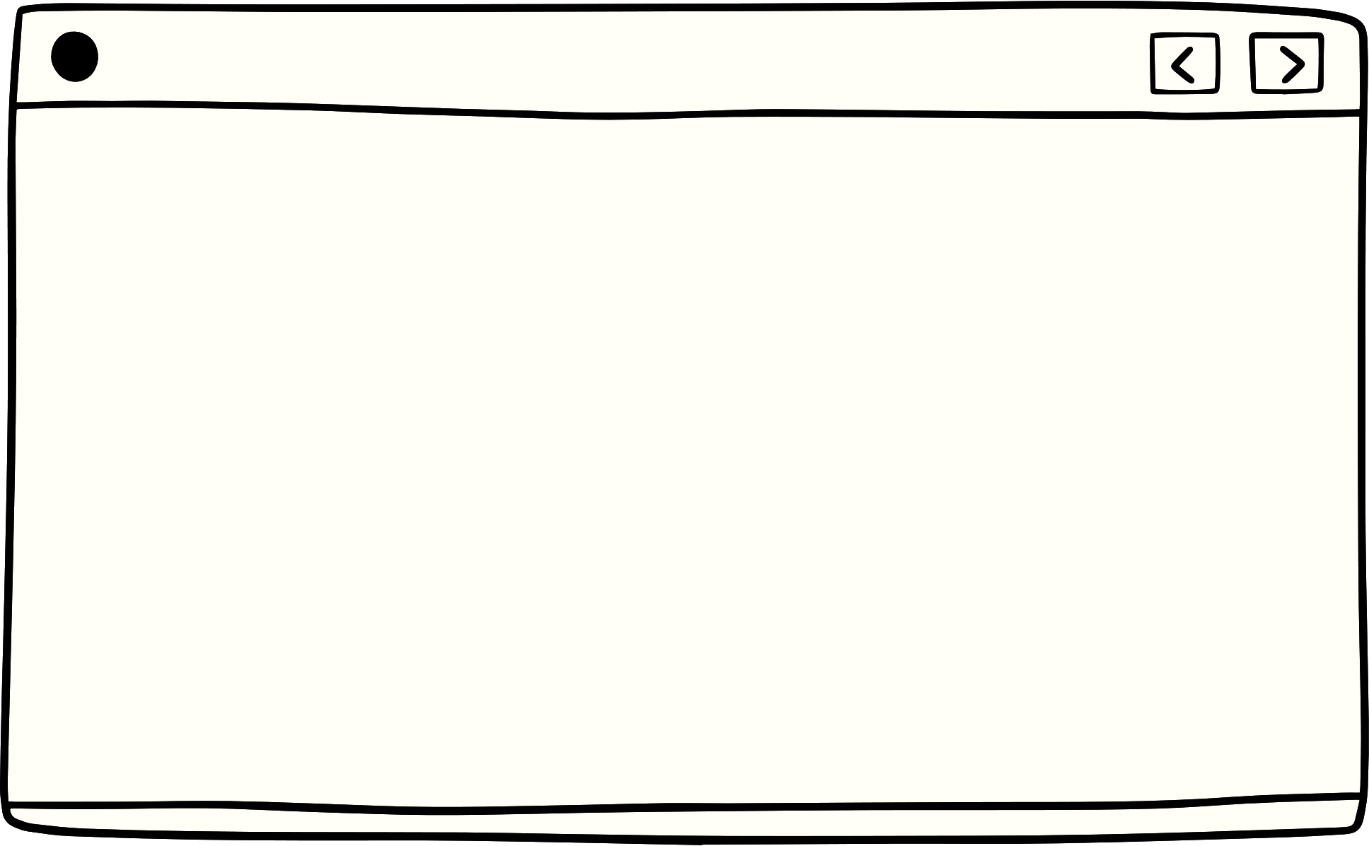


Contents
01
02
03
Introduction
Ideas
Analysis
04
05
06
Implementation
Conclusion
The team

Slide 3
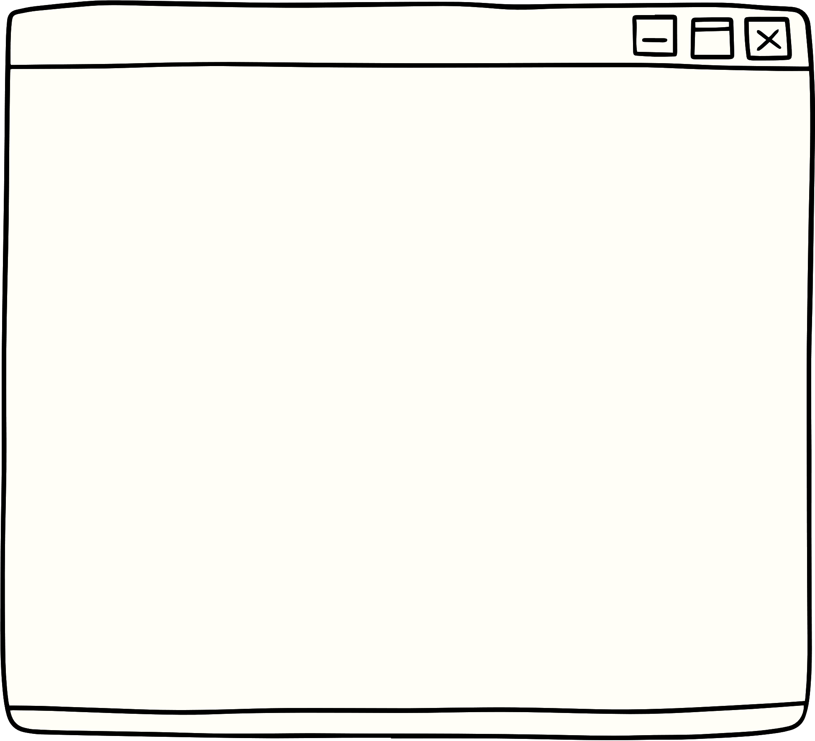


Introduction
Problem Statement:
To develop a comprehensive safety solution for individuals that leverages advanced technologies to detect and mitigate threats in real-time, ensuring their security and well-being.

Slide 4





Core Features:
About Surakshak
Real-time Threat Identification
Emergency Response Automation
A real-time safety platform that utilizes AI, IoT, and data analytics to provide proactive threat detection, emergency response, and personalized security measures.
Personalized Safety Measures
Data-Driven Insights

Slide 5
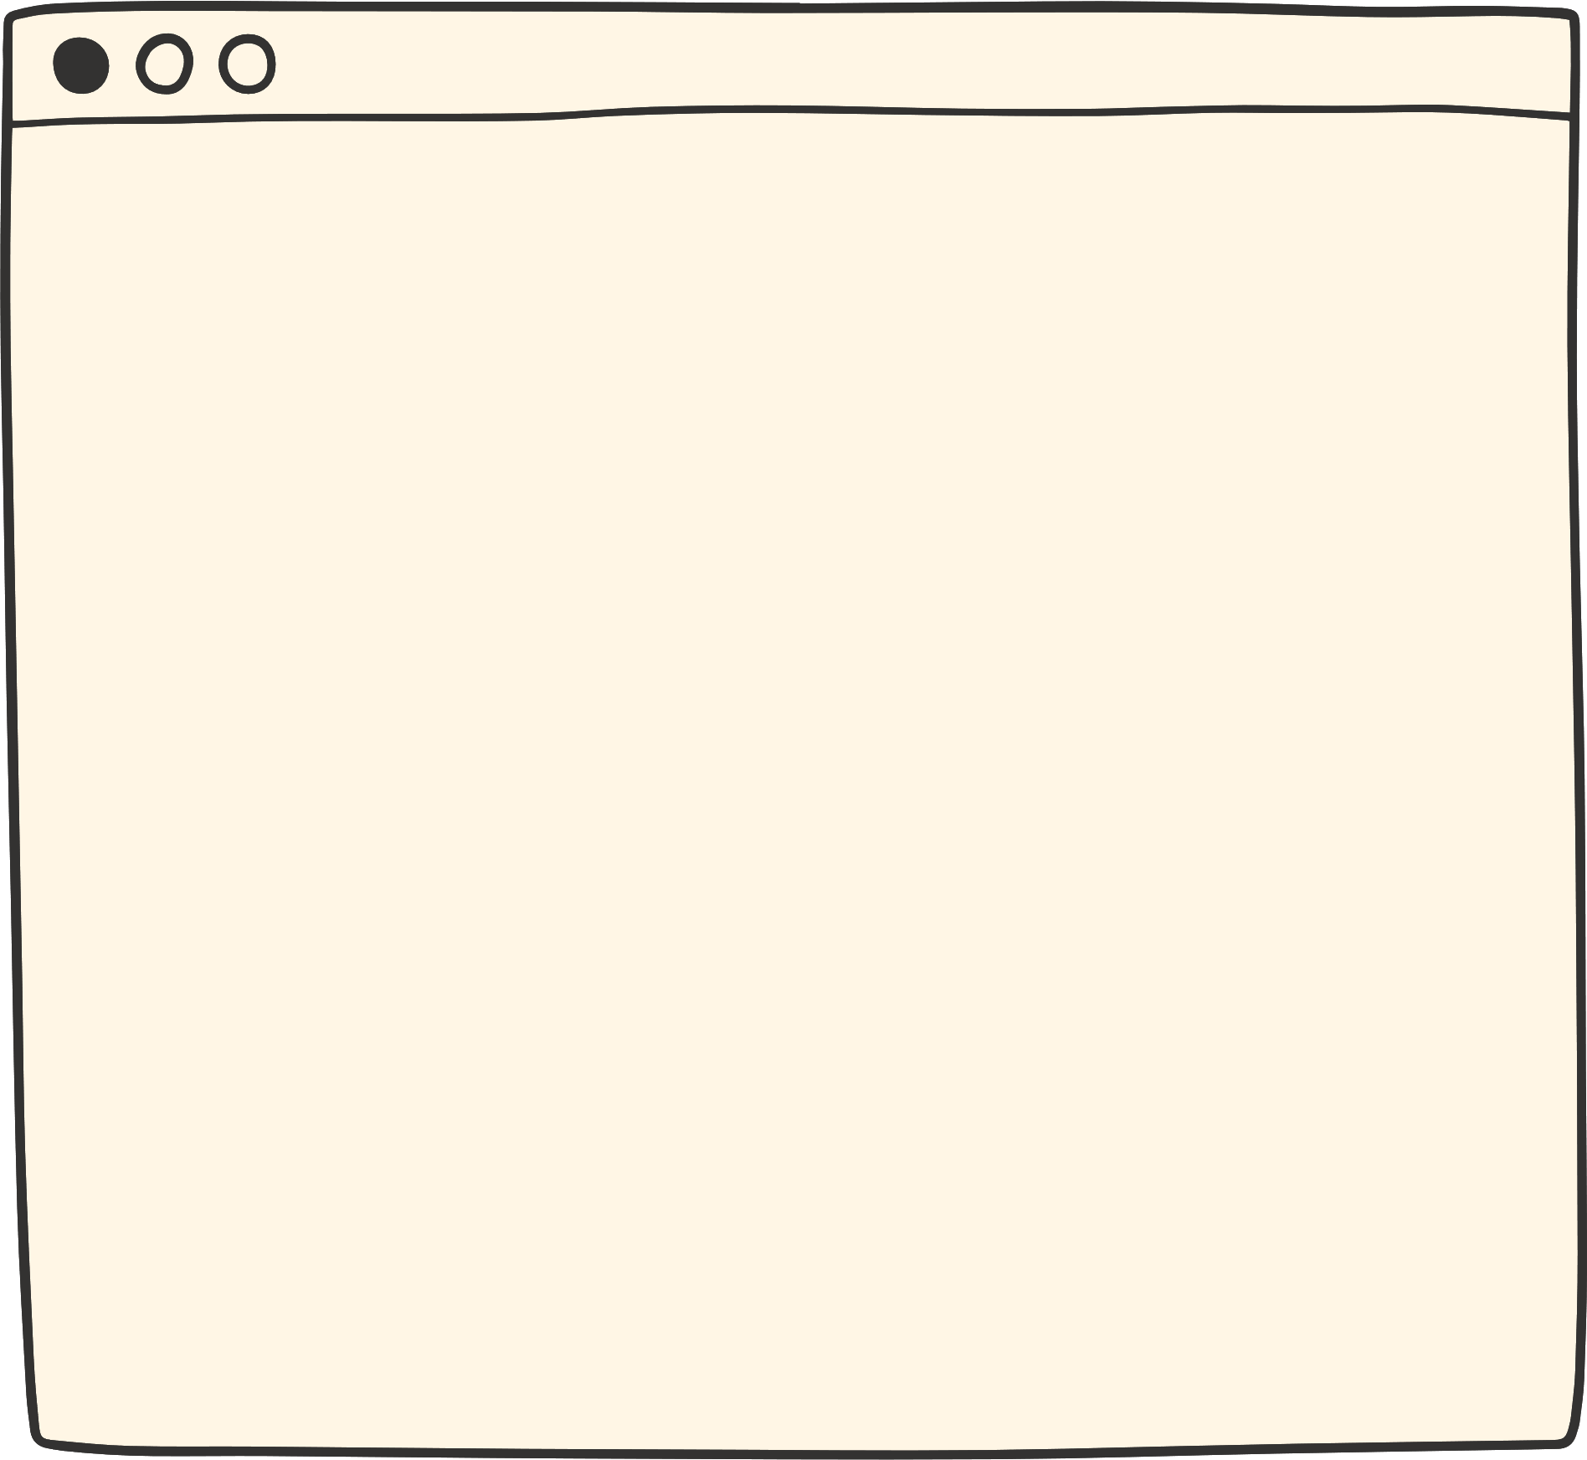
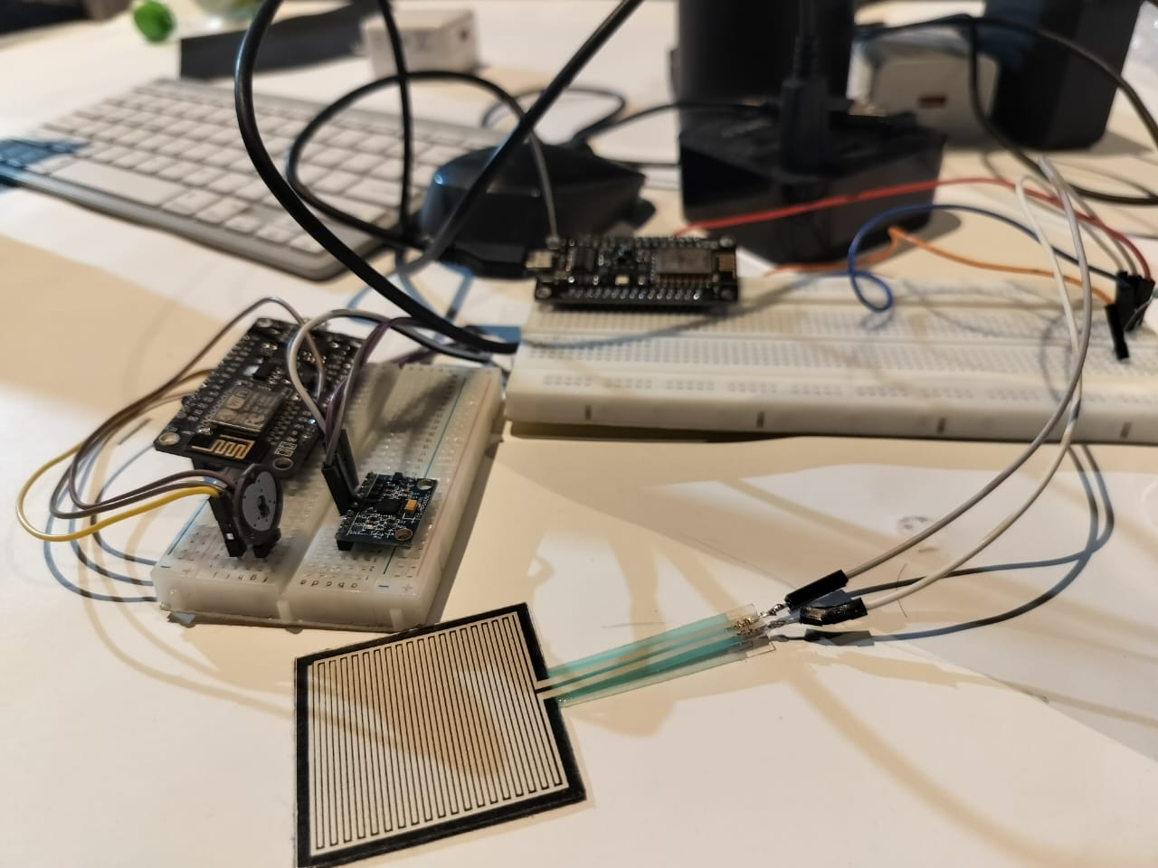

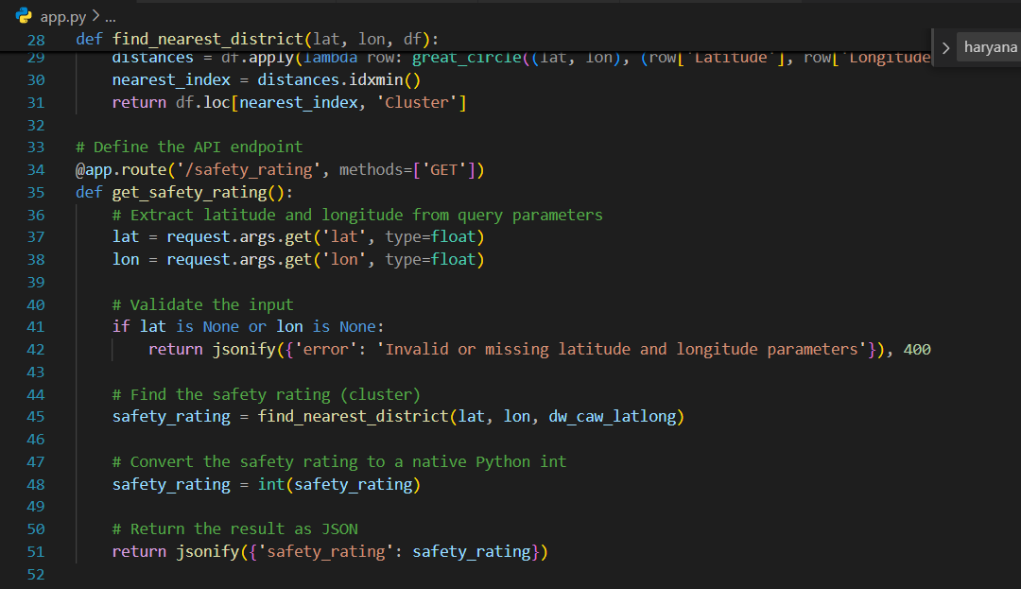

Real-time Threat Identification
01
Live Vital Monitoring: IOT Sensers monitor your body vitals for any abnormal spikes
02
Gesture Analysis ML model performs gesture analysis for any threat identification.

Slide 6
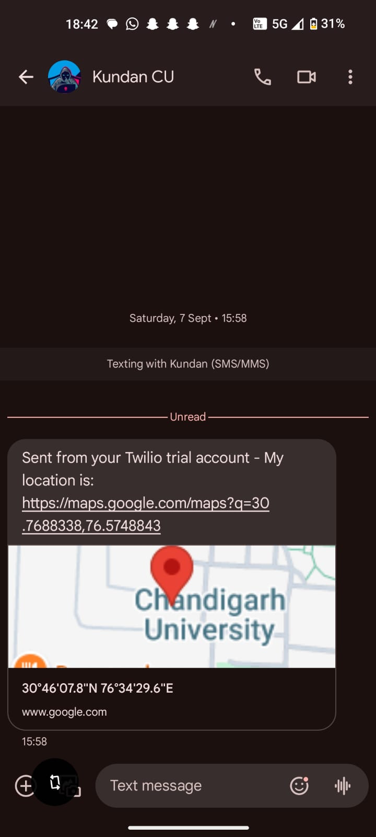
Emergency Response Automation
01
Smart SOS System: Automates Calls and message Location directly with officials and other users.
02
Satellite Communication Channel: Alternative for no network Zones

Slide 7
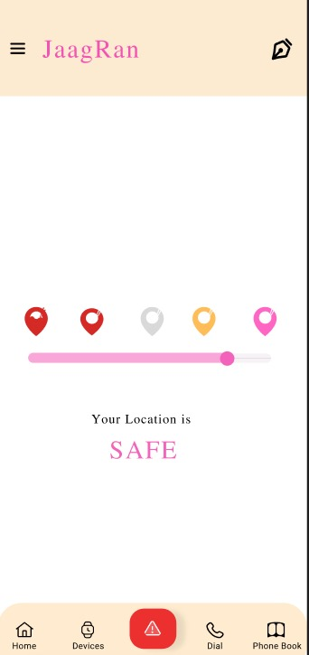
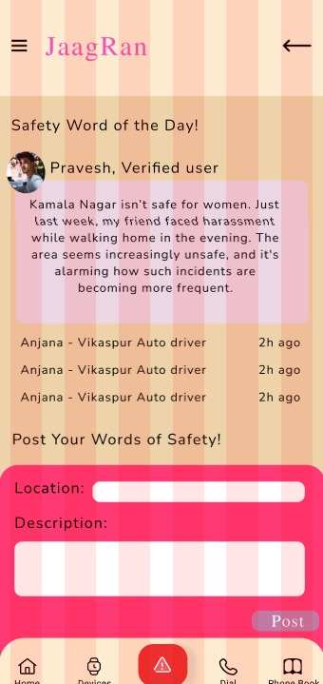
Personalized Safety Measures
01
Safety Recommendation: Allow app to comment on Safety Tips
02
Community Based Forums: Feed based forum for data collection and personalized safety.

Slide 8
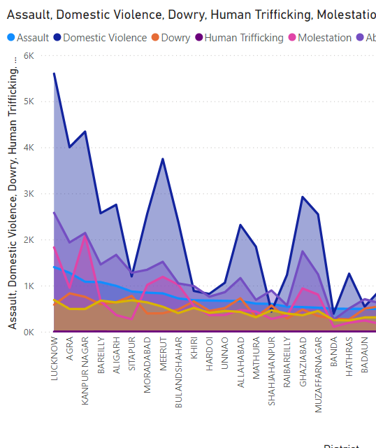
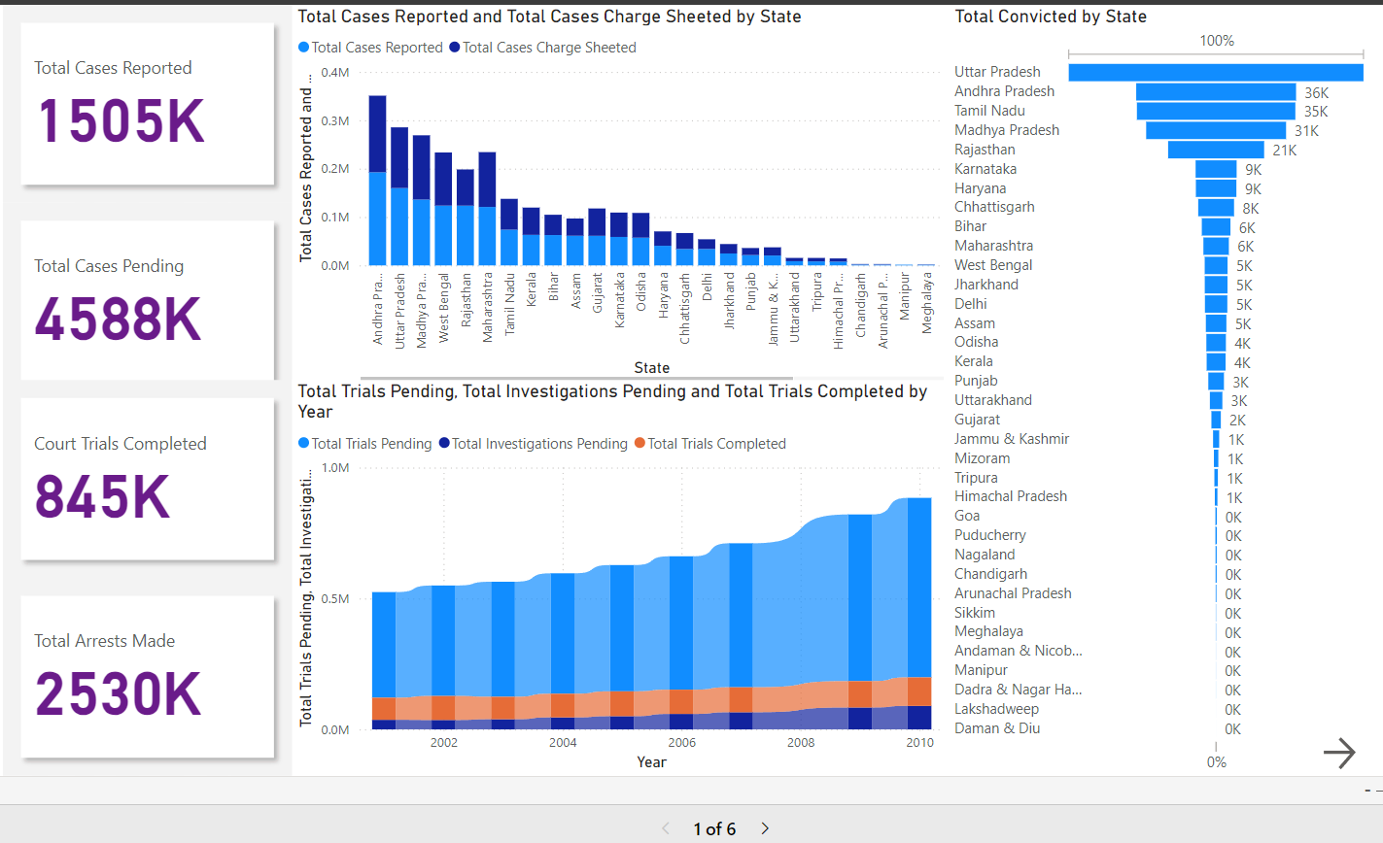
Data Driven Insights
01
Snippet Sharing: Share reusable snippets with the community for quick access.

Slide 9

The best idea
Develop a comprehensive safety platform that utilizes AI and IoT to provide real-time threat detection, emergency response, and personalized security measures for individuals and communities.
DECREASES MANUAL INTERVATION
ENHANCES SAFETY

Slide 10

Planning and Design:
Core Features to add:
Collaboration
Remotification
Version Control
UI/UX Design
Implementation
Integration with the IDE:
IDE’s plugin development tools and SDKs. For example, Visual Studio Code uses Node.js and TypeScript
Implementing this community-like feature in an Real Life involves several key steps, from designing the user experience to integrating with existing tools and platforms.
Future Expansion:
Cross-Platform Compatibility: To support other popular users, ensuring that it works consistently across different development environments.

Slide 11
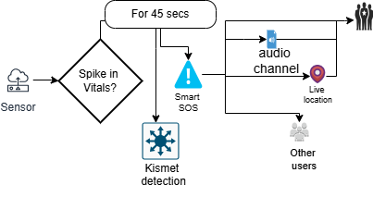
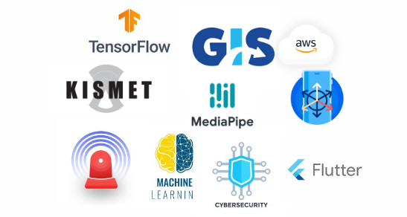








Chart:
Tech stack:

Slide 12

The team
Sahil Wadhwa
Aditi R Sinha
Kundan Singh
222BCS13323
22BCS13346
22BCS15176

Slide 13
Thank you

