Slide 1
YUVAINTERN • WEEK 4
AI Project Deployment
& Capstone
Wine Classifier Prediction API
Model training • Joblib serialization • FastAPI • Automated testing
Prepared by Sahil Sant
Educational dataset; class labels are cultivar categories, not quality grades.

Slide 2
Objective and Solution
Turn a trained classifier into a small, reusable prediction service.
01 Prepare
02 Evaluate
03 Serve
Export dataset, split data reproducibly, fit preprocessing and candidate models.
Use 5-fold stratified cross-validation and held-out metrics to compare models.
Serialize the chosen pipeline and expose validated predictions through FastAPI.
Result: documented code, serialized artifact, prediction API, tests, setup guide, report and presentation.
02

Slide 3
Dataset and Workflow
Scikit-learn Wine Recognition dataset; bundled with the library.
178
13
3
142 / 36
observations
numeric features
dataset classes
train / test rows
Stratified 80/20 split with random_state=42 keeps class proportions comparable.
Logistic Regression uses StandardScaler inside a Pipeline; Random Forest is evaluated without scaling.
Five-fold StratifiedKFold is applied to training data; the test split is reserved for final reporting.
03

Slide 4
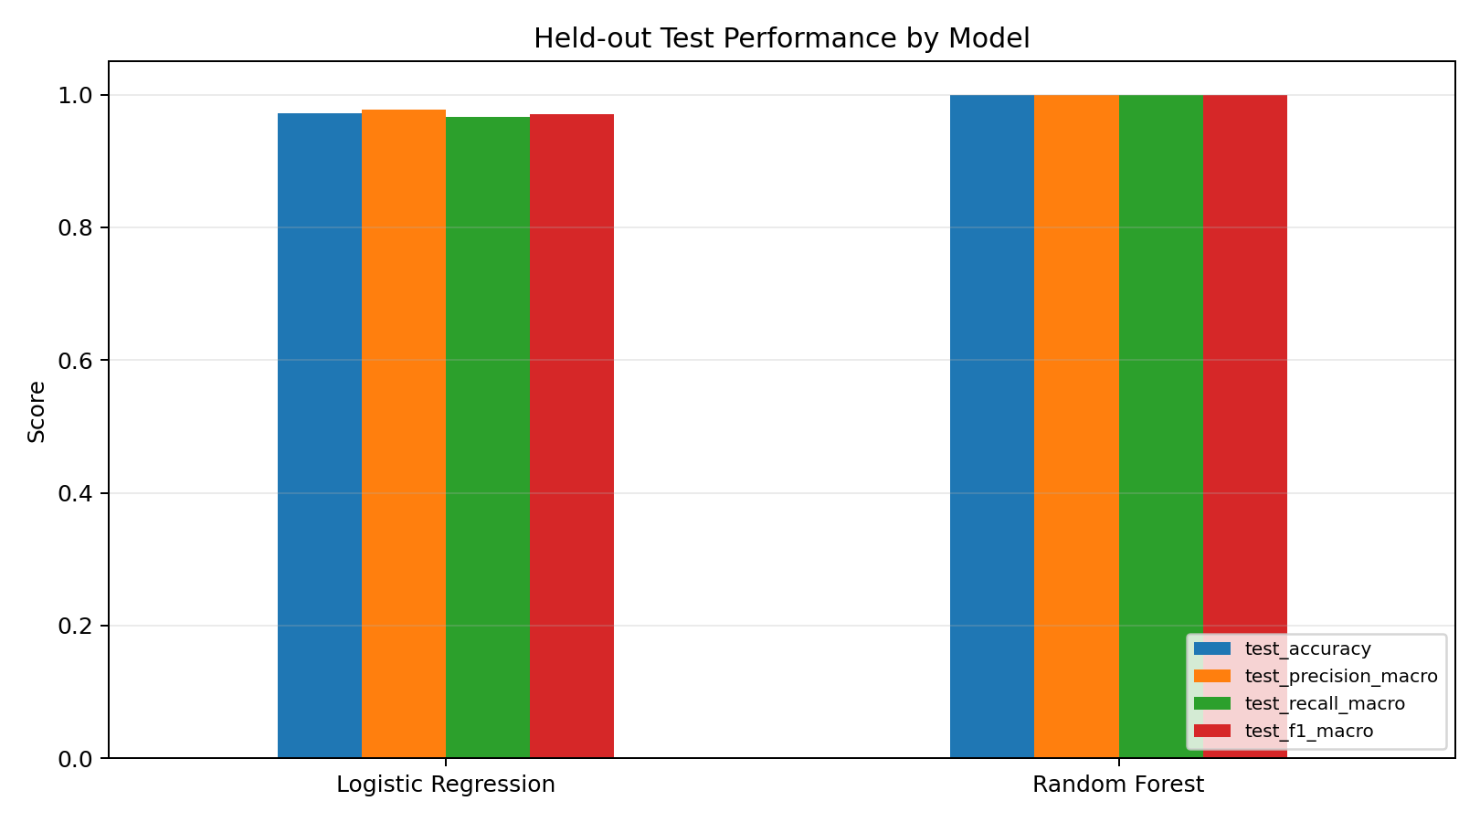
Results: Candidate Models
Percentages are computed from the actual training run.
Logistic Regression
CV accuracy: 97.91% ± 2.77%
Test accuracy: 97.22%
Macro F1: 97.10%
Random Forest
CV accuracy: 97.91% ± 2.77%
Test accuracy: 100.00%
Macro F1: 100.00%
Selection: CV means tied, so the predefined tie-break favors the simpler Logistic Regression baseline—not the held-out test result.
04

Slide 5
Serialization and Request Lifecycle
One fitted pipeline is reused for each request.
Client JSON
→
Pydantic
→
Joblib pipeline
→
JSON response
13 numeric fields
validate input
scale + classify
class + probabilities
Model: artifacts/wine_classifier.joblib
Metadata: artifacts/model_metadata.json
Training results and charts are saved reproducibly for inspection.
05

Slide 6
FastAPI Endpoints
Interactive OpenAPI docs are available at /docs.
GET /
Service info
GET /health
Model readiness
GET /model-info
Feature list and selected model
POST /predict
Validated classification request
Response includes predicted class ID, dataset class label, per-class probability estimates, and model name.
06

Slide 7
Verification and Demo
A runnable local API is included; public hosting is an optional next step.
Test suite
API example
Documentation
4 automated tests passed:
health, model info, prediction, invalid input.
Predicted dataset class: class_0
Prediction probability: 99.97%
(one held-out sample)
Report (.docx), presentation (.pptx), README, requirements and deployment configs.
Run locally from the repository root:
pip install -r requirements.txt
python -m ml.train
uvicorn app.main:app --reload
python -m pytest -q
Then visit http://127.0.0.1:8000/docs
07

Slide 8
Conclusion
The model is trained, serialized, served, and tested.
The API is ready to run locally with interactive docs and validated inputs.
Dockerfile and Render configuration provide a path to cloud deployment after repository connection.
Dataset is small and educational; 100% test accuracy for one model is not a guarantee of future performance.
Class labels are cultivar categories, not wine-quality or safety assessments.
Thank you

