Slide 1
Statement of Project Objectives
To analyze Supply Chain logistics data and make a classification model to predict late deliveries and fraudulent transactions based on the features provided in the dataset

Slide 2
Challenges in Logistics
Problem #1 What are the factors involved for Orders to get Delivered Late?
Problem #2 Why the some transactions are suspected as fraudulent?
01
02

Slide 3




Pirates working on this UNH Intro to Data Science 6002.03 Group 8 - 2022 Fall (https://github.com/sahil095/DS_Group-8_Project)
Sahil Sehgal Team Leader
Business Understanding and Model Building
ssehg1@unh.Newhaven.edu
Yegneshwar Rao Ginjupalli
Data Wrangling and Business Modelling
yginj1@unh.newhaven.edu
Bello Salisu
Data Visualization and Model Deployment
undefined bsali2@unh.newhaven.edu
Sai Kumar Gude
Data Analysis and Visualization
sgude3@unh.newhaven.edu

Slide 4
Business model / Plan Following CRISP-DM methodology for Data Science Process
Understand the Domain and Analyze the data
Deploy the system and automate the process
Perform Hypothesis testing and back those with the data given
Our Plan
Validate the generated model with testing data
Perform Exploratory Data Analysis for Model building
Build the Classification Model with maximum accuracy

Slide 5
Business Understanding
From the Operations perspective if we can analyze the factors affecting the deliveries of the orders and the transactions, we can predict the future delivery and order status. We need to work on the below mention steps
Research around Supply Chain sector and dig deep into logistics domain to understand the pipeline of an order (every chain involved from seller to buyer)
Analyze the dataset to understand the relationship between different features affecting the delivery of the order and also causing suspicion to the transaction
Identify factors like payment modes, shipping methods, order and customer regions, sales, order quantity, days for shipment etc. to back any hypothesis
To find any improvement/implementations in the overall logistics pipeline which can prevent the above challenges
At last, Build a classification Model to classify any order (given order details) to fall under on-time delivery or late delivery and any order to fall under fraudulent transaction or valid transaction

Slide 6
Data Understanding
The following fields can be found in the dataset (The dataset is big so we only incorporated a few columns)
The dataset consists of roughly 180k transactions from supply chains used by the company DataCo Global for 3 years.
FIELDS DESCRIPTION
Type: Type of transaction made
Days for shipping (real): Actual shipping days of the purchased product
Days for shipment (scheduled): Days of scheduled delivery of the purchased product
Benefit per order: Earnings per order placed
Sales per customer: Total sales per customer made per customer
Delivery Status: Delivery status of orders: Advance shipping , Late delivery , Shipping canceled , Shipping on time
Late_delivery_risk: Categorical variable that indicates if sending is late (1), it is not late (0).
Customer City: City where the customer made the purchase
Customer Country: Country where the customer made the purchase
Customer Segment: Types of Customers: Consumer , Corporate , Home Office
Market: Market to where the order is delivered : Africa , Europe , LATAM , Pacific Asia , USCA
Order City: Destination city of the order
Order Country: Destination country of the order
Sales: Value in sales
Order Region: Region of the world where the order is delivered : Southeast Asia ,South Asia etc
Order State: State of the region where the order is delivered
Order Status: Order Status : COMPLETE , PENDING , CLOSED , PENDING_PAYMENT ,CANCELED , PROCESSING ,SUSPECTED_FRAUD ,ON_HOLD ,PAYMENT_REVIEW
Shipping date (DateOrders): Exact date and time of shipment
Shipping Mode: The following shipping modes are presented : Standard Class , First Class , Second Class , Same Day

Slide 7
Data Preparation
Removed all the unnecessary columns which is not affecting our analysis like Customer Email, Customer Password, Product Image etc.
Removed Null data (The complete columns were null), or filled NULL rows with mean values (0 for zip codes)
Converted string date to Datetime object
Performed Visualization and Exploratory Data Analysis

Slide 8
Tools
A DataSet of Supply Chains used by the company DataCo Global was used for the analysis. (https://data.mendeley.com/datasets/8gx2fvg2k6/5)
Anaconda (python) for all the statistical analysis, visualizations and model building
Any hosting services (GCP, AWS, Heroku, Github etc.)
Github Account

Slide 9
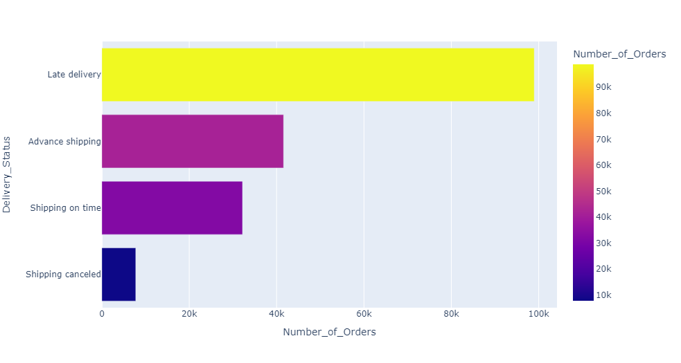
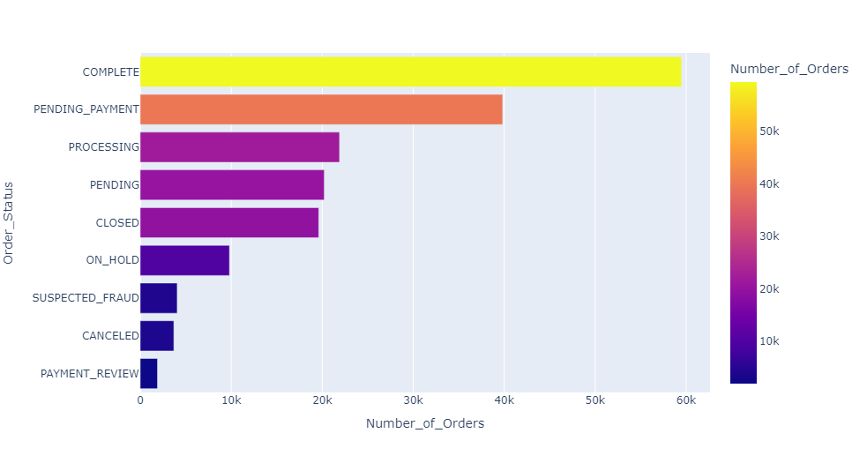
How many orders are tagged as late deliveries and tagged as Fraudulent?
More than half of the orders (54.1%) are at tagged as late delivery risk or are delivered late
A very few (2.25%, which is good) transactions are tagged as ‘Suspected Fraud’ but the sales amount they hold is around $0.74 millions

Slide 10
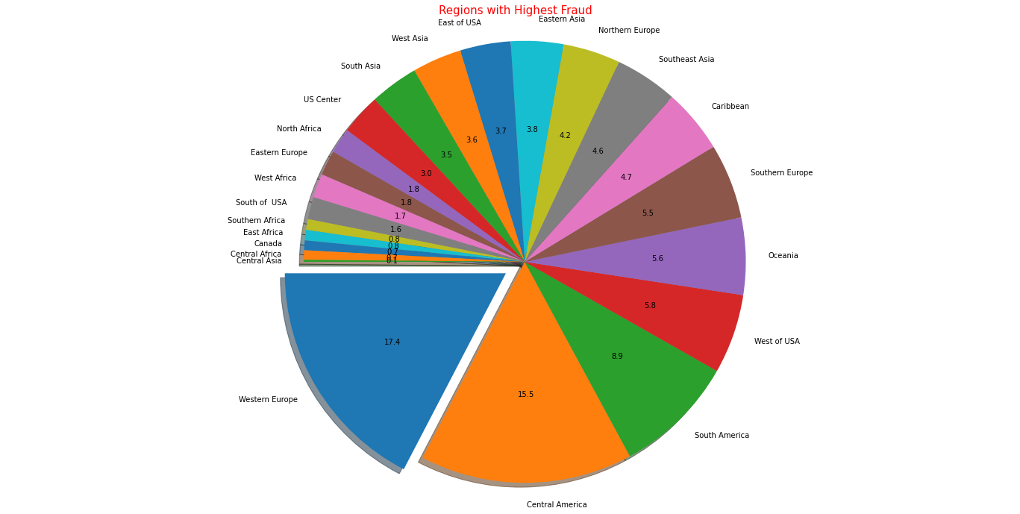
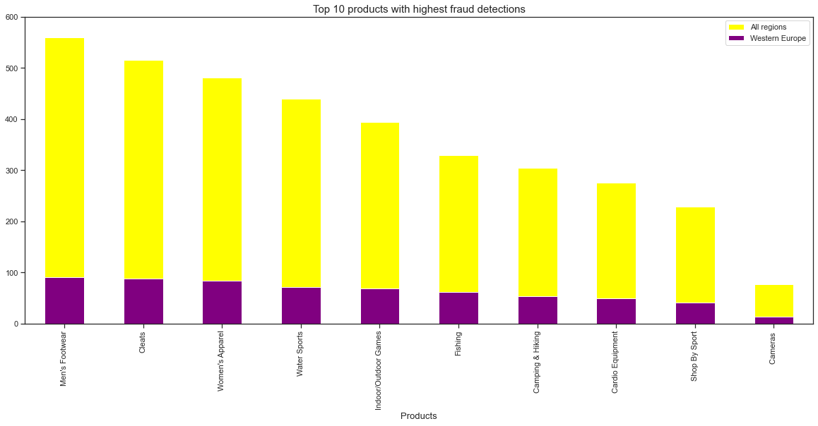
Which region and what product is being suspected to the fraud the most?
It can be observed that highest number of suspected fraud orders are from Western Europe which is approximately 17.4% of total orders followed by Central America with 15.5%.
It is very surprising to see that cleats department is being suspected to fraud the most followed by Men's footwear in all the regions and also in Western Europe.

Slide 11
Next Steps?
Next steps will be to analyze the dataset more and research on the logistics domain
To perform extensive EDA and feature engineering
Build a Model to predict the late deliveries and fraudulent transactions
Validate the model with real testing data
Create a user friendly website and deploy the Model

