Slide 1
Coursera Capstone IBM Applied Data Science Capstone
Opening a New supermarket in Kuala Lumpur, Malaysia
By: Sahil Aggarwal

Slide 2
Business Problem
• Location of the supermarket is one of the most important decisions that will determine whether it will be a success or a failure
• Objective: To analyse and select the best locations in the city of Kuala Lumpur, Malaysia to open a new supermarket
• Business question: In the city of Kuala Lumpur, Malaysia, if a property developer is looking to open a new shopping mall, where would you recommend that they open it?

Slide 3
Data
• Data required
List of neighbourhoods in Kuala Lumpur
Latitude and longitude coordinates of the neighbourhoods
Venue data, particularly data related to supermarkets
• Sources of data
Wikipedia page for neighbourhoods (https://en.wikipedia.org/wiki/Neighbourhoods_of_Kuala Lampur)
Geocoder package for latitude and longitude coordinates
Foursquare API for venue data

Slide 4
Methodology
Web scraping Wikipedia page for neighbourhoods list
Get latitude and longitude coordinates using Geocoder
Use Foursquare API to get venue data
Group data by neighbourhood and taking the mean of the frequency of occurrence of each venue category
Filter venue category by Supermarket
Perform clustering on the data by using k-means clustering
Visualize the clusters in a map using Folium

Slide 5
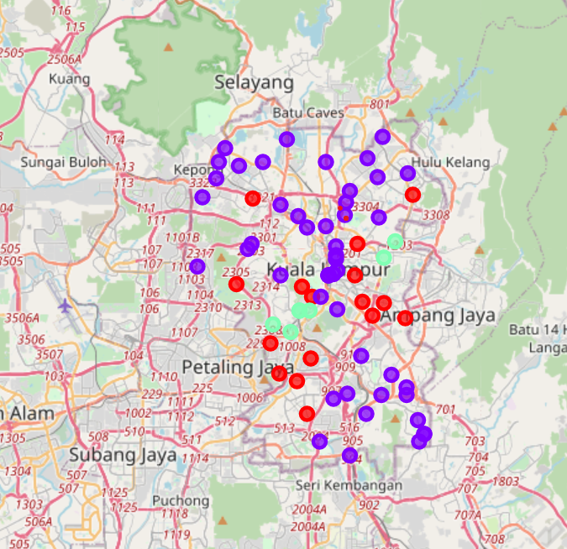
Results
Categorized the neighbourhoods into 3 clusters :
Cluster 0: Neighbourhoods with moderate number of supermarkets
Cluster 1: Neighbourhoods with low number to no existence of supermarkets
Cluster 2: Neighbourhoods with high concentration of supermarkets

Slide 6
Discussion
Most of the supermarkets are concentrated in the central area of the city
Highest number in cluster 2 and moderate number in cluster 0
Cluster 1 has very low number to no shopping mall in the neighbourhoods.
Oversupply of supermarkets mostly happened in the central area of the city, with the suburb area still have very few supermarkets.

Slide 7
Recommendations
Open new supermarkets in neighbourhoods in cluster 1 with little to no competition
01
Can also open in neighbourhoods in cluster 0 with moderate competition if have unique selling propositions to stand out from the competition
02
Avoid neighbourhoods in cluster 2, already high concentration of supermarkets and intense competition
03

Slide 8
Conclusion
Answer to business question: The neighbourhoods in cluster 1 are the most preferred locations to open a new supermarket
Findings of this project will help the relevant stakeholders to capitalize on the opportunities on high potential locations while avoiding overcrowded areas in their decisions to open a new supermarket

